Slide 1
Chapter 1
EMS Systems
Notes:
Chapter 1: EMS Systems

Slide 2
National EMS Education Standard Competencies (1 of 3)
Preparatory
Applies fundamental knowledge of the emergency medical services (EMS) system, safety/well-being of the emergency medical technician (EMT), medical/legal, and ethical issues to the provision of emergency care.
Notes:
National EMS Education Standard Competencies
Preparatory
Applies fundamental knowledge of the emergency medical services (EMS) system, safety/well-being of the emergency medical technician (EMT), medical/legal, and ethical issues to the provision of emergency care.

Slide 3
National EMS Education Standard Competencies (2 of 3)
Emergency Medical Services (EMS) Systems
EMS systems
History of EMS
Roles/responsibilities/professionalism
of EMS personnel
Quality improvement
Patient safety
Notes:
National EMS Education Standard Competencies
EMS Systems
• EMS systems
• History of EMS
• Roles/responsibilities/professionalism of EMS personnel
• Quality improvement
• Patient safety

Slide 4
National EMS Education Standard Competencies (3 of 3)
Research
Impact of research on emergency medical responder (EMR) care
Data collection
Evidence-based decision making
Public Health
Uses simple knowledge of the principles of illness
and injury prevention to emergency care.
Notes:
National EMS Education Standard Competencies
Research
• Impact of research on emergency medical responder (EMR) care
• Data collection
• Evidence-based decision making
Public Health
Uses simple knowledge of the principles of illness and injury prevention to emergency care.

Slide 5
Introduction
The text is the primary resource for
the emergency medical technician (EMT) course.
EMS is a system.
Chapter 1 discusses that system’s key components.
Notes:
Lecture Outline
I. Introduction
The text is the primary resource for the EMT course.
It discusses what will be expected of you during the course and what other requirements you will have to meet to be licensed or certified as an EMT in most states.
You will learn the differences between first aid training, a Department of Transportation (DOT) EMR training course, and the training courses for an EMT, AEMT, and paramedic.
EMS is a system.
Chapter 1 discusses that system’s key components.

Slide 6
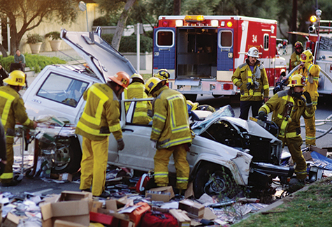
Course Description (1 of 8)
EMS system
  Team of health care professionals
  Provides emergency care and transport
  Is governed by state laws
<Figure CP01-01>
© Corbis
Notes:
Lecture Outline
II. Course Description
A. EMS system:
1. Consists of a team of health care professionals
2. Provides emergency care and transport
3. Is governed by state laws

Slide 7
Course Description (2 of 8)
After you complete this course, you are eligible to take either:
  The National Registry of EMTs exam
  Your state’s certification exam
After you pass this exam, you are eligible to apply for state licensure.
Notes:
Lecture Outline
B. After you successfully complete this course, you should be eligible to take either the National Registry of EMTs exam or your state’s certification exam.
C. After you pass the certification exam, you are eligible to apply for state licensure. Licensure is the process by which states ensure applicant competency in an examination setting. This allows states to manage who can function as a health care provider.

Slide 8
Course Description (3 of 8)
Most states have four training and licensure levels:
  EMR
  EMT
  AEMT
  Paramedic
Notes:
Lecture Outline
D. In most states, there are four training and licensure levels:
1. EMR
2. EMT
3. AEMT
4. Paramedic

Slide 9
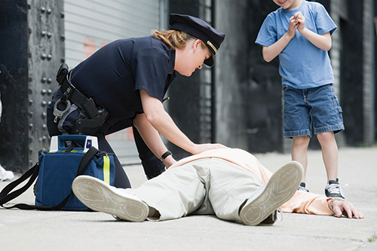
Course Description (4 of 8)
An EMR has very basic training.
  Provides care before ambulance arrives
  May assist in ambulance
© Hunterstock/Thinkstock.
Notes:
Lecture Outline
E. An EMR has very basic training.
1. Provides care before ambulance arrives
2. May assist in the ambulance

Slide 10
Course Description (5 of 8)
An EMT has training in basic life support (BLS), including:
  Automated external defibrillation
  Airway adjuncts
  Assisting patients with certain medications
Notes:
Lecture Outline
F. An EMT has training in basic life support (BLS), including:
1. Automated external defibrillation
2. Airway adjuncts
3. Assisting patients with certain medications

Slide 11
Course Description (6 of 8)
An AEMT has training in specific aspects of advanced life support (ALS), including:
  Intravenous (IV) therapy
  Administration of a limited number of emergency medications
Notes:
Lecture Outline
G. An AEMT has training in specific aspects of advanced life support (ALS), including:
1. Intravenous (IV) therapy
2. Administration of a limited number of emergency medications

Slide 12
Course Description (7 of 8)
A paramedic has extensive ALS training, including:
  Endotracheal intubation
  Emergency pharmacology
  Cardiac monitoring
  Other advanced assessment and treatment skills
Notes:
Lecture Outline
H. A paramedic has extensive ALS training, including:
1. Endotracheal intubation
2. Emergency pharmacology
3. Cardiac monitoring
4. Other advanced assessment and treatment skills

Slide 13
Course Description (8 of 8)
EMT course includes four learning activities:
  Reading assignments, lecture presentations, and classroom discussions
  Step-by-step demonstrations
  Summary skills sheets
  Case presentations and scenarios
Notes:
Lecture Outline
I. The EMT course includes four types of learning activities:
1. Reading assignments from the text, lecture presentations, and classroom discussions provide you with the necessary knowledge base.
2. Step-by-step demonstrations teach you the hands-on skills that you will then practice repeatedly in supervised small-group workshops.
3. Summary skills sheets help you memorize the sequence of steps in complex skills that contain a large number of steps or variations so you can perform the skills with no errors or omissions.
4. Case presentations and scenarios used in class help you learn how to apply the knowledge and skills acquired to situations you will encounter in the field.

Slide 14
EMT Training: Focus and Requirements (1 of 2)
EMTs are the backbone of EMS system in the United States.
EMTs provide emergency care to the sick and injured.
  Some patients are in life-threatening situations.
  Others require only supportive care.
Notes:
Lecture Outline
III. EMT Training: Focus and Requirements
A. EMTs are the backbone of the EMS system in the United States.
B. They provide emergency care to the sick and injured.
1. Some patients are in life-threatening situations.
2. Other patients require only supportive care.

Slide 15
EMT Training: Focus and Requirements (2 of 2)
Some of the subjects discussed in this text include:
  Scene size-up
  Patient assessment
  Treatment
  Packaging
  EMS as a career
Notes:
Lecture Outline
C. Some of the subjects discussed in the text include:
1. Scene size-up
2. Patient assessment
3. Treatment
4. Packaging
5. EMS as a career

Slide 16
Licensure Requirements (1 of 2)
* Requirements differ from state to state. General requirements to be an EMT are:
High school diploma or equivalent
Proof of immunization
Successful completion of a background check and drug screening
Valid driver’s license
Notes:
Lecture Outline
IV. Licensure Requirements
A. Requirements differ from state to state. Generally, the requirements to be licensed and employed as an EMT are:
1. High school diploma or equivalent
2. Proof of immunization against certain communicable diseases
3. Successful completion of a background check and drug screening
4. Valid driver’s license

Slide 17
Licensure Requirements (2 of 2)
Successful completion of required courses and certification exams
Demonstration of the mental and physical abilities necessary to perform the job
Compliance with other state, local, and employer provisions
Notes:
Lecture Outline
5. Successful completion of a recognized health care provider BLS/cardiopulmonary resuscitation (CPR) course
6. Successful completion of a state-approved EMT course
7. Successful completion of a state-recognized written certification exam
8. Successful completion of a state-recognized practical certification exam
9. Demonstration of the mental and physical abilities necessary to safely and properly perform all the tasks and functions described in the defined role of an EMT
10. Compliance with other state, local, and employer provisions

Slide 18
Licensure Requirements
Americans With Disabilities Act (ADA)
  Prohibits employers from failing to provide full and equal employment.
Title I of the ADA
  Protects EMTs with disabilities who are seeking employment
  May require modifying the work environment or how the job is performed
Background checks
Notes:
Lecture Outline
B. The Americans With Disabilities Act (ADA) of 1990:
1. Protects people who have a disability from being denied access to programs and services that are provided by state or local governments
2. Prohibits employers from failing to provide full and equal employment to the disabled
3. Title I: protects EMTs with disabilities who are seeking gainful employment under many circumstances
a. Employers with a certain number of employees are required to adjust processes so that a candidate with a disability can be considered for a position and modify the work environment or how the job is normally performed.
C. Personal background in accordance with state criminal requirements (States have various requirements prohibiting individuals who have committed either misdemeanors or felonies from becoming EMS providers.)

Slide 19
Overview of the EMS System
(1 of 3)
History of EMS
Origins include:
  Volunteer ambulances in World War I
  Field care in World War II
  Field medic and rapid helicopter evacuation in Korean conflict
Notes:
Lecture Outline
V. Overview of the EMS System
A. History of EMS
1. There is a long tradition of people providing emergency medical care to their fellow human beings.
2. Origins of EMS include:
a. Volunteer ambulances in World War I
b. Field care in World War II
c. Field medic and rapid helicopter evacuation in Korean conflict

Slide 20
Overview of the EMS System
(2 of 3)
1966
  Accidental Death and Disability: The Neglected Disease of Modern Society established EMS
Early 1970s
  DOT published the first EMT training curriculum
1971
  AAOS published “The Orange Book”
Notes:
Lecture Outline
3. As recently as the 1960s and early 1970s, emergency ambulance service and care varied widely in the United States.
4. EMS as we know it today originated in 1966 with the publication of Accidental Death and Disability: The Neglected Disease of Modern Society (more commonly known as “The White Paper”).
5. The DOT published the first EMT training curriculum in the early 1970s.
6. The American Academy of Orthopaedic Surgeons prepared and published the first EMT textbook in 1971.
a. It is often called “The Orange Book.”
b. Your textbook is the 11th edition of that book.

Slide 21
Overview of the EMS System
(3 of 3)
National standardization efforts
  1970s - DOT’s National Standard Curriculum
  1980s – Advanced levels of EMTs
  1990s – NHTSA’s EMS Agenda for the Future
Notes:
Lecture Outline
7. Efforts are under way to standardize levels of EMS education nationally.
a. In the late 1970s, the DOT developed a recommended National Standard Curriculum.
b. During the 1980s, many areas enhanced the EMT National Standard Curriculum by adding EMTs with advanced levels of training who could provide key components of ALS care and advanced life-saving procedures.
c. In the 1990s, the National Highway Traffic Safety Administration (NHTSA) developed the EMS Agenda for the Future, a document with a plan to standardize the levels of EMS education and providers.

Slide 22
Levels of Training
Federal level:
  National EMS Scope of Practice Model provides guidelines
State level:
  Laws regulate EMS operations
Local level:
  Medical director provides oversight and support
Notes:
Lecture Outline
VI. Levels of Training
A. Federal level
1. The National EMS Scope of Practice Model provides guidelines for EMS skills. This document provides overarching guidelines for the minimum skills each level of EMS provider should be able to perform.
B. State level
1. Laws regulate EMS provider operations.
C. Local level
1. The medical director provides daily oversight and support to EMS personnel. Examples include the medications that will be carried on an ambulance or where patients are transported.

Slide 23
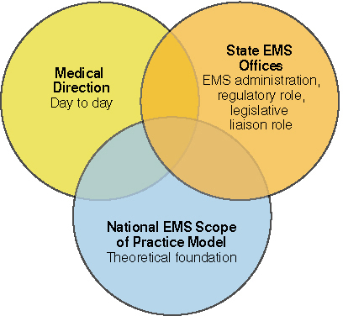
Levels of Training
© Jones & Bartlett Learning.
Notes:
The figure on this slide illustrates the hierarchies of the National EMS Scope of Practice Model.

Slide 24
Public BLS and Immediate Aid
Millions of laypeople are trained in BLS/CPR, including:
  Teachers, coaches, and child care providers
Automated external defibrillators (AEDs) are used by laypeople.
Notes:
Lecture Outline
D. Public BLS and immediate aid
1. Millions of laypeople are trained in BLS/CPR.
a. Teachers, coaches, and child care providers
b. People who regularly accompany groups on trips to remote locations
c. Automated external defibrillators (AEDs) are used by laypeople.

Slide 25
Emergency Medical Responders
Include law enforcement officers and firefighters
Initiate immediate care and assist EMTs
on their arrival
Good Samaritans are trained in first aid and CPR.
  Can provide valuable assistance or interfere with operations
Notes:
Lecture Outline
E. Emergency medical responders (EMRs)
1. Law enforcement officers
2. Firefighters
3. Park rangers
4. Ski patrollers
5. EMR training provides these individuals with the skills necessary to initiate immediate care and assist EMTs upon their arrival. The course focuses on providing immediate BLS and urgent care with limited equipment.
6. Good Samaritans trained in first aid and CPR often show up at a scene.
a. They can provide valuable assistance.
b. They can also interfere with operations and endanger themselves and others.

Slide 26
Emergency Medical Technicians
EMT course requires about 150 hours.
The EMT has knowledge and skills to provide basic emergency care.
The EMT assumes responsibility for assessment, care, packaging, and transport of the patient.
Notes:
Lecture Outline
F. Emergency medical technicians (EMTs)
1. The EMT course requires about 150 hours, and even more hours in some states.
2. The EMT possesses the knowledge and skills to provide basic emergency care.
3. On arrival at the scene, the EMT, together with any other EMTs who have responded, assumes responsibility for the assessment, care, packaging, and transport of the patient.

Slide 27
Advanced Emergency Medical Technicians
Training adds knowledge and skills in specific aspects of ALS, including:
  IV therapy
  Advanced airway adjuncts
  Administration of limited number of medications
Notes:
Lecture Outline
G. Advanced emergency medical technicians (AEMTs)
1. The AEMT course adds knowledge and skills in specific aspects of ALS for those trained and with experience as EMTs.
a. IV therapy
b. Advanced airway adjuncts
c. Administration of a limited number of medications

Slide 28
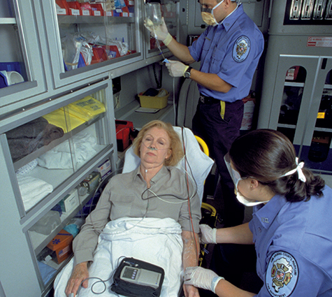
Paramedics
Extensive training
  1,000 to more than 1,300 hours in the classroom and in internships
Training covers a wide range of ALS skills
<Figure CP01-04>
© Jones & Bartlett Learning. Courtesy of MIEMSS.
Notes:
Lecture Outline
H. Paramedics
1. Extensive course of training:
a. Course hours range from 1,000 to more than 1,300 hours, divided between classroom and internship training.
b. Course may be offered within the context of an associate’s or bachelor’s degree college program.
2. Training covers a wide range of ALS skills.

Slide 29
14 Components of the
EMS System (1 of 4)
Public access
Clinical care
Medical direction
Integration of health services
Information systems
Notes:
Lecture Outline
VII. Components of the EMS System
A. The EMS Agenda for the Future outlines 14 components of an EMS system:
1. Public access
2. Clinical care
3. Medical direction
4. Integration of health services
5. Information systems

Slide 30
14 Components of the
EMS System (2 of 4)
Prevention
EMS research
Communication systems
Human resources
Legislation and regulation
Notes:
Lecture Outline
6. Prevention
7. EMS research
8. Communication systems
9. Human resources
10. Legislation and regulation

Slide 31
14 Components of the
EMS System (3 of 4)
Evaluation
System finance
Public education
Education systems
Notes:
Lecture Outline
11. Evaluation
12. System finance
13. Public education
14. Education systems

Slide 32
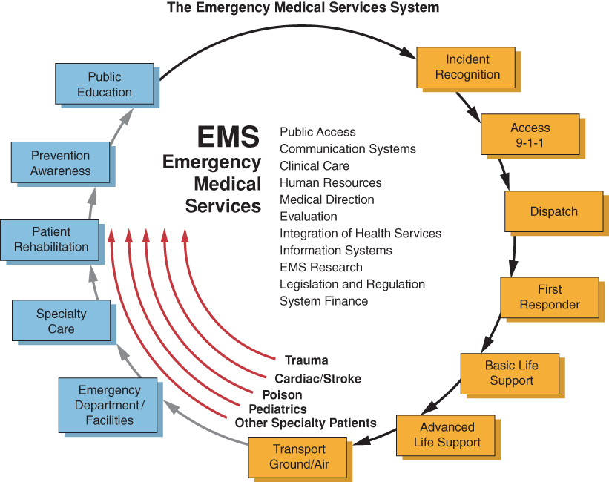
14 Components of the
EMS System (4 of 4)
Source: www.ems.gov
Notes:
The illustration on this slide shows how the components of the NHTSA’s emergency medical services system interact.

Slide 33
Public Access
911 system
  Access public safety
Dispatchers
  Obtain information and dispatch resources
Emergency medical dispatch (EMD) system
  Provides medical instruction
Notes:
Lecture Outline
B. Public access
1. Easy access to help in an emergency is essential.
2. The 911 system is the public safety access point.
3. At the communication center, trained dispatchers obtain information and dispatch the ambulance crew and other equipment and responders.
4. An emergency medical dispatch (EMD) system has been developed to assist dispatchers in providing callers with vital medical instructions until EMS arrival.

Slide 34
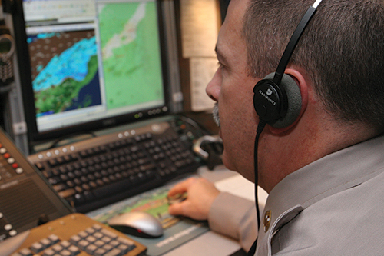
Communication Systems
Dispatcher selects emergency system component to activate
EMS ranges from fire agencies to private services
New technology can help responders locate patients
<Figure CP01-06>
© Jones & Bartlett Learning. Courtesy of MIEMSS.
Notes:
Lecture Outline
C. Communication systems
1. From caller information, the dispatcher selects the appropriate parts of the emergency system to activate.
2. EMS may be:
a. A fire agency
b. Other non-fire governmental agency
c. Private services
d. Hospital-based programs and Native American tribal services (less common)
3. New technology can help responders locate their patients.
a. Example: cellular telephones linked to global positioning system (GPS) units

Slide 35
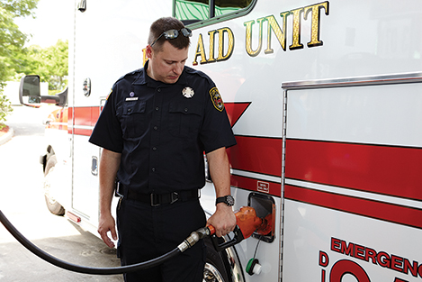
Clinical Care
Describes the pieces of equipment and scope of practice
Familiarizes EMTs with their primary service area (PSA) and the ambulance controls
© Jones & Bartlett Learning.
Notes:
Lecture Outline
D. Clinical care
1. Describes the pieces of equipment
2. Describes the scope of practice for using that equipment
3. Familiarizes EMTs with their primary service area (PSA)—that is, the main area in which an agency operates
4. Familiarizes EMTs with ambulance controls

Slide 36
Human Resources
Focuses on people who deliver the care:
  Compensation
  Interaction with other members of medical community
Efforts are under way to allow EMS
providers to move from state to state.
Notes:
Lecture Outline
E. Human resources
1. Focuses on the people who deliver the care
a. Compensation
b. Interaction with other members of medical community
2. Efforts are under way to allow EMS providers to move from state to state more seamlessly.
3. The EMS Agenda for the Future encourages the creation of systems to help protect the well-being of EMS providers, including the development of career ladders.

Slide 37
Medical Direction (1 of 2)
Physician medical director
  Authorizes EMTs to provide medical care in field
Standing orders and protocols
  Describe appropriate care
  Establish medical direction for providers
Notes:
Lecture Outline
F. Medical direction
1. A physician medical director authorizes EMTs to provide medical care in the field.
2. Appropriate care is described in standing orders and protocols.
a. Protocols are described in a comprehensive guide delineating the EMT’s scope of practice.
b. Standing orders are part of protocols and designate what the EMT is required to do for a specific complaint or condition.
3. Providers are not required to consult medical direction before implementing standing orders.

Slide 38
Medical Direction (2 of 2)
Medical director
  Acts as a liaison
Medical control can be off-line or online.
  Off-line (indirect)
    Standing orders, training, supervision
  Online (direct)
    Physician directions given over the phone or radio
Notes:
Lecture Outline
4. The medical director is the ongoing working liaison between the medical community, hospitals, and the EMTs in the service.
5. Medical control can be off-line or online.
a. Off-line (indirect)
i. Standing orders, training, supervision
b. Online (direct)
i. Physician directions given over the phone or radio

Slide 39
Legislation and Regulation
Training, protocols, and practices follow state legislation.
Senior EMS official handles administrative tasks:
  Scheduling
  Personnel
  Budgets
  Purchasing
  Vehicle maintenance
Notes:
Lecture Outline
G. Legislation and regulation
1. Although each EMS system, medical direction, and training program has some latitude, its training, protocols, and practices must follow state legislation, rules, regulations, and guidelines.
2. A senior EMS official is usually in charge of necessary administrative tasks such as scheduling, personnel, budgets, purchasing, and vehicle maintenance, and the daily operations of ambulances and crews.
a. Similar to a police chief or fire chief
b. Not in charge of medical matters

Slide 40
Integration of Health Services (1 of 2)
Prehospital care is coordinated with hospital care.
Prehospital care is continued in the emergency department (ED).
Integration ensures comprehensive continuity of care for the patient.
Notes:
Lecture Outline
H. Integration of health services
1. Prehospital care by the EMT is coordinated with care administered by the receiving hospital.
2. Care should be continued in the emergency department (ED).
3. Integration ensures that the patient receives comprehensive continuity of care.

Slide 41
Integration of Health Services
(2 of 2)
EMS systems collaborate with hospitals to improve treatment for patients with:
  Heart attacks
  Trauma
  Stroke
Notes:
Lecture Outline
4. Some EMS systems collaborate with local hospitals to improve patient outcomes associated with time-sensitive treatment, such as in heart attacks, trauma, and stroke.
a. Example: When paramedics determine a patient is having a heart attack, they alert the ED, which in turn notifies the cardiac catheterization team or the paramedics may be directed to transport the patient to a cardiac specialty center.

Slide 42
Mobile Integrated Health Care
(1 of 2)
New method of delivering health care
  Utilizes the prehospital spectrum
Evolved from the Patient Protection and Affordable Care Act
Health care provided within the community by team of professionals
Notes:
Lecture Outline
I. Mobile integrated health care
1. Mobile integrated health care (MIH) is a new method of delivering health care that utilizes the prehospital spectrum.
2. MIH has evolved as a result of the Patient Protection and Affordable Care Act, with the goal of facilitating improved access to health care at an affordable price.
3. In the MIH model, health care is provided within the community, rather than at a physician’s office or hospital, by an integrated team of health care professionals.

Slide 43
Mobile Integrated Health Care
(2 of 2)
MIH created additional training levels for EMS providers, including community paramedicine
  Paramedics receive advanced training to provide services within a community
  Community paramedics provide additional services
Notes:
Lecture Outline
4. This new branch of health care is causing the evolution of additional training levels for EMS providers.
a. One new aspect is community paramedicine, in which experienced paramedics receive advanced training to equip them to provide services within a community.
b. In addition to the patient care services a paramedic would typically provide, services provided by community paramedics may include:
i. Performing health evaluations
ii. Monitoring chronic illnesses or conditions
iii. Obtaining laboratory samples
iv. Administering immunizations
v. Serving as patient advocates

Slide 44
Evaluation
Medical director is responsible for maintaining quality control.
Continuous quality improvement (CQI) reviews and audits EMS system.
Refresher training or continuing education is important.
Minimizing errors is the goal.
Notes:
Lecture Outline
J. Evaluation
1. The medical director is responsible for maintaining quality control within the EMS system.
2. The continuous quality improvement (CQI) program reviews and performs audits of the EMS system to identify areas of improvement and/or assign remedial training.
3. Information and skills in emergency medical care change constantly. Refresher training and continuing education are important.
4. Minimizing errors is the goal.
a. Errors are not inevitable.
b. Errors can result from rules-based failure, knowledge-based failure, skills-based failure, or any combination of these problems.
c. Limiting errors requires work from both the EMS agency and EMS personnel.
d. The environment can be part of the reason for errors (for example, distractions, poor lighting).
e. EMTs themselves can help to reduce errors.
f. When you are about to perform a skill, ask yourself, “Why am I doing this?”
g. Using “cheat sheets,” or a copy of your protocol book, can help limit errors.

Slide 45
Information Systems
Used to efficiently document the care that has been delivered
Information can be used to improve care
Can help determine:
  Average on-scene time for trauma patients
  Need for educational sessions
  National trends
Notes:
Lecture Outline
K. Information systems
1. Information systems are used to efficiently document the care that has been delivered.
2. Once stored electronically, the information can be used to improve care.
3. For example, stored information can help determine:
a. How often a department has seen specific types of symptoms
i. Average on-scene time for trauma patients
ii. Need for educational sessions
iii. National trends

Slide 46
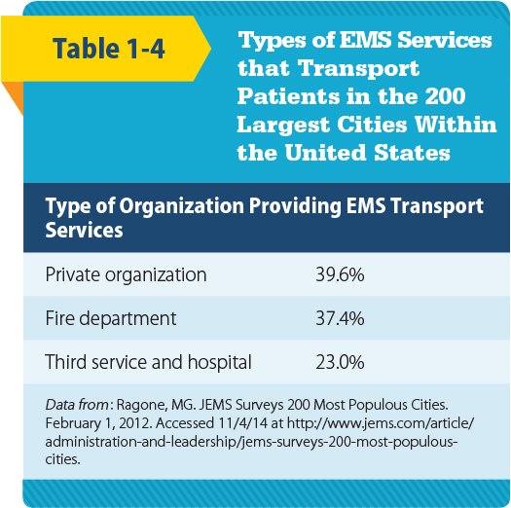
System Finance (1 of 2)
Finance systems vary depending on the organization involved.
© Jones & Bartlett Learning.
Notes:
Lecture Outline
L. System finance
1. Finance systems vary depending on which organization is involved.

Slide 47
System Finance (2 of 2)
Personnel may be paid, volunteer, or a mix.
EMTs may be asked to:
  Gathering insurance information
  Secure signatures
  Obtain permission from patients to bill insurance
Notes:
Lecture Outline
2. Personnel may be paid, volunteer, or a mix of paid and volunteer.
3. EMTs may be asked to:
a. Gather insurance information from patients
b. Secure signatures on certain documents such as HIPAA notifications
c. Obtain written permission from patients to bill their health insurance company

Slide 48
Education Systems (1 of 2)
EMS instructors
  Licensed in most states
Most EMS training programs must adhere national standards.
Continuing education, refresher courses, computer-based or manikin-based self-education exercises
  Measures intended to maintain and update an EMT’s skills and knowledge
Notes:
Lecture Outline
M. Education systems
1. EMS instructors are licensed in most states.
2. Most EMS training programs must adhere to national standards established by two accrediting organizations: Committee on Accreditation of Educational Programs for the Emergency Medical Services Professions (CoAEMSP) and Commission on Accreditation of Allied Health Education Programs (CAAHEP).
3. Frequent continuing education, refresher courses, and computer-based or manikin-based self-education exercises are measures intended to maintain and update an EMT’s skills and knowledge.

Slide 49
Education Systems (2 of 2)
ALS
  Instructors and directors must hold a four-year degree
  Training is provided in college, adult career center, or hospital settings
Notes:
Lecture Outline
4. ALS-level instructors and directors must hold a four-year degree.
5. ALS training is usually provided in college, adult career center, or hospital settings.

Slide 50
Prevention and Public Education (1 of 2)
Prevention and public education
  Two components of the EMS system with a focus on public health
Emphasis is on prevention.
EMS works with public health agencies on:
  Primary prevention
  Secondary prevention
Notes:
Lecture Outline
N. Prevention and public education
1. Prevention and public education are aspects of EMS where the focus is on public health.
2. Public health examines the health needs of entire populations with the goal of preventing health problems.
3. EMS works with public health agencies in two ways:
a. Primary prevention focuses on strategies that will prevent the event from ever happening—for example, educating the community on pool safety and car seat installation.
b. Secondary prevention occurs after the event has already happened. The question then is, How can we decrease the effects of the event? Helmets and seat belts are examples of secondary prevention.

Slide 51
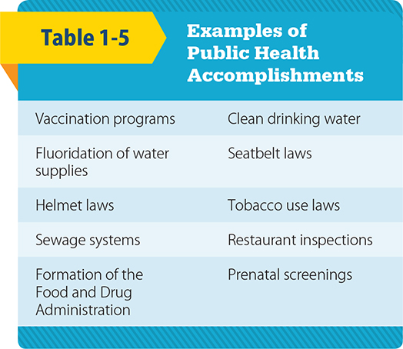
Prevention and Public Education (2 of 2)
© Jones & Bartlett Learning.
Notes:
The table on this slide lists examples of public health accomplishments.

Slide 52
EMS Research
Helps determine the shape of EMS
Application of evidence-based practice
  Integral to being an EMS provider
Role of EMTs
  Gathering data
Evidence-based decision making
  Based on research
Notes:
Lecture Outline
O. EMS research
1. Research helps to determine the shape and impact of EMS on the community.
a. For example, in the early days of EMS, patients with major trauma were stabilized on the scene before they were transported. After compiling prehospital EMS research, it was determined that patients with major trauma should be transported immediately; these patients need an operating room more than they need an IV. EMS now provides rapid transport for patients with major trauma.
2. The application of evidence-based practice is becoming an integral part of functioning as an EMS provider. Patient care should be focused on procedures that have proved useful in improving patient outcomes. All aspects of the EMT role are currently being researched.
3. EMTs may be involved in research through gathering data.
a. Examples: How much oxygen should be given to patients with shortness of breath? How much time does it take to get patients with serious trauma to the emergency department? Record all of the information so it can be analyzed by others.
4. The results could then be shared with the rest of the EMS community.
5. Evidence-based decision making is based on research.
6. It is important for EMS providers to stay current on the latest advances in health care.
7. Be skeptical, ask questions, and conduct your own research.

Slide 53
Roles and Responsibilities of the EMT (1 of 4)
Keep vehicles and equipment ready
Ensure safety
Be familiar with emergency vehicle operation
On-scene leadership
Scene evaluation
Notes:
Lecture Outline
VIII. Roles and Responsibilities of the EMT
A. EMTs are health care professionals, whether paid or volunteer.
B. The roles and responsibilities of an EMT:
1. Keep vehicles and equipment ready for an emergency.
2. Ensure the safety of yourself, your partner, the patient, and bystanders.
3. Be familiar with emergency vehicle operation.
4. Be an on-scene leader.
5. Perform an evaluation of the scene.

Slide 54
Roles and Responsibilities of the EMT (2 of 4)
Call for additional resources as needed.
Gain patient access.
Perform a patient assessment.
Give emergency medical care while awaiting additional medical resources.
Notes:
Lecture Outline
6. Call for additional resources as needed.
7. Gain patient access.
8. Perform a patient assessment.
9. Give emergency medical care to the patient while awaiting the arrival of additional medical resources.

Slide 55
Roles and Responsibilities of the EMT (3 of 4)
Give emotional support.
Maintain continuity of care.
Resolve emergency incidents.
Uphold medical and legal standards.
Ensure and protect patient privacy.
Notes:
Lecture Outline
10. Give emotional support to the patient, the patient’s family, and other responders.
11. Maintain continuity of care by working with other medical professionals.
12. Resolve emergency incidents.
13. Uphold medical and legal standards.
14. Ensure and protect patient privacy.

Slide 56
Roles and Responsibilities of the EMT (4 of 4)
Give administrative support.
Constantly continue professional development.
Cultivate and sustain community relations.
Give back to the profession.
Notes:
Lecture Outline
15. Give administrative support.
16. Constantly continue your professional development.
17. Cultivate and sustain community relations.
18. Give back to the profession.

Slide 57
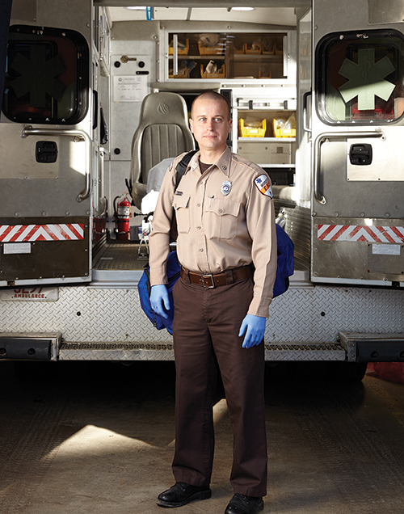
Professional Attributes (1 of 3)
Integrity
Empathy
Self-motivation
Appearance and
hygiene
Self-confidence
© Jones & Bartlett Learning.
Notes:
Lecture Outline
C. Professional attributes:
1. Integrity: acting consistently; maintaining a firm adherence to a code of honest behavior
2. Empathy: being aware of and thoughtful toward the needs of others
3. Self-motivation: discovering problems and solving them without someone directing you
4. Appearance and hygiene: using your persona to project a sense of trust, professionalism, knowledge, and compassion
5. Self-confidence: knowing what you know and knowing what you do not know; being able to ask for help

Slide 58
Professional Attributes (2 of 3)
Time management
Communications
Teamwork and diplomacy
Respect
Patient advocacy
Careful delivery of care
Notes:
Lecture Outlines
6. Time management: performing or delegating multiple tasks while ensuring efficiency and safety
7. Communications: understanding others and making yourself understood to others
8. Teamwork and diplomacy: being able to work with others; knowing your place within a team; communicating while giving respect to the listener
9. Respect: holding others in high regard or importance; understanding that others are more important than you
10. Patient advocacy: constantly keeping the needs of the patient at the center of care
11. Careful delivery of care: paying attention to details; making sure that what is being done for the patient is done as safely as possible

Slide 59
Professional Attributes (3 of 3)
Every patient is entitled to compassion, respect, and the best care.
EMTs are bound by patient confidentiality.
Be familiar with requirements of the Health Insurance Portability and Accountability Act (HIPAA).
Notes:
Lecture Outline
D. Most patients will treat you with respect, but some will not. Yet every patient is entitled to compassion, respect, and the best care you can provide.
E. As a new EMT, you will receive lots of advice and training from more experienced EMTs. Some may voice a callous disregard for some types of patients. You should not be influenced by the unprofessional attitude of these individuals, regardless of how experienced or skilled they appear.
F. As health care professionals, EMTs are bound by patient confidentiality.
1. Patient privacy must be protected.
2. Findings or disclosures made by the patient should be discussed only in the following circumstances:
a. With those treating the patient
b. In limited situations, as required by law, with the police or other social agencies
G. Protection of patient privacy has drawn national attention with the passage of the Health Insurance Portability and Accountability Act (HIPAA).
1. You should be familiar with the requirements of this legislation, especially as it applies to your particular practice.

Slide 60
Review
Which of the following is an example of care that is provided using standing orders?
  Medical control is contacted by the EMT after a patient with chest pain refuses EMS care.
  The EMT defibrillates a patient in cardiac arrest, begins CPR, and then contacts medical control.
  A physician gives the EMT an order via radio to administer oral glucose to a diabetic patient.
  Following an overdose, the EMT contacts the medical director for permission to give activated charcoal.

Slide 61
Review
Answer: B
Rationale: Standing orders—a form of
off-line (indirect) medical control—involves performing certain life-saving interventions
(ie, CPR, defibrillation, bleeding control) before contacting a physician for further instructions.

Slide 62
Review (1 of 2)
Which of the following is an example of care that is provided using standing orders?
  Medical control is contacted by the EMT after a patient with chest pain refuses EMS care.
  Rationale: This is an example of online medical control given via the phone or radio.
  The EMT defibrillates a patient in cardiac arrest, begins CPR, and then contacts medical control.
  Rationale: Correct answer

Slide 63
Review (2 of 2)
Which of the following is an example of care that is provided using standard orders?
  A physician gives the EMT an order via radio to administer oral glucose to a diabetic patient.
  Rationale: This is an example of online medical control given via the phone or radio.
  Following an overdose, the EMT contacts the medical director for permission to give activated charcoal.
  Rationale: This is an example of online medical control given via the phone or radio.

Slide 64
Review
Quality control in an EMS system is the ultimate responsibility of the:
  paramedic.
  lead EMT.
  medical director.
  EMS administrator.

Slide 65
Review
Answer: C
Rationale: The medical director is responsible for maintaining quality control, which ensures that all staff members who are involved in caring for patients meet the standard of care on every call.

Slide 66
Review (1 of 2)
Quality control in an EMS system is the ultimate responsibility of the:
  paramedic.
  Rationale: A paramedic has the knowledge and mastery of BLS and ALS skills.
  lead EMT.
  Rationale: This is the senior EMT with a service or company.

Slide 67
Review (2 of 2)
Quality control in an EMS system is the ultimate responsibility of the:
  medical director.
  Rationale: Correct answer
  EMS administrator.
  Rationale: The EMS administrator sees to the daily operations and overall direction of the service or company.

Slide 68
Review
Upon arriving at the scene of a domestic dispute, you hear yelling and the sound of breaking glass from inside the residence. You should:
  immediately gain access to the patient.
  carefully enter the house and then call the police.
  retreat to a safe place until the police arrive.
  tell the patient to exit the residence so you can provide care.

Slide 69
Review
Answer: C
Rationale: Never enter a scene in which signs of violence are present, including yelling, screaming, or the sound of breaking glass. Law enforcement must secure the scene prior to the EMT’s entry.

Slide 70
Review (1 of 2)
Upon arriving at the scene of a domestic dispute, you hear yelling and the sound of breaking glass from inside the residence. You should:
  immediately gain access to the patient.
  Rationale: Never enter a scene in which signs of violence are present. Law enforcement must secure the scene.
  carefully enter the house and then call the police.
  Rationale: Never enter a scene in which signs of violence are present. Law enforcement must secure the scene.

Slide 71
Review (2 of 2)
Upon arriving at the scene of a domestic dispute, you hear yelling and the sound of breaking glass from inside the residence. You should:
  retreat to a safe place until the police arrive.
  Rationale: Correct answer
  tell the patient to exit the residence so you can provide care.
  Rationale: Never enter a scene in which signs of violence are present. Law enforcement must secure the scene.

Slide 72
Review
Which of the following is NOT a component of continuous quality improvement (CQI)?
  Periodic review of run reports
  Discussion of needs for improvement
  Negative feedback given to those who make mistakes while on a call
  Remedial training as deemed necessary by the medical director

Slide 73
Review
Answer: C
Rationale: The purpose of CQI is to ensure that the standard of care is provided on all calls. This involves periodic run report reviews, discussing needs for improvement, and providing remedial training as deemed necessary by the medical director. Positive feedback should be provided during this process.

Slide 74
Review
Which of the following is NOT a component of continuous quality improvement (CQI)?
  Periodic review of run reports
  Rationale: This is a part of CQI.
  Discussion of needs for improvement
  Rationale: This is a part of CQI.
  Negative feedback given to those who make mistakes while on a call
  Rationale: Correct answer
  Remedial training as deemed necessary by the medical director
  Rationale: This is a part of CQI.

Slide 75
Review
All of the following are responsibilities of the EMS medical director, EXCEPT:
  evaluating patient insurance information.
  serving as a liaison to the medical community.
  ensuring that the appropriate standards are met by EMTs.
  ensuring appropriate EMT education and continuing training.

Slide 76
Review
Answer: A
Rationale: Responsibilities of the medical director include serving as a liaison to the medical community, ensuring that appropriate standards are met by EMS personnel, and ensuring appropriate EMT education and continuing training. Insurance matters are handled by the EMS billing department.

Slide 77
Review (1 of 2)
All of the following are responsibilities of the EMS medical director, EXCEPT:
  evaluating patient insurance information.
  Rationale: Correct answer
  serving as a liaison to the medical community.
  Rationale: This is the responsibility of the medical director.

Slide 78
Review (2 of 2)
All of the following are responsibilities of the EMS medical director, EXCEPT:
  ensuring that the appropriate standards are met by EMTs.
  Rationale: This is the responsibility of the medical director.
  ensuring appropriate EMT education and continuing training.
  Rationale: This is the responsibility of the medical director.

Slide 79
Review
Which of the following situations would MOST likely disqualify a person for EMS certification?
  A misdemeanor committed at age 17
  Driving under the influence of alcohol
  Possessing a valid driver’s license from another state
  A mild hearing impairment that is corrected with hearing aids

Slide 80
Review
Answer: B
Rationale: In most states, a person may be denied EMS certification for being convicted of a felony, such as driving under the influence of alcohol or other drugs.

Slide 81
Review (1 of 2)
Which of the following situations would MOST likely disqualify a person for EMS certification?
  A misdemeanor committed at age 17
  Rationale: Most states seal misdemeanor juvenile records, so this act would not likely disqualify a person.
  Driving under the influence of alcohol
  Rationale: Correct answer

Slide 82
Review (2 of 2)
Which of the following situations would MOST likely disqualify a person for EMS certification?
  Possessing a valid driver's license from another state
  Rationale: Most states require providers to have a valid in-state driver’s license.
  A mild hearing impairment that is corrected with hearing aids
  Rationale: If the performance of tasks are not impaired, it would not disqualify a person.

Slide 83
Review
Which of the following should be the EMT’s highest priority?
  Controlling severe bleeding
  Maintaining a patient’s airway
  Ensuring patient safety
  Ensuring personal safety

Slide 84
Review
Answer: D
Rationale: Personal safety is of utmost concern for the EMT. This involves sizing up a scene to determine whether the scene is safe to enter. This will ensure the safety of all personnel.

Slide 85
Review (2 of 2)
Which of the following should be the EMT’s highest priority?
  Controlling severe bleeding
  Rationale: This is the priority once the patient’s airway and breathing have been addressed.
  Maintaining a patient’s airway
  Rationale: This is the most important priority once patient contact is made.

Slide 86
Review (2 of 2)
Which of the following should be the EMT’s highest priority?
  Ensuring patient safety
  Rationale: Safety is first determined during scene size-up. You do not enter an unsafe scene.
  Ensuring personal safety
  Rationale: Correct answer

Slide 87
Review
A patient who requires cardiac monitoring in the field would require, at a minimum, which level of EMS provider?
  EMR
  EMT
  Paramedic
  AEMT

Slide 88
Review
Answer: C
Rationale: Of all levels of EMS provider, the paramedic is trained in advanced medical care, including cardiac monitoring, IV therapy, and administration of a variety of emergency drugs.

Slide 89
Review (1 of 2)
A patient who requires cardiac monitoring in the field would require, at a minimum, which level of EMS provider?
  EMR
  Rationale: This level is trained to initiate BLS before an ambulance arrives.
  EMT
  Rationale: This level has the knowledge and skills to provide basic emergency care.

Slide 90
Review (2 of 2)
A patient who requires cardiac monitoring in the field would require, at a minimum, which level of EMS provider?
  Paramedic
  Rationale: Correct answer
  AEMT
  Rationale: This level is not trained to perform cardiac monitoring.

Slide 91
Review
Which of the following is a professional responsibility of the EMT?
  Telling the family of a dying patient that everything will be OK
  Maintaining only the skills that he or she feels uncomfortable with
  Maintaining a professional demeanor in even the most stressful situations
  Advising an emergency department nurse that patient reports are given only to a physician

Slide 92
Review
Answer: C
Rationale: Because the public relies upon the EMT to remain calm when others cannot, he or she must project a professional and calm demeanor even when under extreme stress.

Slide 93
Review (1 of 2)
Which of the following is a professional responsibility of the EMT?
  Telling the family of a dying patient that everything will be OK
  Rationale: Discussions about dying patients are handled by providers of a higher level.
  Maintaining only the skills that he or she feels uncomfortable with
  Rationale: The quality of care depends upon your ability, so you must maintain all of your skills.

Slide 94
Review (2 of 2)
Which of the following is a professional responsibility of the EMT?
  Maintaining a professional demeanor in even the most stressful situations
  Rationale: Correct answer
  Advising an emergency department nurse that patient reports are given only to a physician
  Rationale: You must give your report to the receiving hospital emergency department staff, including a nurse.

Slide 95
Review
Emergency patient care occurs in progressive phases. What occurs first?
  Activation of EMS
  Initial prehospital care
  The patient receives definitive care
  Incident recognition

Slide 96
Review
Answer: D
Rationale: Someone must recognize an emergency before EMS can be activated.

Slide 97
Review (1 of 2)
Emergency patient care occurs in progressive phases. What occurs first?
  Activation of EMS
  Rationale: This occurs once an incident is recognized.
  Initial prehospital care
  Rationale: This occurs when the EMT arrives on scene.

Slide 98
Review (2 of 2)
Emergency patient care occurs in progressive phases. What occurs first?
  The patient receives definitive care
  Rationale: This occurs when the EMT and patient reach the hospital.
  Incident recognition
  Rationale: Correct answer

