Slide 1

Chapter 1
EMS Systems
Notes:
Chapter 1: EMS Systems

Slide 2
Introduction
The text is the primary resource for
the emergency medical technician (EMT) course.
EMS is a system.
Chapter 1 introduces the system’s key components.
Notes:
Lecture Outline
I. Introduction
A. The text is the primary resource for the EMT course.
B. It discusses what will be expected of you during the course and what other requirements you will have to meet to be licensed or certified as an EMT in most states.
C. Students will learn the differences between first aid training, a Department of Transportation (DOT) EMR training course, and the training courses for an EMT, AEMT, and paramedic.
D. EMS is a system, and Chapter 1 discusses the system’s key components.

Slide 3
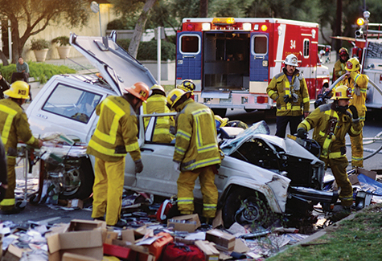
Course Description (1 of 4)
EMS system
  Team of health care professionals
  Provides emergency care and transport
  Governed by state laws
© Corbis
Notes:
Lecture Outline
II. Course Description
A. EMS system:
1. Consists of a team of health care professionals
2. Provides prehospital emergency care and transport
3. Is governed by state laws

Slide 4
Course Description (2 of 4)
After you complete this course, you are eligible to take either:
  The National Registry of EMTs exam
  Your state’s certification exam
After you pass this exam, you are eligible to apply for state certification.
Notes:
Lecture Outline
B. After you successfully complete this course, you should be eligible to take either the National Registry of EMTs exam or your state’s certification exam.
C. After you pass the certification exam, you are eligible to apply for state licensure. Licensure is the process by which states ensure applicant competency in an examination setting. It allows states to manage who can function as a health care provider.

Slide 5
Course Description (3 of 4)
Most states have four training and licensure levels:
  EMR
  EMT
  AEMT
  Paramedic
Notes:
Lecture Outline
D. In most states, there are four training and licensure levels:
1. EMR
2. EMT
3. AEMT
4. Paramedic

Slide 6
Course Description (4 of 4)
The EMT course includes four types of learning activities:
  Reading assignments, lecture presentations, and discussions
  Step-by-step demonstrations
  Summary skills sheets
  Case presentations and scenarios
Notes:
Lecture Outline
E. The EMT course includes four types of learning activities:
1. Reading assignments
2. Step-by-step demonstrations teach hands-on skills
3. Summary skills sheets
4. Case presentations and scenarios

Slide 7
EMT Training: Focus and Requirements
EMTs are the backbone of the EMS system in the United States.
EMTs provide emergency care and transportation to the sick and injured.
  Some patients are in life-threatening situations.
  Others require only supportive care.
Notes:
Lecture Outline
III. EMT Training: Focus and Requirements
A. EMTs are the backbone of the EMS system in the United States.
B. They provide emergency care to the sick and injured.
1. Some patients are in life-threatening situations, while other patients require only supportive care.

Slide 8
Licensure Requirements (1 of 2)
Requirements differ from state to state.
Typical requirements to be an EMT:
High school diploma or equivalent
Proof of immunization
Successful completion of background check and drug screening
Valid driver’s license
Notes:
Lecture Outline
IV. Licensure Requirements
A. Requirements differ from state to state. Generally, the requirements to be licensed and employed as an EMT are as follows:
1. High school diploma or equivalent
2. Proof of immunization against certain communicable diseases
3. Successful completion of a background check and drug screening
4. Valid driver’s license

Slide 9
Licensure Requirements (2 of 2)
Successful completion of required courses and certification exams
Demonstration of the mental and physical ability necessary to perform the job
Compliance with other state, local, and employer provisions
Notes:
Lecture Outline
5. Successful completion of a recognized health care provider BLS/cardiopulmonary resuscitation (CPR) course
6. Successful completion of a state-approved EMT course
7. Successful completion of a state-recognized written certification exam
8. Successful completion of a state-recognized practical certification exam
9. Demonstration of the mental and physical ability necessary to safely and properly perform all the tasks and functions described in the defined role of an EMT
10. Compliance with other state, local, and employer provisions

Slide 10
Licensure Requirements
Americans with Disabilities Act (ADA)
  Prohibits employers from failing to provide full and equal employment.
Background checks
Notes:
Lecture Outline
B. Americans with Disabilities Act (ADA) of 1990
1. Protects people who have a disability from being denied access to programs and services that are provided by state or local governments
2. Prohibits employers from failing to provide full and equal employment to the disabled
C. Personal background in accordance with state criminal requirements (States have various requirements prohibiting individuals who have committed either misdemeanors and/or felonies from becoming EMS providers.)

Slide 11
Overview of the EMS System
(1 of 3)
Origins of EMS:
  Volunteer ambulances in World War I
  Field care in World War II
  Field medic and rapid helicopter evacuation in Korean conflict
Notes:
Lecture Outline
V. Overview of the EMS System
A. History of EMS
1. There is a long tradition of people providing emergency medical care to their fellow human beings.
2. Origins of EMS:
a. Volunteer ambulances in World War I
b. Field care in World War II
c. Field medic and rapid helicopter evacuation in Korean conflict

Slide 12
Overview of the EMS System
(2 of 3)
1966
  Accidental Death and Disability: The Neglected Disease of Modern Society established EMS
Early 1970s
  DOT published the first EMT training curriculum
1971
  AAOS publication of the first EMT textbook
Notes:
Lecture Outline
4. EMS as we know it today originated in 1966 with the publication of Accidental Death and Disability: The Neglected Disease of Modern Society (more commonly known as “The White Paper”).
5. DOT published the first EMT training curriculum in the early 1970s.
6. The American Academy of Orthopaedic Surgeons prepared and published the first EMT textbook in 1971. It was the predecessor to the text you are currently using.

Slide 13
Overview of the EMS System
(3 of 3)
National standardization efforts
  1970s: DOT’s National Standard Curriculum
  1980s: Advanced levels of EMTs
  1990s: NHTSA’s EMS Agenda for the Future
Notes:
Lecture Outline
7. Efforts are under way to standardize levels of EMS education nationally.
a. In the late 1970s, the DOT developed a recommended National Standard Curriculum.
b. During the 1980s, many areas enhanced the EMT National Standard Curriculum by adding EMTs with advanced levels of training who could provide key components of ALS care and advanced life-saving procedures.
c. In the 1990s, the NHTSA developed the EMS Agenda for the Future, a document with a plan to standardize the levels of EMS education and providers.

Slide 14
Levels of Training (1 of 2)
Federal level:
  National EMS Scope of Practice Model provides guidelines
State level:
  Laws regulate EMS operations
Local level:
  Medical director provides oversight and support
Notes:
Lecture Outline
VI. Levels of Training
A. Federal level
1. The National EMS Scope of Practice Model provides guidelines for EMS skills. This document provides overarching guidelines for the minimum skills each level of EMS provider should be able to accomplish.
B. State level
1. Laws regulate EMS provider operations.
C. Local level
1. The medical director provides daily oversight and support to EMS personnel. Examples include the medications that will be carried on an ambulance or where patients are transported.

Slide 15
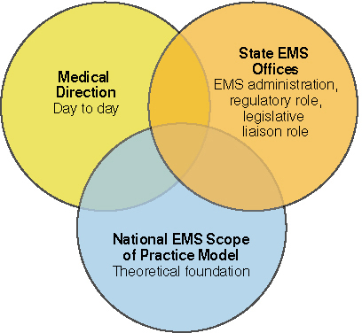
Levels of Training (2 of 2)
© Jones & Bartlett Learning.
Source: Based on the Emergency Medical Services System from the office of EMS.
Notes:
The figure on this slide shows the hierarchies of the National EMS Scope of Practice Model.

Slide 16
Public BLS and Immediate Aid
Millions of laypeople are trained in BLS/CPR.
Increased availability of public access automated external defibrillators (AEDs)
Notes:
Lecture Outline
D. Public BLS and immediate aid
1. Millions of laypeople are trained in BLS/CPR.
2. Increased availability of public access AEDs

Slide 17
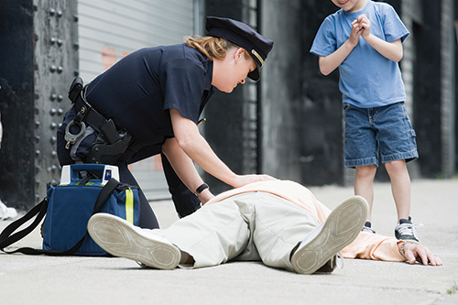
Emergency Medical Responders
EMRs are first responders such as:
  Law enforcement officers
  Firefighters
Provide immediate BLS and urgent care
  Use limited equipment
© Hunterstock/Thinkstock.
Notes:
Lecture Outline
E. Emergency medical responders
1. Generally are first responders such as law enforcement officers and firefighters
2. EMR training provides these individuals with the skills necessary to initiate immediate care and assist EMTs upon their arrival.
3. This course focuses on providing immediate BLS and urgent care with limited equipment.

Slide 18
Emergency Medical Technicians
Course requires about 150 hours
The EMT has the knowledge and skills to provide basic emergency care.
The EMT assumes responsibility for assessment, care, packaging, and transport of the patient.
Notes:
Lecture Outline
F. Emergency medical technicians
1. The EMT course requires about 150 hours, and even more hours in some states.
2. The EMT possesses the knowledge and skills to provide basic emergency care.
3. On arrival at the scene, the EMT assumes responsibility for the assessment, care, package, and transport of the patient.

Slide 19
Advanced Emergency Medical Technicians
Training adds knowledge and skills in specific aspects of ALS:
  IV therapy
  Advanced airway adjuncts
  Administration of limited number of medications
Notes:
Lecture Outline
G. Advanced emergency medical technicians (AEMTs)
1. The AEMT course adds knowledge and skills in specific aspects of ALS for those individuals who are trained and have experience as EMTs:
a. IV therapy
b. Advanced airway adjuncts
c. Administration of a limited number of medications

Slide 20
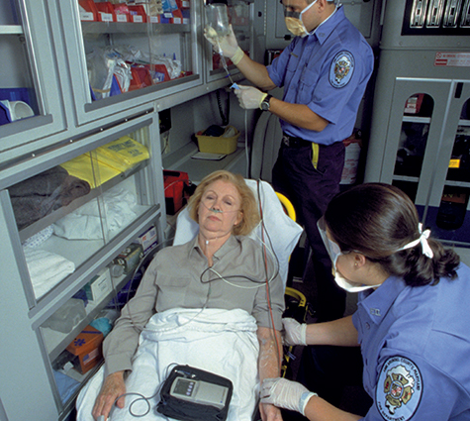
Paramedics
Extensive course of training
  1,000 to more than 1,300 hours
Training cover a wide range of ALS skills:
  Endotracheal intubation
  Emergency pharmacology
  Cardiac monitoring
© Jones and Bartlett Publishers.
Courtesy of MIEMSS.
Notes:
Lecture Outline
H. Paramedics
1. Extensive course of training:
a. Course hours range from 1,000 to more than 1,300 hours, divided between classroom and internship training.
b. The course may be offered within the context of an associate’s or bachelor’s degree college program.
2. Training covers a wide range of ALS skills:
a. Endotracheal intubation
b. Emergency pharmacology
c. Cardiac monitoring
d. Other advanced assessment and treatment skills

Slide 21
14 Components of the
EMS System (1 of 4)
Public access
Clinical care
Medical direction
Integration of health services
Information systems
Notes:
Lecture Outline
VII. Components of the EMS System
A. The EMS Agenda for the Future outlines 14 components of an EMS system:
1. Public access
2. Clinical care
3. Medical direction
4. Integration of health services
5. Information systems

Slide 22
14 Components of the
EMS System (2 of 4)
Prevention
EMS research
Communication systems
Human resources
Legislation and regulation
Notes:
Lecture Outline
6. Prevention
7. EMS research
8. Communication systems
9. Human resources
10. Legislation and regulation

Slide 23
14 Components of the
EMS System (3 of 4)
Evaluation
System finance
Public education
Education systems
Notes:
Lecture Outline
11. Evaluation
12. System finance
13. Public education
14. Education systems

Slide 24
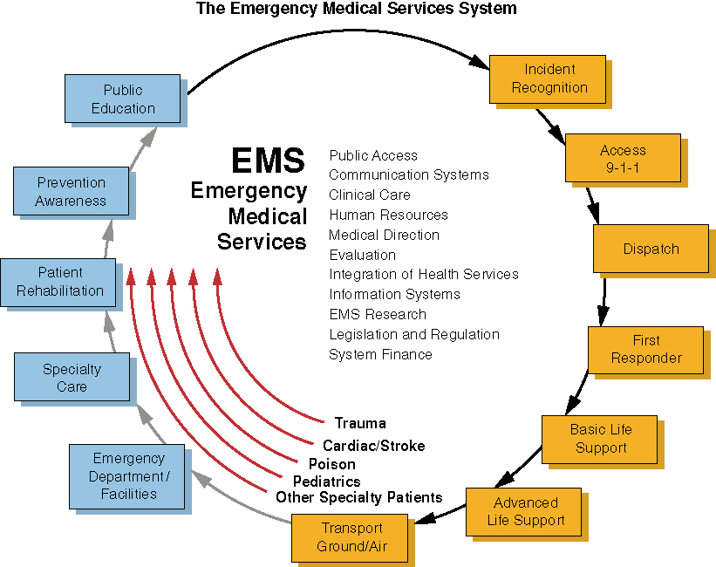
14 Components of the
EMS System (4 of 4)
Source: www.ems.gov
Notes:
The illustration on this slide shows how the components of the NHTSA’s emergency medical services system interact.

Slide 25
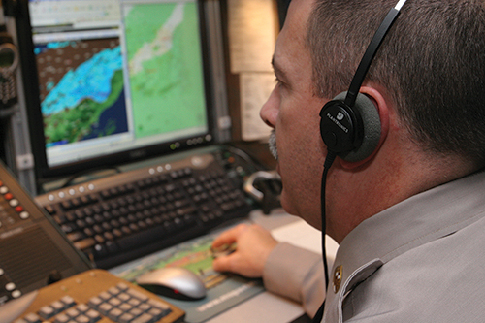
Public Access and Communication Systems (1 of 2)
911 system
  Access public safety
Dispatchers
  Obtain information and dispatch resources
© Jones & Bartlett Learning. Courtesy of MIEMSS.
Notes:
Lecture Notes
B. Public access and communication systems
1. Easy access to help in an emergency is essential.
2. The 911 system is the public safety access point.
3. At the communication center, trained dispatchers obtain information and dispatch the ambulance crew and other equipment and responders.

Slide 26
Public Access and Communication Systems (2 of 2)
Emergency medical dispatch (EMD) system
  Provides medical instruction
© Jones & Bartlett Learning. Courtesy of MIEMSS.
Notes:
Lecture Notes
4. An emergency medical dispatch (EMD) system has been developed to assist dispatchers in providing callers with vital medical instructions until EMS arrival.
5. New technology can help responders locate their patients.
a. Example: cellular telephones linked to Global Positioning System (GPS) units

Slide 27
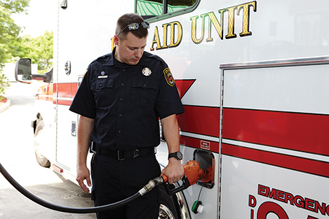
Clinical Care
Describes the pieces of equipment and scope of practice
Familiarizes EMTs with their primary service area (PSA) and ambulance controls
© Jones & Bartlett Learning.
Notes:
Lecture Outline
C. Clinical care
1. Describes the pieces of equipment and the scope of practice for using that equipment
2. Familiarizes EMTs with their primary service area (PSA) and ambulance controls

Slide 28
Human Resources
Focuses on the people who deliver the care
EMS Agenda for the Future
  Encourages systems to help protect EMS providers’ well-being
Notes:
Lecture Outline
D. Human resources
1. Focuses on the people who deliver the care
2. The EMS Agenda for the Future encourages the creation of systems to help protect the well-being of EMS providers, including the development of career ladders.

Slide 29
Medical Direction (1 of 2)
Physician medical director
  Authorizes EMTs to provide medical care in the field
Medical director
  Acts as a liaison
Standing orders and protocols
  Describe appropriate care
  Establish medical direction for providers
Notes:
Lecture Outline
E. Medical direction
1. The physician medical director authorizes EMTs to provide medical care in the field.
2. The medical director is the ongoing working liaison between the medical community, hospitals, and the EMTs in the service.
3. Appropriate care is described in standing orders and protocols.
a. Protocols are described in a comprehensive guide delineating the EMT’s scope of practice.
b. Standing orders are part of protocols and designate what the EMT is required to do for a specific complaint or condition.
4. Providers are not required to consult medical direction before implementing standing orders.

Slide 30
Medical Direction (2 of 2)
Medical control can be off-line or online.
  Off-line (indirect)
    Standing orders, training, supervision
  Online (direct)
    Physician directions given over the phone or radio
Notes:
Lecture Outline
5. Medical control can be off-line or online.
a. Off-line (indirect)
i. Standing orders, training, supervision
b. Online (direct)
i. Physician directions given over the phone or radio

Slide 31
Legislation and Regulation
Training, protocols, and practices follow state legislation.
Senior EMS official handles administrative tasks:
  Scheduling
  Personnel
  Budgets
  Purchasing
  Vehicle maintenance
Notes:
Lecture Outline
F. Legislation and regulation
1. Although each EMS system, medical direction, and training program has latitude, its training, protocols, and practices must follow state legislation, rules, regulations, and guidelines.
2. A senior EMS official is usually in charge of necessary administrative tasks such as scheduling, personnel, budgets, purchasing, and vehicle maintenance, and the daily operations of ambulances and crews.

Slide 32
Integration of Health Services
Treatment initiated in the field should be continued in the emergency department
  Ensures continuity of care
Notes:
Lecture Outlines
G. Integration of health services
1. Prehospital care should be continued in the emergency department to ensure that the patient receives comprehensive continuity of care.

Slide 33
Mobile Integrated Health Care
(1 of 2)
New method of delivering health care
  Utilizes the prehospital spectrum
Evolved from the Patient Protection and Affordable Care Act
Health care is provided within the community by a team of professionals.
Notes:
Lecture Outline
H. Mobile integrated health care
1. Mobile integrated health care (MIH) is a new method of delivering health care that utilizes the prehospital spectrum.
2. MIH evolved as a result of the Patient Protection and Affordable Care Act, with the goal to facilitate improved access to health care at an affordable price.
3. In the MIH model, health care is provided within the community, rather than at a physician’s office or hospital, by an integrated team of health care professionals.

Slide 34
Mobile Integrated Health Care
(2 of 2)
MIH necessitates additional training levels for EMS providers, including community paramedicine.
  Paramedics receive advanced training to provide services within a community.
  Community paramedics provide additional services.
Notes:
Lecture Outline
4. This new branch of health care is causing the evolution of additional training levels for EMS providers.
a. One new aspect is community paramedicine, in which experienced paramedics receive advanced training to equip them to provide services within a community.
b. In addition to the patient care services a paramedic would typically provide, services provided by community paramedics may include:
i. Performing health evaluations
ii. Monitoring chronic illnesses or conditions
iii. Obtaining laboratory samples
iv. Administering immunizations

Slide 35
Evaluation
The medical director maintains quality control.
Continuous quality improvement (CQI) reviews and audits the EMS system.
Minimizing errors is the goal.
Notes:
Lecture Outline
I. Evaluation
1. The medical director maintains quality control.
2. Continuous quality improvement (CQI) reviews and performs audits of the EMS system to identify areas of improvement and/or assign remedial training.
3. Minimizing errors is the goal.

Slide 36
Information Systems
Computer systems
  Used to document patient care
Information can be used to improve care.
Notes:
Lecture Outline
J. Information systems
1. Computer systems are used to document patient care.
2. Once stored electronically, the information can be used to improve care.

Slide 37
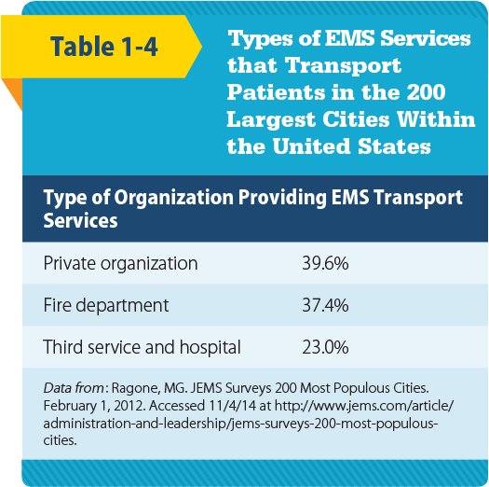
System Finance (1 of 2)
Finance systems vary depending on the organization involved.
Notes:
Lecture Outline
K. System finance
1. Finance systems vary depending on which organization is involved.

Slide 38
System Finance (2 of 2)
Personnel may be paid, volunteer, or a mix.
EMTs may be asked to:
  Gather insurance information
  Secure signatures
  Obtain permission from patients to bill insurance
Notes:
Lecture Outline
2. Personnel may be paid, volunteer, or a mix of the two.
3. EMTs may be asked to:
a. Gather insurance information from patients
b. Secure signatures on certain documents such as HIPAA notifications
c. Obtain written permission from patients to bill their health insurance company

Slide 39
Education Systems (1 of 2)
EMS instructors
  Licensed in most states
Most EMS training programs must adhere national standards
ALS training locations
  College
  Adult career center
  Hospital
Notes:
Lecture Outline
L. Education systems
1. EMS instructors are licensed in most states.
2. Most EMS training programs must adhere to national standards established by two accrediting organizations: Committee on Accreditation of Educational Programs for the Emergency Medical Services Professions (CoAEMSP) and Commission on Accreditation of Allied Health Education Programs (CAAHEP).
3. ALS training is usually provided in college, adult career center, or hospital settings.
4. Information and skills in emergency medical care change constantly. Refresher training and continuing education are important, as are computer-based or manikin-based self-education exercises

Slide 40
Education Systems (2 of 2)
Continuing education and refresher courses
  Measures to maintain an EMT’s skills and knowledge
Notes:
Lecture Outline
4. Information and skills in emergency medical care change constantly. Refresher training and continuing education are important, as are computer-based or manikin-based self-education exercises

Slide 41
Prevention and Public Education (1 of 2)
Prevention and public education
  Two components of the EMS system with a focus on public health
EMS works with public health agencies on:
  Primary prevention
  Secondary prevention
Notes:
Lecture Notes
M. Prevention and public education
1. Prevention and public education are aspects of EMS where the focus is on public health.
2. Public health examines the health needs of entire populations with the goal of preventing health problems.
3. EMS works with public health agencies:
a. Primary prevention focuses on strategies that will prevent the event from ever happening—for example, educating the community on pool safety and car seat installation.
b. Secondary prevention occurs after the event has already happened—for example, use of helmets and seat belts. The key question is, How can we decrease the effects of the event?

Slide 42
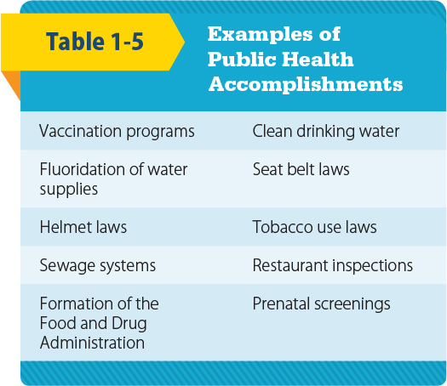
Prevention and Public Education (2 of 2)
© Jones and Bartlett Publishers.
Notes:
The table on this slide lists examples of public health accomplishments.

Slide 43
EMS Research
Helps determine the shape of EMS
Application of evidence-based practice
  Integral part of functioning as an EMS provider
Role of EMTs
  May be involved through gathering data
Notes:
Lecture Outline
N. EMS research
1. Research helps to determine the shape and impact of EMS on the community.
2. Applying evidence-based practice is an integral part of functioning as an EMS provider. Patient care should be focused on procedures that have proved useful in improving patient outcomes. All aspects of the EMT role are currently being researched.
3. EMTs may be involved in research through gathering data.

Slide 44
Roles and Responsibilities of the EMT (1 of 4)
Keep vehicles and equipment ready.
Ensure safety.
Operate the emergency vehicle.
Be an on-scene leader.
Perform a scene evaluation.
Notes:
Lecture Outline
VIII. Roles and Responsibilities of the EMT
A. EMTs are health care professionals, whether paid or volunteer.
B. Roles and responsibilities of an EMT:
1. Keep vehicles and equipment ready for an emergency.
2. Ensure the safety of yourself, your partner, the patient, and bystanders.
3. Operate the emergency vehicle.
4. Be an on-scene leader.
5. Perform an evaluation of the scene.

Slide 45
Roles and Responsibilities of the EMT (2 of 4)
Call for additional resources as needed.
Gain patient access.
Perform a patient assessment.
Give emergency medical care while awaiting additional medical resources.
Notes:
Lecture Outline
6. Call for additional resources as needed.
7. Gain patient access.
8. Perform a patient assessment.
9. Give emergency medical care to the patient while awaiting the arrival of additional medical resources.

Slide 46
Roles and Responsibilities of the EMT (3 of 4)
Give emotional support.
Maintain continuity of care.
Resolve emergency incidents.
Uphold medical and legal standards.
Ensure and protect patient privacy.
Ensure and protect patient privacy.
Notes:
Lecture Outline
10. Give emotional support to the patient, the patient’s family, and other responders.
11. Maintain continuity of care by working with other medical professionals.
12. Resolve emergency incidents.
13. Uphold medical and legal standards.
14. Ensure and protect patient privacy.

Slide 47
Roles and Responsibilities of the EMT (4 of 4)
Give administrative support.
Constantly continue professional development.
Cultivate and sustain community relations.
Give back to the profession.
Notes:
Lecture Outline
15. Give administrative support.
16. Constantly continue your professional development.
17. Cultivate and sustain community relations.
18. Give back to the profession.

Slide 48
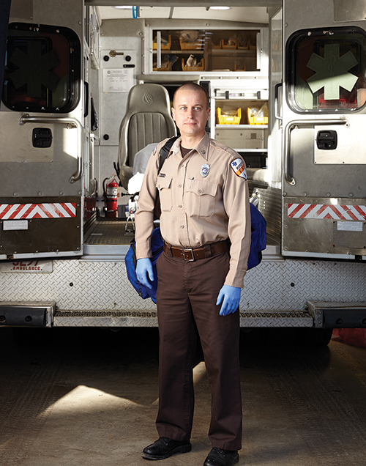
Professional Attributes (1 of 3)
Integrity
Empathy
Self-motivation
Appearance and
hygiene
Self-confidence
© Jones & Bartlett Learning.
Notes:
Lecture Notes
C. Professional attributes
1. Integrity: adhering to a code of fair and honest behavior
2. Empathy: being aware of and thoughtful toward the needs of others
3. Self-motivation: discovering problems and solving them without someone directing you
4. Appearance and hygiene: using your persona to project a sense of trust, professionalism, knowledge, and compassion
5. Self-confidence: knowing what you know and knowing what you do not know; being able to ask for help

Slide 49
Professional Attributes (2 of 3)
Time management
Communications
Teamwork and diplomacy
Respect
Patient advocacy
Careful delivery of care
Notes:
Lecture Outline
6. Time management: performing or delegating multiple tasks while ensuring efficiency and safety
7. Communications: understanding others and making yourself understood to others
8. Teamwork and diplomacy: being able to work with others; knowing your place within a team; communicating while giving respect to the listener
9. Respect: placing others in high regard or importance; understanding that others are more important than you
10. Patient advocacy: constantly keeping the needs of the patient at the center of care
11. Careful delivery of care: paying attention to detail; making sure that what is being done for the patient is done as safely as possible

Slide 50
Professional Attributes (3 of 3)
Every patient is entitled to compassion, respect, and the best care.
EMTs are bound by patient confidentiality.
Be familiar with requirements of the Health Insurance Portability and Accountability Act (HIPAA).
Notes:
Lecture Outline
D. Most patients will treat you with respect, but some will not. Yet every patient is entitled to compassion, respect, and the best care you can provide.
E. As health care professionals, EMTs are bound by patient confidentiality.
1. Patient privacy must be protected.
2. Findings or disclosures made by the patient should be discussed only:
a. With those treating the patient
b. In limited situations, as required by law, with the police or other social service agencies
F. Protection of patient privacy has drawn national attention with the passage of the Health Insurance Portability and Accountability Act (HIPAA).

Slide 51

Review
Which of the following is an example of care that is provided using standing orders?
  Medical control is contacted by the EMT after a patient with chest pain refuses EMS care.
  The EMT defibrillates a cardiac arrest patient, begins CPR, and then contacts medical control.
  A physician gives the EMT an order via radio to administer oral glucose to a diabetic patient.
  Following an overdose, the EMT contacts the medical director for permission to give activated charcoal.

Slide 52
Review
Answer: B
Rationale: Standing orders—a form of
off-line (indirect) medical control—involve performing certain life-saving interventions
(ie, CPR, defibrillation, bleeding control) before contacting a physician for further instructions.

Slide 53
Review (1 of 2)
Which of the following is an example of care that is provided using standing orders?
  Medical control is contacted by the EMT after a patient with chest pain refuses EMS care.
  Rationale: This is an example of online medical control given via the phone or radio.
  The EMT defibrillates a cardiac arrest patient, begins CPR, and then contacts medical control.
  Rationale: Correct answer

Slide 54
Review (2 of 2)
Which of the following is an example of care that is provided using standard orders?
  A physician gives the EMT an order via radio to administer oral glucose to a diabetic patient.
  Rationale: This is an example of online medical control given via the phone or radio.
  Following an overdose, the EMT contacts the medical director for permission to give activated charcoal.
  Rationale: This is an example of online medical control given via the phone or radio.

Slide 55
Review
Quality control in an EMS system is the ultimate responsibility of the:
  paramedic.
  lead EMT.
  medical director.
  EMS administrator.

Slide 56
Review
Answer: C
Rationale: The medical director is responsible for maintaining quality control, which ensures that all staff members who are involved in caring for patients meet the standard of care on every call.

Slide 57
Review (1 of 2)
Quality control in an EMS system is the ultimate responsibility of the:
  paramedic.
  Rationale: A paramedic has the knowledge and mastery of BLS and ALS skills.
  lead EMT.
  Rationale: This is the senior EMT with a service or company.

Slide 58
Review (2 of 2)
Quality control in an EMS system is the ultimate responsibility of the:
  medical director.
  Rationale: Correct answer
  EMS administrator.
  Rationale: The EMS administrator sees to the daily operations and overall direction of the service or company.

Slide 59
Review
Upon arriving at the scene of a domestic dispute, you hear yelling and the sound of breaking glass from inside the residence. You should:
  immediately gain access to the patient.
  carefully enter the house and then call the police.
  retreat to a safe place until the police arrive.
  tell the patient to exit the residence so you can provide care.

Slide 60
Review
Answer: C
Rationale: Never enter a scene in which signs of violence are present, including yelling, screaming, or the sound of breaking glass. Law enforcement must secure the scene prior to the EMT’s entry.

Slide 61
Review (1 of 2)
Upon arriving at the scene of a domestic dispute, you hear yelling and the sound of breaking glass from inside the residence. You should:
  immediately gain access to the patient.
  Rationale: Never enter a scene in which signs of violence are present. Law enforcement must secure the scene.
  carefully enter the house and then call the police.
  Rationale: Never enter a scene in which signs of violence are present. Law enforcement must secure the scene.

Slide 62
Review (2 of 2)
Upon arriving at the scene of a domestic dispute, you hear yelling and the sound of breaking glass from inside the residence. You should:
  retreat to a safe place until the police arrive.
  Rationale: Correct answer
  tell the patient to exit the residence so you can provide care.
  Rationale: Never enter a scene in which signs of violence are present. Law enforcement must secure the scene.

Slide 63
Review
Which of the following is NOT a component of continuous quality improvement (CQI)?
  Periodic review of run reports
  Discussion of needs for improvement
  Negative feedback to those who make mistakes while on a call
  Remedial training as deemed necessary by the medical director

Slide 64
Review
Answer: C
Rationale: The purpose of CQI is to ensure that the standard of care is provided on all calls. This involves periodic run report reviews, discussing needs for improvement, and providing remedial training as deemed necessary by the medical director. Positive feedback should be provided during this process.

Slide 65
Review
Which of the following is NOT a component of continuous quality improvement (CQI)?
  Periodic review of run reports
  Rationale: This is a part of CQI.
  Discussion of needs for improvement
  Rationale: This is a part of CQI.
  Negative feedback to those who make mistakes while on a call
  Rationale: Correct answer
  Remedial training as deemed necessary by the medical director
  Rationale: This is a part of CQI.

Slide 66
Review
All of the following are responsibilities of the EMS medical director, EXCEPT:
  evaluating patient insurance information.
  serving as liaison with the medical community.
  ensuring that the appropriate standards are met by EMTs.
  ensuring appropriate EMT education and continuing training.

Slide 67
Review
Answer: A
Rationale: Responsibilities of the medical director include serving as liaison with the medical community, ensuring that appropriate standards are met by EMS personnel, and ensuring appropriate EMT education and continuing training. Insurance matters are handled by the EMS billing department.

Slide 68
Review (1 of 2)
All of the following are responsibilities of the EMS medical director, EXCEPT:
  evaluating patient insurance information.
  Rationale: Correct answer
  serving as liaison with the medical community.
  Rationale: This is a responsibility of the medical director.

Slide 69
Review (2 of 2)
All of the following are responsibilities of the EMS medical director, EXCEPT:
  ensuring that the appropriate standards are met by EMTs.
  Rationale: This is a responsibility of the medical director.
  ensuring appropriate EMT education and continuing training.
  Rationale: This is a responsibility of the medical director.

Slide 70
Review
Which of the following situations would MOST likely disqualify a person for EMS certification?
  A misdemeanor at the age of 17
  Driving under the influence of alcohol
  Possessing a valid driver’s license from another state
  A mild hearing impairment that is corrected with hearing aids

Slide 71
Review
Answer: B
Rationale: In most states, a person may be denied EMS certification for being convicted of a felony, such as driving under the influence of alcohol or other drugs.

Slide 72
Review (1 of 2)
Which of the following situations would MOST likely disqualify a person for EMS certification?
  A misdemeanor at the age of 17
  Rationale: Most states seal misdemeanor juvenile records, so this history would not likely disqualify a person.
  Driving under the influence of alcohol
  Rationale: Correct answer

Slide 73
Review (2 of 2)
Which of the following situations would MOST likely disqualify a person for EMS certification?
  Possessing a valid driver's license from another state
  Rationale: Most states require providers to have a valid in-state driver’s license.
  A mild hearing impairment that is corrected with hearing aids
  Rationale: If the performance of tasks are not impaired, the hearing impairment would not disqualify a person.

Slide 74
Review
Which of the following should be the EMT’s highest priority?
  Controlling severe bleeding
  Maintaining a patient’s airway
  Ensuring patient safety
  Ensuring personal safety

Slide 75
Review
Answer: D
Rationale: Personal safety is of utmost concern for the EMT. This involves sizing up a scene to determine whether the scene is safe to enter. This will ensure the safety of all personnel.

Slide 76
Review (2 of 2)
Which of the following should be the EMT’s highest priority?
  Controlling severe bleeding
  Rationale: This is the priority once the patient’s airway and breathing have been addressed.
  Maintaining a patient’s airway
  Rationale: This is most the important priority once patient contact is made.

Slide 77
Review (2 of 2)
Which of the following should be the EMT’s highest priority?
  Ensuring patient safety
  Rationale: Safety is first determined during scene size-up. You should not enter an unsafe scene.
  Ensuring personal safety
  Rationale: Correct answer

Slide 78
Review
A patient who requires cardiac monitoring in the field would require, at a minimum, which level of EMS provider?
  EMR
  EMT
  Paramedic
  AEMT

Slide 79
Review
Answer: C
Rationale: Of all levels of EMS provider, the paramedic is trained in advanced medical care, including cardiac monitoring, IV therapy, and the administration of a variety of emergency drugs.

Slide 80
Review (1 of 2)
A patient who requires cardiac monitoring in the field would require, at a minimum, which level of EMS provider?
  EMR
  Rationale: This level is trained to initiate BLS before an ambulance arrives.
  EMT
  Rationale: This level has the knowledge and skills to provide basic emergency care.

Slide 81
Review (2 of 2)
A patient who requires cardiac monitoring in the field would require, at a minimum, which level of EMS provider?
  Paramedic
  Rationale: Correct answer
  AEMT
  Rationale: This level is not trained to perform cardiac monitoring.

Slide 82
Review
Which of the following is a professional responsibility of the EMT?
  Telling the family of a dying patient that everything
  will be OK
  Maintaining only the skills that the EMT feels uncomfortable with
  Maintaining a professional demeanor even under the most stressful situations
  Advising an emergency department nurse that patient reports are given only to a physician

Slide 83
Review
Answer: C
Rationale: Because the public relies upon the EMT to remain calm when others cannot, he or she must project a professional and calm demeanor even when under extreme stress.

Slide 84
Review (1 of 2)
Which of the following is a professional responsibility of the EMT?
  Telling the family of a dying patient that everything will be OK
  Rationale: Discussions about dying patients are handled by providers of a higher level.
  Maintaining only the skills that the EMT he feels uncomfortable with
  Rationale: The quality of care depends upon your ability, so you must maintain all of your skills.

Slide 85
Review (2 of 2)
Which of the following is a professional responsibility of the EMT?
  Maintaining a professional demeanor even under the most stressful situations
  Rationale: Correct answer
  Advising an emergency department nurse that patient reports are given only to a physician
  Rationale: You must give your report to the receiving hospital emergency department staff, including a nurse.

Slide 86
Review
Emergency patient care occurs in progressive phases. What occurs first?
  Activation of EMS
  Initial prehospital care
  The patient receives definitive care
  Incident recognition

Slide 87
Review
Answer: D
Rationale: Someone must recognize an emergency before EMS can be activated.

Slide 88
Review (1 of 2)
Emergency patient care occurs in progressive phases. What occurs first?
  Activation of EMS
  Rationale: This occurs once an incident is recognized.
  Initial prehospital care
  Rationale: This occurs when the EMT arrives on scene.

Slide 89
Review (2 of 2)
Emergency patient care occurs in progressive phases. What occurs first?
  The patient receives definitive care
  Rationale: This occurs when the EMT and patient reach the hospital.
  Incident recognition
  Rationale: Correct answer

