Slide 1
Chapter 2
Workforce Safety and Wellness
Notes:
Chapter 2: Workplace Safety and Wellness

Slide 2
National EMS Education Standard Competencies (1 of 5)
Medicine
Applies fundamental knowledge to provide basic emergency care and transportation based on assessment findings for an acutely ill patient.
Notes:
National EMS Education Standard Competencies
Medicine
Applies fundamental knowledge to provide basic emergency care and transportation based on assessment findings for an acutely ill patient.

Slide 3
National EMS Education Standard Competencies (2 of 5)
Infectious Diseases
Awareness of
How to decontaminate equipment after treating a patient
Assessment and management of
How to decontaminate the ambulance and equipment after treating a patient
Notes:
National EMS Education Standard Competencies
Infectious Diseases
• Awareness of how to decontaminate equipment after treating a patient
• Assessment and management of how to decontaminate the ambulance and equipment after treating a patient

Slide 4
National EMS Education Standard Competencies (3 of 5)
Preparatory
Applies fundamental knowledge of the emergency medical services (EMS) system, safety/well-being of the emergency medical technician (EMT), medical/legal, and ethical issues to the provision of emergency care.
Notes:
National EMS Education Standard Competencies
Preparatory
Applies fundamental knowledge of the emergency medical services (EMS) system, safety/well-being of the emergency medical technician (EMT), medical/legal, and ethical issues to the provision of emergency care.

Slide 5
National EMS Education Standard Competencies (4 of 5)
Workforce Safety and Wellness
Standard safety precautions
Personal protective equipment
Stress management
Dealing with death and dying
Prevention of response-related injuries
Notes:
National EMS Education Standard Competencies
Workforce Safety and Wellness
• Standard safety precautions
• Personal protective equipment
• Stress management
• Dealing with death and dying
• Prevention of response-related injuries

Slide 6
National EMS Education Standard Competencies (5 of 5)
Workforce Safety and Wellness (cont'd)
Prevention of work-related injuries
Lifting and moving patients
Disease transmission
Wellness principles
Notes:
National EMS Education Standard Competencies
• Prevention of work-related injuries
• Lifting and moving patients
• Disease transmission
• Wellness principles

Slide 7
Introduction
To take care of others, we must take care of ourselves.
EMT training includes recognition of hazards:
Personal neglect
Environmental and human-made threats
Mental and physical stress
Notes:
Lecture Outline
I. Introduction
A. To take care of others, we must take care of ourselves.
1. If your safety is threatened, you will not be able to care for the patient.
B. EMT training includes recognition of hazards to your health, safety, and well-being:
1. Personal neglect
2. Environmental and human-made threats
3. Mental and physical stress
C. The emotional well-being of the EMT and the patient are intertwined, especially in high-stress rescues.

Slide 8
General Health and Wellness (1 of 4)
Wellness is a state of complete mental, physical, and social well-being.
A state of wellness must occur at work and at home.
Notes:
Lecture Outline
II. General Health and Wellness
A. Wellness goes beyond the prevention of disease. It is a state of complete mental, physical, and social well-being.
B. As a health care provider, you should model a life of health and wellness.
C. A state of wellness must occur at:
1. Work—through protection from communicable disease and scene hazards.
2. Home—through a healthy diet; exercise; getting enough sleep; refraining from use of tobacco, drugs, and excessive alcohol; and taking time to relax.

Slide 9
General Health and Wellness (2 of 4)
Components of wellness
Protection from disease and hazards
Proper nutrition
Sufficient exercise
Sufficient sleep
Refraining from tobacco, drugs, and alcohol
Taking time to relax
Notes:
Lecture Outline
C. A state of wellness must occur at:
1. Work—through protection from communicable disease and scene hazards.
2. Home—through a healthy diet; exercise; getting enough sleep; refraining from use of tobacco, drugs, and excessive alcohol; and taking time to relax.

Slide 10
General Health and Wellness (3 of 4)
EMTs often work in stressful situations.
As an EMT, your role is to:
Be prepared
Anticipate needed resources
Control the scene
Care for the patient
Your calm manner will calm the patient, family members, and bystanders.
Notes:
Lecture Outline
D. EMTs are often called upon to work in circumstances that result in both acute and cumulative stress. As an EMT, your role is to:
1. Be prepared
2. Anticipate needed resources
3. Control the scene
4. Care for the patient
E. The calm manner in which you approach the scene will help to calm the patient, family members, and bystanders.

Slide 11
General Health and Wellness (4 of 4)
Stress is any event, thought, or action perceived as a threat.
Regardless of how stressful the situation, you must focus on, in this order:
Personal safety
Scene safety, including the safety of others
Patient care
Notes:
Lecture Outline
F. Wellness and stress management
1. Prolonged physical stress can drain the body of its reserves.
a. Depleted of key nutrients
b. Weakened
c. More susceptible to illness
2. Stress is any event, thought, or action perceived as a threat.
3. Even people who are completely healthy may be constantly dealing with stress.
4. Understanding how stress affects you physiologically, physically, and psychologically can help you:
a. Control your reactions
b. Minimize the effect of stress
G. Regardless how stressful the situation, you must focus on the following considerations, in this order:
1. Personal safety
2. Scene safety, including safety of others
3. Patient care

Slide 12
Strategies to Manage Stress (1 of 3)
Minimize or eliminate stressors.
Change partners to avoid a negative or hostile personality.
Change work hours.
Change the work environment.
Cut back on overtime.
Notes:
Lecture Outline
H. Utilize the help of others, including your partner, police, a supervisor, other additional personnel, or even bystanders to help manage crisis situations.
I. Stress management refers to the tactics that have been shown to alleviate or eliminate stress reactions.
1. These steps may involve changing a few habits, changing your attitude, and perseverance.
2. Strategies to manage stress:
a. Minimize or eliminate stressors as much as possible.
b. Change partners to avoid a negative or hostile personality.
c. Change work hours.
d. Change the work environment.
e. Cut back on overtime.

Slide 13
Strategies to Manage Stress (2 of 3)
Change your attitude about the stressor.
Talk about your feelings.
Seek professional counseling if needed.
Do not obsess over frustrating situations.
Try to adopt a relaxed, philosophical outlook.
Notes:
Lecture Outline
f. Change your attitude about the stressor.
g. Talk about your feelings with people you trust.
h. Seek professional counseling if needed.
i. Do not obsess over frustrating situations that you are unable to change, such as relapsing alcoholics and nursing home transfers; focus on delivering high-quality care.
j. Try to adopt a relaxed, philosophical outlook.

Slide 14
Strategies to Manage Stress (3 of 3)
Expand your social support system.
Develop friends and interests outside emergency services.
Minimize the physical response to stress.
Periodic stretching or yoga
Slow, deep breathing
Regular physical exercise
Meditation
Limit intake of caffeine, alcohol, and tobacco.
Notes:
Lecture Outline
k. Expand your social support system beyond your coworkers.
l. Develop friends and interests outside emergency services.
m. Minimize the physical response to stress by using various techniques, including:
i. Periodic stretching or yoga
ii. Slow, deep breathing
iii. Regular physical exercise (150 minutes per week, including cardiovascular effort)
iv. Progressive muscle relaxation
v. Meditation
n. Limit your intake of caffeine, alcohol, and tobacco.

Slide 15
Wellness and Stress Management (1 of 2)
Nutrition
Eat nutritious food.
Physically prepare your body for stress.
Exercise and relaxation
Sleep
Regular and uninterrupted
Courtesy of the USDA Center for Nutrition Policy and Promotion.
Notes:
Lecture Outline
J. Nutrition
1. Your body’s three sources of fuel—carbohydrates, fat, and protein—are consumed in increased quantities during times of stress, particularly if physical activity is involved.
2. The quickest source of energy is glucose, taken from stored glycogen in the liver.
3. Protein, drawn primarily from muscle, is a long-term source of fuel.
4. Tissues can use fat for energy.
5. The body conserves water during stress.
6. Other nutrients that are susceptible to depletion are the vitamins and minerals that are not stored by the body in substantial quantities.
K. You should physically prepare your body for stress.
1. Physical conditioning and proper nutrition are the two variables over which you have absolute control.
2. To perform efficiently, you must eat nutritious food. Food is the fuel that makes the body run.
3. Limit your consumption of sugar, fats, sodium, and alcohol.
4. Complex carbohydrates rank next to simple sugars in their ability to produce energy. Complex carbohydrates such as pasta, rice, and vegetables are among the most reliable sources for long-term energy production.
5. Fats are also easily converted to energy, but eating too much fat can lead to obesity, cardiac disease, and other long-term health problems.
a. Fats should be limited to 10% of calories, and intake should focus on monounsaturated and polyunsaturated fats while avoiding saturated fats or trans fats.
b. Carry an individual supply of high-energy food to help maintain energy levels.
c. Maintain adequate fluid intake.
L. Exercise and relaxation
1. Regular exercise will enhance the benefits of maintaining good nutrition and adequate hydration.
2. When you are in good physical condition, you can handle stress more easily.
3. Regular exercise will increase your strength and endurance.
4. Plan physical activities ahead of time and use strategies that make your sessions more convenient.
5. Exercise will help you maintain sufficient strength to lift patients and heavy equipment.
M. Sleep
1. Sleep should be regular and uninterrupted.
2. Limit your caffeine and alcohol intake and tobacco use.
3. Eight straight hours of sleep may not be possible, but three sleep episodes of 2 to 3 hours each will provide similar effects.
4. Routine exercise will promote the needed fatigue for restful sleep.

Slide 16
Wellness and Stress Management (2 of 2)
Disease prevention
Know your family’s health history.
Adjust your lifestyle.
Balancing work, family, and health
Rotate your schedule.
Take time off.
Notes:
Lecture Outline
N. Disease prevention
1. Know your family’s health history. The most common hereditary health factors are heart disease and cancer. Share this information with your personal physician.
2. Lifestyle can be adjusted to help prevent disease. Avoid tobacco and electronic cigarettes (e-cigs).
3. Although there may be health benefits related to some use of alcohol, increased alcohol use may adversely impact other body systems, including the cardiovascular, hepatic, immune, and central nervous systems.
4. Both prescription medications and illegal (illicit) drugs may be used or misused. Both are potentially dangerous and can lead to health problems.
O. Balancing work, family, and health
1. When possible, rotate your schedule to give yourself time off.
2. Take vacations.
3. If at any point you feel the stress of work is more than you can handle, seek help.

Slide 17
Infectious and Communicable Diseases (1 of 2)
Infectious disease is caused by organisms within the body.
Communicable disease can be spread
From person to person
From one species to another
Notes:
Lecture Outline
III. Infectious and Communicable Diseases
A. An infectious disease is caused by organisms within the body.
B. A communicable disease can be spread:
1. From person to person
2. From one species to another

Slide 18
Infectious and Communicable Diseases (2 of 2)
Infection risk can be minimized by
Immunizations
Protective techniques
Handwashing
Terminology
Pathogen
Contamination
Exposure
Notes:
Lecture Outline
C. Infection risk can be minimized by:
1. Immunizations
2. Protective techniques
3. Handwashing
D. When these protective measures are used, the risk of the health care provider contracting a serious disease is negligible.
E. Familiarize yourself with the following terminology related to infectious diseases.
1. Pathogen: a microorganism that is capable of causing disease
2. Contamination: the presence of infectious organisms or foreign bodies on or within objects such as dressings, water, food, needles, wounds, or a patient’s body
3. Exposure: a situation in which a person has had contact with blood, body fluids, tissues, or airborne particles in a manner that may allow disease transmission to occur
4. Personal protective equipment (PPE): protective equipment that an individual wears to prevent exposure to a pathogen or a hazardous material

Slide 19
Routes of Transmission (1 of 2)
Routes include:
Direct contact (eg, blood-borne pathogens)
Indirect contact (eg, needlesticks)
Airborne transmission (eg, sneezing)
Foodborne transmission (eg, contaminated food)
Vector-borne transmission (eg, fleas)
Notes:
Lecture Outline
F. Routes of transmission
1. Transmission is the way an infectious disease is spread.
a. Direct contact (eg, blood-borne pathogens)
b. Indirect contact (eg, needlesticks)
c. Airborne transmission (eg, sneezing)
d. Foodborne transmission (eg, contaminated food)
e. Vector-borne transmission (eg, fleas)

Slide 20
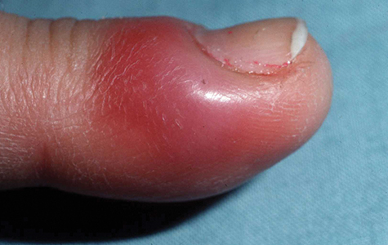
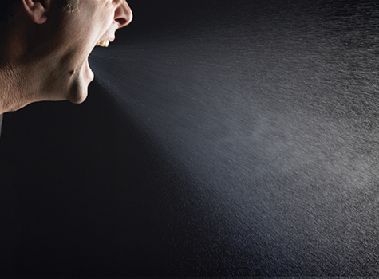
Routes of Transmission (2 of 2)
© DermQuest.com. Used with permission of Galderma S.A.
© James Klotz/ShutterStock, Inc.
Notes:
The figures on this slide show examples of direct contact transmission and airborne transmission.

Slide 21
Risk Reduction and Prevention for Infectious and Communicable Diseases (1 of 2)
All EMTs are trained in handling blood-borne pathogens.
CDC developed standard precautions:
Hand hygiene
Personal protective equipment
Gloves
Gown
Mask, eye protection, face shield
Notes:
Lecture Outline
G. Risk reduction and prevention for infectious and communicable diseases
1. All EMTs are trained in handling blood-borne pathogens.
2. The CDC has developed standard precautions concerning:
a. Hand hygiene
b. Personal protective equipment: gloves, gown, mask, eye protection, face shield

Slide 22
Risk Reduction and Prevention for Infectious and Communicable Diseases (2 of 2)
Patient care environment
Soiled patient care equipment
Environmental controls
Textiles and laundry
Needles and other sharp objects
Special circumstances
Patient resuscitation
Respiratory hygiene/cough etiquette
Notes:
Lecture Outline
c. Patient care environment: soiled patient care equipment, environmental controls, textiles and laundry, needles and other sharp objects
d. Special circumstances: patient resuscitation, respiratory hygiene/cough etiquette

Slide 23
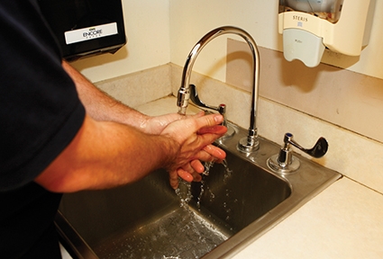
Proper Hand Hygiene (1 of 2)
Handwashing is the simplest, yet most effective way to control disease transmission.
Wash hands before and after patient contact, even if you wear gloves.
© Jones & Bartlett Learning. Courtesy of MIEMSS.
Notes:
Lecture Outline
3. Proper hand hygiene
a. Handwashing is the simplest, yet most effective way to control disease transmission.
b. Wash hands before and after patient contact, even if you wear gloves.

Slide 24
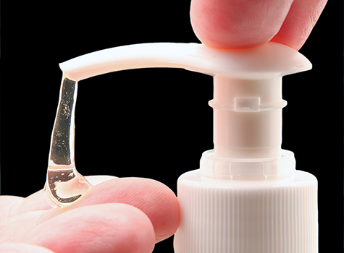
Proper Hand Hygiene (2 of 2)
If there is no running water, use a waterless handwashing substitute.
© Svanblar/ShutterStock, Inc.
Notes:
Lecture Outline
c. If there is no running water, use a waterless handwashing substitute.

Slide 25
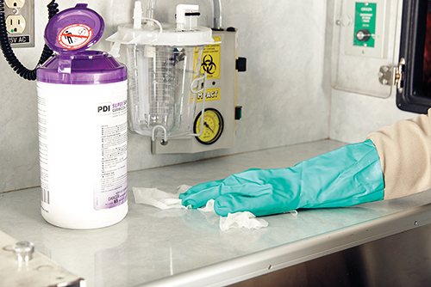
Gloves (1 of 2)
Wear gloves if there is any possibility for exposure to blood or body fluids.
Vinyl, nitrile, and latex gloves are effective protection.
© Jones & Bartlett Learning.
Notes:
Lecture Outline
4. Gloves
a. Wear gloves if there is any possibility for exposure to blood or body fluids.
b. Vinyl, nitrile, and latex gloves are effective protection. Wear heavy-duty gloves when cleaning the ambulance.
c. Change gloves between patients.

Slide 26
Gloves (2 of 2)
Removing gloves requires a special technique.
Avoid contaminating yourself with materials on the outside of the gloves.
Notes:
Lecture Outline
d. Removing gloves requires a special technique to avoid contaminating yourself with the materials on the outside of the gloves (see Skill Drill 2-1).

Slide 27
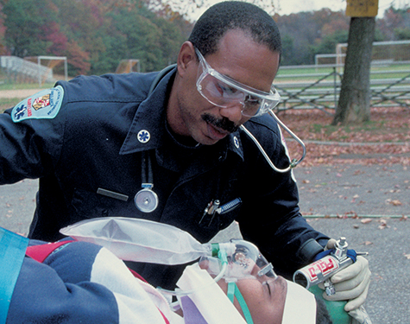
Eye Protection and Face Shields
Eye protection protects from blood splatters.
Prescription glasses are not adequate.
Goggles or face shields are best.
© Jones & Bartlett Learning. Courtesy of MIEMSS.
Notes:
Lecture Outline
5. Eye protection and face shields
a. Eye protection protects from blood splatters.
b. Prescription glasses are not adequate.
c. Goggles or face shields are best.

Slide 28
Gowns
Provide protection from extensive blood splatter
May not be practical in many situations
May even pose a risk for injury
Notes:
Lecture Outline
6. Gowns
a. A gown provides protection from extensive blood splatter.
b. A gown may not be practical in many situations.
i. May even pose a risk for injury

Slide 29
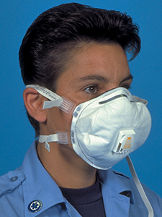
Masks, Respirators, and Barrier Devices (1 of 2)
Standard surgical mask for fluid spatter
Surgical mask on patient with communicable disease
Mask with particulate air respirator on yourself if disease is tuberculosis
© Jones & Bartlett Learning. Courtesy of MIEMSS.
Notes:
Lecture Outline
7. Masks, respirators, and barrier devices
a. Wear a standard surgical mask for fluid spatter.
b. Place a surgical mask on any patient with a communicable disease.
i. Use a mask with a particulate air respirator on yourself if the disease is tuberculosis.

Slide 30
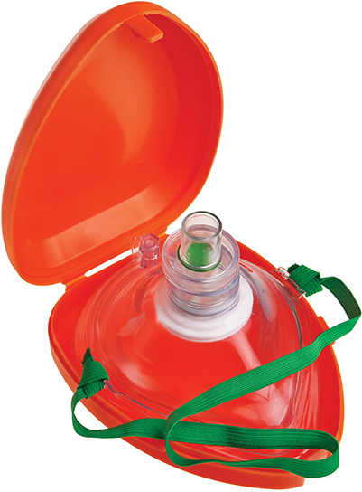
Masks, Respirators, and Barrier Devices (2 of 2)
Mouth-to-mouth resuscitation may transmit disease
With an infected patient, use:
Pocket mask
Bag-valve mask
Dispose of these devices according to local guidelines
© Bart_J/Shutterstock, Inc.
Notes:
Lecture Outline
c. Mouth-to-mouth resuscitation may transmit disease.
d. With an infected patient, use:
i. Pocket mask
ii. Bag-valve mask
e. Dispose of these devices according to local guidelines.

Slide 31
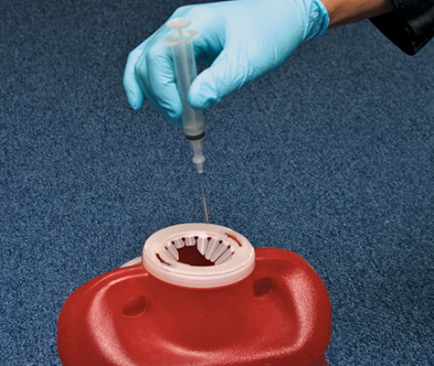
Proper Disposal of Sharps
Proper disposal helps avoid HIV and hepatitis
Do not recap, break, or bend needles.
Dispose of used sharp items in an approved closed container.
© Jones & Bartlett Learning. Courtesy of MIEMSS.
Notes:
Lecture Outline
8. Proper disposal of sharps
a. Proper disposal helps to avoid exposure to HIV and hepatitis.
b. Do not recap, break, or bend needles.
c. Dispose of used sharp items in an approved, closed, rigid container.

Slide 32
Employer Responsibilities
No guarantee of a 100% risk-free environment
Risk of exposure to communicable disease is a hazard of your job.
Know your department’s infection control plan and follow it!
Notes:
Lecture Outline
9. Employer responsibilities
a. There is no guarantee of a 100% risk-free environment. The risk of being exposed to a communicable disease is a hazard of your job.
b. Follow OSHA guidelines and other national guidelines and standards to reduce your risk of exposure to blood-borne pathogens and airborne diseases.
c. Know your department’s infection control plan and follow it.

Slide 33
Establishing an Infection Control Routine
Infection control should be part of your daily routine.
Clean the ambulance after each run and on a daily basis.
Cleaning should be done at the hospital whenever possible.
Notes:
Lecture Outline
H. Establishing an infection control routine
1. Infection control should be an important part of your daily routine.
2. Components of an infection control plan:
a. Determination of exposure risk
b. Education and training
c. Hepatitis B vaccine program
d. Personal protective equipment
e. Cleaning and disinfection practices
f. Tuberculin skin testing/fit testing
g. Postexposure management
h. Compliance monitoring
i. Record keeping
3. Follow the steps in Skill Drill 2-2 to manage potential exposure situations.
4. Cleaning is an essential part of the prevention and control of communicable diseases, as it ensures the removal of surface organisms that may remain in the unit.
a. Clean the ambulance after each run and on a daily basis.
b. Use appropriate PPE while cleaning.
c. Remove contaminated linens, and put them in an appropriate bag for handling.
5. Whenever possible, cleaning should be done at the hospital. There is more information about cleaning the ambulance in Chapter 37, “Transport Operations.”

Slide 34
Immunity
Even if germs reach you, you may not become infected.
You may be immune.
Preventive measures
Maintain your personal health.
Receive immunizations.
Notes:
Lecture Outline
I. Immunity
1. Even if germs reach you, you are not necessarily at risk for infection.
a. Immunity is a major factor in determining which hosts become ill from which germs.
b. Host: the organism or individual that is attacked by the infecting agent
c. You may be immune, or resistant, to particular germs.
d. Immunity:
i. Having been immunized or vaccinated
ii. Able to recover from an infection from that germ
2. Preventive measures
a. Maintain your personal health. Annual health examinations should be required for all EMS personnel.
b. Immunizations.
i. You are required to get the hepatitis B vaccine or sign a waiver.
ii. Other recommended immunizations include tetanus, diphtheria, and pertussis boosters every 10 years; measles, mumps, and rubella (MMR) vaccine; influenza vaccine (yearly); and varicella (chickenpox) vaccine or having chickenpox.

Slide 35
General Postexposure Management
If you are exposed to a patient’s blood or bodily fluids:
Turn over patient care to another EMS provider.
Clean the exposed area.
Rinse your eyes if necessary (20 minutes).
Activate your department’s infection control plan.
Complete an exposure report.
Notes:
Lecture Outline
J. General postexposure management
1. If you are exposed to a patient’s blood or bodily fluids:
a. Turn over patient care to another EMS provider.
b. Clean the exposed area with soap and water.
c. If your eyes were exposed, rinse your eyes for 20 minutes.
d. Activate your department’s infection control plan.
2. You will have to complete an exposure report.
3. Time is important! Some diseases will act quickly, whereas others will remain dormant.
4. Early activation of a plan is critical.

Slide 36
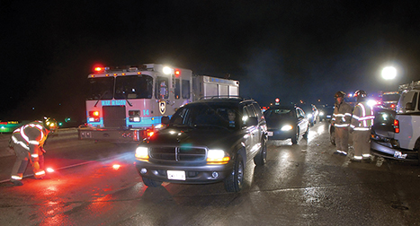
Scene Safety
Begin protecting yourself as soon as you are dispatched.
Continue to protect yourself once on scene.
© Glen E. Ellman.
Notes:
Lecture Outline
IV. Scene Safety
A. The personal safety of all those involved in an emergency situation is very important.
1. Begin protecting yourself as soon as you are dispatched.
a. Wear seat belts.
b. Don appropriate PPE.
2. Continue to protect yourself once on scene.
a. Make sure the scene is well marked.
b. Place warning devices to alert other motorists of the scene.
c. Park at a safe distance from the scene.
d. Make sure there is plenty of light if it is dark.
e. Wear reflective clothing if it is dark.

Slide 37
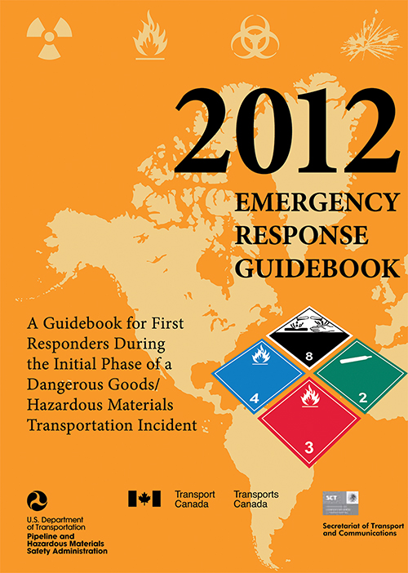
Scene Hazards (1 of 4)
Hazardous materials
Identify what you can from a distance.
Do not enter unless safe to do so.
Courtesy of the U.S. Department of Transportation.
Notes:
Lecture Outline
B. Scene hazards
1. Hazardous materials
a. Upon arrival, look at the scene and try to read any labels, placards, and identification numbers from a distance, perhaps using binoculars.
b. A specially trained and equipped hazardous materials team will be called to the scene to handle disposal of materials and removal of patients.
c. The DOT’s Emergency Response Guidebook is an important resource to help identify hazards.
d. Do not begin caring for patients until they have been moved away from the scene and are decontaminated or the scene is safe for you to enter.
e. Do not enter the scene unless it is safe to do so.

Slide 38
Scene Hazards (2 of 4)
Electricity
Beyond the scope of EMT training
Mark off a danger zone.
Lightning
A repeat strike can occur.
Either direct hit or ground current is possible.
Notes:
Lecture Outline
2. Electricity
a. Dealing with downed power lines is beyond the scope of EMT training.
b. Mark off a danger zone around the downed lines using utility poles as landmarks. The safety zone is one span of the power pole’s distance.
c. Energized lines behave in unpredictable ways.
d. If you must enter the scene, wear the proper protective equipment according to the type of incident.
e. Lightning is a threat in two ways:
i. A direct hit
ii. Ground current
f. A repeat lightning strike in the same area can occur.
g. Avoid high ground to minimize risk of a direct lightning strike.
h. To avoid being injured by ground current, stay away from drainage ditches, moist areas, small depressions, and wet ropes.
i. When lightning is nearby, make yourself the smallest target possible and drop all equipment.

Slide 39
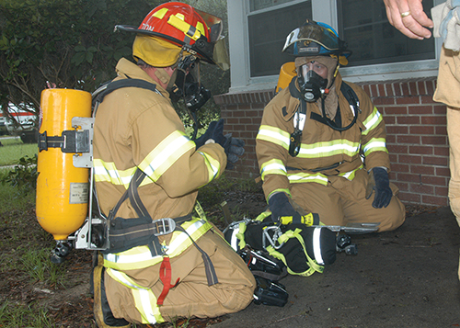
Scene Hazards (3 of 4)
Fire
Fire hazards include smoke, oxygen deficiency, high temperatures, toxic gases, and building collapse.
Use proper protection.
© Courtesy of Lance Cpl. Brian Kester/U.S. Marines.
Notes:
Lecture Outline
3. Fire
a. Common hazards:
i. Smoke
ii. Oxygen deficiency
iii. High ambient temperatures
iv. Toxic gases
v. Building collapse
vi. Equipment
vii. Explosions
b. Make sure you are properly protected.
c. Be trained in the use of appropriate airway protection.
d. A number of toxic gases may be produced in a fire, including carbon monoxide, cyanide, and carbon dioxide.
i. Carbon monoxide, cyanide, and carbon dioxide are colorless, odorless gases.
ii. Carbon monoxide is responsible for most fire deaths.
iii. Inhaling cyanide prevents cells from using oxygen.
e. There is always a possibility that a burning structure will collapse.

Slide 40
Scene Hazards (4 of 4)
Vehicle crashes
Common events for EMS providers
Traffic
Unstable vehicles
Downed power lines
Sharp objects
Use protective gear
Notes:
Lecture Outline
4. Vehicle crashes
a. Vehicle crashes are common events for EMS providers.
b. They provide some of the most unstable and potentially lethal situations an EMS provider will face.
c. Vehicle collision hazards include traffic, an unstable vehicle that may fall on you, downed power lines, risk of violence, airbags, glass, and sharp metal objects.
d. Use sufficient protective gear to reduce the risk of injury.

Slide 41
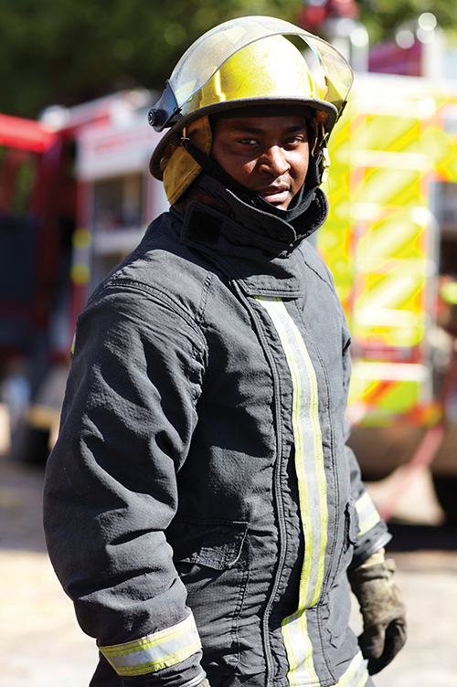
Protective Clothing: Preventing Injury (1 of 3)
Critical to personal safety
Become familiar with various types
Cold-weather clothing
Three layers
Turnout gear
Heat, fire, sparks, and flashover
© PeopleImages/iStock.
Notes:
Lecture Outline
V. Protective Clothing: Preventing Injury
A. Wearing protective clothing and other appropriate gear is critical to your personal safety.
B. Become familiar with the protective equipment available to you.
C. Inspect your clothing and gear regularly—ideally before you reach the scene.
D. Types
1. Cold-weather clothing consists of three layers:
a. A thin inner layer that pulls moisture away from the skin
b. A thermal middle layer that serves as insulation
c. An outer layer that resists wind, rain, sleet, and snow
2. Turnout gear
a. Protects from heat, fire, sparks, and flashover
b. Also called bunker gear

Slide 42
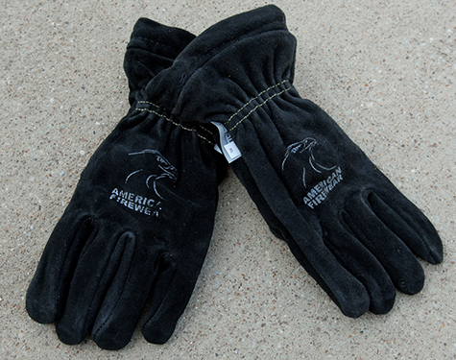
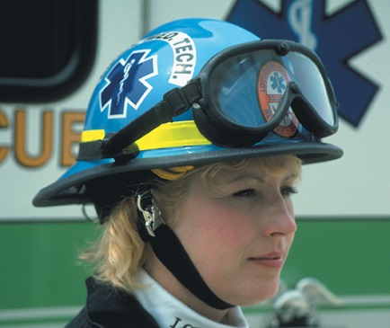
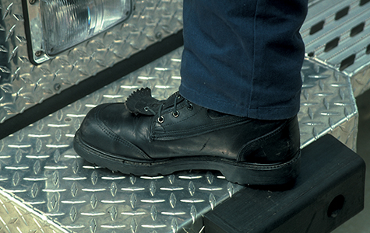
Protective Clothing: Preventing Injury (2 of 3)
Gloves
Heat, cold, cuts
May reduce dexterity
Helmets
Falling objects
Boots
Steel-toed is preferred
© Jones and Bartlett Publishers. Photographed by Glen E. Ellman.
© Jones and Bartlett Publishers. Courtesy of MIEMSS.
© Jones and Bartlett Publishers. Courtesy of MIEMSS.
Notes:
Lecture Outline
3. Gloves
a. Protect from heat, cold, and cuts
b. May reduce dexterity in a rescue situation
4. Helmets
a. Helmets should be worn to protect the EMT from falling objects.
b. Helmets should provide top and side impact protection.
c. Secure chin straps are needed.
d. In electrical hazard situations, wear a chin strap and face shield.
5. Boots
a. Should be water resistant, fit well, and be flexible
b. Steel-toed boots are preferred.
c. Traction is important for rescue situations.
d. Two pairs of socks are better than one thick pair of socks.

Slide 43
Protective Clothing: Preventing Injury (3 of 3)
Eye protection
Glasses with side shield
Ear protection
Foam earplugs
Skin protection
Sunblock
Body armor
Vests
Notes:
Lecture Outline
6. Eye protection
a. Wear protective glasses with side shields during routine patient care.
b. When tools are in use, use a face shield and goggles.
7. Ear protection
a. Soft foam industrial-type earplugs
8. Skin protection
a. Protect against sunburn during outside work.
b. Use a sunscreen with a minimum rating of SPF 15.
9. Body armor
a. Bulletproof vests
b. Range from lightweight and flexible to heavy and bulky
c. Vests may not be practical for daily use; they are costly and do not protect against rifle ammunition or stabling attacks.
10. Long/loose hair, rings, and jewelry
a. Many EMS services have restricted policies regarding hair, rings, and jewelry.
b. You should tie hair up neatly, limit the number of rings worn, and wear only a watch on the wrist.

Slide 44
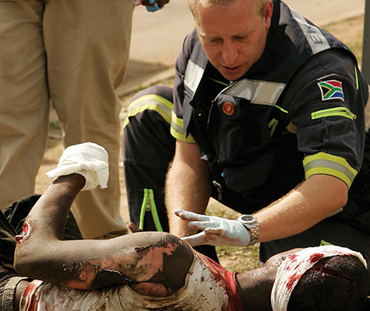
Caring for Critically Ill and Injured Patients (1 of 4)
Let the patient know who you are and what you are doing.
Let the patient know you are attending to his or her immediate needs.
© Siphiwe Sibeko/Reuters/Landov
Notes:
Lecture Outline
VI. Caring for Critically Ill and Injured Patients
A. The patient needs to know who you are and what you are doing.
1. Let the patient know that you are attending to his or her immediate needs.
2. Avoid making unprofessional comments during resuscitation.
3. Treat all patients with dignity and respect.

Slide 45
Caring for Critically Ill and Injured Patients (2 of 4)
Responses of the critical patient include:
Anxiety
Pain and fear
Anger and hostility
Depression
Dependence
Guilt
Mental health problems
Receiving unrelated bad news
Notes:
Lecture Outline
B. Responses of the critical patient
1. Anxiety
a. Emotional upset
b. Sweaty and cool
c. Rapid breathing
d. Fast pulse
e. Restlessness
f. Tension
g. Fear
h. Shakiness
2. Pain and fear
a. Pain is often associated with illness or trauma.
b. Fear usually relates to the oncoming pain and outcome of the illness or trauma.
c. Encourage patients to express their pains and fears.
3. Anger and hostility
a. Reactions may be expressed with demanding or complaining behavior.
b. Personal safety is important.
c. Be tolerant.
d. Back out of the situation if the patient becomes hostile.
4. Depression
a. Response to illness, especially if prolonged, debilitating, or terminal, can be physiologic and psychological.
b. Be compassionate, supportive, and nonjudgmental.
5. Dependency
a. Patients may become dependent due to their helplessness.
b. Remain supportive and compassionate.
6. Guilt
a. When patients are dying, long-term caregivers, family members, or even the patient may experience feelings of guilt over what has happened.
b. The guilty feelings may result in a delay seeking medical care.
7. Mental health problems
a. Disorientation, confusion, and delusions may develop in the dying patient. Common characteristics include:
i. Loss of contact with reality
ii. Distortion of perception
iii. Regression
iv. Diminished control of impulses and desires
v. Abnormal mental content
8. Receiving unrelated bad news
a. May be the death of someone close to the patient
b. May cause the patient to give up hope

Slide 46
Caring for Critically Ill and Injured Patients (3 of 4)
Communicating with the critical patient:
Avoid sad and grim comments.
Orient the patient.
Be honest.
Deal with possible initial refusal of care.
Allow for hope.
Locate and notify family members.
Notes:
Lecture Outline
C. Techniques for communicating with the critical patient
1. Avoid sad and grim comments.
a. Remarks about a patient’s condition may increase the patient’s anxiety or compromise recovery.
2. Orient the patient.
a. Use brief statements.
b. Orient the patient to his or her surroundings.
3. Be honest.
a. Decide how much information your patient can understand and accept.
b. Allow the patient to be part of the care being given.
4. Initial refusal of care
a. Impress on the patient the seriousness of his or her condition without causing undue alarm.
b. If you say, “Everything will be okay,” when it is obvious that it is not okay, you are not being truthful.
5. Allow for hope.
a. If there is the slightest chance of hope remaining, transmit that message to the patient.
b. It is not your role to tell a patient that he or she is going to die.
c. Let the patient know you are doing everything possible.
D. Locate and notify family members.
1. Assure the patient that you will take care of notifying the appropriate people.
2. This may be a significant part of patient care because it will calm the patient.

Slide 47
Caring for Critically Ill and Injured Patients (4 of 4)
Injured and critically ill children
Ask a responsible adult to accompany the child.
Death of a child
A tragic event
Help the family in any way you can.
Let the family’s actions be your guide.
Prepare the parents.
Notes:
Lecture Outline
E. Injured and critically ill children
1. Children should be cared for as any adult would be.
2. Consider variations in height, weight, and size when caring for pediatric patients.
3. It is important that a relative or responsible adult accompany the child to relieve anxiety and assist in care as appropriate.
F. Dealing with the death of a child
1. The death of a child is a tragic and dreaded event.
2. Help the family through the initial period after the death.
3. Provide information about follow-up counseling and support services.
G. Helping the family
1. Acknowledge the death in a private place.
2. Shock, denial, and disbelief are common emotions and reactions to a child’s death.
3. If circumstances allow, let the parents hold the child. Use your best judgment to determine if this is appropriate.
4. Let the family’s actions be your guide.
5. The family may want to see the child, and you should allow them to do so.
6. Prepare the parents for what they will see.
7. Nonverbal communication may be valuable, such as holding a hand or grasping a shoulder. Silence may be more comforting.

Slide 48
Death and Dying (1 of 4)
Death occurs:
Quite suddenly, or
After a prolonged, terminal illness
The EMT will face death.
Notes:
Lecture Outline
VII. Death and Dying
A. Death is likely to be either:
1. Quite sudden
2. After a prolonged, terminal illness
B. The EMT will sometimes face death.

Slide 49
Death and Dying (2 of 4)
Stages of grieving:
Denial
Anger, hostility
Bargaining
Depression
Acceptance
Notes:
Lecture Outline
C. The grieving process:
1. Denial
2. Anger, hostility
3. Bargaining
4. Depression
5. Acceptance

Slide 50
Death and Dying (3 of 4)
The EMT’s role:
Ask how you can help.
Reinforce reality.
Be honest.
Allow the patient and family to grieve.
Notes:
Lecture Outline
D. What can the EMT do?
1. Ask the patient and family if there is anything you can do to help.
2. Reinforce the reality of the situation.
3. Be honest and sincere.
4. Do not say you know how the patient or family feels.
5. Let the patient or family members grieve in their own way.
E. Dealing with the patient and family members
1. Use special care with dying patients and their families,
2. It is best to be honest; do not give them false hope.

Slide 51
Death and Dying (4 of 4)
© Jones and Bartlett Publishers
Notes:
The table on this slide shows suggestions for responding to grief.

Slide 52
Stress Management on the Job (1 of 2)
EMS is a high-stress job.
Important to know causes and how to deal with stress
General adaptation syndrome:
Alarm response to stress
Reaction and resistance
Recovery—or exhaustion
Notes:
Lecture Outline
VIII. Stress Management on the Job
A. EMS is a high-stress job.
B. It is important to know the causes of stress and ways to deal with stress.
C. General adaptation syndrome:
1. Alarm response to stress
2. Reaction and resistance to stress
3. Recovery—or exhaustion from stress

Slide 53
Stress Management on the Job (2 of 2)
Physiologic signs of stress
Increased respirations and heart rate
Increased blood pressure
Cool, clammy skin
Dilated pupils
Tensed muscles
Increased blood glucose level
Perspiration
Decreased blood flow to gastrointestinal tract
Notes:
Lecture Outline
D. Physiologic manifestations of stress:
1. Increased respirations and heart rate
2. Increased blood pressure
3. Dilated venous vessels near the skin surface (cause cool, clammy skin)
4. Dilated pupils
5. Tensed muscles
6. Increased blood glucose levels
7. Perspiration
8. Decreased blood flow to the gastrointestinal tract

Slide 54
Stressful Situations (1 of 2)
Dangerous situations
Physical and psychological demands
Critically ill or injured patients
Dead and dying patients
Overpowering sights, smells, and sounds
Notes:
Lecture Outline
E. Situations that are stressful for EMS providers include the following:
1. Dangerous situations
2. Physical and psychological demands
3. Critically ill or injured patients
4. Dead and dying patients
5. Overpowering sights, smells, and sounds

Slide 55
Stressful Situations (2 of 2)
Multiple patient situations
Angry or upset patients, family, or bystanders
Unpredictability and demands of EMS
Noncritical/non–911 patients
Hospital wait times
Notes:
Lecture Outline
6. Multiple-patient situations
7. Angry or upset patients, family, or bystanders
8. Unpredictability and demands of EMS
9. Noncritical/non–911 patients
10. Hospital wait times

Slide 56
Stress Reactions (1 of 2)
Acute stress reactions
Occur during a stressful situation
Delayed stress reactions
Manifest after stressful event
Cumulative stress reactions
Prolonged or excessive stress
Notes:
Lecture Outline
F. Stress reactions
1. Acute stress reactions
a. Occur during a stressful situation
2. Delayed stress reactions
a. Manifest after stressful event
3. Cumulative stress reactions
a. Prolonged or excessive stress

Slide 57
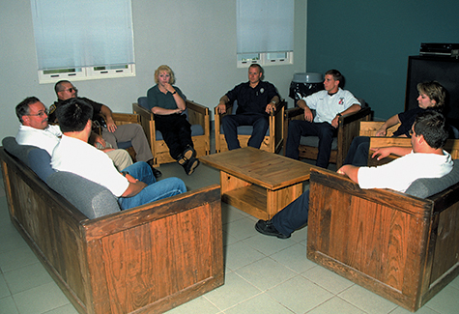
Stress Reactions (2 of 2)
Posttraumatic stress disorder (PTSD) can develop
Critical incident stress management (CISM) was developed to decrease likelihood of PTSD.
© Jones and Bartlett Publishers. Courtesy of MIEMSS.
Notes:
Lecture Outline
4. PTSD can develop.
a. Characterized by reexperiencing the event and overresponding to the stimuli that recall the event
b. Critical incident stress management was developed to decrease the likelihood of PTSD.
G. CISM is used to help providers relieve stress.
1. CISM can occur formally.
a. Trained CISM professionals facilitate.
2. CISM can also occur at an ongoing scene.
a. Defusing sessions are held during or immediately after the event.
b. Debriefing sessions are held 24 to 72 hours after the incident.
3. CISM defuses responses to critical incidents.
a. If CISM is not an option, private counseling by a mental health professional may be preferable.

Slide 58
Warning Signs of Stress (1 of 3)
Irritability toward coworkers, family, and friends
Inability to concentrate
Difficulty sleeping, increased sleeping, nightmares
Feelings of sadness, anxiety, or guilt
Indecisiveness
Notes:
Lecture Outline
H. Warning signs of cumulative stress:
1. Irritability toward coworkers, family, and friends
2. Inability to concentrate
3. Difficulty sleeping, increased sleeping, or nightmares
4. Feelings of sadness, anxiety, or guilt
5. Indecisiveness

Slide 59
Warning Signs of Stress (2 of 3)
Loss of appetite
Loss of interest in sexual activities
Isolation
Loss of interest in work
Increased use of alcohol
Recreational drug use
Notes:
Lecture Outline
6. Loss of appetite (gastrointestinal disturbances)
7. Loss of interest in sexual activities
8. Isolation
9. Loss of interest in work
10. Increased use of alcohol
11. Recreational drug use

Slide 60
Warning Signs of Stress (3 of 3)
Physical symptoms such as chronic pain
Headache
Backache
Feelings of hopelessness
Notes:
Lecture Outline
12. Physical symptoms such as chronic pain (headache, backache)
13. Feelings of hopelessness

Slide 61
Emotional Aspects of Emergency Care
Personal reactions to difficult situations are difficult to overcome.
This is normal.
Every EMT must deal with these feelings.
Notes:
Lecture Outline
I. Emotional aspects of emergency care
1. Even the most experienced health care providers have difficulty overcoming personal reactions and proceeding without hesitation.
2. These are normal feelings.
3. Every EMT must deal with these feelings.
4. The struggle to remain calm in the face of horrible circumstances contributes to the emotional stress of the job.

Slide 62
Stressful Situations (1 of 2)
Many situations are stressful for everyone involved.
Use extreme care in words and actions.
Bring a sense of order and stability to the situation.
Notes:
Lecture Outline
J. Stressful situations
1. Many situations are stressful for everyone involved.
2. Exercise extreme care in your words and actions.
3. Bring a sense of order and stability to the terrifying chaos that the patient is experiencing.

Slide 63
Stressful Situations (2 of 2)
A patient’s reaction is influenced by many factors.
Allow patients to express fears and concerns.
Transport parents with their children.
Notes:
Lecture Outline
4. A patient’s reaction may be influenced by personality traits.
5. Other factors that influence reaction:
a. Socioeconomic background
b. Fear of medical personnel
c. Alcohol or substance abuse
d. History of chronic disease
e. Mental disorders
f. Reaction to medication
g. Age
h. Nutritional status
i. Feelings of guilt
j. Past experience with illness or injury
6. Give patients the opportunity to express their fears and concerns.
7. Quickly and calmly assess the actions of the patient, family members, and bystanders.
8. It is usually best to transport parents with their children.

Slide 64
Uncertain Situations
If it is unclear whether a true medical emergency exists:
Contact medical control about the need to transport.
If in doubt, transport.
Notes:
Lecture Outline
9. Uncertain situations
a. Sometimes it is unclear whether a true medical emergency exists.
i. Contact medical control about the need to transport.
ii. If in doubt, transport.

Slide 65
Violent Situations (1 of 2)
Created by:
Civil disturbances
Large gatherings of potentially hostile people
Domestic disputes
Crime scenes
Notes:
Lecture Outline
10. Violent situations
a. Violent situations can be created by:
i. Civil disturbances
ii. Large gatherings of potentially hostile people
iii. Domestic disputes
iv. Crime scenes

Slide 66
Violent Situations (2 of 2)
Know who is in command.
Protect from dangers to provide care.
Law enforcement secures the scene before your entry, or uses cover and concealment technique.
Call for additional help if needed.
Do not disturb crime scene evidence.
Notes:
Lecture Outline
b. When multiple agencies respond, it is important to know who is in command and will be issuing orders.
c. You and your partner must be protected from dangers at the scene to provide care.
i. Law enforcement secures the scene before your entry, or uses the cover and concealment technique. This involves the tactical use of an impenetrable barrier for protection.
d. Call for additional help if needed.
e. Do not disturb crime scene evidence unless it is necessary to care for the patient.

Slide 67
Behavioral Emergencies
Emergencies that do not have a clear physical cause
Cause may turn out to be physical (eg, hypoglycemia, head trauma).
Result in aberrant behavior
Use caution.
Notes:
Lecture Outline
11. Behavioral emergencies
a. Emergencies that do not have a clear physical cause
i. The cause may turn out to be physical (eg, hypoglycemia, head trauma, hypoxia, toxic ingestion).
b. These emergencies result in aberrant behavior.
c. Most behavioral emergencies do not pose a threat, but some do, and you must use caution in such circumstances.
d. Evaluate the patient for behavioral or psychiatric emergency, considering these questions:
i. How does this patient respond to you? Are your questions answered appropriately? Are the patient’s vocabulary and expressions what you would expect under the circumstances?
ii. Is the patient withdrawn or detached? Is the patient hostile or friendly? Overly friendly?
iii. Does the patient understand why you are there?
iv. How is the patient dressed? Is the dress appropriate for the time of the year and occasion? Are the clothes clean? Dirty?
v. Does the patient appear relaxed, stiff, or guarded? Are the patient’s movements coordinated or jerky and awkward? Is there hyperactivity? Are the patient’s movements purposeful—for example, in putting his or her clothes on? Are the actions aimless—for example, sitting and rocking back and forth in a chair?
vi. Has the patient harmed herself or himself? Is there damage to the surroundings?
vii. What are the patient’s facial expressions? Are they bland or flat, or are they expressive? Does the patient show joy, fear, or anger to appropriate stimuli? If so, to what degree?
e. If the patient does not respond, the patient’s facial expressions, pulse, and respirations, tears, sweating, and blushing may be significant indicators of his or her emotional state.

Slide 68
Workplace Issues (1 of 6)
Cultural diversity on the job
Each individual is different.
Communicate respectfully.
Use cultural diversity as an asset.
© Jones & Bartlett Learning.
Notes:
Lecture Outline
IX. Workplace Issues
A. Cultural diversity on the job
1. Each individual is different.
2. Communicate in a respectful way.
3. Cultural diversity is an asset.

Slide 69
Workplace Issues (2 of 6)
Cultural diversity on the job (cont’d)
Diversity is an effective way to strengthen a public safety workforce.
Understand how to communicate effectively with coworkers from various backgrounds.
Notes:
Lecture Outline
4. Diversity is an effective way to strengthen a public safety workforce.
5. Understand how to communicate effectively with coworkers from various backgrounds.

Slide 70
Workplace Issues (3 of 6)
Sexual Harassment
Two types
Quid pro quo: request for sexual favors
Hostile work environment: jokes, touching, etc.
Report harassment to your supervisor immediately, and keep notes.
Notes:
Lecture Outline
B. Avoiding sexual harassment
1. There are two types of sexual harassment:
a. Quid pro quo
i. Harasser requests sexual favors in exchange for something else, such as a promotion
b. Hostile work environment
i. Jokes, touching, leering, requests for a date, talking about body parts
2. The intent of the harasser does not matter; rather, the perception of the act and the impact the behavior has on someone else are the key questions.
3. Because EMTs and other public safety professionals depend on one another for their safety, it is especially important for you to develop nonadversarial relationships with coworkers.
4. Report harassment to your supervisor immediately.
5. Keep notes of what happened and what was said.
6. Confront the harasser if you feel comfortable doing so.

Slide 71
Workplace Issues (4 of 6)
Substance Abuse
Increases risks on the job
Leads to poor decision making
Seek help, or find a way to confront an addicted coworker.
Employee assistance programs (EAPs) are often available.
Notes:
Lecture Outline
C. Substance abuse
1. Increases risks of accidents and tension
2. Causes poor treatment decisions
3. EMS systems now require their personnel to undergo periodic random tests for illegal drug use.
4. Addicts and alcoholics develop great skills at covering for their behavior.
5. Seek help, or find a way to confront an addicted coworker.
6. Allowing substance abuse to go on presents a tremendous hazard to the public.
7. Employee assistance programs (EAPs) are often available.
a. EAPs provide an array of mental health, substance abuse, crisis management, and counseling services.

Slide 72
Workplace Issues (5 of 6)
Suicide prevention
Cumulative stress and acute, intense stress can weigh heavily on EMS providers.
If you or a colleague expresses suicidal ideations, seek professional help.
Notes:
Lecture Outline
D. Suicide prevention
1. A combination of cumulative stress and acute, intense stress can weigh heavily on EMS providers.
2. If you or a colleague expresses suicidal ideations, you should seek professional help.

Slide 73
Workplace Issues (6 of 6)
Elements of an injury and illness prevention program
Management leadership
Worker participation
Hazard identification and assessment
Hazard prevention and control
Education and training
Program evaluation and improvement
Notes:
Lecture Outline
E. Injury and illness prevention
1. Many EMS departments have established injury and illness prevention programs.
2. Each program should include six interrelated and interdependent elements:
a. Management leadership
b. Worker participation
c. Hazard identification and assessment
d. Hazard prevention and control
e. Education and training
f. Program evaluation and improvement

Slide 74
Review
A disease that can be spread from person-to-person is known as:
an infectious disease.
a communicable disease.
a transmittable disease.
a spreadable disease.

Slide 75
Review
Answer: B
Rationale: A communicable disease can be spread from one person or a species to another.

Slide 76
Review (1 of 2)
A disease that can be spread from person-to-person is known as:
an infectious disease.
Rationale: An infectious disease is a medical condition caused by the growth and spread of small, harmful organisms within the body.
a communicable disease.
Rationale: Correct answer
.

Slide 77
Review (2 of 2)
A disease that can be spread from person-to-person is known as:
C. a transmittable disease.
Rationale: The correct answer is an infectious disease.
D. a spreadable disease.
Rationale: The correct answer is an infectious disease.
.

Slide 78
Review
The MOST effective way of preventing the spread of disease is:
handwashing.
keeping your immunizations up-to-date.
placing a HEPA respirator on the patient.
wearing goggles, gloves, a gown, and a mask.

Slide 79
Review
Answer: A
Rationale: According to the CDC, the most effective way of preventing the spread of disease is thorough handwashing—especially in between patients. Up-to-date immunizations and PPE will minimize the risk of contracting a disease.

Slide 80
Review (1 of 2)
The MOST effective way of preventing the spread of disease is:
handwashing. Rationale: Correct answer
keeping your immunizations up-to-date. Rationale: This is part of the overall prevention process.

Slide 81
Review (2 of 2)
The MOST effective way of preventing the spread of disease is:
placing a HEPA respirator on the patient. Rationale: This PPE helps to block the entry of an organism into the rescuer.
wearing goggles, gloves, a gown, and a mask. Rationale: This PPE is selected according to manner in which a communicable disease is spread.

Slide 82
Review
While caring for a trauma patient, the EMT has blood splashed into her eyes. This is an example of:
infection.
exposure.
indirect contact.
transmission.

Slide 83
Review
Answer: B
Rationale: Exposure occurs when a person comes in (direct or indirect) contact with blood or other bodily fluids. Blood splattered into the eyes is an example of direct contact. It is important to note that exposure does not always lead to infection. Proper use of PPE minimizes this risk.

Slide 84
Review
While caring for a trauma patient, the EMT has blood splashed into her eyes. This is an example of:
infection. Rationale: This is an abnormal invasion by an organism.
exposure. Rationale: Correct answer
indirect contact. Rationale: This is exposure through contact with a contaminated object.
transmission. Rationale: This is the way an infectious agent is spread including direct, indirect, and airborne transmission.

Slide 85
Review
Protective measures that prevent health care workers from coming into contact with germs are referred to as:
exposure.
standard precautions.
transmission.
PPE.

Slide 86
Review
Answer: B
Rationale: Standard precautions prevent health care workers from coming into contact with germs.

Slide 87
Review (1 of 2)
Protective measures that prevent health care workers from coming into contact with germs are referred to as:
exposure. Rationale: Exposure occurs when a person comes into contact with blood or body fluids.
standard precautions. Rationale: Correct answer

Slide 88
Review (2 of 2)
Protective measures that prevent health care workers from coming into contact with germs are referred to as:
transmission. Rationale: Transmission is the way in which an infectious agent is spread.
PPE. Rationale: PPE is the equipment used to shield health care workers from infectious agents.

Slide 89
Review
What is the second stage of response in the stress response known as the general adaptation syndrome?
Recovery
Exhaustion
Alarm
Reaction and resistance

Slide 90
Review
Answer: D
Rationale: The body typically reacts to stress in three stages: the alarm response, which is followed by reaction and resistance, and then recovery. If the individual cannot reduce stress, the last stage may progress to exhaustion.

Slide 91
Review
What is the second stage of response in the stress response known as the general adaptation syndrome?
Recovery Rationale: This is the third stage.
Exhaustion Rationale: If the third stage (recovery) is prolonged, then exhaustion occurs.
Alarm Rationale: This is the first stage.
Reaction and resistance Rationale: Correct answer

Slide 92
Review
A condition characterized by reexperiencing an event and overresponding to stimuli that recall the event is called:
acute stress reaction.
delayed stress reaction.
cumulative stress reaction.
posttraumatic stress disorder (PTSD).

Slide 93
Review
Answer: D
Rationale: PTSD may develop after a person has experienced a psychologically distressing event.

Slide 94
Review
A condition characterized by reexperiencing an event and overresponding to stimuli that recall the event is called:
acute stress reaction. Rationale: This occurs during a stressful event.
delayed stress reaction. Rationale: This occurs after a stressful event.
cumulative stress reaction. Rationale: This occurs when the EMT is exposed to prolonged or excessive stress.
posttraumatic stress disorder. Rationale: Correct answer

Slide 95
Review
______ is the fuel to make the body run.
Sleep
Exercise
Food
Work/life balance

Slide 96
Review
Answer: C
Rationale: To perform efficiently, you must eat nutritious food. The physical exertion and stress of your job require high energy output.

Slide 97
Review
______ is the fuel to make the body run.
Sleep Rationale: A consistent cycle of sleep will improve concentration and motivation.
Exercise Rationale: A regular program of exercise will increase strength and endurance.
Food Rationale: Correct answer
Work/life balance Rationale: A balance will allow you to relax off the job and motivate you on the job.

Slide 98
Review
Which stage of grieving commonly results in blame?
Denial
Anger, hostility
Bargaining
Depression

Slide 99
Review
Answer: B
Rationale: The person may lash out at the EMT or blame the EMT for the unfortunate event.

Slide 100
Review (1 of 2)
Which stage of grieving commonly results in blame?
Denial Rationale: Denial is refusal to accept the circumstances.
Anger, hostility Rationale: Correct answer

Slide 101
Review (2 of 2)
Which stage of grieving commonly results in blame?
C. Bargaining Rationale: The patient may try to make a deal.
Depression Rationale: Depression commonly results in a silent patient.

Slide 102
Review
Placards are used on:
buildings.
individual packages.
storage lockers.
storage papers.

Slide 103
Review
Answer: A
Rationale: Placards are used for buildings and transportation vehicles.

Slide 104
Review
Placards are used on:
buildings. Rationale: Correct answer
individual packages. Rationale: Labels are used to identify packages.
storage lockers.
Rationale: Placards are used for buildings and transportation vehicles.
D. storage papers.
Rationale: Placards are used for buildings and transportation vehicles.

Slide 105
Review
The five most common hazards associated with a structural fire include:
smoke, oxygen deficiency, high ambient temperatures, toxic gases, and building collapse.
smoke, oxygen deficiency, inhalation of tar particles, injury from breaking glass, and building collapse.
smoke, high ambient temperatures, toxic gases, electric shock, and inhalation of tar particles.
oxygen deficiency, high ambient temperatures, toxic gases, electric shock, and injury from breaking glass.

Slide 106
Review
Answer: A
Rationale: The five hazards most commonly associated with a structural fire are smoke, oxygen deficiency, high ambient temperatures, toxic gases, and building collapse.

Slide 107
Review (1 of 2)
The five most common hazards associated with a structural fire include:
smoke, oxygen deficiency, high ambient temperatures, toxic gases, and building collapse. Rationale: Correct answer
smoke, oxygen deficiency, inhalation of tar particles, injury from breaking glass, and building collapse. Rationale: Smoke is made up of particles of both tar and carbon.

Slide 108
Review (2 of 2)
The five most common hazards associated with a structural fire include:
smoke, high ambient temperatures, toxic gases, electric shock, and inhalation of tar particles. Rationale: Smoke is made up of particles of both tar and carbon.
oxygen deficiency, high ambient temperatures, toxic gases, electric shock, and injury from breaking glass. Rationale: Smoke is missing from this option.

