Slide 1
Chapter 2
Workforce Safety and Wellness
Notes:
Chapter 2: Workforce Safety and Wellness

Slide 2
Introduction
To take care of others, we must take care of ourselves.
EMT training includes recognition of hazards:
Personal neglect
Environmental and human-made threats
Mental and physical stress
Notes:
Lecture Outline
I. Introduction
A. To take care of others, we must take care of ourselves.
B. EMT training includes recognition of hazards to your health, safety, and well-being:
1. Personal neglect
2. Environmental and human-made threats
3. Mental and physical stress

Slide 3
General Health and Wellness (1 of 2)
Wellness is a state of complete mental, physical, and social well-being.
A state of wellness must occur at work and at home.
Notes:
Lecture Outline
II. General Health and Wellness
A. Wellness goes beyond the prevention of disease. It is a state of complete mental, physical, and social well-being.
B. As a health care provider, you should model a life of health and wellness.
C. A state of wellness must occur at:
1. Work: protection from communicable disease and scene hazards.
2. Home: healthy diet; exercise; getting enough sleep; refraining from use of tobacco, drugs, and excessive alcohol; and taking time to relax.

Slide 4
General Health and Wellness (2 of 2)
EMTs often work in stressful situations.
Your calm manner will calm the patient, family members, and bystanders.
You must focus on:
Personal safety
Scene safety, including the safety of others
Patient care
Notes:
Lecture Outline
D. EMTs are often called upon to work in circumstances that result in both acute and cumulative stress. As an EMT, your role is to:
1. Be prepared
2. Anticipate needed resources
3. Control the scene
4. Care for the patient
E. The calm manner in which you approach the scene will help to calm the patient, family members, and bystanders.
F. Wellness and stress management
1. Prolonged physical stress can drain the body of its reserves.
a. Depleted of key nutrients
b. Weakened
c. More susceptible to illness
2. Understanding how stress affects you physiologically, physically, and psychologically can help you:
a. Control your reactions
b. Minimize the effect of stress
G. Regardless how stressful the situation, you must focus on the following, in this order:
1. Personal safety
2. Scene safety, including the safety of others
3. Patient care

Slide 5
Strategies to Manage Stress (1 of 2)
Minimize or eliminate stressors.
Change partners.
Change work hours.
Change the work environment.
Cut back on overtime.
Change your attitude.
Talk about your feelings.
Notes:
Lecture Outline
H. Stress management refers to tactics that have been shown to alleviate or eliminate stress reactions. They may involve changing a few habits, changing your attitude, and perseverance.
1. Strategies to manage stress
a. Minimize or eliminate stressors as much as possible.
b. Change partners to avoid a negative or hostile personality.
c. Change work hours.
d. Change the work environment.
e. Cut back on overtime.
f. Change your attitude about the stressor.
g. Talk about your feelings with people you trust.

Slide 6
Strategies to Manage Stress (2 of 2)
Seek professional counseling.
Do not obsess over frustrating situations.
Try to adopt a relaxed, philosophical outlook.
Expand your social support system.
Develop friends and interests outside of EMS.
Minimize the physical response to stress.
Notes:
Lecture Outline
h. Seek professional counseling if needed.
i. Do not obsess over frustrating situations that you are unable to change, such as relapsing alcoholics and nursing home transfers; focus on delivering high-quality care.
j. Try to adopt a relaxed, philosophical outlook.
k. Expand your social support system beyond your coworkers.
l. Develop friends and interests outside emergency services.
m. Minimize the physical response to stress by using various techniques:
i. Periodic stretching or yoga
ii. Slow, deep breathing
iii. Regular physical exercise (150 minutes per week, including cardiovascular effort)
iv. Progressive muscle relaxation
v. Meditation
vi. Limiting intake of caffeine, alcohol, and tobacco use

Slide 7
Wellness and Stress Management
Nutritious food
Regular exercise and relaxation
Regular, uninterrupted sleep
Disease prevention
Balancing work, family, and health
Notes:
Lecture Outline
I. Nutrition
1. Your body’s three sources of fuel—carbohydrates, fat, and protein—are consumed in increased quantities during stress, particularly if physical activity is involved.
2. To perform efficiently, you must eat nutritious food. Food is the fuel that makes the body run.
3. Limit your consumption of sugar, fats, sodium, and alcohol.
4. Complex carbohydrates rank next to simple sugars in their ability to produce energy. Complex carbohydrates such as pasta, rice, and vegetables are among the most reliable sources for long-term energy production.
5. Fats are easily converted to energy, but eating too much fat can lead to obesity, cardiac disease, and other long-term health problems.
J. Exercise and relaxation
1. Regular exercise will enhance the benefits of maintaining good nutrition and adequate hydration.
2. When you are in good physical condition, you can handle stress more easily.
3. Exercise will help you maintain the strength to lift patients and heavy equipment.
K. Sleep
1. Sleep should be regular and uninterrupted.
2. Limit your caffeine and alcohol intake and tobacco use.
3. Eight straight hours of sleep may not be possible, but three sleep episodes of 2 to 3 hours each will provide similar effects.
4. Routine exercise will promote the needed fatigue for restful sleep.
L. Disease prevention
1. Know your family’s health history. The most common hereditary health factors are heart disease and cancer. Share this information with your personal physician.
2. Lifestyle can be adjusted if necessary to help prevent disease.
M. Balancing work, family, and health
1. When possible, rotate your schedule to give yourself time off.
2. Take vacations.
3. If at any point you feel the stress of work is more than you can handle, seek help.

Slide 8
Infectious and Communicable Diseases
Infectious disease is caused by organisms within the body.
Communicable disease can be spread:
From person to person
From one species to another
Take steps to minimize infection risk.
Notes:
Lecture Outline
III. Infectious and Communicable Diseases
A. An infectious disease is caused by harmful organisms within the body.
B. A communicable disease can be spread:
1. From person to person
2. From one species to another
C. Infection risk can be minimized by:
1. Immunizations
2. Protective techniques
3. Handwashing
D. When these protective measures are used, the health care provider’s risk of contracting a serious disease is negligible.

Slide 9
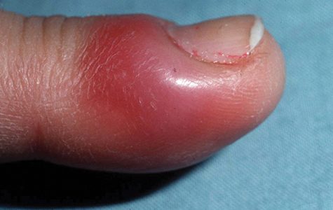
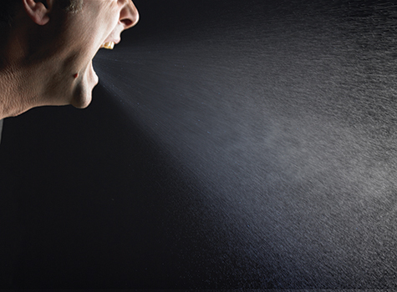
Routes of Transmission
Direct contact
Indirect contact
Airborne transmission
Foodborne transmission
Vector-borne transmission
© DermQuest.com. Used with permission of Galderma S.A.
© James Klotz/ShutterStock, Inc.
Notes:
Lecture Outline
E. Routes of transmission
1. Transmission is the way an infectious disease is spread.
a. Direct contact (eg, blood-borne pathogens)
b. Indirect contact (eg, needle sticks)
c. Airborne transmission (eg, sneezing)
d. Foodborne transmission (eg, contaminated food)
e. Vector-borne transmission (eg, fleas)

Slide 10
Risk Reduction and Prevention for Infectious and Communicable Diseases
Proper handling of blood-borne pathogens
CDC standard precautions
Personal protective equipment
Patient care environment
Special circumstances
Notes:
Lecture Outline
F. Risk reduction and prevention for infectious and communicable diseases
1. All EMTs are trained in handling blood-borne pathogens.
2. The CDC has developed standard precautions concerning:
a. Personal protective equipment
b. Patient care environment
c. Special circumstances

Slide 11
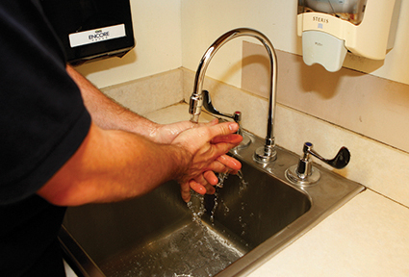
Proper Hand Hygiene
Wash hands before and after patient contact.
If no running water, use a waterless substitute.
© Jones and Bartlett Publishers. Courtesy of MIEMSS.
Notes:
Lecture Outline
3. Proper hand hygiene
a. This is the simplest, yet most effective way to control disease transmission.
b. Wash hands before and after patient contact, even if you wear gloves.
c. If there is no running water, use a waterless handwashing substitute.

Slide 12
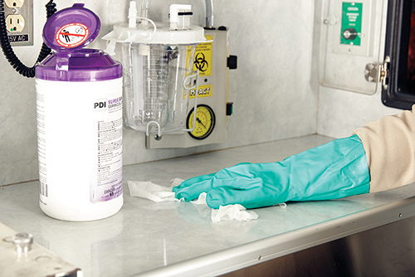
Gloves (1 of 2)
Wear gloves if there is any possibility for exposure to blood or body fluids.
Vinyl, nitrile, and latex gloves are effective protection.
© Jones & Bartlett Learning.
Notes:
Lecture Outline
4. Gloves
a. Wear gloves if there is any possibility for exposure to blood or body fluids.
b. Vinyl, nitrile, and latex gloves are effective protection. Wear heavy-duty gloves when cleaning the ambulance.
c. Change gloves between patients.

Slide 13
Gloves (2 of 2)
Removing gloves requires a special technique.
Avoid contaminating yourself with materials on the outside of the gloves.
Notes:
Lecture Outline
d. Removing gloves requires a special technique to avoid contaminating yourself with the materials on the outside of the gloves (see Skill Drill 2-1).

Slide 14
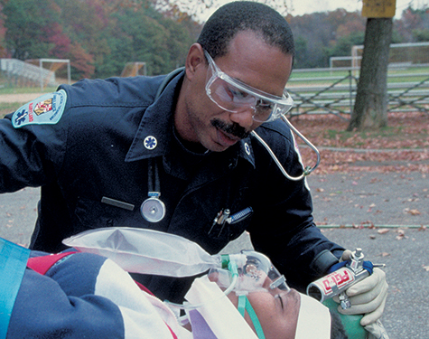
Eye Protection and Face Shields
Eye protection protects from blood splatters.
Prescription glasses are not adequate.
Goggles or face shields are best.
© Jones and Bartlett Publishers. Courtesy of MIEMSS.
Notes:
Lecture Outline
5. Eye protection and face shields
a. Eye protection protects from blood splatters.
b. Prescription glasses are not adequate.
c. Goggles or face shields are best.

Slide 15
Gowns
Provide protection from extensive blood splatter
May not be practical in many situations
Notes:
Lecture Outline
6. Gowns
a. A gown provides protection from extensive blood splatter.
b. A gown may not be practical in many situations.
i. May even pose a risk for injury

Slide 16
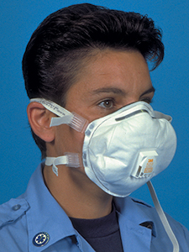
Masks, Respirators, and Barrier Devices
Wear a standard surgical mask for fluid spatter.
Wear a particulate respirator if the disease agent is airborne.
When performing ventilations, use a barrier device.
© Jones and Bartlett Publishers. Courtesy of MIEMSS.
Notes:
Lecture Outline
7. Masks, respirators, and barrier devices
a. Wear a standard surgical mask for fluid spatter.
b. Place a surgical mask on the patient with a communicable disease.
c. Use a mask with a particulate air respirator on yourself if the disease is tuberculosis.
d. When performing artificial resuscitation, use a pocket mask or a bag-valve mask.
e. With an infected patient, use:
i. Pocket mask
ii. Bag-valve mask
f. Dispose of these devices according to local guidelines.

Slide 17
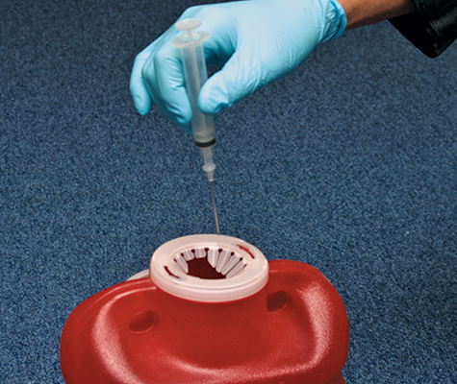
Proper Disposal of Sharps
Do not recap, break, or bend needles.
Dispose of used sharp items in an approved, closed container.
© Jones and Bartlett Publishers. Courtesy of MIEMSS.
Notes:
Lecture Outline
8. Proper disposal of sharps
a. Do not recap, break, or bend needles.
b. Dispose of used sharp items in an approved, closed, rigid, container.

Slide 18
Employer Responsibilities
The risk of exposure to a communicable disease is a hazard of your job.
Know your department’s infection control plan and follow it!
Notes:
Lecture Outline
9. Employer responsibilities
a. The risk of being exposed to a communicable disease is a hazard of your job.
b. Follow OSHA guidelines and other national guidelines and standards to reduce your risk of exposure to blood-borne pathogens and airborne diseases.
c. Know your department’s infection control plan and follow it.

Slide 19
Establishing an Infection Control Routine
Infection control should be part of your daily routine.
Clean the ambulance after each run and on a daily basis.
Cleaning should be done at the hospital whenever possible.
Notes:
Lecture Outline
G. Establishing an infection control routine
1. Infection control should be an important part of your daily routine.
2. Components of an infection control plan:
a. Determination of exposure risk
b. Education and training
c. Hepatitis B vaccine program
d. Personal protective equipment (PPE)
e. Cleaning and disinfection practices
f. Tuberculin skin testing/fit testing
g. Postexposure management
h. Compliance monitoring
i. Record keeping
3. Follow the steps in Skill Drill 2-2 to manage potential exposure situations.
4. Cleaning is an essential part of the prevention and control of communicable diseases, ensuring removal of surface organisms that may remain in the unit.
a. Clean the ambulance after each run and on a daily basis.
b. Use appropriate PPE while cleaning.
c. Remove contaminated linens, and put them in an appropriate bag for handling.
5. Whenever possible, cleaning should be done at the hospital. There is more information about cleaning the ambulance in Chapter 37, “Transport Operations.”

Slide 20
Immunity
Even if germs reach you, you may not become infected.
You may be immune.
Preventive measures:
Maintain personal health.
Get immunizations.
Notes:
Lecture Outline
H. Immunity
1. Even if germs reach you, you are not necessarily at risk for infection.
a. Immunity is a major factor in determining which hosts become ill from which germs.
b. You may be immune, or resistant, to particular germs.
c. Characteristics of immunity:
i. Having been immunized or vaccinated
ii. Able to recover from an infection from that germ
2. Preventive measures
a. Maintain your personal health. Annual health examinations should be required for all EMS personnel.
b. Get immunizations. You are required to get the hepatitis B vaccine or sign a waiver. Other recommended immunizations include tetanus, diphtheria, and pertussis boosters every 10 years; measles, mumps, and rubella (MMR) vaccine; influenza vaccine (yearly); and varicella (chickenpox) vaccine or having chickenpox.

Slide 21
General Postexposure Management
If you are exposed to a patient’s blood or bodily fluids:
Turn over patient care to another EMS provider.
Clean the exposed area.
Rinse eyes if necessary for 20 minutes.
Activate your department’s infection control plan.
Complete an exposure report.
Notes:
Lecture Outline
I. General postexposure management
1. If you are exposed to a patient’s blood or bodily fluids:
a. Turn over patient care to another EMS provider.
b. Clean the exposed area with soap and water.
c. If your eyes were exposed, rinse your eyes for 20 minutes.
d. Activate your department’s infection control plan.
2. You will have to complete an exposure report.
3. Time is important! Some infectious agents will act quickly and others will lay dormant.
a. Early activation of a plan is critical.

Slide 22
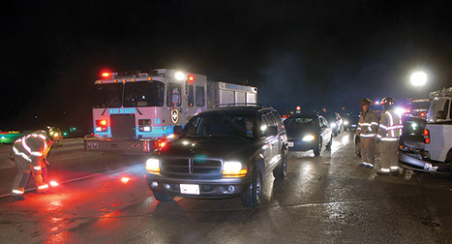
Scene Safety (1 of 2)
Begin protecting yourself as soon as you are dispatched.
Continue to protect yourself once on scene.
© Glen E. Ellman.
Notes:
Lecture Outline
IV. Scene Safety
A. The personal safety of all those involved in an emergency situation is very important.
1. Begin protecting yourself as soon as you are dispatched.
a. Wear seat belts.
b. Don appropriate PPE.
2. Continue to protect yourself once on scene.
a. Make sure the scene is well marked.
b. Place warning devices to alert other motorists to the scene.
c. Park at a safe distance from the scene.
d. Make sure there is plenty of light if it is dark.
e. Wear reflective clothing if it is dark.

Slide 23
Scene Safety (2 of 2)
Scene hazards
Hazardous materials
Electricity
Fire
Vehicle crashes
Notes:
Lecture Outline
B. Scene hazards
1. Hazardous materials
a. Upon arrival, look at the scene and try to read any labels, placards, and identification numbers from a distance, perhaps using binoculars.
b. A specially trained and equipped hazardous materials team will be called to the scene to handle disposal of materials and removal of patients.
c. You should not begin caring for patients until they have been moved away from the scene and are decontaminated or the scene is safe for you to enter.
d. Do not enter the scene unless it is safe to do so.
2. Electricity
a. Dealing with downed power lines is beyond the scope of EMT training.
b. Mark off a danger zone around the downed lines using utility poles as landmarks. The safety zone is one span of the power pole’s distance.
c. Lightning is a threat:
i. A direct hit
ii. Ground current
d. A repeat strike in the same area can occur.
e. Avoid high ground to minimize risk of a direct lightning strike.
f. To avoid being injured by ground current, stay away from drainage ditches, moist areas, small depressions, and wet ropes.
g. Make yourself the smallest target possible and drop all equipment.
3. Fire
a. Common hazards:
i. Smoke
ii. Oxygen deficiency
iii. High ambient temperatures
iv. Toxic gases
v. Building collapse
vi. Equipment
vii. Explosions
4. Vehicle crashes
a. Vehicle crashes are common events for EMS providers.
b. Vehicle collision hazards include traffic, an unstable vehicle, downed power lines, risk of violence, airbags, and sharp objects.
c. Use sufficient protective gear to reduce the risk of injury.

Slide 24
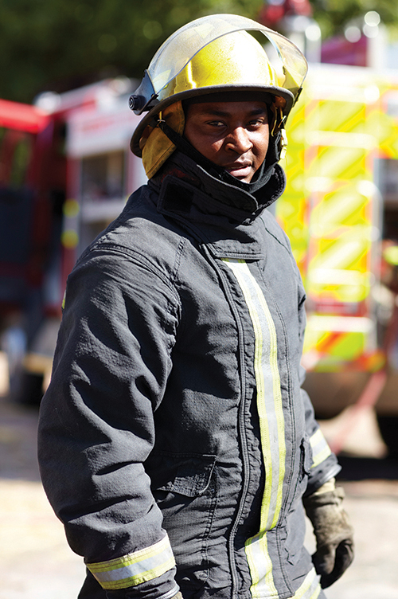
Protective Clothing: Preventing Injury
Cold-weather clothing
Turnout gear
Gloves
Helmets
Boots
Eye protection
Ear protection
Skin protection
© PeopleImages/iStock.
Notes:
Lecture Outline
V. Protective Clothing: Preventing Injury
A. Wearing protective clothing and other appropriate gear is critical to your personal safety.
B. Become familiar with the protective equipment available to you.
C. Inspect your clothing and gear regularly, ideally before you reach the scene.
D. Types
1. Cold-weather clothing (consists of three layers)
a. A thin inner layer that pulls moisture away from the skin
b. A thermal middle layer that serves as insulation
c. An outer layer that resists wind, rain, sleet, or snow
2. Turnout gear
a. Protects from heat, fire, sparks, and flashover
b. Also called bunker gear
3. Gloves
a. Protect from heat, cold, and cuts
b. May reduce dexterity in a rescue situation.
4. Helmets
a. Helmets should be worn to protect the EMT from falling objects.
b. Helmets should provide top and side impact protection.
c. Secure chin straps are needed.
5. Boots
a. Should be water resistant and fit well, and be flexible.
b. Steel-toed boots are preferred.
c. Traction is important for rescue situations.
6. Eye protection
a. Wear protective glasses with side shields during routine patient care.
b. When tools are in use, use a face shield and goggles.
7. Ear protection
a. Soft foam industrial-type earplugs
8. Skin protection
a. Protect against sunburn during outside work.
b. Use a sunscreen with a minimum SPF rating of 15.
9. Body armor
a. Bulletproof vests
b. Range from lightweight and flexible to heavy and bulky
c. Vests may not be practical for daily use.
10. Long/loose hair, rings, jewelry
a. Many EMS services have restrictive policies regarding hair, rings, and jewelry.
b. You should tie hair up neatly, limit the number of rings worn, and wear only a watch on the wrist.

Slide 25
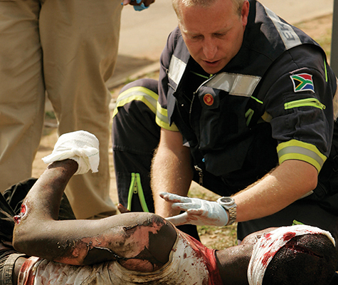
Caring for Critically Ill and Injured Patients (1 of 4)
Let the patient know:
Who you are and what you are doing
That you are attending to the patient’s immediate needs
© Siphiwe Sibeko/Reuters/Landov
Notes:
Lecture Outline
VI. Caring for Critically Ill and Injured Patients
A. The patient needs to know who you are and what you are doing
1. Let the patient know that you are attending to his or her immediate needs.
2. Avoid making unprofessional comments during resuscitation.
3. Treat all patients with dignity and respect.

Slide 26
Caring for Critically Ill and Injured Patients (2 of 4)
Responses of the critical patient:
Anxiety
Pain and fear
Anger
Depression
Dependency
Guilt
Notes:
Lecture Outline
B. Responses of the critical patient
1. Anxiety
2. Pain and fear
3. Anger and hostility
4. Depression
5. Dependency
6. Guilt
7. Mental health problems
8. Receiving unrelated bad news

Slide 27
Caring for Critically Ill and Injured Patients (3 of 4)
Communicating with the critical patient:
Avoid sad and grim comments.
Orient the patient.
Be honest.
Allow for hope.
Locate and notify family members.
Notes:
Lecture Outline
C. Techniques for communicating with the critical patient
1. Avoid sad and grim comments.
a. Remarks about a patient’s condition may increase the patient’s anxiety or compromise recovery.
2. Orient the patient to his or her surroundings.
3. Be honest.
a. Decide how much information the patient can understand and accept.
b. Allow the patient to be part of the care being given.
4. Allow for hope.
a. If there is the slightest chance of hope remaining, transmit that message to the patient.
D. Locate and notify family members.
1. Assure the patient that you will take care of notifying the appropriate people.

Slide 28
Caring for Critically Ill and Injured Patients (4 of 4)
Injured and critically ill children.
Ask a responsible adult to accompany the child.
Death of a child
Tragic event
Help the family in any way you can.
Notes:
Lecture Outline
E. Injured and critically ill children
1. Children should be cared for as any adult would be.
2. It is important that a family member or responsible adult accompany the child to relieve anxiety and assist in care as appropriate.
F. Dealing with death of a child
1. The death of a child is a tragic and dreaded event.
2. Help the family through the initial period after the death.
G. Helping the family
1. Acknowledge the death in a private place.
2. Shock, denial, and disbelief are common emotions and reactions to a child’s death.
3. If circumstances allow, let the parents hold the child. Use your best judgment to determine if this is appropriate.
4. Let the family’s actions be your guide.
5. The family may want to see the child, and you should allow them to do so.
6. Prepare the parents for what they will see.

Slide 29
Death and Dying (1 of 3)
Death may occur:
Quite suddenly
After a prolonged, terminal illness
The EMT will face death.
Stages of grieving:
Denial
Anger, hostility
Bargaining
Depression
Acceptance
Notes:
Lecture Outline
VII. Death and Dying
A. Death may occur:
1. Quite suddenly
2. After a prolonged, terminal illness
B. The EMT will sometimes face death.
C. The grieving process:
1. Denial
2. Anger, hostility
3. Bargaining
4. Depression
5. Acceptance

Slide 30
Death and Dying (2 of 3)
The EMT’s role:
Ask how you can help.
Reinforce reality.
Be honest.
Allow the patient or family to grieve.
Notes:
Lecture Outline
D. What can the EMT do?
1. Ask the patient and family if there is anything you can do to help.
2. Reinforce the reality of the situation.
3. Be honest and sincere.
4. Do not say you know how the patient or family feels.
5. Let the patient or family members grieve in their own way.

Slide 31
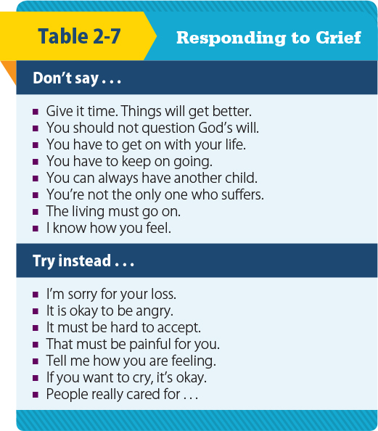
Death and Dying (3 of 3)
© Jones and Bartlett Publishers
Notes:
The table on this slide lists the statements to use when responding to grief.

Slide 32
Stress Management on the Job (1 of 2)
EMS is a high-stress job.
It is important to know the causes of stress and how to deal with stress.
General adaptation syndrome:
Alarm response to stress
Reaction and resistance
Recovery (or exhaustion)
Notes:
Lecture Outline
VIII. Stress Management on the Job
A. EMS is a high-stress job.
B. It is important to know the causes of stress and how to deal with stress.
C. General adaptation syndrome:
1. Alarm response to stress
2. Reaction and resistance to stress
3. Recovery—or exhaustion from stress

Slide 33
Stress Management on the Job (2 of 2)
Physiologic signs of stress
Increased respirations and heart rate
Cool, clammy skin
Dilated pupils
Tensed muscles
Increased blood glucose level
Perspiration
Decreased blood flow to gastrointestinal tract
Notes:
Lecture Outline
D. Physiologic manifestations of stress:
1. Increased respirations and heart rate
2. Increased blood pressure
3. Dilated venous vessels near the skin surface (causes cool, clammy skin)
4. Dilated pupils
5. Tensed muscles
6. Increased blood glucose levels
7. Perspiration
8. Decreased blood flow to the gastrointestinal tract

Slide 34
Stressful Situations
Dangerous situations
Physical and psychological demands
Dead or critically ill, injured patients
Overpowering sights, smells, and sounds
Multiple-patient situations
Angry or upset patients, family, bystanders
Unpredictability and demands of EMS
Notes:
Lecture Outline
E. Situations that are stressful for EMS providers:
1. Dangerous situations
2. Physical and psychological demands
3. Critically ill or injured patients
4. Dead and dying patients
5. Overpowering sights, smells, and sounds
6. Multiple-patient situations
7. Angry or upset patients, family, bystanders
8. Unpredictability and demands of EMS

Slide 35
Stress Reactions (1 of 2)
Acute stress reactions
Occur during a stressful situation
Delayed stress reactions
Manifest after a stressful event
Cumulative stress reactions
Prolonged or excessive stress
Notes:
Lecture Outline
F. Stress reactions
1. Acute stress reactions
a. Occur during a stressful situation
2. Delayed stress reactions
a. Manifest after a stressful event
3. Cumulative stress reactions
a. Prolonged or excessive stress

Slide 36
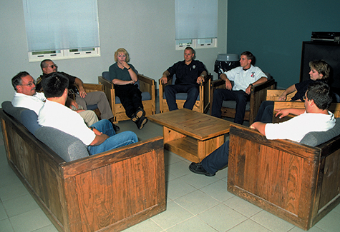
Stress Reactions (2 of 2)
Posttraumatic stress disorder (PTSD) can develop.
Critical incident stress management (CISM) was developed to decrease the likelihood of PTSD.
© Jones and Bartlett Publishers. Courtesy of MIEMSS.
Notes:
Lecture Outline
4. PTSD can develop.
a. Characterized by reexperiencing the event and overresponding to the stimuli that recall the event
b. Critical incident stress management was developed to decrease likelihood of PTSD.
G. CISM is used to help providers relieve stress.
1. CISM can occur formally.
a. Trained CISM professionals facilitate.
i. Defusing sessions are held during or immediately after the event.
ii. Debriefing sessions are held 24–72 hours after the incident.
2. If CISM is not an option, private counseling by a mental health professional may be preferable.

Slide 37
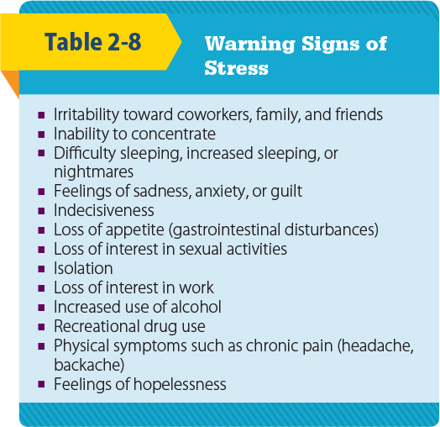
Warning Signs of Stress
© Jones and Bartlett Publishers
Notes:
Lecture Outline
H. Warning signs of cumulative stress:
1. Irritability toward coworkers, family, and friends
2. Inability to concentrate
3. Difficulty sleeping, increased sleeping, or nightmares
4. Feelings of sadness, anxiety, or guilt
5. Indecisiveness
6. Loss of appetite (gastrointestinal disturbances)
7. Loss of interest in sexual activities
8. Isolation
9. Loss of interest in work
10. Increased use of alcohol
11. Recreational drug use
12. Physical symptoms such as chronic pain (headache, backache)
13. Feelings of hopelessness

Slide 38
Stressful Situations
Use extreme care in words and actions.
Bring a sense of order and stability to the situation.
A patient’s reaction is influenced by many factors.
Allow patients to express fears and concerns.
Transport parents with their children.
Notes:
Lecture Outline
I. Stressful situations
1. Many situations are stressful for everyone involved.
2. Exercise extreme care in your words and actions.
3. Bring a sense of order and stability to the terrifying chaos that the patient is experiencing.
4. Give patients the opportunity to express their fears and concerns.
5. It is usually best to transport parents with their children.

Slide 39
Violent Situations
Created by:
Civil disturbances, large gatherings
Domestic disputes
Crime scenes
Law enforcement should secure the scene before your entry.
Do not disturb crime scene evidence.
Notes:
Lecture Outline
6. Violent situations
a. Potentially violent situations:
i. Civil disturbances
ii. Large gatherings of potentially hostile people
iii. Domestic disputes
iv. Crime scenes
b. When multiple agencies respond, it is important to know who is in command and will be issuing orders.
c. You and your partner must be protected from dangers at the scene to provide care.
i. Law enforcement should secure the scene before your entry.
d. Do not disturb crime scene evidence unless necessary to care for the patient.

Slide 40
Behavioral Emergencies
Do not have a clear physical cause and result in unusual behavior
Cause may turn out to be physical (eg, hypoglycemia, head trauma)
Use caution.
Notes:
Lecture Outline
7. Behavioral emergencies
a. Emergencies that do not have a clear physical cause
i. The cause may turn out to be physical (eg, hypoglycemia, head trauma, hypoxia, toxic ingestion).
b. These emergencies result in aberrant behavior.
c. Most behavioral emergencies do not pose a threat, but some do, and you must use caution in such cases.

Slide 41
Workplace Issues (1 of 2)
Cultural diversity
Communicate in a respectful way.
Sexual harassment
Quid pro quo
Hostile work environment
© Jones & Bartlett Learning
Notes:
Lecture Outline
IX. Workplace Issues
A. Cultural diversity on the job
1. Each individual is different.
2. Communicate in a respectful way.
3. Understand how to communicate effectively with coworkers from various backgrounds.
B. Avoiding sexual harassment
1. Two types of sexual harassment:
a. Quid pro quo
i. The harasser requests sexual favors in exchange for something else, such as a promotion.
b. Hostile work environment
i. Jokes, touching, leering, requests for a date, talking about body parts
2. The intent of the harasser does not matter, but rather the perception of the act and the impact the behavior has on someone else.
3. Because EMTs and other public safety professionals depend on one another for their safety, it is especially important for you to develop nonadversarial relationships with coworkers.
4. Report harassment to your supervisor immediately.

Slide 42
Workplace Issues (2 of 2)
Substance abuse
Seek help, or find a way to confront an addicted coworker.
Suicide prevention
Injury and illness prevention
Many EMS departments have established injury and illness prevention programs.
Notes:
Lecture Outline
C. Substance abuse
1. Increases risks of accidents and tension
2. Causes poor treatment decisions
3. Seek help, or find a way to confront an addicted coworker.
4. Allowing it to go on poses a tremendous hazard to the public.
5. Employee assistance programs (EAPs) are often available.
D. Suicide prevention
1. A combination of cumulative stress and acute, intense stress can weigh heavily on EMS providers.
2. If you or a colleague expresses suicidal ideations, you should seek professional help.
E. Injury and illness prevention
1. Many EMS departments have established injury and illness prevention programs.
2. Each program should include six interrelated and interdependent elements:
a. Management leadership
b. Worker participation
c. Hazard identification and assessment
d. Hazard prevention and control
e. Education and training
f. Program evaluation and improvement

Slide 43
Review
A disease that can be spread from person-to-person is known as:
an infectious disease.
a communicable disease.
a transmittable disease.
a spreadable disease.

Slide 44
Review
Answer: B
Rationale: A communicable disease can be spread from one person to another, or from one species to another.

Slide 45
Review (1 of 2)
A disease that can be spread from person-to-person is known as:
an infectious disease.
Rationale: An infectious disease is a medical condition caused by the growth and spread of small, harmful organisms within the body.
a communicable disease.
Rationale: Correct answer
.

Slide 46
Review (2 of 2)
A disease that can be spread from person-to-person is known as:
C. a transmittable disease.
Rationale: The correct answer is an infectious disease.
D. a spreadable disease.
Rationale: The correct answer is an infectious disease.
.

Slide 47
Review
The MOST effective way of preventing the spread of disease is:
handwashing.
keeping your immunizations up-to-date.
placing a HEPA respirator on the patient.
wearing goggles, gloves, a gown, and a mask.

Slide 48
Review
Answer: A
Rationale: According to the CDC, the most effective way of preventing the spread of disease is thorough handwashing—especially in between patients. Up-to-date immunizations and PPE will minimize the risk of contracting a disease.

Slide 49
Review (1 of 2)
The MOST effective way of preventing the spread of disease is:
handwashing. Rationale: Correct answer
keeping your immunizations up-to-date. Rationale: This is part of the overall prevention process.

Slide 50
Review (2 of 2)
The MOST effective way of preventing the spread of disease is:
placing a HEPA respirator on the patient. Rationale: This PPE helps to block the entry of an organism into the rescuer.
wearing goggles, gloves, a gown, and a mask. Rationale: This PPE is selected according to manner in which a communicable disease is spread.

Slide 51
Review
While caring for a trauma patient, the EMT has blood splashed into her eyes. This is an example of:
infection.
exposure.
indirect contact.
transmission.

Slide 52
Review
Answer: B
Rationale: Exposure occurs when a person comes in (direct or indirect) contact with blood or other bodily fluids. Blood splattered into the eyes is an example of direct contact. Note that exposure does not always lead to infection; proper use of PPE minimizes this risk.

Slide 53
Review
While caring for a trauma patient, the EMT has blood splashed into her eyes. This is an example of:
infection. Rationale: This is an abnormal invasion by an organism.
exposure. Rationale: Correct answer
indirect contact. Rationale: This is exposure through contact with a contaminated object.
transmission. Rationale: This is the way an infectious agent is spread, including direct, indirect, and airborne transmission.

Slide 54
Review
Protective measures that prevent health care workers from coming into contact with germs are referred to as:
exposure.
standard precautions.
transmission.
PPE.

Slide 55
Review
Answer: B
Rationale: Standard precautions prevent health care workers from coming into contact with germs.

Slide 56
Review (1 of 2)
Protective measures that prevent health care workers from coming into contact with germs are referred to as:
exposure. Rationale: Exposure occurs when a person comes into contact with blood or body fluids.
standard precautions. Rationale: Correct answer

Slide 57
Review (2 of 2)
Protective measures that prevent health care workers from coming into contact with germs are referred to as:
transmission. Rationale: Transmission is the way in which an infectious agent is spread.
PPE. Rationale: PPE is the equipment used to shield health care workers from infectious agents.

Slide 58
Review
What is the second stage of response in the stress response known as general adaptation syndrome?
Recovery
Exhaustion
Alarm
Reaction and resistance

Slide 59
Review
Answer: D
Rationale: The body typically reacts to stress in three stages: the alarm response, which is followed by reaction and resistance, and then by recovery. If the individual cannot reduce stress, the last stage may progress to exhaustion.

Slide 60
Review
What is the second stage of response in the stress response known as general adaptation syndrome?
Recovery Rationale: This is the third stage.
Exhaustion Rationale: If the third stage (recovery) is prolonged, then exhaustion occurs.
Alarm Rationale: This is the first stage.
Reaction and resistance Rationale: Correct answer

Slide 61
Review
The condition characterized by reexperiencing an event and overresponding to stimuli that recall the event is called:
acute stress reaction.
delayed stress reaction.
cumulative stress reaction.
posttraumatic stress disorder (PTSD).

Slide 62
Review
Answer: D
Rationale: PTSD may develop after a person has experienced a psychologically distressing event.

Slide 63
Review
The condition characterized by reexperiencing an event and overresponding to stimuli that recall the event is called:
acute stress reaction. Rationale: This occurs during a stressful event.
delayed stress reaction. Rationale: This occurs after a stressful event.
cumulative stress reaction. Rationale: This occurs when the EMT is exposed to prolonged or excessive stress.
posttraumatic stress disorder. Rationale: Correct answer

Slide 64
Review
______ is the fuel that makes the body run.
Sleep
Exercise
Food
Work/life balance

Slide 65
Review
Answer: C
Rationale: To perform efficiently, you must eat nutritious food. The physical exertion and stress of your job require high energy output.

Slide 66
Review
______ is the fuel that makes the body run.
Sleep Rationale: A consistent cycle of sleep will improve concentration and motivation.
Exercise Rationale: A regular program of exercise will increase strength and endurance.
Food Rationale: Correct answer
Work/life balance Rationale: A balance will allow you to relax off the job and motivate you on the job.

Slide 67
Review
Which stage of grieving commonly results in blame?
Denial
Anger, hostility
Bargaining
Depression

Slide 68
Review
Answer: B
Rationale: The person may lash out at the EMT or blame the EMT for the unfortunate event.

Slide 69
Review (1 of 2)
Which stage of grieving commonly results in blame?
Denial Rationale: Denial is refusal to accept the circumstances.
Anger, hostility Rationale: Correct answer

Slide 70
Review (2 of 2)
Which stage of grieving commonly results in blame?
Bargaining Rationale: The patient may try to make a deal.
Depression Rationale: Depression commonly results in a silent patient.

Slide 71
Review
Placards are used on:
buildings.
individual packages.
storage lockers.
storage papers.

Slide 72
Review
Answer: A
Rationale: Placards are used for buildings and transportation vehicles.

Slide 73
Review
Placards are used on:
buildings. Rationale: Correct answer
individual packages. Rationale: Labels are used to identify packages.
storage lockers.
Rationale: Placards are used for buildings and transportation vehicles.
D. storage papers.
Rationale: Placards are used for buildings and transportation vehicles.

Slide 74
Review
The five hazards most commonly associated with a structural fire are:
smoke, oxygen deficiency, high ambient temperatures, toxic gases, and building collapse.
smoke, oxygen deficiency, inhalation of tar particles, injury from breaking glass, and building collapse.
smoke, high ambient temperatures, toxic gases, electric shock, and inhalation of tar particles.
oxygen deficiency, high ambient temperatures, toxic gases, electric shock, and injury from breaking glass.

Slide 75
Review
Answer: A
Rationale: The five hazards most commonly associated with a structural fire are smoke, oxygen deficiency, high ambient temperatures, toxic gases, and building collapse.

Slide 76
Review (1 of 2)
The five hazards most commonly associated with a structural fire are:
smoke, oxygen deficiency, high ambient temperatures, toxic gases, and building collapse. Rationale: Correct answer
smoke, oxygen deficiency, inhalation of tar particles, injury from breaking glass, and building collapse. Rationale: Smoke is made up of particles of both tar and carbon.

Slide 77
Review (2 of 2)
The five hazards most commonly associated with a structural fire are:
smoke, high ambient temperatures, toxic gases, electric shock, and inhalation of tar particles. Rationale: Smoke is made up of particles of both tar and carbon.
oxygen deficiency, high ambient temperatures, toxic gases, electric shock, and injury from breaking glass. Rationale: Smoke is missing from this option.

