Slide 1
Chapter 4
Communications and Documentation
Notes:
Chapter 4: Communications and Documentation

Slide 2
National EMS Education Standard Competencies (1 of 5)
Preparatory
Applies fundamental knowledge of the emergency medical services (EMS) system, safety/well-being of the emergency medical technician (EMT), medical/legal and ethical issues to the provision of emergency care.
Notes:
National EMS Education Standard Competencies
Preparatory
Applies fundamental knowledge of the emergency medical services (EMS) system, safety/well-being of the emergency medical technician (EMT), medical/legal, and ethical issues to the provision of emergency care.

Slide 3
National EMS Education Standard Competencies (2 of 5)
Therapeutic Communication
Principles of communicating with patients in a manner that achieves a positive relationship
Interviewing techniques
Adjusting communication strategies for age, stage of development, patients with special needs, and differing cultures
Verbal defusing strategies
Family presence issues
Notes:
National EMS Education Standard Competencies
Therapeutic Communication
Principles of communicating with patients in a manner that achieves a positive relationship
• Interviewing techniques
• Adjusting communication strategies for age, stage of development, patients with special needs, and differing cultures
• Verbal defusing strategies
• Family presence issues

Slide 4
National EMS Education Standard Competencies (3 of 5)
EMS System Communication
Communication needed to
Call for resources
Transfer care of the patient
Interact within the team structure
EMS communication system
Communication with other health care professionals
Team communication and dynamics
Notes:
National EMS Education Standard Competencies
EMS System Communication
Communication needed to
• Call for resources
• Transfer care of the patient
• Interact within the team structure
• EMS communication system
• Communication with other health care professionals
• Team communication and dynamics

Slide 5
National EMS Education Standard Competencies (4 of 5)
Documentation
Recording patient findings
Principles of medical documentation and report writing
Notes:
National EMS Education Standard Competencies
Documentation
• Recording patient findings
• Principles of medical documentation and report writing

Slide 6
National EMS Education Standard Competencies (5 of 5)
Medical Terminology
Uses foundational anatomical and medical terms and abbreviations in written and oral communication with colleagues and other health care professionals
Notes:
National EMS Education Standard Competencies
Medical Terminology
Uses foundational anatomical and medical terms and abbreviations in written and oral communication with colleagues and other health care professionals.

Slide 7
Introduction (1 of 3)
Communication is the transmission of information to another person.
Verbal
Nonverbal (through body language)
Verbal communication skills are important for EMTs.
Enable you to gather critical information, coordinate with other responders, and interact with other health care professionals
Notes:
Lecture Outline
I. Introduction
A. Communication is the transmission of information to another person, whether it is verbal or through body language (nonverbal).
1. Effective communication is an essential component of prehospital care.
2. It is necessary to achieve a positive relationship with patients and coworkers.
B. Verbal communication skills are important for EMTs.
1. Enable you to gather information from the patient and bystanders
2. Make it possible for you to coordinate all the responders who are often present at the scene
3. An integral part of transferring the patient’s care to the nurses and physicians at the hospital

Slide 8
Introduction (2 of 3)
Documentation
Patient’s permanent medical record
Demonstrates appropriate care was delivered
Helps others in patient’s future care
Complete patient records
Guarantee proper transfer of responsibility
Comply with requirements of health departments and law enforcement agencies
Fulfill your organization’s administrative needs
Notes:
Lecture Outline
C. Documentation
1. The written or electronically recorded part of the patient’s permanent medical record
2. Demonstrates that appropriate care was delivered
3. Communicates the patient’s story to others who may participate in the patient’s future care
4. Adequate reporting and accurate records ensure the continuity of patient care.
5. Complete patient records
a. Guarantee proper transfer of responsibility
b. Comply with requirements of health departments and law enforcement agencies
c. Fulfill your organization’s administrative needs

Slide 9
Introduction (3 of 3)
Radio and telephone communications
Link the EMT to EMS, fire department, and law enforcement
You must know:
What your system can and cannot do
How to use the system efficiently and effectively
Notes:
Lecture Outline
D. Radio and telephone communications
1. Link the EMT to other members of the EMS, fire department, and law enforcement communities
2. You must know:
a. What your system can and cannot do
b. How to use the system efficiently and effectively

Slide 10
Therapeutic Communication (1 of 4)
Uses various communication techniques and strategies:
Both verbal and nonverbal
Encourages patients to express how they feel
Achieves a positive relationship with each patient
Notes:
Lecture Outline
II. Therapeutic Communication
A. Therapeutic communication uses various communication techniques and strategies.
1. Both verbal and nonverbal
2. Encourages patients to express how they feel and achieves a positive relationship with each patient

Slide 11
Therapeutic Communication (2 of 4)
Shannon-Weaver communication model
Sender takes a thought
Encodes it into a message
Sends the message to the receiver
Receiver decodes the message
Sends feedback to the sender
Notes:
Lecture Outline
B. The Shannon-Weaver communication model was developed to assist in the mathematical theory of communication for Bell Telephone Labs in the late 1940s. This model remains a valuable tool in understanding human communications:
1. Sender takes a thought
2. Encodes it into a message
3. Sends the message to the receiver
4. Receiver decodes the message
5. Sends feedback to the sender

Slide 12
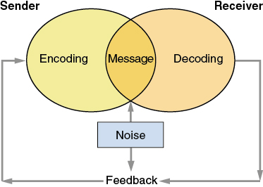
Therapeutic Communication (3 of 4)
© Jones and Bartlett Publishers
Notes:
The figure on this screen illustrates how the Shannon-Weaver communication model works.

Slide 13
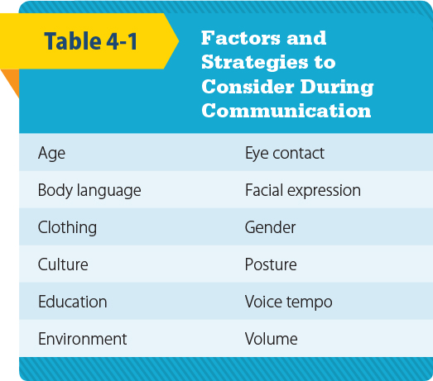
Therapeutic Communication (4 of 4)
© Jones and Bartlett Publishers
Notes:
The table on this screen lists the factors and strategies to consider during communication.

Slide 14
Age, Culture, and Personal Experience (1 of 2)
Shape how a person communicates
Body language and eye contact are greatly affected by culture.
In some cultures, direct eye contact is impolite.
In other cultures, it is impolite to look away while speaking.
Notes:
Lecture Outline
C. Age, culture, and personal experience
1. Shape how a person communicates
2. Body language and eye contact are greatly affected by culture.
a. In some cultures, direct eye contact is impolite.
b. In other cultures, it is impolite to look away while speaking.

Slide 15
Age, Culture, and Personal Experience (2 of 2)
Tone, pace, and volume of language
Reflect mood of the person and perceived importance of the message
Ethnocentrism: considering your own cultural values more important than those of others
Cultural imposition: forcing your values onto others
Notes:
Lecture Outline
3. Tone, pace, and volume of the language
a. Offer clues about the mood of the person communicating
b. Provide insight into the perceived importance of the message
4. Ethnocentrism: considering your own cultural values more important than those of others
a. People tend to translate messages they receive using their own worldview.
5. Cultural imposition: forcing your values onto others
a. Health care providers may consciously or subconsciously force their cultural values onto their patients because they believe their values are better.

Slide 16
Nonverbal Communication (1 of 3)
Body language provides more information than words alone.
Even without exchanging any words, you should be able to tell the mood of your patient.
Facial expressions, body language, and eye contact are powerful communication tools.
Help people understand messages being sent
Notes:
Lecture Outline
D. Nonverbal communication
1. Body language provides more information than words alone.
a. Even without exchanging any words, you should be able to tell the mood of your patient.
E. Facial expressions, body language, and eye contact
1. Eye contact and body language are powerful communication tools.
2. Pay attention to body language—both your own and that of your patients.
3. Physical cues will help you and your patient to truly understand the message being sent.

Slide 17
Nonverbal Communication (2 of 3)
When treating a potentially hostile patient, be aware of your own body language.
Stay calm and try to defuse the situation:
Assess the safety of the scene.
Do not assume an aggressive posture.
Make good eye contact, but do not stare.
Speak calmly, confidently, and slowly
Never threaten the patient, either verbally or physically.
Notes:
Lecture Outline
4. When you are treating a potentially hostile patient, it is important that you understand and be aware of your own body language. Stay calm and try to defuse the situation:
a. Assess the safety of the scene.
b. Do not assume an aggressive posture.
c. Make good eye contact, but do not stare.
d. Speak calmly, confidently, and slowly.
e. Never threaten the patient, either verbally or physically.

Slide 18
Nonverbal Communication (3 of 3)
Physical factors
Literal noise, sounds in the environment, lighting, distance, or physical obstacles may affect your communication.
Cultural norms often dictate the amount of space, or proximity, between people when communicating.
Gestures, body movements, and attitude toward the patient are critically important.
Notes:
Lecture Outline
F. Physical factors
1. Noise: anything that dampens or obscures true meaning of message
a. Literal noise, sounds in the environment, lighting, distance, or physical obstacles may affect your communication.
2. Cultural norms often dictate the amount of space, or proximity, between people when communicating.
a. As a person gets closer, a greater sense of trust must be established.
3. Your gestures, body movements, and attitude toward the patient are critically important in gaining the trust of both patient and family.

Slide 19
Verbal Communication (1 of 2)
Asking questions is a fundamental aspect of prehospital care.
Open-ended questions require some level of detail.
Use whenever possible
Example: “What seems to be bothering you?”
Notes:
Lecture Outline
G. Verbal communication
1. One of the most fundamental functions of EMTs is to ask patients questions.
2. Open-ended questions require some level of detail in the response.
a. Use whenever possible
b. Example: “What seems to be bothering you?”

Slide 20
Verbal Communication (2 of 2)
Closed-ended questions can be answered in very short responses.
Response is sometimes a single word
Use if patients cannot provide long answers
Example: “Are you having trouble breathing?”
Notes:
Lecture Outline
3. Closed-ended questions can be answered in very short responses.
a. Response is sometimes a single word like yes or no
b. Use if patients cannot provide long answers
c. Example: “Are you having trouble breathing?”
d. May miss important issues if pertinent questions are not asked

Slide 21
Communication Tools
Facilitation
Silence
Reflection
Empathy
Clarification
Confrontation
Interpretation
Explanation
Summary
Notes:
Lecture Outline
4. You can use many powerful communication tools when trying to obtain information from patients:
a. Facilitation: encouraging the patient to talk more or provide more information
b. Silence: gives the patient space and time to think and respond
c. Reflection: restating a patient’s statement made to you to confirm your understanding
d. Empathy: being sensitive to the patient’s feelings and thoughts
e. Clarification: asking the patient to explain what he or she meant by an answer
f. Confrontation: making the patient who is in denial or in a mental state of shock focus on urgent and life-critical issues
g. Interpretation: summing up the patient’s complaint to confirm your understanding
h. Explanation: providing factual information to support a conversation
i. Summary: providing the patient with an overview of the conversation and the steps you will be taking

Slide 22
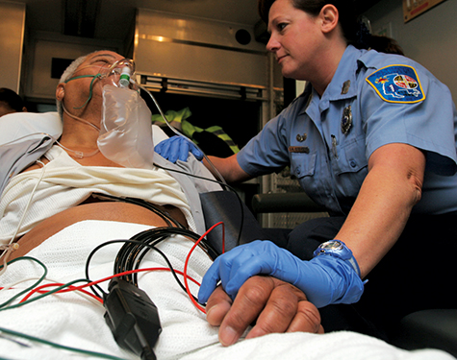
Interviewing Techniques
When interviewing a patient, consider using touch to show caring and compassion.
Use consciously and sparingly.
Avoid touching the torso, chest, and face.
© Jones and Bartlett Publishers
Notes:
Lecture Outline
5. When interviewing a patient, consider the careful use of touch to show caring and compassion.
a. Touch is a powerful tool.
b. Use it consciously and sparingly.
c. Avoid touching the patient’s torso, chest, or face simply as a means of communication, because these areas are often viewed as intimate.

Slide 23
Interviewing Techniques to Avoid
Providing false assurance or reassurance
Giving unsolicited advice
Asking leading or biased questions
Talking too much
Interrupting
Using “why” questions
Using authoritative language
Speaking in professional jargon
Notes:
Lecture Outline
6. Interview techniques to avoid
a. Providing false assurance or reassurance
b. Giving unsolicited advice
c. Asking leading or biased questions
d. Talking too much
e. Interrupting
f. Using “why” questions
g. Using authoritative language
h. Speaking in professional jargon

Slide 24
Presence of Family, Friends, and Bystanders
Friends and family may be valuable during the patient interview process.
Allow the patient to answer even if well-meaning family members attempt to answer for the individual.
Do not be afraid to ask others to step aside for a moment.
Notes:
Lecture Outline
7. Presence of family, friends, and bystanders
a. They may be valuable during the patient interview process.
b. Be sure to allow the patient to answer if he or she is able to and wants to, even if well-meaning family members attempt to answer for the individual.
c. Do not be afraid to ask others to step aside for a moment while you talk to the patient.
d. You may need to decide if having family and friends nearby will help or hinder care.

Slide 25
Golden Rules (1 of 2)
Make and keep eye contact at all times.
Provide your name and use the patient’s proper name.
Tell the patient the truth.
Use language the patient can understand.
Be careful what you say about the patient to others.
Be aware of your body language.
Notes:
Lecture Outline
8. Golden Rules to help calm and reassure a patient
a. Make and keep eye contact at all times.
b. Provide your name, and use the patient’s proper name.
c. Tell the patient the truth.
d. Use language the patient can understand.
e. Be careful what you say about the patient to others.
f. Be aware of your body language.

Slide 26
Golden Rules (2 of 2)
Speak slowly, clearly, and distinctly.
If the patient is hard of hearing, face the patient so he or she can read your lips.
Allow the patient time to answer or respond.
Act and speak in a calm, confident manner.
Notes:
Lecture Outline
g. Speak slowly, clearly, distinctly.
h. If the patient is hard of hearing, face the patient so he or she can read your lips.
i. Allow the patient time to answer or respond.
j. Act and speak in a calm, confident manner.

Slide 27
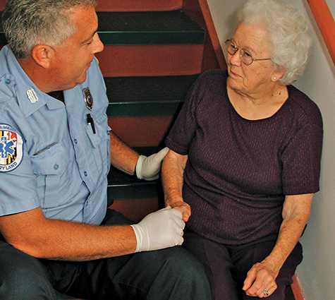
Communicating With Older Patients (1 of 5)
Identify yourself.
Present yourself as competent, confident, and caring.
Do not assume that an older patient is senile or confused.
© Jones & Bartlett Publishers. Courtesy of MIEMSS.
Notes:
Lecture Outline
H. Communicating with older patients
1. Identify yourself.
2. Present yourself as competent, confident, and caring.
3. Do not assume that an older patient is senile or confused.

Slide 28
Communicating With Older Patients (2 of 5)
You may encounter hostility, irritability, and some confusion.
Do not assume this is normal behavior
Approach an older patient slowly and calmly.
Allow plenty of time for the patient to respond to your questions.
Notes:
Lecture Outline
4. You may encounter hostility, irritability, and some confusion.
a. Do not assume this is normal behavior.
5. Approach an older patient slowly and calmly.
6. Allow plenty of time for the patient to respond to your questions.

Slide 29
Communicating With Older Patients (3 of 5)
Watch for signs of confusion, anxiety, or impaired hearing or vision.
The patient should feel confident that you are in charge and that everything possible is being done for him or her.
Be patient!
Notes:
Lecture Outline
7. Watch for signs of confusion, anxiety, or impaired hearing or vision.
8. The patient should feel confident that you are in charge and that everything possible is being done for him or her.
9. Be patient!

Slide 30
Communicating With Older Patients (4 of 5)
Older patients:
Often do not feel much pain
May not be fully aware of important changes in their body systems
You must be especially vigilant for objective changes.
Notes:
Lecture Outline
10. Older patients:
a. Often do not feel much pain
b. May not be fully aware of important changes in their body systems
c. You must be especially vigilant for objective changes.

Slide 31
Communicating With Older Patients (5 of 5)
When possible, give patients time to pack a few personal items before leaving for hospital.
Locate hearing aids, glasses, and dentures before departure.
Older patients are often worried about the safety of their home, valuable items, and pets.
Notes:
Lecture Outline
11. When possible, give the patient time to pack a few personal items before leaving for the hospital.
12. Locate any hearing aids, eyeglasses, and dentures before departure.
13. Older patients are often worried about the safety of their home, valuable items, and pets.
a. Share these concerns with the person assuming care of the patient at the hospital.

Slide 32
Communicating With Children (1 of 4)
Emergency situations are frightening.
Fear is most obvious and severe in children.
Children may be frightened by:
Your uniform
The ambulance
A crowd of people gathered around them
Notes:
Lecture Outline
I. Communicating with children
1. An emergency situation frightens anyone.
2. Fear is most obvious and severe in children.
3. Children may be frightened by:
a. Your uniform
b. The ambulance
c. A crowd of people gathered around them

Slide 33
Communicating With Children (2 of 4)
Let a child keep a favorite toy, doll, security blanket.
If possible, have a family member or friend nearby.
If practical, let the parent or guardian hold the child during evaluation and treatment.
Notes:
Lecture Outline
4. Let a child keep a favorite toy, doll, or security blanket.
5. If possible, have a family member or friend nearby.
a. If practical, let the parent or guardian hold the child during evaluation and treatment.

Slide 34
Communicating With Children (3 of 4)
Be honest.
Children easily see through lies or deception.
Tell the child ahead of time if something will hurt.
Respect the child’s modesty.
Notes:
Lecture Outline
6. Be honest. Children easily see through lies or deception.
7. Tell the child ahead of time if something will hurt.
8. Respect the child’s modesty.

Slide 35
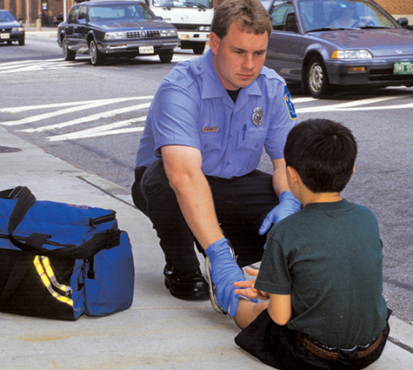
Communicating With Children (4 of 4)
Speak in a professional, friendly way.
Maintain eye contact.
Position yourself at the child’s level.
© Jones & Bartlett Publishers. Courtesy of MIEMSS.
Notes:
Lecture Outline
9. Speak in a professional, yet friendly way.
10. Use an appropriate tone and vocabulary.
11. Maintain eye contact.
12. Position yourself down at the child’s level.
a. Do not tower over a child.

Slide 36
Communicating With Hearing-Impaired Patients (1 of 3)
Most have normal intelligence and are not embarrassed by their disability.
Position yourself so the patient can see your lips.
Hearing aids
Be careful that they are not lost during an accident.
They may be forgotten if the patient is confused.
Ask family about use of a hearing aid.
Notes:
Lecture Outline
J. Communicating with patients who are hard of hearing
1. Most people who are hard of hearing have normal intelligence and are not embarrassed by their disability.
2. Position yourself so that the patient can see your lips.
3. Hearing aids
a. Be careful that they are not lost during an accident or fall.
b. They may be forgotten if the patient is confused.
c. Ask the family about use of a hearing aid.

Slide 37
Communicating With Hearing-Impaired Patients (2 of 3)
Steps to take to efficiently communicate with patients who are hard of hearing:
Have paper and pen available.
If the patient can read lips, face the patient and speak slowly and distinctly.
Never shout.
Notes:
Lecture Outline
4. Steps to take to efficiently communicate with patients who are hard of hearing:
a. Have paper and pen available.
b. If the patient can read lips, face the patient and speak slowly and distinctly.
c. Never shout.

Slide 38
Communicating With Hearing-Impaired Patients (3 of 3)
© Jones & Bartlett Publishers.
© Jones & Bartlett Publishers.
© Jones & Bartlett Publishers.
Steps (cont’d):
Listen carefully, ask short questions, and give short answers.
Learn some simple sign language.
Useful to know signs for “sick,” “hurt,” and “help”
Notes:
Lecture Outline
d. Listen carefully, ask short questions, and give short answers.
e. Learn some simple phrases in sign language.
i. It can be useful to know the signs for “sick,” “hurt,” and “help.”

Slide 39
Communicating With Visually Impaired Patients (1 of 3)
Ask the patient if he or she can see at all.
Visually impaired patients are not necessarily completely blind.
Expect the patient to have normal intelligence.
Explain everything you are doing as you are doing it.
Notes:
Lecture Outline
K. Communicating with visually impaired patients
1. Ask the patient if he or she can see at all.
a. Visually impaired patients are not necessarily completely blind.
b. Expect the patient to have normal intelligence.
2. Explain everything that you are doing as you are doing it.

Slide 40
Communicating With Visually Impaired Patients (2 of 3)
Stay in physical contact with the patient as you begin your care.
If the patient can walk to ambulance, place his or her hand on your arm.
Transport mobility aids such as a cane with the patient to the hospital.
Notes:
Lecture Outline
3. Stay in physical contact with the patient as you begin your care.
4. If the patient can walk to the ambulance, place his or her hand on your arm.
5. Transport mobility aids such as a cane with the patient to the hospital.

Slide 41
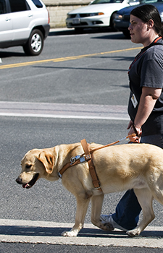
Communicating With Visually Impaired Patients (3 of 3)
Guide dogs
Easily identified by special harnesses
If possible, transport dog with patient
Alleviates stress for both patient and dog
Otherwise, arrange for care of the dog
Courtesy of the Guide Dog Foundation for the Blind. Photographed by Christopher Appoldt.
Notes:
Lecture Outline
6. Guide dogs
a. Easily identified by their special harnesses
b. If possible, transport the dog with the patient.
i. This alleviates stress for both the patient and the dog. Guide dogs are trained not to leave their masters.
c. Otherwise, arrange for care of the dog. A conscious patient can tell you about the dog and give instructions for its care.

Slide 42
Non-English-Speaking Patients (1 of 2)
You must find a way to obtain a medical history.
Find out if the patient speaks some English.
Use short, simple questions.
Point to parts of the body.
Have a family member or friend interpret.
Notes:
Lecture Outline
L. Communicating with non-English-speaking patients
1. You must obtain a medical history even though the patient does not speak English. You cannot skip this step.
2. Find out if the patient knows a few English words or phrases.
3. Use short, simple questions.
4. Point to parts of the body.
5. Have a family member or friend interpret.

Slide 43
Non-English-Speaking Patients (2 of 2)
Consider learning some common phrases in another language that is used in your area.
Pocket cards that show the pronunciation of terms are available.
Use a smartphone app or website to help you translate.
Remember to request a translator at the hospital.
Notes:
Lecture Outline
6. Consider learning some common phrases in another language that is used in your area.
a. Pocket cards that show the pronunciation of terms are available.
b. Use a smartphone app or website to help you translate.
7. Remember to request a translator at the hospital.

Slide 44
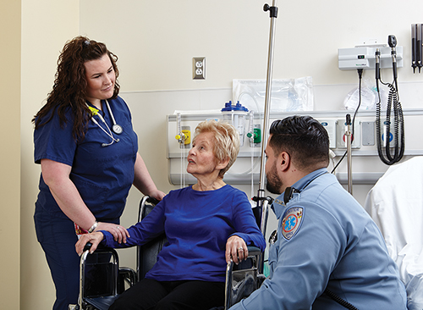
Communicating With Other Health Care Professionals (1 of 3)
Your reporting responsibilities do not end when you arrive at the hospital.
Give an oral report to a hospital staff member who has at least your level of training.
© Jones & Bartlett Learning.
Notes:
Lecture Outline
M. Communicating with other health care professionals
1. Your reporting responsibilities do not end when you arrive at the hospital.
a. Effective communication between EMS providers and other health care professionals in the receiving facility is essential to efficient, effective, and appropriate patient care.
2. You must give an oral report to a hospital staff member.
a. That staff member must have at least your level of training.

Slide 45
Communicating With Other Health Care Professionals (2 of 3)
Oral report components:
Opening information
Name, chief complaint, illness
Detailed information
Not provided during radio report
Any important history
Not already provided
Notes:
Lecture Outline
3. Oral report components:
a. Opening information
i. Name, chief complaint, nature of the illness, or mechanism of injury
b. Detailed information
i. Not provided during radio report
c. Any important history
i. Not already provided

Slide 46
Communicating With Other Health Care Professionals (3 of 3)
Oral report components (cont’d):
Patient’s response to treatment given en route
Vital signs
Other information
Notes:
Lecture Outline
d. Patient’s response to treatment given en route
e. Vital signs
f. Any other information, such as details gathered during transport, known allergies, and patient medications you brought with you

Slide 47
Written Communications and Documentation (1 of 2)
Patient care report (PCR)
Also known as prehospital care report
Legal document
Records all care from dispatch to hospital arrival
There are two types of PCRs: written and electronic.
Notes:
Lecture Outline
III. Written Communications and Documentation
A. Patient care report (PCR)
1. The PCR is also known as the prehospital care report.
2. It is a legal document.
3. It records all care from dispatch to hospital arrival.
4. There are two types of PCRs: written and electronic.

Slide 48
Written Communications and Documentation (2 of 2)
The PCR serves six functions:
Continuity of care
Legal documentation
Education
Administrative information
Essential research record
Evaluation and continuous quality improvement
Notes:
Lecture Outline
5. The PCR serves six functions:
a. Continuity of care
b. Legal documentation
c. Education
d. Administrative information
e. Essential research record
f. Evaluation and continuous quality improvement

Slide 49
Patient Care Reports (1 of 2)
Information collected on the PCR:
Chief complaint
Level of consciousness or mental status
Vital signs
Initial assessment
Patient demographics
Notes:
Lecture Outline
B. The following are examples of information collected on a PCR:
1. Chief complaint
2. Level of consciousness or mental status
3. Vital signs
4. Initial assessment
5. Patient demographics (age, gender, ethnic background)

Slide 50
Patient Care Reports (2 of 2)
Administrative information gathered from a PCR includes the time that:
The incident was reported
The EMS unit was notified
The EMS unit arrived at the scene
The EMS unit left the scene
The EMS unit arrived at the receiving facility
Patient care was transferred
Notes:
Lecture Outline
C. A lot of administrative information for use in billing, research, and quality improvement can be gathered from a PCR. Examples include the time that:
1. The incident was reported
2. The EMS unit was notified
3. The EMS unit arrived at the scene
4. The EMS unit left the scene
5. The EMS unit arrived at the receiving facility
6. Patient care was transferred

Slide 51
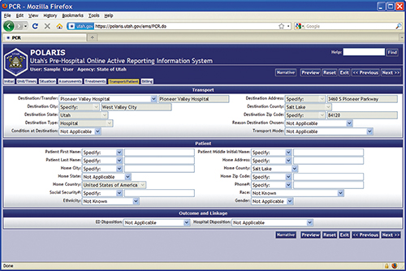
Types of Forms
Traditional written form with:
Check boxes
Narrative section
Computerized version
Courtesy of the Utah Department of Health.
Notes:
Lecture Outline
D. Types of forms
1. Traditional written form with check boxes and a narrative section
2. Computerized version or electronic PCR (ePCR)
a. Information is filled in using a computer or tablet device that uploads data over a secure Internet connection.
b. ePCRs allow patient information to be transmitted directly to hospital computers.

Slide 52
Narrative Section of the PCR (1 of 2)
Elements of the narrative section:
Time of events
Assessment findings
Emergency medical care provided
Changes in patient after treatment
Observations at the scene
Final patient disposition
Refusal of care
Staff person who continued care
Notes:
Lecture Outline
3. The narrative section of the PCR may be the most important.
4. Elements in the narrative section:
a. Time of events
b. Assessment findings
c. Emergency medical care provided
d. Changes in the patient after treatment
e. Observations at the scene
f. Final patient disposition
g. Refusal of care
h. Staff person who continued care

Slide 53
Narrative Section of the PCR (2 of 2)
Include significant negative findings and important observations about the scene.
Do not make any judgments about the patient’s condition.
Avoid radio codes and use only standard abbreviations.
Remember that the report itself is considered a confidential document.
Notes:
Lecture Outline
5. Be sure to include significant negative findings and important observations about the scene.
6. Do not record your conclusions about the incident; use clear descriptions that do not make any judgments about the patient’s condition.
7. In written documentation, avoid radio codes and use only standard abbreviations.
8. Remember that the report itself is considered a confidential document.
a. You should be familiar with state and local laws concerning confidentiality.

Slide 54
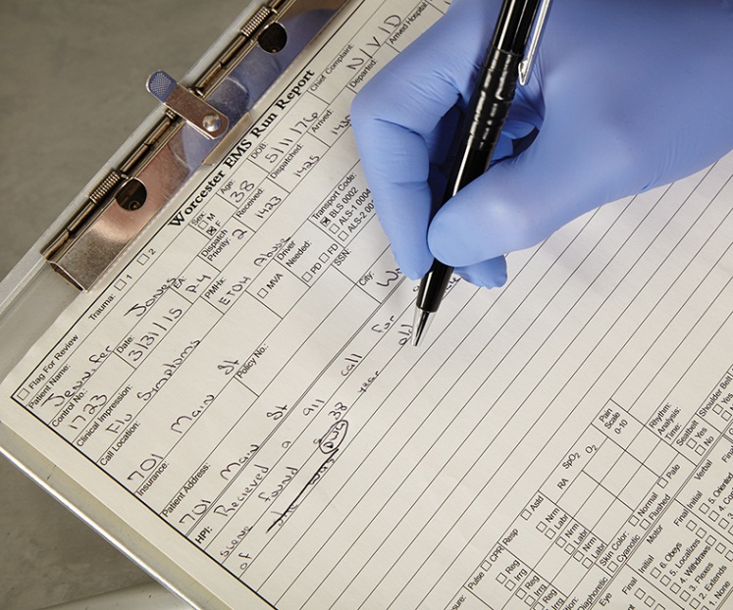
Reporting Errors (1 of 2)
If you leave something out or record it incorrectly, do not try to cover it up.
Falsification:
Results in poor patient care
May result in suspension and/or legal action
© Jones & Bartlett Learning.
Notes:
Lecture Outline
F. Reporting errors
1. Everyone makes mistakes.
2. If you leave something out or record it incorrectly, do not try to cover it up.
3. Falsification:
a. Results in poor patient care
b. May result in suspension and/or legal action

Slide 55
Reporting Errors (2 of 2)
If you discover an error as you are writing your report, draw a single horizontal line through the error, initial it, and write the correct information next to it.
Do not try to erase or cover the error with correction fluid.
Notes:
Lecture Outline
4. If you discover an error as you are writing your report, draw a single horizontal line through the error, initial it, and write the correct information next to it.
a. Do not try to erase or cover the error with correction fluid.

Slide 56
Documenting Refusal of Care
A common source of lawsuits.
Thorough documentation is crucial.
Document any assessment findings and emergency medical care given.
Have patient sign a refusal of care form.
Have family member, police officer, or bystander also sign as witness.
Complete the PCR.
Notes:
Lecture Outline
G. Documenting refusal of care
1. Refusal of care is a common source of lawsuits.
a. Thorough documentation is crucial.
2. Document any assessment findings and emergency medical care given.
3. Have the patient sign a refusal of care form.
a. Have a family member, police officer, or bystander also sign the refusal of care form as a witness.
4. Depending on local requirements, the PCR might contain:
a. Complete assessment
b. Evidence that the patient is able to make a rational, informed decision
c. Discussion with the patient as to what care/transportation EMS recommends
d. Discussion with the patient as to what may happen if he or she does not allow care or transportation
e. Discussion with family, friends, and bystanders to try to encourage the patient to allow care
f. Discussion with medical direction according to local protocol
g. Providing the patient with other alternatives—for example, going to see his or her family doctor, or having a family member drive him or her to the hospital
h. Willingness of EMS to return
i. Signatures
5. Complete the PCR.

Slide 57
Special Reporting Situations
Depending on local requirements:
Gunshot wounds
Dog bites
Some infectious diseases
Suspected physical or sexual abuse
Multiple-casualty incident (MCI)
Notes:
Lecture Outline
H. Special reporting situations
1. Depending on local requirements:
a. Gunshot wounds
b. Dog bites
c. Certain infectious diseases
d. Suspected physical or sexual abuse
e. Multiple-casualty incident (MCI)

Slide 58
Communications Systems and Equipment
Radio and telephone communications link you and your team with other members of the EMS, fire, and law enforcement communities.
Help the entire team work together more effectively
Provide an important layer of safety and protection
Notes:
Lecture Outline
IV. Communications Systems and Equipment
A. Radio and telephone communications link you and your team with other members of the EMS, fire, and law enforcement communities.
1. Help the entire team to work together more effectively
2. Provide an important layer of safety and protection

Slide 59
Base Station Radios
A base station contains a transmitter and a receiver in a fixed place.
Two-way radio consists of a transmitter and a receiver.
Notes:
Lecture Outline
B. Base station radios
1. A base station is any radio hardware containing a transmitter and a receiver that is located in a fixed place.
2. A two-way radio consists of a transmitter and a receiver.

Slide 60
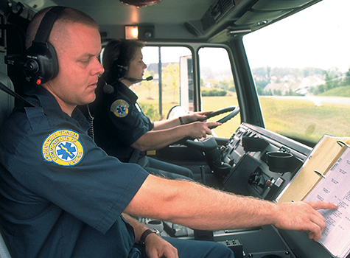
Mobile and Portable Radios (1 of 2)
Mobile radio is installed in a vehicle.
Used to communicate with:
Dispatcher
Medical control
Ambulances often have more than one.
© Jones & Bartlett Publishers. Courtesy of MIEMSS.
Notes:
Lecture Outline
C. Mobile and portable radios
1. A mobile radio is installed in a vehicle.
2. Mobile radios are used in the ambulance to communicate with:
a. The dispatcher
b. Medical control
3. An ambulance often has more than one mobile radio.

Slide 61
Mobile and Portable Radios (2 of 2)
Portable radios are hand-held devices.
Essential at the scene of an MCI
Helpful when away from the ambulance to communicate with:
Dispatch
Another unit
Medical control
Notes:
Lecture Outline
4. Portable radios are hand-held devices.
5. Portable radios are essential at the scene of an MCI.
6. When away from the ambulance, a portable radio is helpful to communicate with:
a. Dispatch
b. Another unit
c. Medical control

Slide 62
Repeater-Based Systems (1 of 2)
A repeater is a special base station radio.
Receives messages and signals on one frequency
Automatically retransmits them on a second frequency
Allows two mobile or portable units that cannot reach each other directly to communicate using its greater power and antenna
Notes:
Lecture Outline
D. Repeater-based systems
1. A repeater is a special base station radio.
a. Receives messages and signals on one frequency
b. Automatically retransmits them on a second frequency
c. Allows two mobile or portable units that cannot reach each other directly to communicate using its greater power and antenna

Slide 63
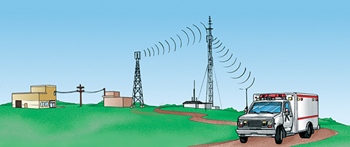
Repeater-Based Systems (2 of 2)
© Jones & Bartlett Publishers
Notes:
The figure on this slide illustrates how repeater-based systems work. A message is sent from the control center to the transmitter by a landline. The radio carrier wave is picked up by the repeater for rebroadcast to outlying units. Return radio traffic is picked up by the repeater and rebroadcast to the control center.

Slide 64
Digital Equipment
Digital signals are a part of EMS communications.
Telemetry allows electronic signals to be converted into coded, audible signals.
Signals can be transmitted by radio or telephone to a receiver with a decoder at the hospital.
Data from cardiac monitors can be transmitted via Bluetooth-enabled mobile devices.
Notes:
Lecture Outline
E. Digital equipment
1. Digital signals are a part of EMS communications.
2. Telemetry allows electronic signals to be converted into coded, audible signals.
a. Signals can be transmitted by radio or telephone to a receiver with a decoder at the hospital.
b. Data from cardiac monitors can be transmitted via Bluetooth-enabled mobile devices to monitoring centers.
3. Digital signals are also used in some kinds of paging and tone-alerting systems.

Slide 65
Cellular/Satellite Telephones
EMTs often communicate with receiving facilities by cellular telephone.
Simply low-power portable radios
Satellite phones (satphones) are another option.
Can be easily overheard on scanners
Notes:
Lecture Outline
F. Cellular/satellite telephones
1. EMTs often communicate with receiving facilities by cellular telephone.
a. A cellular telephone is simply a low-power portable radio.
2. Satellite phones (satphones) are another option.
3. Conversations can be easily overheard on scanners. Always be careful to respect patient privacy and speak in a professional manner whenever you use any form of EMS communications system.

Slide 66
Other Communications Equipment (1 of 2)
Ambulances usually have an external public address system.
EMS systems may use a variety of two-way radio hardware.
Simplex is push to talk, release to listen.
Duplex is simultaneous talk–listen.
Multiplex utilizes two or more frequencies
MED channels are reserved for EMS use.
Notes:
Lecture Outline
G. Other communications equipment
1. Ambulances usually have an external public address system.
2. EMS systems may use a variety of two-way radio hardware.
a. Simplex is push to talk, release to listen.
b. Duplex is simultaneous talk–listen.
c. Multiplex utilizes two or more frequencies, which enables more than one transmission to occur simultaneously.
3. MED channels are reserved for EMS use.

Slide 67
Other Communications Equipment (2 of 2)
Trunking systems use the latest technology to allow greater traffic.
An interoperable communications system allows all of the agencies involved to share valuable information in real time.
Mobile data terminals inside ambulance
Receive data directly from dispatch center
Allow for expanded communication capabilities (eg, maps)
Notes:
Lecture Outline
4. Trunking, or 800-MHz, systems use the latest technology to allow greater traffic.
5. An interoperable communications system allows all of the agencies involved to share valuable information with one another in real time.
6. Mobile data terminals (MDTs) inside ambulance
a. Receive data directly from dispatch center
b. Allow for expanded communication capabilities
i. For example, maps

Slide 68
Radio Communications
The Federal Communications Commission (FCC) regulates all radio operations in the United States
Allocates specific radio frequencies
Licenses call signs
Establishes licensing standards and operating specifications
Establishes limitations for transmitter output
Monitors radio operations
Notes:
Lecture Outline
V. Radio Communications
A. The Federal Communications Commission (FCC) regulates all radio operations in the United States.
1. The FCC has five principal EMS-related responsibilities.
a. Allocating specific radio frequencies for use by EMS providers
b. Licensing base stations and assigning appropriate radio call signs for those stations
c. Establishing licensing standards and operating specifications for radio equipment used by EMS providers
d. Establishing limitations for transmitter power output
e. Monitoring radio operations
2. The FCC’s rules and regulations section (part 90, subpart C) deals with EMS communications issues.

Slide 69
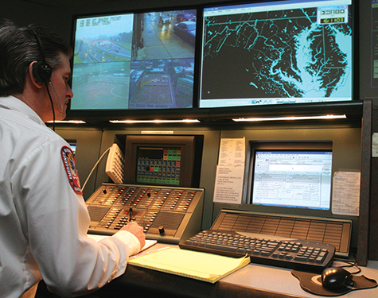
Responding to the Scene (1 of 3)
The dispatcher
Receives and determines the relative importance of the 911 call
Assigns appropriate EMS response unit(s)
© Jones & Bartlett Publishers. Courtesy of MIEMSS.
Notes:
Lecture Outline
B. Responding to the scene
1. The dispatcher receives the first call to 911.
2. The dispatcher has several important responsibilities:
a. Properly screen and assign priority to each call (according to predetermined protocols)
b. Select and alert the appropriate EMS response unit(s)
c. Dispatch and direct EMS response unit(s) to the correct location
d. Coordinate EMS response unit(s) with other public safety services until the incident is over
e. Provide emergency medical instructions to the telephone caller

Slide 70
Responding to the Scene (2 of 3)
The dispatcher (cont’d)
Selects, dispatches, and directs the appropriate EMS response unit(s)
Coordinates with other public safety services
Provides emergency medical instructions to the telephone caller
Notes:
Lecture Outline
3. The dispatcher assigns the appropriate EMS response unit(s) based on several criteria:
a. Nature and severity of the problem
b. Anticipated response time to the scene
c. Level of training of available EMS response unit(s)
d. The need for additional support
4. Dispatcher should give the responding unit(s) the following information:
a. Nature and severity of the injury, illness, or incident
b. Exact location of the incident
c. Number of patients
d. Responses by other public safety agencies
e. Special directions or advisories (adverse road or traffic conditions or severe weather reports)
f. Time unit(s) are dispatched

Slide 71
Responding to the Scene (3 of 3)
EMTs report any problems that took place during a run to the dispatcher.
EMTs inform the dispatcher upon arrival at the scene.
© Jones & Bartlett Publishers. Courtesy of MIEMSS.
Notes:
Lecture Outline
5. EMTs report any problems that took place during a run to the dispatcher.
6. EMTs inform the dispatcher upon arrival at the scene.
a. Arrival report should include any obvious details observed during scene size-up.
b. Radio communications must be brief and easily understood.
c. Speaking in plain English is best.
d. Report only important information.

Slide 72
Communicating With Medical Control and Hospitals (1 of 2)
The principal reason for radio communication is to facilitate communication between you and medical control.
Medical control may be located at the receiving hospital, at another facility, or sometimes even in another city or state.
Notes:
Lecture Outline
C. Communicating with medical control and hospitals
1. The principal reason for radio communication is to facilitate communication between you and medical control (and the hospital).
2. Medical control may be located at the receiving hospital, in another facility, or sometimes even in another city or state.

Slide 73
Communicating With Medical Control and Hospitals (2 of 2)
Consulting with medical control serves several purposes:
Notifies the hospital of an incoming patient
Provides an opportunity to request advice or orders from medical control
Advises the hospital of special situations
Notes:
Lecture Outline
3. Consulting with medical control serves several purposes.
a. Notifies the hospital of an incoming patient
b. Provides an opportunity to request advice or receive orders from medical control
c. Advises the hospital of special situations

Slide 74
Giving a Patient Report (1 of 2)
Follow the established format and include:
Your unit identification and level of services
The receiving hospital and your estimated time of arrival (ETA)
The patient’s age and gender
The patient’s chief complaint
Notes:
Lecture Outline
4. Plan and organize your radio communication before you transmit.
5. How to give the patient report
a. Follow the standard format established by your EMS system.
b. Include nine elements:
i. Your unit identification and level of services
ii. The receiving hospital and your estimated time of arrival (ETA)
iii. The patient’s age and gender
iv. The patient’s chief complaint or your perception of the problem and its severity

Slide 75
Giving a Patient Report (2 of 2)
Follow the established format and include (cont’d):
A brief history of the patient's problem
A brief report of physical findings
A brief summary of the care given
A brief description of the patient’s response to treatment
Notes:
Lecture Outline
v. A brief history of the patient’s current problem
vi. A brief report of physical findings
vii. A brief summary of the care given
viii. A brief description of the patient’s response to the treatment provided
vix. Determine whether the receiving facility has any additional questions or orders.
c. Report all patient information in an objective, accurate, and professional manner.
d. Remember that people with scanners may be listening.

Slide 76
The Role of Medical Control (1 of 2)
Medical control is either off-line (indirect) or online (direct).
You may need to call medical control for permission to:
Administer certain treatments
Determine the transport destination of patients
Stop treatment and/or not transport a patient
Notes:
Lecture Outline
6. Role of medical control
a. Medical control is either off-line (indirect) or online (direct).
b. Depending on how the protocols are written, you may need to call medical control for direct orders (permission) to conduct certain tasks:
i. Administering certain treatments
ii. Determining the transport destination of patients
iii. Stopping treatment and/or not transporting a patient

Slide 77
The Role of Medical Control (2 of 2)
In most areas, medical control is provided by the physicians working at the receiving hospital.
Many variations have developed across the country.
The link to medical control is vital to maintain a high quality of care.
Notes:
Lecture Outline
c. In most areas, medical control is provided by the physicians working at the receiving hospital.
d. Many variations have developed across the country.
e. The link to medical control is vital to maintain a high quality of care.

Slide 78
Calling Medical Control (1 of 3)
There are a number of ways to control access on ambulance-to-hospital channels.
The dispatcher monitors and assigns appropriate, clear medical control channels.
Centralized medical emergency dispatch or resource coordination centers
Notes:
Lecture Outline
7. Calling medical control
a. There are a number of ways to control access on ambulance-to-hospital channels.
i. The dispatcher monitors and assigns appropriate, clear medical control channels.
ii. Centralized medical emergency dispatch or resource coordination centers

Slide 79
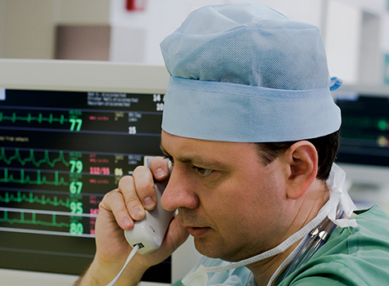
Calling Medical Control (2 of 3)
The physician bases his or her instructions on the information the EMT provides.
Never use codes unless directed to do so by local protocol.
© Andrei Malov/Dreamstime.com.
Notes:
Lecture Outline
b. The physician on the other end bases his or her instructions on the information the EMT provides.
c. Never use codes when communicating with medical control, unless you are directed to do so by local protocol.

Slide 80
Calling Medical Control (3 of 3)
Repeat orders back word for word and then receive confirmation.
Do not blindly follow an order that does not make sense to you.
Notes:
Lecture Outline
d. Once you receive an order from medical control, repeat the order back word for word and then receive confirmation.
e. Do not blindly follow an order that does not make sense to you.

Slide 81
Information Regarding Special Situations (1 of 2)
You may initiate communication with hospitals to advise them of an extraordinary call or situation.
Example special situations:
Hazardous materials situations
Rescues in progress
Multiple-casualty incidents
Notes:
Lecture Outline
8. Information regarding special situations
a. You may initiate communication with hospitals to advise them of an extraordinary call or situation.
b. A small rural hospital may be better able to respond to multiple patients from a highway crash if notified when the ambulance is first responding.
c. An entire hospital system must be notified of any disaster.
d. Other special situations:
i. Hazardous materials situations
ii. Rescues in progress
iii. Multiple-casualty incidents

Slide 82
Information Regarding Special Situations (2 of 2)
Keep several points in mind:
The earlier the notification, the better.
Provide an estimate of the number of patients
Identify any special needs
Follow your system’s plan.
Notes:
Lecture Outline
e. When notifying the hospital of special situations, keep several points in mind:
i. The earlier the notification, the better.
ii. Provide an estimate of the number of individuals who may need to be transported to the facility.
iii. Identify any special needs the patients might have (eg, burns or hazardous materials exposure) to assist the hospital in preparation.
f. Follow the plan for your system.

Slide 83
Maintenance of Radio Equipment (1 of 2)
Like other EMS equipment, radio equipment must be serviced.
The radio is your lifeline.
To other public safety agencies (who protect you)
To medical control
Notes:
Lecture Outline
D. Maintenance of radio equipment
1. Like other EMS equipment, radio equipment must be serviced.
2. The radio is your lifeline.
a. To other public safety agencies (whose duties include protecting you)
b. To medical control

Slide 84
Maintenance of Radio Equipment (2 of 2)
At the beginning of your shift, check the radio equipment.
Radio equipment may fail during a run.
Backup plan must then be followed.
May include standing orders
Notes:
Lecture Outline
3. At the beginning of a shift, check the radio equipment.
4. Radio equipment may fail during a run.
a. The backup plan must then be followed.
b. Standing orders are written documents signed by the EMS systems medical director outlining specific directions, permissions, and sometimes prohibitions regarding patient care.
i. When properly followed, standing orders have the same authority and legal status as orders given over the radio.

Slide 85
Review
When health care providers force their cultural values onto their patients because they believe their values are better, they are displaying:
ethnocentrism.
proxemics.
nonverbal communication.
cultural imposition.

Slide 86
Review
Answer: D
Rationale: Forcing your own cultural values onto others because you believe your values are better is referred to as cultural imposition.

Slide 87
Review (1 of 2)
When health care providers force their cultural values onto their patients because they believe their values are better, they are displaying:
ethnocentrism. Rationale: Ethnocentrism means considering your own cultural values as more important.
proxemics. Rationale: Proxemics is the study of space and how the distance between people affects communication.

Slide 88
Review (2 of 2)
When health care providers force their cultural values onto their patients because they believe their values are better, they are displaying:
nonverbal communication. Rationale: Nonverbal communication refers to any communication that does not use language.
cultural imposition. Rationale: Correct answer

Slide 89
Review
When communicating with an older patient, you should:
approach the patient slowly and calmly.
step back to avoid making the patient uncomfortable.
raise your voice to ensure that the patient can hear you.
obtain the majority of your information from family members.

Slide 90
Review
Answer: A
Rationale: Approach an older patient slowly and calmly, use him or her as your primary source of information whenever possible, and allow ample time for the patient to respond to your questions. Not all older patients are hearing impaired; if the patient is hearing impaired, you may need to elevate your voice slightly.

Slide 91
Review (1 of 2)
When communicating with an older patient, you should:
approach the patient slowly and calmly. Rationale: Correct answer
step back to avoid making the patient uncomfortable. Rationale: You may need to get closer. You have to touch the patient to take vital signs.

Slide 92
Review (2 of 2)
When communicating with an older patient, you should:
raise your voice to ensure that the patient can hear you. Rationale: Not all older patients are hearing impaired.
obtain the majority of your information from family members. Rationale: Always speak to the patient; the patient’s responses can provide unlimited information.

Slide 93
Review
While caring for a 5-year-old boy with respiratory distress, you should:
avoid direct eye contact with the child, as this may frighten him.
avoid letting the child hold any toys, as this may hinder your care.
avoid alerting the child prior to a patient procedure.
allow a parent or caregiver to hold the child if the situation allows.

Slide 94
Review
Answer: D
Rationale: When caring for children, take special care to avoid upsetting them. Allowing a parent to hold the child or allowing the child to play with a favorite toy often helps to keep the child calm. Never lie to a child, or any other patient for that matter; children can see through lies and deceptions. Assure the child that you can be trusted and are there to help by maintaining eye contact.

Slide 95
Review (1 of 2)
While caring for a 5-year-old boy with respiratory distress, you should:
avoid direct eye contact with the child, as this may frighten him. Rationale: Eye contact helps to establish trust with children.
avoid letting the child hold any toys, as this may hinder your care. Rationale: Playing with a toy can calm a child and keep the child occupied.

Slide 96
Review (2 of 2)
While caring for a 5-year-old boy with respiratory distress, you should:
avoid alerting the child prior to a patient procedure. Rationale: Never lie to a child; children can detect deception.
allow a parent or caregiver to hold the child if the situation allows. Rationale: Correct answer

Slide 97
Review
Which of the following pieces of patient information is of LEAST pertinence when giving a verbal report to a nurse or physician at the hospital?
The patient’s name and age
The patient’s family medical history
Vital signs that may have changed
Medications that the patient is taking

Slide 98
Review
Answer: B
Rationale: Information given to the receiving nurse or physician should include the patient’s name and age, vital signs (especially if they have changed), a summary of the past medical history, and the patient’s response to any treatment that you rendered. Family medical history is not essential in the emergency treatment of a patient.

Slide 99
Review
Which of the following pieces of patient information is of LEAST pertinence when giving a verbal report to a nurse or physician at the hospital?
The patient’s name and age Rationale: This is very important in a verbal report.
The patient’s family medical history Rationale: Correct answer
Vital signs that may have changed Rationale: This is very important in a verbal report.
Medications that the patient is taking Rationale: This is very important in a verbal report.

Slide 100
Review
Which of the following statements about the patient care report (PCR) is true?
It is not a legal document in the eyes of the law.
It cannot be used for patient billing information.
It helps ensure efficient continuity of patient care.
It is intended for use only by the prehospital care provider.

Slide 101
Review
Answer: C
Rationale: The PCR is an important document for more than one reason. It helps to ensure efficient continuity of patient care by providing the hospital with an account of all prehospital assessments and treatment. It also serves as a legal document that reflects the care provided by the EMT.

Slide 102
Review (1 of 2)
Which of the following statements about the patient care report is true?
It is not a legal document in the eyes of the law. Rationale: A patient care report is a legal document.
It cannot be used for patient billing information. Rationale: A patient care report can be used by hospital administration, which includes the billing department.

Slide 103
Review (2 of 2)
Which of the following statements about the patient care report is true?
It helps ensure efficient continuity of patient care. Rationale: Correct answer
It is intended for use only by the prehospital care provider. Rationale: While it may not be read immediately by the hospital, it can be used later to review patient care procedures and for quality improvement purposes.

Slide 104
Review
A device that receives a low-frequency signal and then transmits it at a relatively higher frequency is called a:
duplex.
scanner.
repeater.
receiver.

Slide 105
Review
Answer: C
Rationale: A repeater receives messages and signals from one frequency and then automatically transmits them on a second, higher frequency.

Slide 106
Review (1 of 2)
A device that receives a low-frequency signal and then transmits it at a relatively higher frequency is called a:
duplex. Rationale: Duplex is the ability to transmit and receive messages simultaneously.
scanner. Rationale: A scanner is a device that searches or scans across several frequencies until a message is completed.

Slide 107
Review (2 of 2)
A device that receives a low-frequency signal and then transmits it at a relatively higher frequency is called a:
repeater. Rationale: Correct answer
receiver. Rationale: A receiver is a device that only receives and does not transmit.

Slide 108
Review
When treating a potentially hostile patient, you should try to diffuse the situation by:
assuming an aggressive posture.
staring at the patient.
speaking calmly, confidently, and slowly.
verbally threatening the patient.

Slide 109
Review
Answer: C
Rationale: Speak calmly, confidently, and slowly. With your backup clearly visible, advise the patient what needs to be done, or provide the patient with limited, acceptable choices. “Sir, I need you to sit on the ambulance cot now. Either you will sit on the cot, or we will help you to the cot.”

Slide 110
Review
When treating a potentially hostile patient, you should try to diffuse the situation by:
assuming an aggressive posture.
Rationale: Do not assume an aggressive posture. Stand with your palms facing out; this communicates openness and acceptance and allows for quick movement, if necessary.
B. staring at the patient.
Rationale: Make good eye contact, but do not stare.

Slide 111
Review
When treating a potentially hostile patient, you should try to diffuse the situation by:
C. speaking calmly, confidently, and slowly.
Rationale: Correct answer.
verbally threatening the patient.
Rationale: Never threaten the patient, either verbally or physically.

Slide 112
Review
All of the following are functions of the emergency medical dispatcher, EXCEPT:
alerting the appropriate EMS response unit.
screening a call and assigning it a priority.
providing emergency medical instructions to the caller.
providing medical direction to the EMT in the field.

Slide 113
Review
Answer: D
Rationale: Functions of the emergency medical dispatcher include screening a call and assigning it a priority, alerting the appropriate EMS response unit, coordinating EMS units with other public safety services, and providing prearrival emergency medical instructions to the caller.

Slide 114
Review (1 of 2)
All of the following are functions of the emergency medical dispatcher, EXCEPT:
alerting the appropriate EMS response unit. Rationale: The dispatcher notifies the closest appropriate EMS unit.
screening a call and assigning it a priority. Rationale: The dispatcher prioritizes incoming calls.

Slide 115
Review (2 of 2)
All of the following are functions of the emergency medical dispatcher, EXCEPT:
providing emergency medical instructions to the caller. Rationale: The dispatcher helps callers with medical instructions.
providing medical direction to the EMT in the field. Rationale: Correct answer

Slide 116
Review
After receiving an order from medical control over the radio, the EMT should:
carry out the order immediately.
disregard the order if it is not understood.
obtain the necessary consent from the patient.
repeat the order to the physician word for word.

Slide 117
Review
Answer: D
Rationale: After receiving an order from medical control, the EMT should repeat the order back to the physician word for word. This will ensure that he or she heard the order correctly. After confirming the order, the EMT should obtain the necessary consent from the patient.

Slide 118
Review
After receiving an order from medical control over the radio, the EMT should:
carry out the order immediately. Rationale: The order must be repeated back first to confirm that it was heard correctly.
disregard the order if it is not understood. Rationale: Repeating the order will help the EMT to clarify any misunderstandings.
obtain the necessary consent from the patient. Rationale: This step is carried out after the order has been confirmed and understood by the EMT.
repeat the order to the physician word for word. Rationale: Correct answer

Slide 119
Review
When requesting medical direction for a patient who was involved in a major car accident, the EMT should avoid:
using radio codes to describe the situation.
questioning an order that seems inappropriate.
relaying vital signs unless they are abnormal.
the use of medical terminology when speaking.

Slide 120
Review
Answer: A
Rationale: When giving a report to medical control or requesting medical direction, the EMT should avoid the use of codes, such as “10-50” or “Signal 70.” One cannot assume that the physician is familiar with these codes. Plain English is more effective.

Slide 121
Review (1 of 2)
When requesting medical direction for a patient who was involved in a major car accident, the EMT should avoid:
using radio codes to describe the situation. Rationale: Correct answer
questioning an order that seems inappropriate. Rationale: If an order seems inappropriate, EMS providers must question the validity of the order.

Slide 122
Review (2 of 2)
When requesting medical direction for a patient who was involved in a major car accident, the EMT should avoid:
relaying vital signs unless they are abnormal. Rationale: Vital signs are necessary to describe the patient’s condition to the medical director.
the use of medical terminology when speaking. Rationale: The use of appropriate medical terminology shows the EMS provider’s confidence, knowledge, and expertise to the medical director.

