Slide 1
Chapter 6
The Human Body
Notes:
Chapter 6: The Human Body

Slide 2
Introduction
A working knowledge of anatomy is important.
Knowledge of anatomy helps to communicate correct information:
To other medical professionals
To others who may not understand medical terms
Notes:
Lecture Outline
I. Introduction
A. A working knowledge of anatomy is important.
B. Knowledge of anatomy helps to communicate correct information:
1. To other medical professionals
2. To others who may not understand medical terms

Slide 3
Topographic Anatomy
Superficial landmarks
Serve as guides to the structures that lie beneath
Topographic anatomy applies to a body in the anatomic position.
Patient stands facing you, arms at side, palms forward.
Notes:
Lecture Outline
II. Topographic Anatomy
A. Superficial landmarks serve as guides to the structures that lie beneath them.
B. Topographic anatomy applies to the body in the anatomic position, so that everyone is referring to the body in the same way.
1. Anatomic position: patient stands facing you, arms at side, palms forward

Slide 4
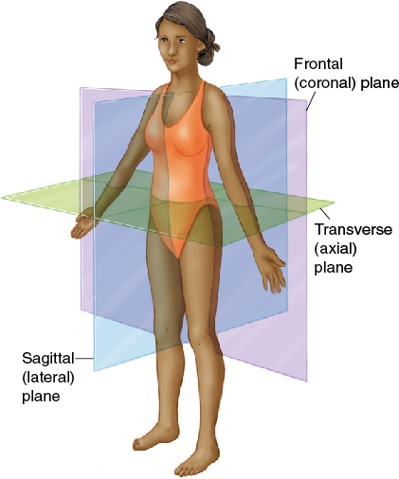
Planes of the Body
Imaginary straight lines that divide the body
Coronal plane: front/back
Transverse plane: top/bottom
Sagittal (lateral) plane: left/right
© Jones and Bartlett Publishers
Notes:
Lecture Outline
C. Planes of the body
1. Imaginary straight lines that divide the body
2. Three main areas depending on how the body is divided:
a. Frontal (coronal) plane: divides the body front and back
b. Transverse (axial) plane: divides the body top and bottom
c. Sagittal (lateral) plane: divides the body left and right

Slide 5
The Skeletal System: Anatomy
The skeleton gives us our recognizable human form.
Protects vital internal organs
Contains
Bones
Ligaments
Tendons
Cartilage
Notes:
Lecture Outline
III. The Skeletal System: Anatomy
A. The skeleton gives us our recognizable human form and protects vital internal organs.
B. Components of the skeleton:
1. 206 bones (constitute the structure of skeletal system)
2. Ligaments (connect bones to each other)
3. Tendons (connect muscles to bones)
4. Cartilage (smooth connective tissue covering the ends of bones at mobile joints)

Slide 6
The Axial Skeleton (1 of 4)
The axial skeleton is the foundation to which the arms and legs are attached.
It includes:
Skull
Spinal column
Thorax
Notes:
Lecture Outline
D. The skeletal system is divided into two portions: the axial skeleton and the appendicular skeleton.
1. Axial skeleton: foundation to which the arms and legs are attached

Slide 7
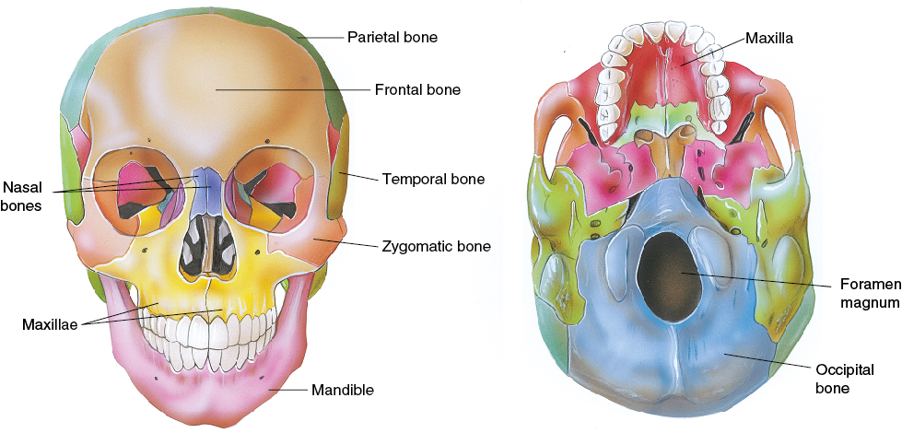
The Axial Skeleton (2 of 4)
Skull
Cranium: made up of 4 bones
Face: made up of 14 bones
© Jones and Bartlett Publishers
Notes:
Lecture Outline
a. Skull
i. Cranium
(a) Protects the brain and consists of 4 bones:
(1) Occiput (posterior portion)
(2) Temporal bones (lateral portions)
(3) Parietal bone (located between the temporal bones and occiput)
(4) Frontal bone (forehead)
ii. Facial bones consist of 14 bones
(a) Upper, nonmovable jawbones (maxillae)
(b) Cheekbones (zygomas)
(c) Lower, movable portion of jaw (mandible)
(d) Orbits (eye sockets) include zygomas, maxillae, and frontal bones of cranium.
(e)Very short bones that form the bridge of the nose

Slide 8
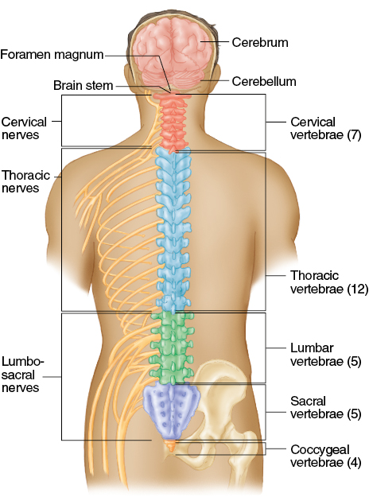
The Axial Skeleton (3 of 4)
Spinal column
Composed of 33 bones (vertebrae)
Divided into 5 sections:
Cervical
Thoracic
Lumbar
Sacrum
Coccyx
© Jones and Bartlett Publishers
Notes:
Lecture Outline
b. Spinal column
i. Central supporting structure of the body
ii. Composed of 33 vertebrae
iii. The spine is divided into 5 sections (top to bottom), and the vertebrae in each section are numbered from top to bottom.
(a) The cervical spine (neck) has 7 vertebrae.
(b) The thoracic spine (upper back) has one pair of ribs attached to each of the 12 vertebrae.
(c) The lumbar spine (lower back) has 5 vertebrae.
(d) The sacrum (back wall of pelvis) consists of 5 fused vertebrae that join the pelvis.
(e) The coccyx (tailbone) consists of 4 fused vertebrae.

Slide 9
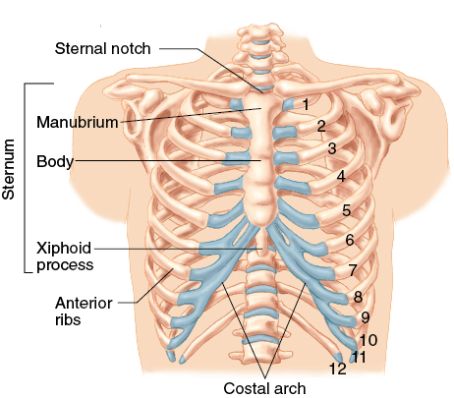
The Axial Skeleton (4 of 4)
Thorax
Formed by 12 thoracic vertebrae and 12 pairs of ribs
Thoracic cavity contains:
Heart
Lungs
Esophagus
Great vessels
© Jones and Bartlett Publishers.
Notes:
Lecture Outline
c. Thorax
i. The thoracic cavity contains the heart, lungs, esophagus, and great vessels.
ii. Formed by 12 thoracic vertebrae and 12 pairs of ribs
iii. Midline of chest is the sternum

Slide 10
The Appendicular Skeleton
Arms, legs, their connection points, and pelvis
Notes:
Lecture Outline
2. Appendicular skeleton: arms, legs, their connection points, and pelvis

Slide 11
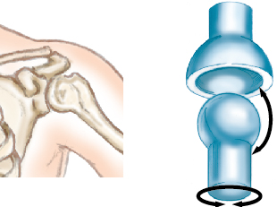
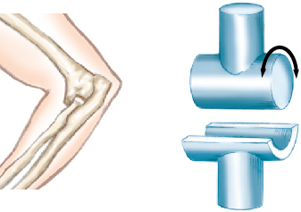
Joints
Occur wherever bones come in contact
Hinge joint
Motion restricted to one plane
Ball-and-socket joint
Allows rotation and bending
© Jones and Bartlett Publishers.
© Jones and Bartlett Publishers.
Notes:
Lecture Outline
a. Joints
i. Occur wherever bones come in contact
ii. Consist of the ends of the bones and the surrounding connecting and supporting tissues
iii. Two types of joints
(a) Ball-and-socket joint (eg, shoulder)
(1) Allows rotation and bending
(b) Hinge joint
(2) Motion is restricted to flexion (bending and extension)

Slide 12
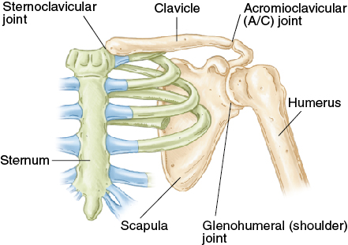
The Upper Extremities (1 of 3)
Composed of arms, forearms, hands, and fingers
Shoulder girdle
Clavicle
Scapula
Humerus
© Jones and Bartlett Publishers.
Notes:
Lecture Outline
b. Upper extremities
i. Extend from shoulder girdle to fingertips
ii. Composed of arms, forearms, hands, and fingers
(a) The shoulder girdle is where three bones come together:
(1) Clavicle (collarbone)
(2) Scapula (shoulder blade)
(3) Humerus (supporting bone of the arm)

Slide 13
The Upper Extremities (2 of 3)
Arm
Humerus is the supporting bone
Forearm
Radius on lateral side
Ulna on medial side
Notes:
Lecture Outline
(b) Arm
(1) Humerus is the supporting bone
(2) Forearm consists of radius and ulna
(3) Radius lies on the lateral, or thumb, side
(4) Ulna is on the medial, or little, finger

Slide 14
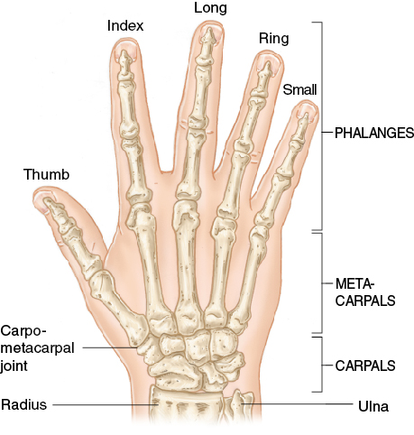
The Upper Extremities (3 of 3)
Wrist and hand
Ball-and-socket joint
Principal bones:
Carpals
Metacarpals
Phalanges
© Jones and Bartlett Publishers.
Notes:
Lecture Outline
(c) Wrist and hand
(1) A modified ball-and-socket joint formed by the ends of the radius and ulna and carpal bones
(3) Five metacarpals extend from the carpal bones and make up the hand
(4) Fingers are composed of phalanges

Slide 15
The Pelvis (1 of 2)
Closed bony ring consisting of three bones
Sacrum
Two pelvic bones
Each pelvic bone is formed by fusion of the ilium, ischium, and pubis.
Notes:
Lecture Outline
c. Pelvis
i. Closed bony ring consisting of three bones: the sacrum and two pelvic bones
ii. Each pelvic bone is formed by fusion of the ilium, ischium, and pubis.

Slide 16
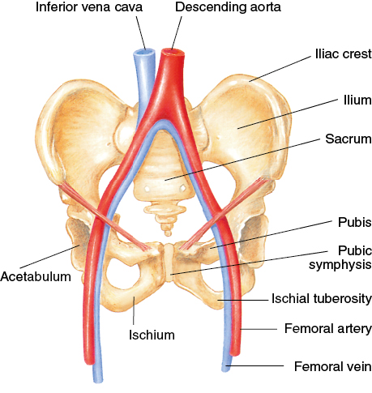
The Pelvis (2 of 2)
Posteriorly, the ilium, ischium, and pubis bones are joined by the sacrum.
Anteriorly, the pubic symphysis is where the right and left pubis are joined.
© Jones & Bartlett Learning.
Notes:
Lecture Outline
c. Pelvis
(a) These three bones are joined posteriorly by the sacrum.
(b) Anteriorly, the right pubis and left pubis are joined by a hard bony and cartilaginous joint with minimal motion. This area is called the pubic symphysis.

Slide 17
The Lower Extremities (1 of 2)
Main components: thigh, leg, and foot
Femur (thighbone)
Femur connects into pelvic girdle by ball-and-socket joint
Knee connects upper leg to lower leg
Kneecap (patella)
Lower leg
Tibia (shinbone)
Fibula
Notes:
Lecture Outline
d. Lower extremities
i. Femur (thighbone)
(a) Longest and one of the strongest bones in the body
(b) The femoral head is where the femur connects into the acetabulum (the pelvic girdle) by a ball-and-socket joint.
ii. Knee
(a) Connects the upper leg to the lower leg
(b) Hinge joint
(c) Kneecap (patella)
iii. Lower leg
(a) Tibia: shinbone
(b) Fibula

Slide 18
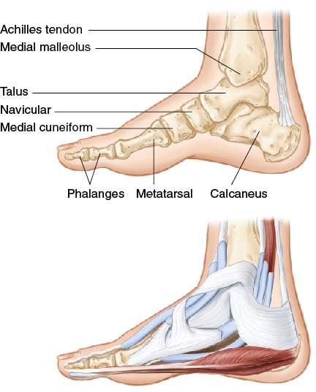
The Lower Extremities (2 of 2)
Ankle
A hinge joint
Allows flexion/extension of foot
Foot
7 tarsal bones
5 metatarsal bones
Toes are formed by phalanges
© Jones & Bartlett Learning.
Notes:
Lecture Outline
iv. Ankle
(a) Hinge joint
(b) Allows flexion and extension of the foot
v. Foot
(a) Contains 7 tarsal bones
(b) 5 metatarsal bones form the substance of the foot
(c) 5 toes formed by 14 phalanges

Slide 19
The Skeletal System: Physiology
Functions of the skeletal system
Gives the body its shape
Protects fragile organs
Allows for movement
Stores calcium
Helps create blood cells
Notes:
Lecture Outline
IV. The Skeletal System: Physiology
A. Functions of the skeletal system
1. Gives the body its shape
2. Protects fragile organs
3. Allows for movement
4. Stores calcium
5. Helps create blood cells

Slide 20
The Musculoskeletal System: Anatomy (1 of 3)
The musculoskeletal system provides:
Form
Upright posture
Movement
Protection for vital internal organs
Notes:
Lecture Outline
V. The Musculoskeletal System: Anatomy
A. The musculoskeletal system provides:
1. Form
2. Upright posture
3. Movement
4. Protection for vital internal organs

Slide 21
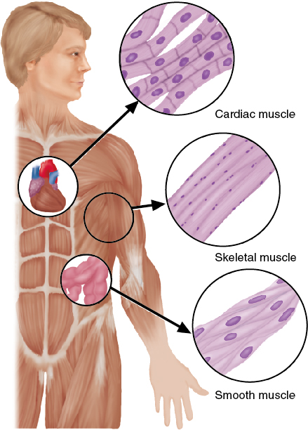
The Musculoskeletal System: Anatomy (2 of 3)
3 types of muscle
Skeletal (voluntary) muscle
Smooth muscle
Cardiac muscle
© Jones and Bartlett Publishers
Notes:
Lecture Outline
B. Three types of muscle: skeletal, smooth, and cardiac
1. Skeletal muscle attaches to the bones of the skeleton and forms the major muscle mass of the body.
a. Also called voluntary muscle, because it is under direct voluntary control of the brain
b. Movement of the body results from skeletal muscle contraction or relaxation.
2. Smooth muscle is found within blood vessels and intestines.
3. Cardiac muscle is found only within the heart.

Slide 22
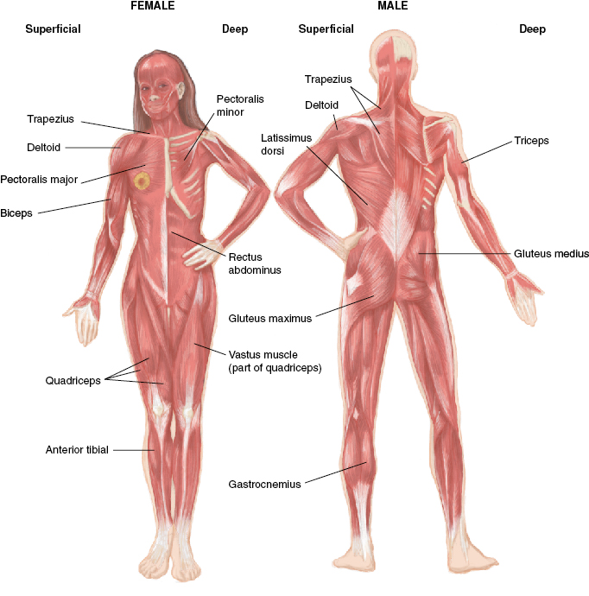
The Musculoskeletal System: Anatomy (3 of 3)
© Jones and Bartlett Publishers
Notes:
This figure shows the muscles of the human body.

Slide 23
The Musculoskeletal System: Physiology
Contraction and relaxation of this system make it possible to move and manipulate the environment.
A by-product of this movement is heat.
Another function of the muscles is to protect the structures under them.
Notes:
Lecture Outline
VI. The Musculoskeletal System: Physiology
A. Contraction and relaxation of the system make it possible to move and manipulate the environment.
1. A by-product of this movement is heat.
2. When you get cold, you shiver to produce heat.
B. Another function of muscles is to protect the structures under them.

Slide 24
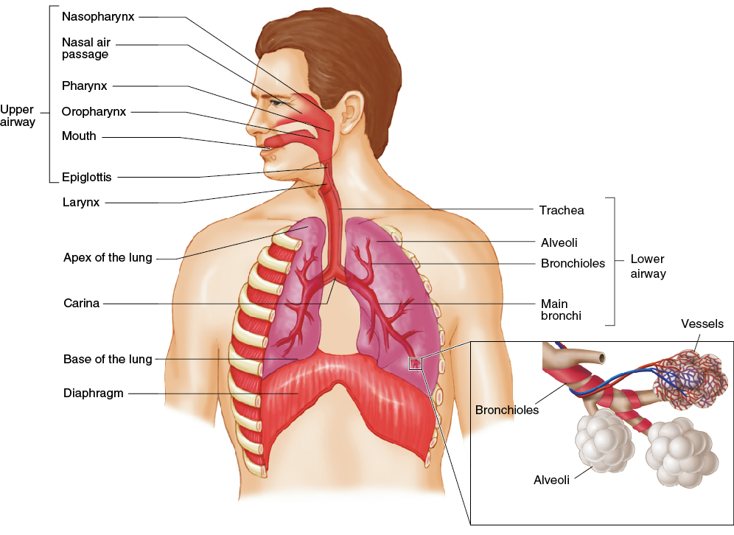
The Respiratory System: Anatomy
Structures of the body that contribute to respiration (the process of breathing)
© Jones and Bartlett Publishers
Notes:
Lecture Outline
VII. The Respiratory System: Anatomy
A. The respiratory system consists of structures of the body that contribute to the process of breathing (respiration).

Slide 25
Upper Airway
Nose
Mouth (oral cavity)
Tongue
Jaw (mandible)
Larynx
Pharynx
Nasopharynx
Oropharynx
Laryngopharynx
Trachea
Epiglottis
Esophagus
Notes:
Lecture Outline
B. Upper airway
1. Nose
2. Mouth (oral cavity)
3. Tongue
4. Jaw (mandible)
5. Larynx
a. Dividing line between the upper and lower airways
6. Pharynx
a. Nasopharynx
b. Oropharynx (throat)
c. Laryngopharynx
7. Trachea (windpipe)
a. Located at the bottom of the pharynx
8. Epiglottis
a. Thin, leaf-shaped flap that prevents food and liquid from entering the trachea
9. Esophagus
a. Immediately posterior to the trachea
b. Food and liquids enter the pharynx and then pass into the esophagus, which carries them to the stomach.

Slide 26
Lower Airway
Thyroid cartilage
Adam’s apple
Cricoid cartilage: immediately below the thyroid cartilage
Cricothyroid membrane
Trachea
Ends at the carina, dividing into right and left bronchi leading to bronchioles
Notes:
Lecture Outline
C. Lower airway
1. Thyroid cartilage (Adam’s apple): forms the anterior part of the larynx
2. Cricoid cartilage: lies immediately below the thyroid cartilage
3. Cricothyroid membrane: lies between the thyroid and cricoid cartilage
4. Trachea: lies below the cricoid cartilage
a. The trachea ends at the carina.
b. It divides into the right and left main stem bronchi, which enter the lungs and branch into smaller airways.

Slide 27
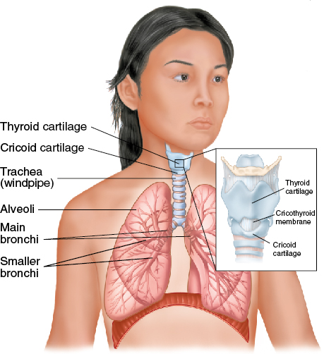
Lungs
Divided into lobes
Contain bronchi, bronchioles, and alveoli
Allow for gas exchange
© Jones and Bartlett Publishers
Notes:
Lecture Outline
D. Lungs
1. Each lung is divided into lobes.
2. Within the lobes are the bronchi and bronchioles, which end in small grape-like sacs called alveoli.
a. Alveoli allow for gas exchange (oxygen and carbon dioxide).

Slide 28
Muscles of Breathing
The diaphragm and intercostal muscles are primary muscles of breathing.
Other muscles involved in breathing:
Neck (cervical muscles)
Abdominal muscles
Pectoral muscles
Notes:
Lecture Outline
E. Muscles involved in breathing
1. Diaphragm
a. Primary muscle of breathing
b. Divides the thorax from the abdomen
2. Intercostal muscles
a. During inhalation, the diaphragm and intercostal muscles contract, moving the ribs up and out, enlarging the chest cavity, decreasing the pressure in the lungs, and moving air in.
b. During exhalation, the diaphragm and intercostal muscles relax, decreasing the chest cavity, increasing the pressure in the lungs, and moving air out.
3. Neck (cervical muscles)
4. Abdominal muscles
5. Pectoral muscles

Slide 29
The Respiratory System: Physiology (1 of 3)
Functions to provide the body with oxygen and eliminate carbon dioxide
Ventilation and respiration are two separate, interdependent functions of the respiratory system.
Notes:
Lecture Outline
VIII. The Respiratory System: Physiology
A. The respiratory system’s function is to provide the body with oxygen and eliminate carbon dioxide.
B. Ventilation and respiration are two separate, yet interdependent functions of the respiratory system.

Slide 30
The Respiratory System: Physiology (2 of 3)
Respiration: the exchange of oxygen and carbon dioxide in alveoli and tissues
Provides oxygen to the cells and removes waste carbon dioxide
Diffusion: the passive process in which oxygen molecules move from an area with a higher concentration of molecules to an area of lower concentration.
The brain stem controls breathing.
Notes:
Lecture Outline
1. Respiration
a. Respiration: the exchange of oxygen and carbon dioxide in the alveoli and in tissues of the body
b. Diffusion: the passive process in which oxygen molecules move from an area with a higher concentration of oxygen molecules to an area of lower concentration.
c. The brain stem automatically controls breathing if the level of carbon dioxide or oxygen in arterial blood is too high or too low.
i. The medulla initiates the ventilation cycle when stimulated by high carbon dioxide levels.

Slide 31
The Respiratory System: Physiology (3 of 3)
Ventilation: simple air movement into and out of the lungs
Tidal volume
Residual volume
Dead space
Minute volume
Notes:
Lecture Outline
2. Ventilation
a. Ventilation: simple movement of air into and out of the lungs
b. Tidal volume: the amount of air that is moved into or out of the lungs during a single breath
c. Residual volume: the gas that remains in the lungs to keep the lungs open
d. Minute volume: the amount of air that moves in and out of the lungs in 1 minute minus the dead space
e. Respiratory rate × tidal volume = minute volume

Slide 32
Characteristics of Normal Breathing
Normal rate and depth (tidal volume)
Regular rhythm or pattern of inhalation and exhalation
Clear, audible breath sounds on both sides of chest
Regular rise and fall movement on both sides of the chest
Movement of the abdomen
Notes:
Lecture Outline
C. Normal breathing
1. Normal rate and depth (tidal volume)
2. Regular rhythm or pattern of inhalation and exhalation
3. Clear, audible breath sounds on both sides of chest
4. Regular rise and fall movement on both sides of the chest
5. Movement of the abdomen

Slide 33
Inadequate Breathing Patterns in Adults
Labored breathing
Muscle retractions
Pale, cyanotic, cool, damp skin
Tripod position
Agonal gasps (gasping breaths)
Notes:
Lecture Outline
D. Inadequate breathing patterns
1. Labored breathing
2. Muscle retractions above the clavicles, between the ribs, and below the rib cage
3. Pale or cyanotic (blue) skin
4. Cool, damp (clammy) skin
5. Patient in the tripod position (leaning forward on arms stretched forward)
6. Agonal gasps

Slide 34
The Circulatory System: Anatomy (1 of 2)
A complex arrangement of connected tubes
Arteries, arterioles, capillaries, venules, veins
Two circuits
Systemic circulation (body)
Pulmonary circulation (lungs)
Notes:
Lecture Outline
IX. The Circulatory System: Anatomy
A. The circulatory system (cardiovascular system) is a complex arrangement of connected tubes.
1. Arteries, arterioles, capillaries, venules, and veins
B. Two circuits
1. The systemic circulation carries oxygen-rich blood from the left ventricle through the body and back to the right atrium.
2. The pulmonary circulation carries oxygen-poor blood from the right ventricle through the lungs and back to the left atrium.

Slide 35
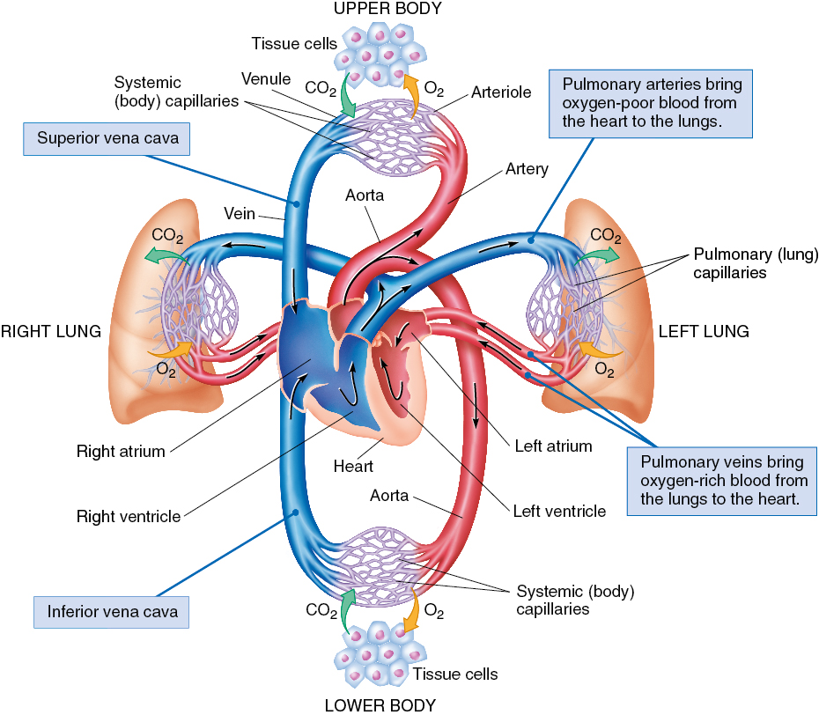
The Circulatory System: Anatomy (2 of 2)
© Jones and Bartlett Publishers
Notes:
This figure shows the circulatory system.

Slide 36
The Heart (1 of 5)
Made of specialized cardiac muscle
Works as two paired pumps
Septum divides right and left sides
Each side is divided into:
Atrium (upper chamber)
Ventricle (lower chamber)
Notes:
Lecture Outline
C. Heart
1. Made of specialized cardiac muscle (myocardium)
2. Works as two paired pumps
3. Each side is divided into:
a. Atrium (upper chamber)
b. Ventricle (lower chamber)

Slide 37
The Heart (2 of 5)
Circulation
The heart receives its blood from the aorta.
The right side receives deoxygenated blood from the veins.
The left side receives oxygenated blood from the lungs.
Notes:
Lecture Outline
4. Circulation
a. The heart receives its blood from the aorta.
b. The right side of the heart receives deoxygenated blood from the veins of the body.
c. Oxygenated blood returns from the lungs through the pulmonary veins into the left side of the heart and is pumped into the aorta and then to the arteries of the body.

Slide 38
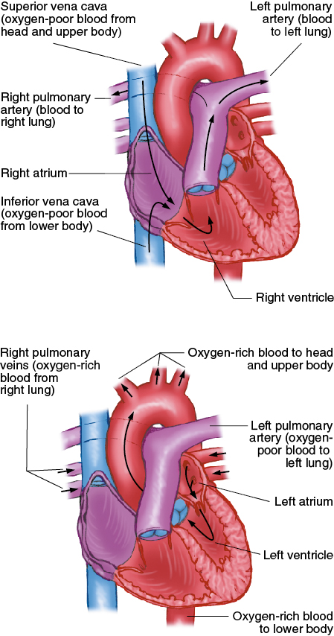
The Heart (3 of 5)
© Jones and Bartlett Publishers
Notes:
This figure shows the right and left sides of the heart.

Slide 39
The Heart (4 of 5)
Normal adult resting heart rate (HR): 60–100 beats/min
Stroke volume (SV)
Amount of blood moved by one beat
Cardiac output (CO)
Amount of blood moved in 1 minute
HR × SV = CO
Notes:
Lecture Outline
5. Normal heart rate (HR)
a. Normal pulse rate for an adult: 60–100 beats/min
b. Stroke volume (SV): the amount of blood moved by one beat
c. Cardiac output (CO): the amount of blood moved in 1 minute
i. CO = HR × SV

Slide 40
The Heart (5 of 5)
Electrical conduction system
Causes smooth, coordinated contractions
Contractions produce the pumping action
Notes:
Lecture Outline
6. Electrical conduction system
a. A network of specialized tissue that is capable of initiating and conducting electrical current runs throughout the heart.
b. Electrical impulses begin high in the atria at the sinoatrial (SA) node, travel to the atrioventricular (AV) node and bundle of His, and then move through the Purkinje fibers to the ventricles.
c. This movement produces a smooth flow of electricity, producing a coordinated pumping action.

Slide 41
Arteries (1 of 3)
Arteries carry blood from the heart to all body tissues.
Pulmonary artery
Carries oxygen-poor blood to the lungs
Arteries branch into smaller arteries and then into arterioles.
Arterioles branch into smaller vessels until they connect to the capillaries.
Notes:
Lecture Outline
D. Arteries
1. Carry blood from the heart to all body tissues
2. Aorta
a. Main artery leaving the left side of the heart and carrying freshly oxygenated blood to the body
b. Has many branches that supply the vital organs
3. The pulmonary artery originates at the right ventricle and carries oxygen-poor blood to the lungs.
4. Arteries branch first into smaller arteries and then into arterioles.
a. Arterioles branch into increasingly smaller vessels until they connect to the capillaries.

Slide 42
Arteries (2 of 3)
Pulse
Created by forceful pumping of blood out of the left ventricle and into the major arteries
Palpated most easily at the neck, wrist, or groin
Notes:
Lecture Outline
5. Pulse is created by the forceful pumping of blood out of the left ventricle and into the major arteries
a. Palpated most easily at the neck, wrist, or groin

Slide 43
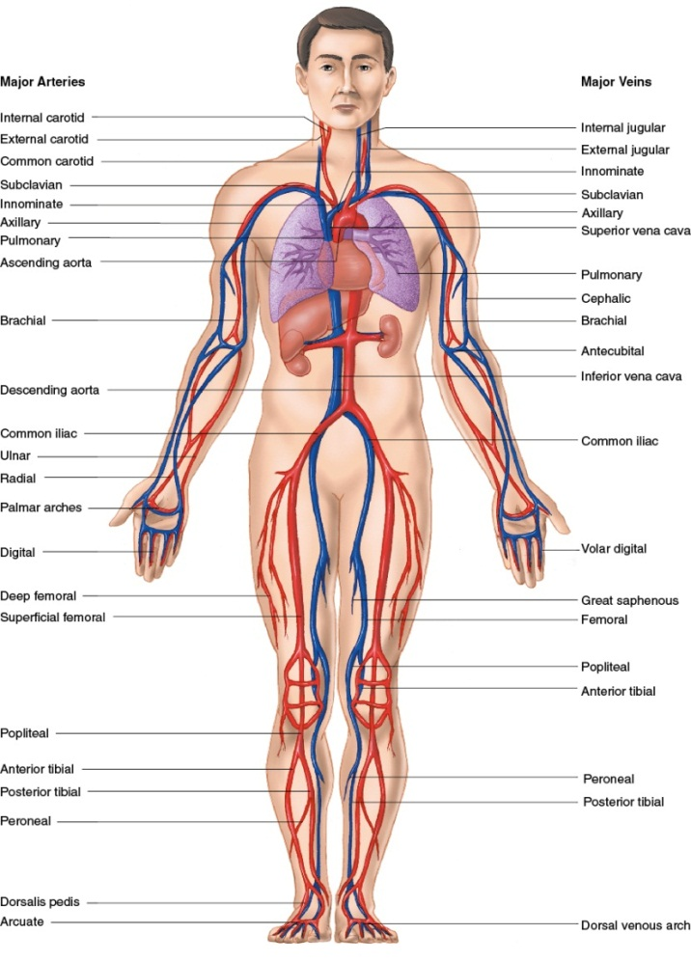
Arteries (3 of 3)
© Jones and Bartlett Publishers.
Notes:
This figure shows the major arteries of the human body.

Slide 44
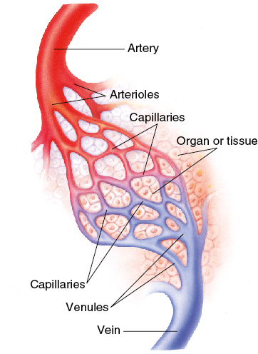
Capillaries
Connect arterioles to venules
Allow contact between blood and cells
© Jones and Bartlett Publishers.
Notes:
Lecture Outline
E. Capillaries
1. Tiny blood vessels that connect arterioles to venules
2. Oxygen and nutrients pass from blood cells and plasma in the capillaries to individual tissue cells through the very thin walls of the capillaries.

Slide 45
Veins
Return oxygen-depleted blood to the heart
Superior vena cava carries blood returning from head, neck, shoulders, and upper extremities
Inferior vena cava carries blood from abdomen, pelvis, and lower extremities
Notes:
Lecture Outline
F. Veins
1. Return oxygen-depleted blood to the heart
2. Major veins
a. The superior vena cava carries blood returning from the head, neck, shoulders, and upper extremities.
b. The inferior vena cava carries blood from the abdomen, pelvis, and lower extremities.

Slide 46
Spleen
Solid organ located under the rib cage
Filters blood
Particularly susceptible to injury from blunt trauma
Can lead to severe internal bleeding
Notes:
Lecture Outline
G. Spleen
1. Solid organ located under the rib cage in the left upper part of the abdomen
2. Filters worn-out blood cells, foreign substances, and bacteria from the blood
3. Highly vascular and is particularly susceptible to injury from blunt trauma

Slide 47
Blood Composition
Plasma (liquid)
Red blood cells (erythrocytes)
White blood cells (leukocytes)
Platelets
Notes:
Lecture Outline
H. Blood composition
1. Plasma (the liquid portion of blood) contains:
a. Water (primary component)
b. Proteins (primary component)
c. Oxygen, carbon dioxide, nitrogen
d. Nutrients
e. Cellular wastes
2. Red blood cells (erythrocytes)
a. Contain hemoglobin, which carries oxygen
3. White blood cells (leukocytes)
a. Play a role in the body’s immune defense to fight infection
4. Platelets
a. Essential in the initial formation of a blood clot

Slide 48
The Circulatory System: Physiology
Blood pressure: the pressure blood exerts against the walls of the arteries
Systole occurs when the left ventricle contracts
Diastole occurs when the left ventricle relaxes
Blood pressure readings
Systolic blood pressure: high point of wave
Diastolic blood pressure: low point of wave
Notes:
Lecture Outline
X. The Circulatory System: Physiology
A. Blood pressure: pressure that blood exerts against the walls of arteries
B. Systole: When the left ventricle of heart contracts, it pumps blood from the ventricle into the aorta.
C. Diastole: When the muscle of the ventricle relaxes, the ventricle fills with blood.
D. Forceful ejection of blood from the left ventricle into the aorta is transmitted through the arteries as a pulsatile pressure wave.
1. Can be measured with a blood pressure cuff (sphygmomanometer)
2. Systolic blood pressure: high point of wave as heart is contracting
3. Diastolic blood pressure: low point of wave as heart is in relaxation phase

Slide 49
Normal Circulation in Adults
Automatically adjusted and controlled
Perfusion: circulation of blood in an organ or tissue in adequate amounts to meet the needs of cells
Blood enters organs and tissues through arteries.
Blood leaves organs and tissues through veins.
Notes:
Lecture Outline
E. Normal circulation in adults
1. Automatically adjusted and controlled
2. Perfusion: the circulation of blood in an organ or tissue in adequate amounts to meet the current needs of the cells
3. Blood enters organs and tissues through the arteries and leaves through the veins

Slide 50
Inadequate Circulation in Adults
The system can adjust to small blood loss.
With a large loss, adjustment fails, and the patient goes into shock.
Notes:
Lecture Outline
F. Inadequate circulation in adults
1. The system can adjust to compensate for a small blood loss.
a. Vessels constrict.
b. The heart pumps more rapidly.
2. With a large loss, adjustment fails, and the patient goes into shock.

Slide 51
Functions of Blood
Perfusion
Transporting oxygen
Transporting carbon dioxide
Transporting wastes and nutrients
Clotting (coagulation)
Notes:
Lecture Outline
G. Functions of blood
1. Perfusion
2. Transporting oxygen
3. Transporting carbon dioxide
4. Transporting wastes and nutrients
5. Clotting (coagulation)

Slide 52
The Nervous System: Anatomy and Physiology
The nervous system is perhaps the most complex organ in body
Divided into two main portions:
Central nervous system (CNS)
Peripheral nervous system
Notes:
Lecture Outline
XI. The Nervous System: Anatomy and Physiology
A. The nervous system is perhaps the most complex organ system in the body.
B. Divided into two main portions

Slide 53
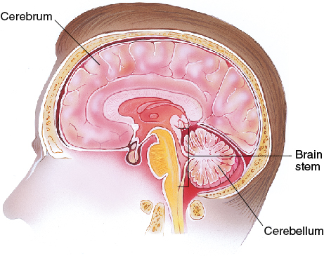
Central Nervous System (1 of 2)
Brain
Controlling organ of the body
Subdivisions
Cerebrum
Cerebellum
Brain stem
© Jones and Bartlett Publishers.
Notes:
Lecture Outline
1. Central nervous system (CNS): the brain and spinal cord
a. The brain is the controlling organ of the body.
i. Cerebrum
(a) Largest part of the brain
(b) Four lobes, each responsible for a specific function such as hearing, balance, and speech
ii. Cerebellum
(a) Coordinates body movements
iii. Brain stem
(a) Controls body functions necessary for life, including cardiac and respiratory functions and regulation of consciousness

Slide 54
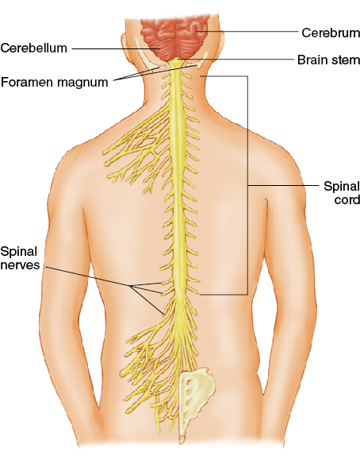
Central Nervous System (2 of 2)
Spinal cord
Continuation of the brain
Transmits messages between brain and body
© Jones and Bartlett Publishers.
Notes:
Lecture Outline
b. The spinal cord is an extension of the brain.
i. Transmits messages between the brain and the body
ii. Cerebrospinal fluid (CSF) cushions the brain and spinal cord.

Slide 55
Peripheral Nervous System (1 of 2)
Somatic nervous system
Transmits signals from brain to voluntary muscles
Autonomic nervous system
Involuntary actions
Split into two areas
Sympathetic nervous system (fight-or-flight)
Parasympathetic nervous system (slows body)
Notes:
Lecture Outline
2. Peripheral nervous system
a. Links the CNS to the various organs of the body
b. Divided into two parts:
i. Somatic nervous system (voluntary)
(a) Transmits signals from the brain to voluntary muscles
(b) Allows for activities such as walking, talking, and writing
ii. Autonomic nervous system (involuntary)
(a) Controls involuntary actions necessary for basic body functions such as digestion, dilation, and constriction of blood vessels

Slide 56
Peripheral Nervous System (2 of 2)
Two types of nerves within peripheral nervous system
Sensory nerves carry information from the body to the CNS.
Motor nerves carry information from the CNS to the muscles.
Notes:
Lecture Outline
c. Two types of nerves within peripheral nervous system
i. Sensory nerves carry information from the body to the CNS.
ii. Motor nerves carry information from the CNS to the muscles.

Slide 57
The Integumentary System (Skin): Anatomy (1 of 2)
Two layers
Epidermis (superficial)
Dermis (deeper)
Below the skin lies subcutaneous tissue.
Fat that insulates and serves as energy reservoir
Notes:
Lecture Outline
XII. The Integumentary System (Skin): Anatomy
A. Two layers of skin
1. Epidermis (superficial)
a. Composed of several layers of cells
i. Germinal layer: produces new cells
ii. Stratum corneal layer: surface layer of dead cells
iii. Skin cells are constantly being replaced.
2. Dermis (deeper)
a. Contains special structures of the skin
i. Sweat glands
ii. Sebaceous glands
iii. Hair follicles
iv. Blood vessels
v. Mucous membranes
B. Below the skin lies subcutaneous tissue, a layer of fat that serves as an insulator and as an energy reservoir.

Slide 58
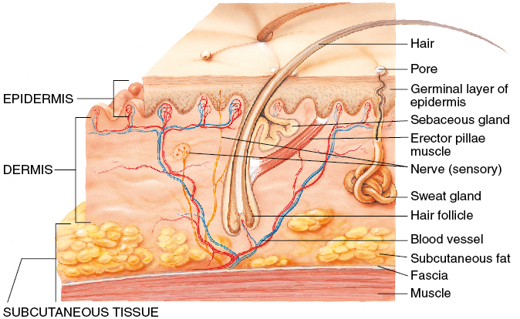
The Integumentary System (Skin): Anatomy (2 of 2)
© Jones and Bartlett Publishers.
Notes:
This figure shows the layers of the skin.

Slide 59
The Integumentary System (Skin): Physiology
The skin is the largest single organ in the body.
Three major functions
Protect the body in the environment
Regulate body temperature
Transmit information from environment to brain
Notes:
Lecture Outline
XIII. The Integumentary System (Skin): Physiology
A. The skin is the largest single organ in the body.
B. Three major functions:
1. Protect the body in the environment
2. Regulate body temperature
a. Sweat is secreted to the skin surface from the sweat glands.
3. Transmit information from the environment to the brain

Slide 60
The Digestive System: Anatomy (1 of 4)
Digestion: processing of food that nourishes the cells
Abdomen: the second major body cavity
Contains major organs of digestion and excretion
Quadrants are the easiest way to identify areas:
Right upper
Lower upper
Right lower
Left lower
Notes:
Lecture Outline
XIV. The Digestive System: Anatomy
A. Digestion: the processing of food that nourishes the individual cells of the body
1. The digestive system is also called the gastrointestinal system.
B. Components of the digestive system
1. Abdomen
a. Contains major organs of digestion and excretion
b. Quadrants are the easiest way to identify areas.
i. Right upper (RUQ): contains the liver, gallbladder, and a portion of the colon
ii. Left upper (LUQ): contains the stomach, spleen, and a portion of the colon
iii. Right lower (RLQ): contains two portions of the large intestine (cecum and ascending colon)
iv. Left lower (LLQ): contains the descending and sigmoid portions of the colon
c. The small intestine, pancreas, large intestine, and urinary bladder lie in more than one quadrant.

Slide 61
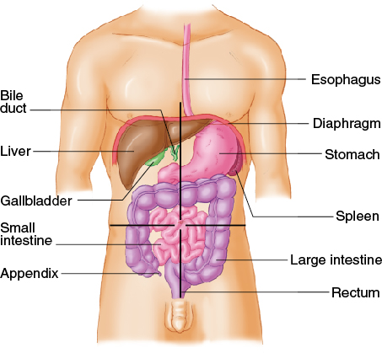
The Digestive System: Anatomy (2 of 4)
© Jones and Bartlett Publishers.
Notes:
This figure shows the main organs of the digestive system.

Slide 62
The Digestive System: Anatomy (3 of 4)
Mouth
Lips, cheeks, gums, teeth, tongue
Salivary glands
Oropharynx
Esophagus
Stomach
Pancreas
Notes:
Lecture Outline
2. Mouth
a. Consists of lips, cheeks, gums, teeth, and tongue
b. Salivary glands
3. Oropharynx
a. Tubular structure that extends from the back of the mouth to the esophagus and trachea
4. Esophagus
a. Collapsible tube about 10 inches long that extends from the end of the pharynx to the stomach
b. Muscles in the wall of the esophagus propel food to the stomach.
5. Stomach
a. Hollow organ in LUQ
b. Receives food, stores it, and provides for its movement into the bowel
6. Pancreas
a. Flat, solid organ that lies below and behind the liver and stomach
b. Contains two portions: exocrine and endocrine
i. The exocrine portion secretes pancreatic juice containing enzymes that aid in digestion of fat, starch, and protein.
ii. The endocrine portion (islets of Langerhans) produces insulin and glucagon.

Slide 63
The Digestive System: Anatomy (4 of 4)
Liver
Bile ducts
Small intestine
Large intestine
Appendix
Rectum
Notes:
Lecture Outline
7. Liver
a. Large, solid organ immediately beneath the diaphragm in the RUQ, extending into the LUQ
b. Functions of the liver:
i. Filtering harmful substances
ii. Forming the factors needed for blood clotting and normal plasma production
iii. Storing sugar or starch for immediate use by the body for energy
iv. Producing bile to assist with the digestion of fat
8. Small intestine
a. Major hollow organ of the abdomen
b. Produces enzymes and mucus to aid in digestion
c. Composed of the duodenum, jejunum, and ileum
9. Large intestine
a. Major hollow organ consisting of the cecum, colon, and rectum
b. The major function of the colon is to absorb the final 5–10% of digested food and water from the intestine to form solid stool.
10. Appendix
a. A 3- to 4-inch-long tube that opens into the cecum (first part of large intestine) in the RLQ of the abdomen
b. May easily become obstructed, inflamed, or infected (appendicitis)
11. Rectum
a. Large, hollow organ at the lowermost end of the colon adapted to hold quantities of feces until it is expelled
b. At its terminal end is the anus.

Slide 64
The Digestive System: Physiology
Enzymes are added to food.
By salivary glands, stomach, liver, pancreas, and small intestine
Enzymes convert food into basic sugars, fatty acids, amino acids.
Further processed by liver
Circulated via blood throughout the body
Notes:
Lecture Outline
XV. The Digestive System: Physiology
A. Digestion is a complicated chemical process.
1. Enzymes are added to food by the salivary glands, stomach, liver, pancreas, and small intestine.
2. They convert food into basic sugars, fatty acids, and amino acids.
3. These basic products of digestion are carried across the wall of the intestine to the liver and processed further and stored or transported to the heart.
4. Circulated via blood throughout the body

Slide 65
The Lymphatic System
Supports the circulatory system and immune system
Lymph is a thin, straw-colored fluid that carries oxygen and nutrients to cells and waste products away.
Helps to rid the body of toxins and other harmful materials
Notes:
Lecture Outline
XVI. The Lymphatic System: Anatomy and Physiology
A. Composed of the spleen, lymph nodes, lymph, lymph vessels, thymus gland, and other components
B. Supports the circulatory system and immune system
C. Lymph is a thin, straw-colored fluid that carries oxygen, nutrients, and hormones to the cells and waste products of metabolism away from the cells to be excreted.
1. Lymph vessels form a network throughout the body that serves as an auxiliary to the circulatory system.
2. Lymph nodes are tiny, oval-shaped structures that filter lymph.
3. They help rid the body of toxins and other harmful materials.

Slide 66
The Endocrine System: Anatomy and Physiology (1 of 2)
Complex message and control system
Integrates many body functions
Hormones are released directly into the bloodstream.
Each hormone has a specific effect on some organ, tissue, or process.
Notes:
Lecture Outline
XVII. The Endocrine System: Anatomy and Physiology
A. The endocrine system is a complex message and control system that integrates many body functions.
B. Endocrine glands release hormones directly into the bloodstream.
1. Each endocrine gland produces one or more hormones.
2. Each hormone has a specific effect on some organ, tissue, or process.

Slide 67
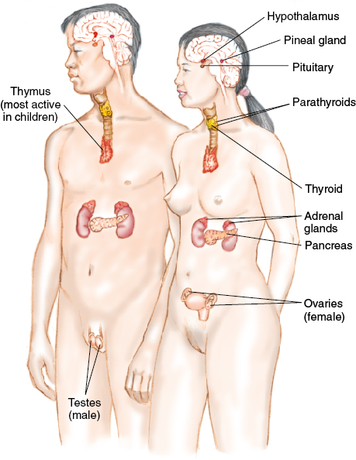
The Endocrine System: Anatomy and Physiology (2 of 2)
The brain controls the release of hormones.
Excesses or deficiencies in hormones can cause disease.
© Jones and Bartlett Publishers.
Notes:
Lecture Outline
C. The brain controls the release of hormones.
1. This tightly controlled communication system uses primary and secondary feedback loops to keep the body in balance.
D. Excesses or deficiencies in hormones can cause disease processes, such as diabetes.

Slide 68
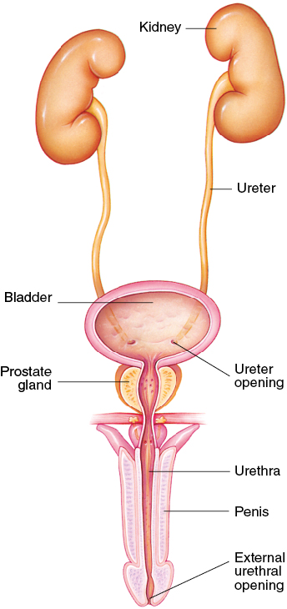
The Urinary System: Anatomy and Physiology
Controls fluid balance in the body
Filters and eliminates wastes
Controls pH balance
Kidneys, ureter, urinary bladder
© Jones and Bartlett Publishers.
Notes:
Lecture Outline
XVIII. The Urinary System: Anatomy and Physiology
A. The urinary system controls the discharge of certain waste materials filtered from the blood by the kidneys.
B. Functions of the urinary system:
1. Control fluid balance in the body
2. Filter and eliminate wastes
3. Control pH balance
C. The kidneys are two solid organs that lie in the retroperitoneal space.
1. Rid the blood of toxic waste products and control the balance of water and salt
2. A ureter passes from each kidney and drains into the urinary bladder.
D. The urinary bladder is located immediately behind the pubic symphysis in the pelvic cavity and empties to the outside of the body through the urethra.

Slide 69
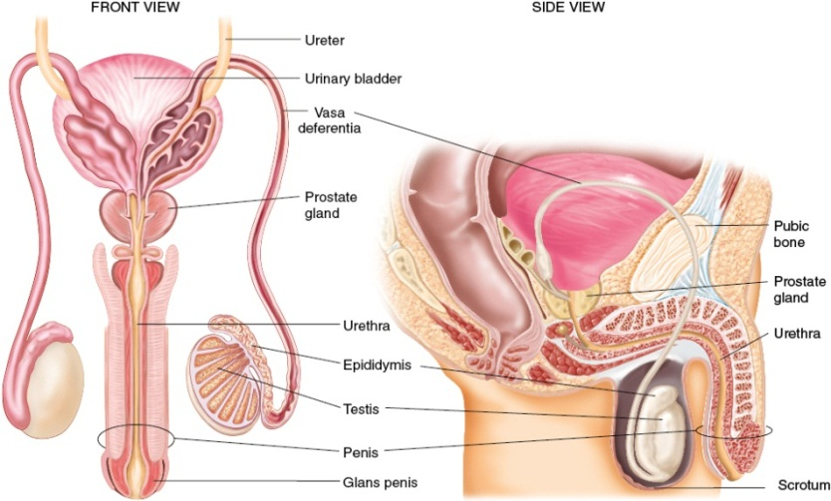
The Genital System: Anatomy and Physiology (1 of 2)
Controls reproductive processes
Male system:
Testicles
Epididymis
Vasa deferentia
Prostate gland
Seminal vesicles
Penis
© Jones and Bartlett Publishers.
Notes:
Lecture Outline
XIX. The Genital System: Anatomy and Physiology
A. The genital system controls the reproductive processes by which life is created.
B. The male reproductive system consists of the testicles, epididymis, vasa deferentia, prostate gland, seminal vesicles, and penis.
1. Lies outside the pelvic cavity (except for the prostate gland and seminal vesicles)

Slide 70
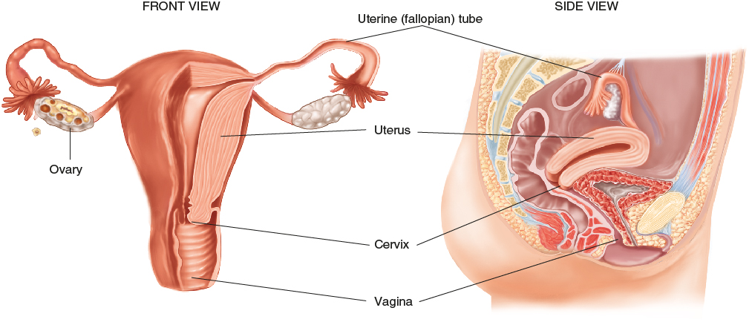
The Genital System: Anatomy and Physiology (2 of 2)
Female system:
Ovaries
Fallopian tubes
Uterus
Cervix
Vagina
© Jones and Bartlett Publishers.
Notes:
Lecture Outline
C. The female reproductive system consists of the ovaries, fallopian tubes, uterus, cervix, and vagina.
1. Contained entirely within the pelvic cavity (except the clitoris and labia)

Slide 71
Life Support Chain (1 of 2)
All cells in body require oxygen, nutrients, and removal of waste.
The respiratory and circulatory systems are the carriers of these supplies and wastes.
If interference occurs, cells become damaged and die.
Notes:
Lecture Outline
XX. Life Support Chain
A. Cells are the foundation of the human body.
1. All cells in the body require oxygen, nutrients, and removal of waste.
2. The respiratory and circulatory systems are the carriers of these supplies and wastes.
3. If interference occurs, cells become damaged and die.

Slide 72
Life Support Chain (2 of 2)
Cells use oxygen to turn nutrients into chemical energy through metabolism.
Adenosine triphosphate (ATP) is used to store energy.
Aerobic metabolism uses oxygen.
Cells switch to anaerobic metabolism when oxygen is limited.
Notes:
Lecture Outline
B. Cells use oxygen to take available nutrients and turn them into chemical energy through metabolism.
1. Adenosine triphosphate (ATP) is used to store energy.
2. Aerobic metabolism uses oxygen.
3. Cells switch to anaerobic metabolism when oxygen is limited.
4. Movement of oxygen, waste, and nutrients occurs by diffusion.

Slide 73
Pathophysiology (1 of 4)
The study of functional changes that occur when the body reacts to disease
Respiratory compromise can lead to:
Hypoxia
Hypercarbia
Notes:
Lecture Outline
XXI. Pathophysiology
A. Pathophysiology is the study of functional changes that occur when the body reacts to disease.
B. Respiratory compromise is the inability to move gas effectively.
1. Can lead to:
a. Hypoxia: decreased level of oxygen in the body
b. Hypercarbia: elevated level of carbon dioxide in the body

Slide 74
Pathophysiology (2 of 4)
Factors that impair ventilation:
Blocked airway
Impairment of the muscles of breathing
Physiologic obstruction of the airway (asthma)
Other factors
Notes:
Lecture Outline
2. Factors that impair ventilation:
a. Blocked airway
b. Impairment of the muscles of breathing
c. Physiologic obstruction of the airway (eg, asthma attack)
d. Numerous other factors

Slide 75
Pathophysiology (3 of 4)
Factors that impair respiration:
Change in atmosphere
High altitudes
Impaired movement of the gas across the cell membrane
Notes:
Lecture Outline
3. Factors that impair respiration:
a. Change in the atmosphere
b. High altitudes
c. Impaired movement of the gas across the cell membrane

Slide 76
Pathophysiology (4 of 4)
Effects of respiratory compromise on the body:
Oxygen levels fall and carbon dioxide levels rise.
Respiratory rate increases.
Blood becomes more acidic.
The brain sends commands to the body to breathe.
Notes:
Lecture Outline
C. Effects of respiratory compromise on the body
1. Oxygen levels throughout the body fall and carbon dioxide levels rise.
2. The brain detects an increase in carbon dioxide levels.
3. The body increases its respiratory rate in an attempt to return the carbon dioxide levels to normal.
4. If increased respiratory does not occur or is not effective in returning the carbon dioxide levels to normal, the blood will become more acidic.
5. Blood oxygen levels will begin to fall, which will cause the brain to issue further commands to breathe.

Slide 77
Shock (1 of 2)
Occurs when organs and tissue do not receive enough oxygen
Categorized into several types depending on the cause
Notes:
Lecture Outline
D. Shock
1. A condition in which organs and tissue receive an inadequate flow of blood and oxygen
2. Impaired oxygen delivery causes cellular hypoxia, which leads to anaerobic metabolism, lactic acid production, and organ dysfunction.
3. Shock is categorized into several types depending on the cause.

Slide 78
Shock (2 of 2)
Effects of shock on the body:
Level of oxygen supplied to tissues falls
Cells engage in anaerobic metabolism
Severe metabolic acidosis ensues
Baroreceptors initiate release of epinephrine and norepinephrine
Heart rate increases
Interstitial fluid moves into the capillaries
Notes:
Lecture Outline
E. The effects of shock on the body are similar to those of respiratory compromise.
1. The level of oxygen supplied to the tissues falls.
2. Cells engage in anaerobic metabolism, resulting in lactic acid production.
3. Severe metabolic acidosis ensues, leading to increased levels of carbon dioxide within the blood.
4. Baroreceptors detect decreased blood pressure and initiate the release of epinephrine and norepinephrine.
5. The heart rate increases, the heart beats more forcefully, and blood vessels constrict.
6. Interstitial fluid moves into the capillaries.

Slide 79
Impairment of Cellular Metabolism
Results in the inability to properly use oxygen and glucose at the cellular level
Cells create energy through anaerobic metabolism.
Can result in metabolic acidosis
Brain cells cannot use alternative fuels.
Cellular injury may become irreversible.
Notes:
Lecture Outline
F. Impairment of cellular metabolism results in the inability to properly use oxygen and glucose at the cellular level.
1. When there is inadequate oxygen, cells will create energy through anaerobic metabolism.
a. Can result in metabolic acidosis
b. Requires more energy than when using glucose for fuel
c. Decreases the blood’s ability to effectively carry oxygen to the cells
d. Decreases the functioning of oxygen within the cell
e. Brain cells cannot use alternative fuels.
i. If their supply of glucose decreases dramatically, brain cells will quickly become damaged or die.
f. Cellular injury, up to a point, may be repairable if normal tissue perfusion is restored.

Slide 80
Review
Which of the following are found in the retroperitoneal space?
Liver
Spleen
Kidneys
Stomach

Slide 81
Review
Answer: C
Rationale: The kidneys lie in the retroperitoneal space—the space behind the abdominal cavity. The spleen, liver, and stomach are all located within the anterior (true) abdomen.

Slide 82
Review
Which of the following are found in the retroperitoneal space?
Liver Rationale: The liver lies immediately beneath the diaphragm in the anterior abdomen.
Spleen Rationale: The spleen lies under the rib cage in the left upper quadrant of the abdominal cavity.
Kidneys Rationale: Correct answer
Stomach Rationale: The stomach lies in the left upper quadrant of the abdominal cavity.

Slide 83
Review
The cartilaginous tip of the sternum is called the:
costal arch.
manubrium.
angle of Louis.
xiphoid process.

Slide 84
Review
Answer: D
Rationale: The xiphoid process projects from the lower part of the sternum. It is made of cartilage and, relative to other parts of the sternum (eg, manubrium, angle of Louis), is soft to palpation.

Slide 85
Review
The cartilaginous tip of the sternum is called the:
costal arch. Rationale: This bridge of cartilage connects the ends of the 6th through 10th ribs to the lower sternum.
manubrium. Rationale: This is the upper section of the sternum, one of three parts.
angle of Louis. Rationale: This is found at the level where the second rib is attached to the sternum.
xiphoid process. Rationale: Correct answer

Slide 86
Review
A person with bilateral femur fractures has:
fractured one of his or her femurs.
fractured both of his or her femurs.
one femur fractured in two places.
fractured the lateral aspect of the femur.

Slide 87
Review
Answer: B
Rationale: The term bilateral refers to both sides of the body with reference to the midline. Therefore, bilateral femur fractures would indicate that both femurs are fractured.

Slide 88
Review
A person with bilateral femur fractures has
fractured one of his or her femurs. Rationale: Bilateral means two.
fractured both of his or her femurs. Rationale: Correct answer
one femur fractured in two places. Rationale: A bilateral fracture is one fracture that occurs in two bones.
fractured the lateral aspect of the femur. Rationale: This means that the outside portion of the femur is broken.

Slide 89
Review
The MOST prominent landmark on the anterior surface of the neck is the:
mastoid process.
cricoid cartilage.
thyroid cartilage.
cricothyroid membrane.

Slide 90
Review
Answer: C
Rationale: The thyroid cartilage, commonly referred to as the “Adam’s apple,” is the most prominent landmark on the anterior (front) surface of the neck. The cricoid cartilage is located directly inferior to (below) the thyroid cartilage; it is a less prominent landmark.

Slide 91
Review (1 of 2)
The MOST prominent landmark on the anterior surface of the neck is the:
mastoid process. Rationale: This is the prominent bony mass at the base of the skull.
cricoid cartilage. Rationale: This is the firm ridge of cartilage inferior (below) to the thyroid cartilage.

Slide 92
Review (2 of 2)
The MOST prominent landmark on the anterior surface of the neck is the:
thyroid cartilage. Rationale: Correct answer
cricothyroid membrane. Rationale: This is the thin sheet of connective tissue that joins the thyroid cartilage and the cricoid cartilage.

Slide 93
Review
Insulin is produced in the:
liver.
pancreas.
thyroid gland.
adrenal glands.

Slide 94
Review
Answer: B
Rationale: The pancreas is a solid organ that produces both insulin and digestive juices. Insulin is produced in the islets of Langerhans, which are a part of the pancreas.

Slide 95
Review
Insulin is produced in the:
liver. Rationale: The poisonous by-products of digestion are rendered harmless by the liver.
pancreas. Rationale: Correct answer
thyroid gland. Rationale: This gland is found in the neck over the larynx and regulates the body’s metabolism.
adrenal glands. Rationale: These glands are located in the kidneys and regulate salt levels, sugar levels, and sexual function.

Slide 96
Review
_____ connect muscles to bones.
Ligaments
Cartilage
Tendons
Joints

Slide 97
Review
Answer: C
Rationale: Tendons connect muscle to bone. Ligaments connect bone to bone. Cartilage is smooth connective tissue covering the ends of bones at mobile joints. Joints consist of the ends of the bones and the surrounding connecting and supporting tissues.

Slide 98
Review
_____ connect muscles to bones.
Ligaments Rationale: Connect bone to bone.
Cartilage Rationale: Cover ends of bones at joints.
Tendons Rationale: Correct answer
Joints Rationale: Occur where two long bones come in contact.

Slide 99
Review
The normal resting adult heart rate is:
50 to 70 beats/min.
60 to 100 beats/min.
80 to 110 beats/min.
110 to 120 beats/min.

Slide 100
Review
Answer: B
Rationale: The normal resting heart rate for an adult is 60 to 100 beats/min. Bradycardia exists when the adult heart rate is less than 60 beats/min, and tachycardia exists when it is greater than 100 beats/min.

Slide 101
Review
The normal resting adult heart rate is:
50 to 70 beats/min. Rationale: Less than 60 beats/min is bradycardia.
60 to 100 beats/min. Rationale: Correct answer
80 to 110 beats/min. Rationale: Normal is more than 100 beats/min.
110 to 120 beats/min. Rationale: More than 100 beats/min is tachycardia.

Slide 102
Review
The left atrium of the heart receives ___________ blood from the ___________.
oxygenated; lungs
deoxygenated; body
oxygenated; body
deoxygenated; lungs

Slide 103
Review
Answer: A
Rationale: The left atrium receives oxygenated blood from the lungs via the pulmonary veins. The right atrium receives deoxygenated blood from the body via the vena cavae.

Slide 104
Review (1 of 2)
The left atrium of the heart receives ___________ blood from the ___________.
oxygenated; lungs Rationale: Correct answer
deoxygenated; body Rationale: The right atrium of the heart receives deoxygenated blood from the body.

Slide 105
Review (2 of 2)
The left atrium of the heart receives ___________ blood from the ___________.
oxygenated; body Rationale: No part of the heart receives oxygenated blood from the body. It receives oxygenated blood only from the lungs.
deoxygenated; lungs Rationale: The right atrium and right ventricle are the only parts of the heart that receive deoxygenated blood from the body.

Slide 106
Review
The largest part of the brain is the:
cerebrum.
brain stem.
cerebellum.
foramen magnum.

Slide 107
Review
Answer: A
Rationale: The three major parts of the brain are the cerebrum, the brain stem, and the cerebellum. The largest part of the brain is the cerebrum, which is sometimes called the “gray matter.” The cerebellum—sometimes called the “athlete’s brain”—is the smallest part of the brain. The brain stem is responsible for vital functions such as heart rate, breathing, and blood pressure. The foramen magnum is the large opening at the base of the skull through which the spinal cord passes.

Slide 108
Review
The largest part of the brain is the:
cerebrum. Rationale: Correct answer
brain stem. Rationale: This bottom portion of the brain is responsible for vital functions, heart rate, breathing, and blood pressure.
cerebellum. Rationale: This smallest part of brain is sometimes called the athlete’s brain.
foramen magnum. Rationale: The spinal cord passes through this large opening at the base of the skull.

Slide 109
Review
Which of the following statements about red blood cells is FALSE?
They contain iron.
They carry oxygen.
They help to fight infection.
They give color to the blood.

Slide 110
Review
Answer: C
Rationale: The hemoglobin molecules in red blood cells contain iron, give color to the blood, and carry oxygen. White blood cells play a role in helping the body to fight infection.

Slide 111
Review
Which of the following statements about red blood cells is FALSE?
They contain iron. Rationale: True; hemoglobin found in red blood cells carries iron.
They carry oxygen. Rationale: True; hemoglobin found in red blood cells carries oxygen.
They help to fight infection. Rationale: Correct answer
They give color to the blood. Rationale: True; hemoglobin found in red blood cells gives blood color.

