Slide 1
Chapter 7
Life Span Development
Notes:
Chapter 7: Life Span Development

Slide 2
National EMS Education Standard Competencies (1 of 2)
Preparatory
Applies fundamental knowledge of the emergency medical services (EMS) system; safety/well-being of the emergency medical technician (EMT), medical/legal, and ethical issues to the provision of emergency care.
Notes:
National EMS Education Standard Competencies
Preparatory
Applies fundamental knowledge of the emergency medical services (EMS) system, safety/well-being of the emergency medical technician (EMT), medical/legal, and ethical issues to the provision of emergency care.

Slide 3
National EMS Education Standard Competencies (2 of 2)
Life Span Development
Applies fundamental knowledge of life span development to patient assessment and management.
Notes:
National EMS Education Standard Competencies
Life Span Development
Applies fundamental knowledge of life span development to patient assessment and management.

Slide 4
Introduction
Humans develop throughout their lives.
EMTs must be aware of the physical changes a person undergoes at various stages of life.
May affect the approach to patient care
Notes:
Lecture Outline
I. Introduction
A. Humans develop throughout their lives.
1. Newborns and infants
2. Toddlers and preschoolers
3. School-age children
4. Adolescents
5. Three stages of adulthood: early, middle, and older
B. EMTs must be aware of the physical changes a person undergoes at various stages of life.
1. They may alter the approach to patient care.

Slide 5
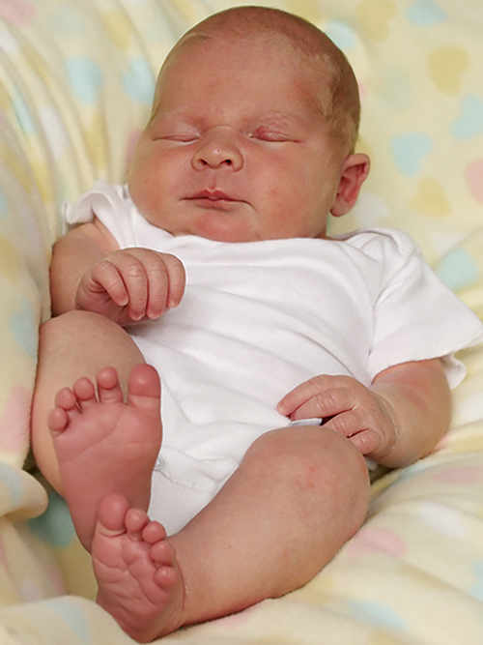
Neonates & Infants (1 of 10)
Neonates
Birth to 1 month
Infants
1 month to 1 year
Develop at a startling rate
© Johanna Goodyear/ShutterStock.
Notes:
Lecture Outline
II. Neonates and Infants
A. Infants (ages 1 month to 1 year) develop at a startling rate.
B. Neonates (birth to 1 month) are covered in Chapter 33, “Obstetrics and Neonatal Care.”
1. The leading cause of death for this age group is congenital abnormalities, according to the Centers for Disease Control and Prevention.

Slide 6
Neonates & Infants (2 of 10)
Vital signs
At birth, pulse rate is 90 to 180 beats/min and respiratory rate is 30 to 60 breaths/min
Shortly after birth, pulse rate drops to 100 to 160 beats/min and respiratory rate slows to 25 to 50 breaths/min.
By 1 year, respiratory rate slows to 20 to 30 breaths/min.
Notes:
Lecture Outline
C. Physical changes
1. Vital signs
a. The younger the person, the faster the pulse rate and respirations.
i. At birth, a pulse rate of 90 to 180 beats/min and a respiratory rate of 30 to 60 breaths/min are normal.
ii. Shortly after birth, the pulse often drops to 120 beats/min and the respiratory rate falls to between 30 to 40 breaths/min.
iii. By 1 year, the respiratory rate slows to 20 to 30 breaths/min.

Slide 7
Neonates & Infants (3 of 10)
Blood pressure
Directly corresponds to the patient’s weight
Typically increases with weight
Weight
Neonate weighs 6 to 8 lb (3 to 3.5 kg) at birth.
Growth of about 1 oz per day
Weight triples by the end of the first year
Notes:
Lecture Outline
b. Blood pressure directly corresponds to the patient’s weight, so it typically increases with age.
i. The average systolic blood pressure is 50 to 70 mm Hg for a neonate, and 70 to 95 mm Hg for a 1-year-old.
2. Weight
a. A neonate usually weighs 6 to 8 lb (3 to 3.5 kg) at birth.
b. The head accounts for 25% of its body weight.
c. After week 2, infants grow at a rate of about 1 oz (30 g) per day, doubling their weight by 4 to 6 months and tripling it by the end of the first year.

Slide 8
Neonates & Infants (4 of 10)
Cardiovascular system
At birth, neonate makes transition from fetal to independent circulation.
Pulmonary system
Infants younger than 6 months are prone to nasal congestion.
Infants have larger tongues and shorter, narrower airways, so airway obstruction is more common than in older children or adults.
Notes:
Lecture Outline
3. Cardiovascular system
a. At birth, the neonate makes the transition from fetal to independent circulation.
4. Pulmonary system
a. Infants younger than 6 months are particularly prone to nasal congestion.
b. The rib cage is less rigid and the ribs sit horizontally.
i. Explains diaphragmatic breathing in infants
c. Infants have proportionately larger tongues and proportionally shorter, narrower airways.
i. Airway obstruction is more common in infants than older children or adults.
d. For bag-mask ventilation, remember that an infant’s lungs are fragile. Too forceful ventilations can result in trauma from pressure, or barotrauma.
e. Respiratory problems can quickly become life threatening.
i. Infants who are struggling to breathe can quickly tire, become overheated, and even become dehydrated.

Slide 9
Neonates & Infants (5 of 10)
Nervous system
Evolution continues after birth
Moro reflex: neonate opens arms wide, spreads fingers, and seems to grab at things
Palmar grasp: occurs when an object is placed into the neonate’s palm
Rooting reflex: neonate instinctively turns head when something touches its cheek
Sucking reflex: Occurs when a neonate’s lips are stroked
Notes:
Lecture Outline
5. Nervous system
a. The nervous system’s evolution continues after birth.
b. A neonate is born with certain reflexes.
i. Moro reflex (startle reflex): when a neonate is caught off guard, it opens its arms wide, spreads its fingers, and seems to grab at things.
ii. Palmar grasp: occurs when an object is placed into the neonate’s palm
iii. Rooting reflex: when something touches a neonate’s cheek, it will turn its head toward the touch.
iv. Sucking reflex: occurs when a neonate’s lips are stroked

Slide 10
Neonates & Infants (6 of 10)
Fontanelles
Spaces between the bones that eventually fuse to form the skull
Posterior fontanelle fuses by 3 months.
Anterior fontanelle fuses between age 9 and 18 months.
Infant’s immune system maintains some of the mother’s immunities.
Notes:
Lecture Outline
c. A neonate’s fontanelles allow the head to be molded.
i. Spaces between the bones that eventually fuse to form the skull
ii. The posterior fontanelle fuses by 3 months.
iii. The anterior fontanelle fuses between 9 and 18 months of age.
iv. If either of the fontanelles is depressed, the infant is most likely dehydrated.
v. A bulging fontanelle is indicative of increased intracranial pressure.
6. Immune system
a. Infants maintain some of the mother’s immunities.
b. Infants can also receive antibodies via breastfeeding, further bolstering their immune system.

Slide 11
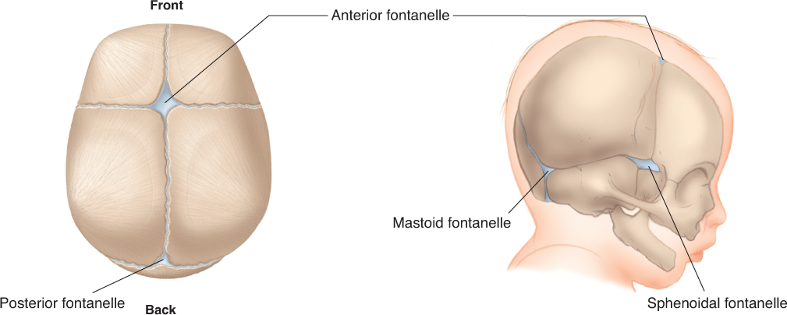
Neonates & Infants (7 of 10)
© Jones & Bartlett Learning.
Notes:
This figure shows the fontanelles on an infant’s head.

Slide 12
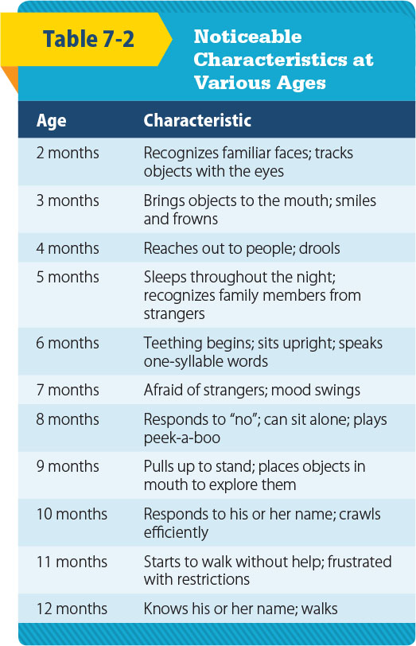
Neonates & Infants (8 of 10)
Psychosocial changes
Begin at birth and evolve as the infant interacts with the environment
© Jones & Bartlett Learning.
Notes:
Lecture Outline
D. Psychosocial changes
1. Begin at birth and evolve as the infant interacts with, and reacts to, the environment

Slide 13
Neonates & Infants (9 of 10)
Psychosocial changes (cont’d)
Crying is the main method of communicating distress.
Infants develop relationships with their parents or caregivers at different rates.
Notes:
Lecture Outline
2. Crying is the main method of communicating distress.
a. Parents can often tell what is wrong just by the tone of their infant’s crying.
3. Infants develop relationships with their parents or caregivers at different rates.

Slide 14
Neonates & Infants (10 of 10)
Psychosocial changes (cont’d)
Bonding is based on a secure attachment.
Anxious-avoidant attachment is found in infants who are repeatedly rejected.
Separation anxiety is common in older infants.
Trust and mistrust involves an infant’s needs being met.
Notes:
Lecture Outline
a. Bonding, or the formation of a close, personal relationship, is based on a secure attachment.
i. A secure attachment occurs when an infant understands that parents or caregivers will be responsive to his or her needs.
4. Anxious-avoidant attachment is found in infants who are repeatedly rejected.
a. Children show little emotional response to their parents or caregivers and treat them as they would strangers.
5. Separation anxiety is common in older infants.
a. It involves clingy behavior and fear of unfamiliar places and people.
6. Trust and mistrust refers to a stage of development from birth to about 18 months, which involves an infant’s needs being met by his or her parents or caregivers.
a. If the environment is not perceived as secure by the infant, a sense of mistrust will develop.

Slide 15
Toddlers and Preschoolers (1 of 4)
Toddlers (1 to 3 years)
Pulse: 90 to 150 beats/min
Respiratory rate: 20 to 30 breaths/min
Systolic blood pressure: 80 to 100 mm Hg
Temperature: 96.8°F to 99.6°F
© EML/ShutterStock.
Notes:
Lecture Outline
III. Toddlers and Preschoolers
A. Physical changes
1. Toddlers (ages 1 to 3 years)
a. Pulse rate is normally 90 to 150 beats/min.
b. Respiratory rate is 20 to 30 breaths/min.
c. Systolic blood pressure is 80 to 100 mm Hg.
d. Average temperature is 96.8°F (36° C) to 99.6°F (38° C).
e. A toddler’s lungs continue to develop more terminal bronchioles and alveoli.

Slide 16
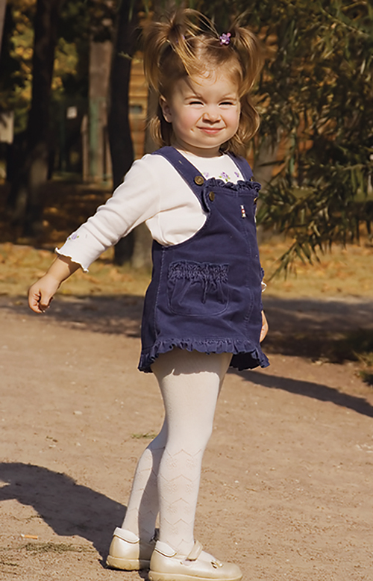
Toddlers and Preschoolers (2 of 4)
Preschoolers (3 to 6 years)
Pulse: 80 to 140 beats/min
Respiratory rate: 20 to 25 breaths/min
Systolic blood pressure: 80 to 100 mm Hg
© Maxim Bolotnikov/ShutterStock.
Notes:
Lecture Outline
2. Preschoolers (ages 3 to 6 years)
a. Pulse rate is 80 to 140 beats/min.
b. Respiratory rate is 20 to 25 breaths/min.
c. Systolic blood pressure is 80 to 100 mm Hg.

Slide 17
Toddlers and Preschoolers (3 of 4)
Preschoolers (cont’d)
Weight gain should level off.
Passive immunity is lost.
Toddlers acquire immunity as their bodies are exposed to various viruses and germs.
Neuromuscular growth also makes considerable progress at this age.
Average age for completion of toilet training is 28 months.
Notes:
Lecture Outline
d. Weight gain should level off.
e. Although toddlers and preschoolers have more lung tissue, they do not have well-developed lung musculature.
i. Prevents them from sustaining deep or rapid respirations for an extended period of time
3. The loss of passive immunity is possibly the most obvious development at this stage of human life.
a. Colds often develop that may manifest as gastrointestinal distress or upper respiratory tract infections.
b. Toddlers acquire immunity as their bodies are exposed to various viruses and germs.
4. Neuromuscular growth also makes considerable progress at this age.
a. Toddlers and preschoolers spend time exploring by walking, running, jumping, and playing catch.
b. Preschoolers will have a brain that weighs 90% of its final adult weight.
c. Muscle mass and bone density increase.
5. Physiologically, toddlers have the neuromuscular control capable for bladder control by 12 to 15 months of age.
a. However, the child may not be psychologically ready until 18 to 30 months of age.
b. The average age for completion of toilet training is 28 months of age.
6. The leading cause of death for this age group is unintentional injuries (accidents).

Slide 18
Toddlers and Preschoolers (4 of 4)
Psychosocial changes
Learn to speak and express themselves
Master basic language
Interact and play games with other children
Begin to understand cause and effect
Learn to recognize gender differences by observing role models
Notes:
Lecture Outline
B. Psychosocial changes
1. Toddlers or preschoolers learn to speak and express themselves.
2. At 36 months of age, basic language is mastered.
3. Interaction and playing games with other children begin.
4. By 18 to 24 months, cause and effect begin to become understood.
6. Children learn to recognize gender differences by observing role models.

Slide 19
School-Age Children (1 of 3)
6 to 12 years
Vital signs approach those in adulthood.
Pulse: 70 to 120 beats/min
Respiration rate: 15 to 20 breaths/min
Systolic blood pressure: 80 to 110 mm Hg
© Trout55/ShutterStock.
Notes:
Lecture Outline
IV. School-Age Children
A. Physical changes
1. From ages 6 to 12 years, a school-age child’s vital signs and body gradually approach those observed in adulthood.
a. Pulse rate is approximately 70 to 120 beats/min.
b. Respiratory rate is 15 to 20 breaths/min.
c. Blood pressure is 80 to 110 mm Hg.

Slide 20
School-Age Children (2 of 3)
Obvious physical traits and body function changes become apparent.
Growth of 4 lb and 2.5″ each year
Permanent teeth come in.
Brain activity increases in both hemispheres.
Notes:
Lecture Outline
2. Obvious physical traits and body function changes become apparent.
a. Growth of 4 lb (2 kg) and 2.5" (6 cm) each year
3. Permanent teeth come in.
4. Brain activity increases in both hemispheres.
5. Unintentional injuries are the leading cause of death in this age group.

Slide 21
School-Age Children (3 of 3)
Psychosocial changes
Preconventional reasoning: children act to avoid punishment and get what they want
Conventional reasoning: children look for approval from peers and society
Postconventional reasoning: children make decisions guided by their conscience.
Self-concept and self-esteem develop.
Notes:
Lecture Outline
B. Psychosocial changes
1. Children learn various types of reasoning.
a. Preconventional reasoning: children act almost purely to avoid punishment and get what they want.
b. Conventional reasoning: children look for approval from their peers and society.
c. Postconventional reasoning: children make decisions guided by their conscience.
2. Children begin to develop their self-concept and self-esteem.
a. Self-concept is our perception of ourselves.
b. Self-esteem is how we feel about ourselves and how we “fit in” with our peers.

Slide 22
Adolescents (Teenagers) (1 of 4)
12 to 18 years
Vital signs level off.
Pulse: 60 to 100 beats/min
Respirations: 12 to 20 breaths/min
Systolic blood pressure: 90 to 110 mm Hg
© Jamie Wilson/ShutterStock.
Notes:
Lecture Outline
V. Adolescents (Teenagers)
A. Physical changes
1. In adolescents (ages 12 to 18 years), vital signs begin to level off within the adult ranges.
a. Pulse rate is 60 to 100 beats/min.
b. Respiratory rate is 12 to 20 breaths/min.
c. Systolic blood pressure is between 90 and 110 mm Hg.

Slide 23
Adolescents (Teenagers) (2 of 4)
2- to 3-year growth spurt
Girls finish by 16 years; boys by 18 years.
Reproductive system matures.
Secondary sexual development takes place.
Voices start to change.
Menstruation begins.
Acne can occur.
Notes:
Lecture Outline
2. Adolescents experience a 2- to 3-year growth spurt (an increase in muscle and bone growth) and body changes.
a. Growth begins with hands and feet, then moves to the long bones of the extremities, and finishes with growth of the torso.
b. Girls generally finish their growth spurt by 16 years and boys by 18 years.
i. When this growth spurt finishes, boys are generally taller and stronger than girls.
ii. Muscle mass and bone density are nearly at adult levels.
3. The reproductive system matures.
a. Secondary sexual development takes place.
i. The external sex organs enlarge.
ii. Pubic hair and axillary hair begin to appear.
iii. Voices start to change.
iv. In girls, the breasts and thighs increase in size as fat tissue is deposited there.
v. Menstruation begins.
b. By the middle of adolescence, boys are able to produce sperm and eggs begin to develop in girls.
i. Acne can also occur due to hormonal changes.
4. Unintentional injuries are the leading cause of death for adolescents.

Slide 24
Adolescents (Teenagers) (3 of 4)
Psychosocial changes
Adolescents and their families often deal with conflict.
Privacy becomes an issue.
Self-consciousness increases.
Adolescents may struggle to create their own identity.
Notes:
Lecture Outline
B. Psychosocial changes
1. Adolescents and their families often deal with conflict as adolescents try to gain control of their lives from their parents.
a. Privacy becomes an issue.
b. Self-consciousness increases.
2. Adolescents may struggle to create their own identity.
3. They often want to be treated like adults, yet cared for like younger children.

Slide 25
Adolescents (Teenagers) (4 of 4)
Psychosocial changes (cont’d)
Antisocial behavior and peer pressure peak at age 14 to 16 years.
Smoking, illicit drug use, unprotected sex
Eating disorders
Code of ethics develops.
High risk of suicide and depression
Notes:
Lecture Outline
4. Antisocial behavior and peer pressure tend to peak at age 14 to 16 years.
a. Smoking, illicit drug use, and unprotected sex are problems that may arise.
b. Eating disorders can arise in adolescents from an attempt to gain self-control through what they eat.
5. Adolescents may show a greater interest in sexual relations.
a. A code of personal ethics develops, based partly on parents’ ethics and values and partly on the influence of the adolescent’s environment.
b. Many adolescents are fixated on their public image and are terri­fied of being embarrassed.
c. Adolescents are at a higher risk than other populations for suicide and depression.

Slide 26
Early Adults (1 of 2)
19 to 40 years
Vital signs do not vary greatly.
Pulse: 60 to 100 beats/min
Respiratory rate: 12 to 20 breaths/min
Systolic blood pressure: 90 to 140 mm Hg
© Rubberball Productions.
Notes:
Lecture Outline
VI. Early Adults
A. Early adults range in age from 19 to 40 years.
B. Physical changes
1. Their vital signs do not vary greatly from those seen through adulthood.
a. Pulse rate will average around 70 beats/min and range between 60 and 100 beats/min.
b. Respiratory rate will stay in the range of 12 to 20 breaths/min.
c. Systolic blood pressure will be between 90 and 140 mm Hg.

Slide 27
Early Adults (2 of 2)
From age 19 to 25 years, the body should be functioning at its optimal level.
Lifelong habits are solidified.
Psychosocial changes
Life centers on work, family, and stress.
Settling down, marriage, and family
One of the more stable periods of life
Notes:
Lecture Outline
2. From age 19 years to shortly after 25 years, the body should be functioning at its optimal level.
a. Lifelong habits are solidified.
b. The body is working at peak efficiency, but, as early adulthood continues, subtle erosion begins.
i. Disks in the spine begin to settle, and height sometimes “shrinks.”
ii. Fatty tissue and weight increase.
iii. Muscle strength decreases, and reflexes slow.
C. Psychosocial changes
1. Life centers on work, family, and stress.
2. During this period, adults strive to create a place for themselves in the world, and many do everything they can to “settle down.”
a. Along with this comes marriage and family.
3. Despite all of this stress and change, this is one of the more stable periods of life.

Slide 28
Middle Adults (1 of 3)
41 to 60 years
Vital signs remain the same.
Pulse: 60 to 100 beats/min
Respiratory rate: 12 to 20 breaths/min
Systolic blood pressure: 90 to 140 mm Hg
© Photodisc.
Notes:
Lecture Outline
VII. Middle Adults
A. Middle adults are ages 41 to 60 years.
B. Physical changes
1. Vital signs remain the same.
a. Average pulse rate remains 70 beats/min, with a range between 60 and 100 beats/min.
b. Respiratory rate continues at 12 to 20 breaths/min.
c. Blood pressure remains between 90 and 140 mm Hg.

Slide 29
Middle Adults (2 of 3)
Vulnerable to vision and hearing loss
Cancer incidence increases.
Menopause occurs in late 40s or early 50s.
Diabetes, hypertension, and weight problems are common.
Exercise and healthy diet can diminish the effects of aging.
Notes:
Lecture Outline
2. Middle adults are vulnerable to vision and hearing loss.
3. Cardiovascular health becomes an issue.
4. Cancer incidence increases.
5. Menopause takes place in the late 40s or early 50s.
6. Diabetes, hypertension, and weight problems are common.
7. Exercise and a healthy diet can diminish the effects of aging.
8. Unintentional injuries are the leading cause of death in ages 41 to 44 years; cancer is the leading cause of death in ages 45 to 60 years.

Slide 30
Middle Adults (3 of 3)
Psychosocial changes
Focus on achieving life goals
Readjust lifestyle as children leave home
Generally have the physical, emotional, and spiritual reserves to handle life’s issues
May be caring for both children leaving for college and aging parents
Notes:
Lecture Outline
C. Psychosocial changes
1. Focus is on achieving life goals
2. Middle adults must readjust their lifestyle as children leave home.
3. Finances become a worrisome issue.
4. Generally, people of this age have the physical, emotional, and spiritual reserves to handle life’s issues.
5. Middle adults may find themselves caring for children leaving for college and caring for their aging parents as well.

Slide 31
Older Adults (1 of 15)
61 years and older
Life expectancy is constantly changing.
Now approximately 78 years
© Photodisc.
Notes:
Lecture Outline
VIII. Older Adults
A. Older adults include those ages 61 years and up.
B. Physical changes
1. Life expectancy is constantly changing.
a. In the early 1900s, life expectancy was 47 years.
b. It is now approximately 78 years.
c. The age to which a person will live is based on many factors, including:
i. Year of birth and country in which the person lives
ii. Public heath advances, changes within diets, attitudes regarding exercise, advances in and access to medical care, and personal behaviors
d. Cancer is the leading cause of death in ages 61 to 65 years; heart disease is the leading cause of death in ages 65 years and older.

Slide 32
Older Adults (2 of 15)
Vital signs depend on the patient’s:
Overall health
Medical conditions
Medications taken
Older adults are often able to overcome numerous medical problems but may need multiple medications.
Notes:
Lecture Outline
2. Vital signs depend on the patient’s:
a. Overall health
b. Medical conditions
c. Medications taken
3. Older adults are often able to overcome numerous medical problems but may need multiple medications.

Slide 33
Older Adults (3 of 15)
Cardiovascular system
Declines with age largely due to atherosclerosis
Heart rate and cardiac output decrease.
Vascular system becomes stiff.
Ability to produce replacement blood cells declines, as does blood volume.
Notes:
Lecture Outline
4. Cardiovascular system
a. Cardiac function declines with age largely due to atherosclerosis.
i. Cholesterol and calcium build up inside the walls of blood vessels, forming plaque.
ii. Accumulation of plaque eventually leads to partial or complete blockage of blood flow.
iii. More than 60% of people older than 65 years have atherosclerotic disease.
b. Heart rate and cardiac output decrease.
i. Cardiac output can no longer meet the demands of the body.
c. The vascular system becomes stiff.
i. Diastolic blood pressure increases with age.
ii. The heart must work harder to move the blood effectively.
d. The ability to produce replacement blood cells declines, as does the blood volume.

Slide 34
Older Adults (4 of 15)
Respiratory system
Size of airway increases.
Surface area of alveoli decreases.
Natural elasticity of the lungs decreases.
Intercostal muscles are used more to breathe.
Breathing becomes more labor intensive.
Notes:
Lecture Outline
5. Respiratory system
a. The size of the airway increases and the surface area of the alveoli decreases.
b. The natural elasticity of the lungs also decreases.
i. Intercostal muscles are used more to breathe.
ii. Breathing becomes more labor intensive.
c. The changes in the respiratory system are often gradual and go unnoticed until a severe, life-threatening condition occurs.
d. Within the mouth and nose, there is a gradual loss of the mechanisms that protect the upper airway.
i. This leads to a decreased ability to clear secretions as well as decreased cough and gag reflexes.

Slide 35
Older Adults (5 of 15)
Respiratory system (cont’d)
Aspiration and obstruction become more likely.
By age 75 years, vital capacity may amount to only 50% of a young adult’s vital capacity.
Loss of respiratory muscle mass
Increased stiffness of the thoracic cage
Decreased surface area available for the exchange of air
Residual volume increases.
Notes:
Lecture Outline
ii. Aspiration and obstruction become more likely.
e. As the smooth muscles of the lower airway weaken with age, strong inhalation can make the walls of the airway collapse inward and cause inspiratory wheezing.
i. The cells of the immune system are less functional.
f. By age 75 years, the vital capacity may amount to only 50% of the vital capacity of a young adult. Factors include:
i. Loss of respiratory muscle mass
ii. Increased stiffness of the thoracic cage
iii. Decreased surface area available for the exchange of air
g. Residual volume increases with age.
i. A lifetime of breathing, especially breathing air with high levels of pollution, causes the accumulation of pollutants in the lungs.

Slide 36
Older Adults (6 of 15)
Endocrine system
Insulin production drops off.
Metabolism decreases.
People tend to slow down their physical activity but do not decrease their food intake.
The reproductive system changes to some extent.
Notes:
Lecture Outline
6. Endocrine system
a. Insulin production drops off and metabolism decreases.
b. People tend to slow down their physical activity.
i. But they tend not to decrease their food intake.
ii. The pancreas may not be able to produce enough insulin for the person’s body size, which can lead to diabetes mellitus.
c. The reproductive system changes to some extent.

Slide 37
Older Adults (7 of 15)
Endocrine system (cont’d)
Men are able to produce sperm, but the rigidity of their penis decreases over time.
Women have a decrease in the size of their uterus and vagina.
Hormone production for both sexes gradually decreases.
Sexual desire may diminish but does not cease.
Notes:
Lecture Outline
i. Men are able to produce sperm long into their 80s, but the rigidity of the penis tends to decrease over time.
ii. Women have a decrease in the size of their uterus and vagina.
iii. Hormone production for both sexes gradually decreases as they age.
iv. Sexual desire may diminish with age but does not cease.

Slide 38
Older Adults (8 of 15)
Digestive system
Taste sensations decrease.
Saliva secretion decreases.
Ability of the intestines to contract and move food diminishes.
Gallstones become increasingly common.
Anal sphincter changes can produce fecal incontinence.
Notes:
Lecture Outline
7. Digestive system
a. Changes in gastric and intestinal function may inhibit nutritional intake and utilization in older adults.
i. Taste sensations decrease.
b. Saliva secretion decreases, and this reduces the body’s ability to process complex carbohydrates.
c. The ability of the intestines to contract and move food diminishes.
d. Gastric acid secretion diminishes.
e. Gallstones become increasingly common.
f. Anal sphincter changes can produce fecal incontinence.

Slide 39
Older Adults (9 of 15)
Renal system
Filtration function declines.
Kidney mass decreases by 20%.
Decreased ability to clear wastes from the body
Decreased ability to conserve fluids when needed
Notes:
Lecture Outline
8. Renal systems
a. The filtration function declines by 50% from age 20 to 90 years.
b. Kidney mass decreases 20% over the same span.
i. Due in part to the decreased effectiveness of the blood vessels that supply blood to the nephrons
c. There is a decreased ability to clear wastes from the body.
d. There is a decreased ability to conserve fluids when needed.

Slide 40
Older Adults (10 of 15)
Nervous system
Motor and sensory neural networks become slower.
Neurons are lost but there is no loss of knowledge or skill.
Sleep patterns change.
Notes:
Lecture Outline
9. Nervous system
a. In the central nervous system, the brain weight may shrink 10% to 20% by age 80 years.
i. Motor and sensory neural networks become slower.
b. Neurons are lost.
i. But there is not a loss of knowledge or skill.
ii. Sleep patterns change.

Slide 41
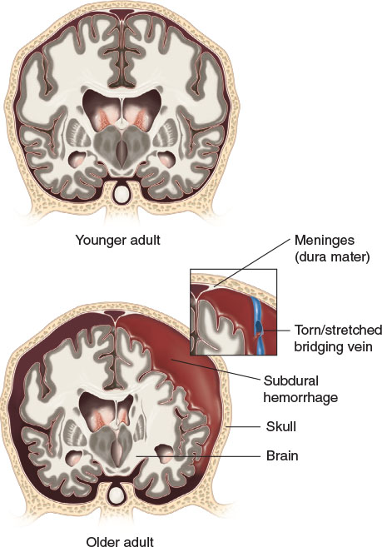
Older Adults (11 of 15)
Nervous system (cont’d)
Age-related shrinkage creates a void between the brain and the outermost layer of the meninges.
© Jones & Bartlett Learning.
Notes:
Lecture Outline
c. In younger adults, the brain, which is surrounded by the meninges, takes up almost all of the space in the skull.
i. Age-related shrinkage creates a void between the brain and the outermost layer of the meninges, which provides room for the brain to move when stressed.

Slide 42
Older Adults (12 of 15)
Nervous system (cont’d)
Peripheral nerve sensation is diminished.
Increased reaction times cause longer delays between stimulation and motion.
Slowdown in reflexes and decreased kinesthetic sense may contribute to falls and trauma.
Notes:
Lecture Outline
d. Peripheral nerve sensation is diminished.
i. Increased reaction times cause longer delays between stimulation and motion.
ii. The resulting slowdown in reflexes and decreased kinesthetic sense may contribute to the incidence of falls and trauma.

Slide 43
Older Adults (13 of 15)
Sensory changes
Most older adults can see and hear well.
May need glasses or hearing aids
Visual distortions are common.
Hearing loss is four times more common than vision loss.
Notes:
Lecture Outline
10. Sensory changes
a. Most older adults can see and hear well.
i. They may need glasses or hearing aids.
ii. It is wrong to assume that older patients are blind or deaf.
iii. Visual distortions are common.
b. Hearing loss is four times more common than vision loss.

Slide 44
Older Adults (14 of 15)
Psychosocial changes
Until about 5 years before death, most people retain high brain function.
Statistics indicate that 95% of the elderly live at home.
Financial limits may restrict access to health care or medications.
Notes:
Lecture Outline
C. Psychosocial changes
1. Until about 5 years before death, most people retain high brain function.
a. In the 5 years preceding death, mental function is presumed to decline, a theory referred to as the terminal drop hypothesis.
2. As the elderly population continues to grow, we have the responsibility to accommodate their needs during their last 20 to 40 years of life.
a. Statistics indicate that 95% of the elderly live at home.
b. The increasing number of elderly in the United States as a result of the baby boom of the 1940s to 1960s has produced a need for additional assisted living facilities.
3. Financial limits may restrict access to health care or medications.

Slide 45
Older Adults (15 of 15)
Psychosocial changes (cont’d)
More than 50% of all single women in the United States who are 60 years of age or older are living at or below the poverty line.
Elderly need to face their own mortality.
Isolation and depression can be challenges.
Notes:
Lecture Outline
a. Today, more than 50% of all single women in the United States who are 60 years of age or older are living at or below the poverty level.
4. One of the important issues that the elderly need to face is their own mortality.
a. Isolation and depression can be challenges.

Slide 46
Review
When providing bag-mask ventilations to an infant, what is most important to remember?
Blood pressure typically increases with age.
An infant’s lungs are fragile.
An infant grows at a rate of about 30 g per day.
An infant has a proportionately larger tongue than an adult.

Slide 47
Review
Answer: B
Rationale: It is important to remember that an infant’s lungs are fragile; ventilations that are too forceful can result in trauma from pressure, or barotrauma. Due to the large size of the infant’s occiput and the increased flexibility of the trachea, the airway can easily be inadvertently occluded by incorrect positioning, either overextension or overflexion.

Slide 48
Review
When providing bag-mask ventilations to an infant, what is most important to remember?
Blood pressure typically increases with age. Rationale: This is not crucial information when giving ventilations.
An infant’s lungs are fragile. Rationale: Correct answer

Slide 49
Review
When providing bag-mask ventilations to an infant, what is most important to remember?
An infant grows at a rate of about 30 g per day. Rationale: This is not crucial information when giving ventilations.
An infant has a proportionately larger tongue than an adult. Rationale: The large tongue could occlude the airway, but it is more important to remember the fragility of the lungs.

Slide 50
Review
You see an infant capable of reaching out to people and drooling. She is most likely:
2 months of age.
3 months of age.
4 months of age.
5 months of age.

Slide 51
Review
Answer: C
Rationale: An infant’s psychosocial development begins at birth and continues to evolve as the infant interacts with, and reacts to, the environment. At 4 months of age, an infant is likely to start reaching out to people and drooling.

Slide 52
Review
You see an infant capable of reaching out to people and drooling. She is most likely:
2 months of age. Rationale: Psychosocial development at this age involves recognizing familiar faces.
3 months of age. Rationale: Psychosocial development involves bringing objects to the mouth.

Slide 53
Review
You see an infant capable of reaching out to people and drooling. She is most likely:
4 months of age. Rationale: Correct answer
5 months of age. Rationale: Psychosocial development involves sleeping through the night.

Slide 54
Review
An infant who is repeatedly rejected experiences what type of attachment?
Secure attachment
Anxious-avoidant attachment
Trust and mistrust
Rejection attachment

Slide 55
Review
Answer: B
Rationale: Anxious-avoidant attachment is observed in infants who are repeatedly rejected. In this attachment style, children show little emotional response to their parents or caregivers and treat them as they would strangers. These children develop an isolated lifestyle where they do not have to depend on the support and care of others.

Slide 56
Review
An infant who is repeatedly rejected experiences what type of attachment?
Secure attachment Rationale: An infant understands that parents or caregivers will be responsive to his or her needs.
Anxious-avoidant attachment Rationale: Correct answer

Slide 57
Review
An infant who is repeatedly rejected experiences what type of attachment?
Trust and mistrust Rationale: An infant’s needs are met by his or her parents or caregivers.
Rejection attachment Rationale: Not a real type of attachment.

Slide 58
Review
Why do colds develop so easily in toddlers and preschoolers?
They experience a loss of passive immunity.
They do not have well-developed lung musculature.
They are spending a lot of time around playmates and classmates.
All of the above

Slide 59
Review
Answer: D
Rationale: All of these choices contribute to a toddler or preschooler’s increased likelihood of contracting a cold.

Slide 60
Review
Why do colds develop so easily in toddlers and preschoolers?
They experience a loss of passive immunity. Rationale: Colds easily develop and can manifest as gastrointestinal distress or upper respiratory tract infections.
They do not have well-developed lung musculature. Rationale: This prevents them from sustaining deep or rapid respirations for an extended period of time.

Slide 61
Review
Why do colds develop so easily in toddlers and preschoolers?
They are spending a lot of time around playmates and classmates. Rationale: They can contract viruses and bacteria easily around other children.
All of the above Rationale: Correct answer

Slide 62
Review
The pulse rate of a toddler is:
80 to 140 beats/min
90 to 150 beats/min
90 to 180 beats/min
100 to 160 beats/min

Slide 63
Review
Answer: B
Rationale: A toddler’s pulse rate is 90 to 150 beats/min.

Slide 64
Review
The pulse rate of a toddler is:
80 to 140 beats/min. Rationale: The pulse rate of a preschool-age child is 80 to 140 beats/min.
90 to 150 beats/min. Rationale: Correct answer
90 to 180 beats/min Rationale: The pulse rate of a neonate is 90 to 180 beats/min.
100 to 160 beats/min Rationale: The pulse rate of an infant is 100 to 160 beats/min.

Slide 65
Review
A school-age child looking for approval from his peers and society is demonstrating what kind of reasoning?
Preconventional reasoning
Conventional reasoning
Postconventional reasoning
Trust and mistrust

Slide 66
Review
Answer: B
Rationale: During school-age development, children begin to develop their self-concept and self-esteem. It is a critical time in human development. Children who look for approval from their peers and society are demonstrating conventional reasoning.

Slide 67
Review
A school-age child looking for approval from his peers and society is demonstrating what kind of reasoning?
Preconventional reasoning Rationale: Children act almost purely to avoid punishment and to get what they want.
Conventional reasoning Rationale: Correct answer

Slide 68
Review
A school-age child looking for approval from his peers and society is demonstrating what kind of reasoning?
Postconventional reasoning Rationale: Children make decisions guided by their conscience.
Trust and mistrust Rationale: Refers to a stage of infant development.

Slide 69
Review
Self-concept is:
our perception of ourselves.
how we feel about ourselves.
how we fit in with peers.
how we react to certain situations.

Slide 70
Review
Answer: A
Rationale: Self-concept is how we perceive ourselves.

Slide 71
Review
Self-concept is:
our perception of ourselves. Rationale: Correct answer.
how we feel about ourselves. Rationale: This is an example of self-esteem.
how we fit in with peers. Rationale: This is an example of self-esteem.
how we feel about others. Rationale: This is an example of how we perceive others.

Slide 72
Review
Why should you be concerned about a 16-year-old patient who seems depressed?
She could be exhibiting rebellious behavior.
She has just finished her growth spurt and may be disappointed in the results.
Adolescents are at a higher risk for suicide.
She may be having unprotected sex.

Slide 73
Review
Answer: C
Rationale: Adolescents are struggling to create their own identity, but are caught between two worlds. They want to be treated like adults yet want to be cared for like younger children. Many adolescents are fixated on their public image and are terrified of being embarrassed. Because of all these factors, adolescents are at a higher risk than other populations for suicide and depression.

Slide 74
Review
Why should you be concerned about a 16-year-old patient who seems depressed?
She could be exhibiting rebellious behavior. Rationale: An adolescent may exhibit rebellious behavior to try and find his or her identity, but it is not a cause for concern.
She has just finished her growth spurt and may be disappointed in the results. Rationale: While girls finish their growth spurt around 16 years of age, it will not likely cause depression.

Slide 75
Review
Why should you be concerned about a 16-year-old patient who seems depressed?
Adolescents are at a higher risk for suicide. Rationale: Correct answer
She may be having unprotected sex. Rationale: Peer pressure among adolescents could cause such rebellious behavior, but depression is not proof of such activity.

Slide 76
Review
Why do finances become an issue during middle adulthood?
Middle adults are often supporting both their children and their parents.
Middle adults make less money than early adults.
Their deteriorating health makes it difficult to get to work.
Hearing loss prevents them from working.

Slide 77
Review
Answer: A
Rationale: The parents of adults in this age group are getting older and now need care. Most of the elderly in the United States are cared for by family members inside the home. Therefore, a person in middle adulthood may need to manage children who are leaving for college while at the same time caring for parents who require greater assistance.

Slide 78
Review
Why do finances become an issue during middle adulthood?
Middle adults are often supporting both their children and their parents. Rationale: Correct answer
Middle adults make less money than early adults. Rationale: This statement has no evidentiary support.

Slide 79
Review
Why do finances become an issue during middle adulthood?
Their deteriorating health makes it difficult to get to work. Rationale: Generally, health is stable during middle adulthood, and crisis is viewed as a challenge to be overcome.
Hearing loss prevents them from working. Rationale: Middle adults are vulnerable to hearing loss, but this does not stop them from excelling in the workplace.

Slide 80
Review
Why is breathing more labor intensive for the elderly?
The size of the airway increases and the surface area of the alveoli decreases.
The natural elasticity of the lungs decreases.
The overall strength of the intercostal muscles and the diaphragm decreases.
All of the above

Slide 81
Review
Answer: D
Rationale: All three of these factors make breathing more labor intensive for the elderly.

Slide 82
Review
Why is breathing more labor intensive for the elderly?
The size of the airway increases and the surface area of the alveoli decreases. Rationale: Breathing becomes more difficult when the alveoli can no longer exchange gases.
The natural elasticity of the lungs decreases. Rationale: This forces individuals to use the muscles between their ribs to breathe, which makes breathing more difficult.

Slide 83
Review
Why is breathing more labor intensive for the elderly?
The overall strength of the intercostal muscles and the diaphragm decreases. Rationale: Breathing becomes more difficult when these muscles are weakened.
All of the above Rationale: Correct answer

