Slide 1
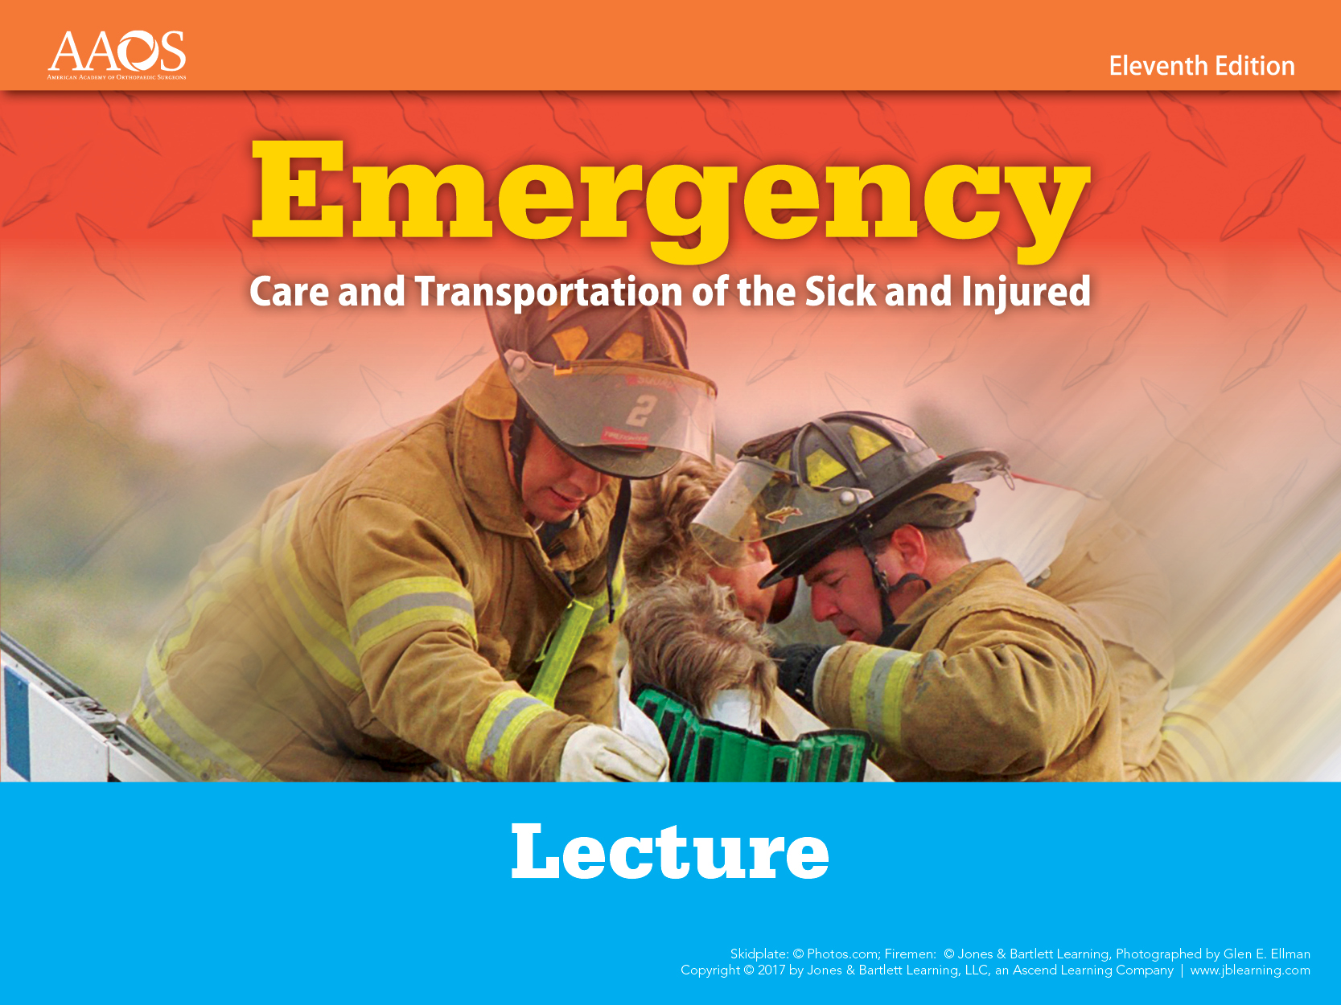
Chapter 7
Life Span Development
Notes:
Chapter 7: Life Span Development

Slide 2

Introduction
Human develop throughout their lives.
EMTs must be aware of the physical changes a person undergoes at various stages of life.
  May alter the approach to patient care
Notes:
Lecture Outline
I. Introduction
A. Humans develop throughout their lives.
B. EMTs must be aware of the physical changes a person undergoes at various stages of life.
1. They may alter the approach to patient care.

Slide 3
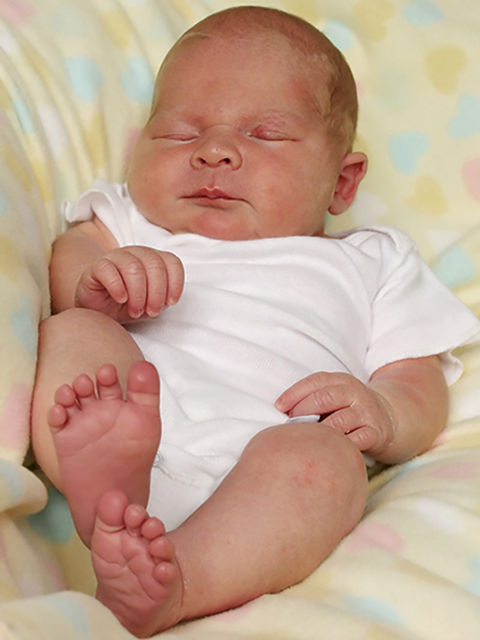
Neonates & Infants (1 of 7)
Neonates
  Birth to 1 month
Infants
  Ages 1 month to
  1 year
  Develop at a startling rate
© Johanna Goodyear/ShutterStock.
Notes:
Lecture Outline
II. Neonates and Infants
A. Neonates (birth to 1 month) are covered in Chapter 33, “Obstetrics and Neonatal Care.”
B. Infants (ages 1 month to 1 year) develop at a startling rate.

Slide 4
Neonates & Infants (2 of 7)
Vital signs
  The younger the person, the faster the pulse rate and respirations
  Blood pressure directly corresponds to the patient’s weight and typically increases with age
Weight
  Neonate weighs 6 to 8 lb (3 to 3.5 kg) at birth.
  Growth of about 30 g per day
Notes:
Lecture Outline
C. Physical changes
1. Vital signs
a. The younger the person, the faster the pulse rate and respirations.
i. At birth, a pulse rate of 90 to 180 beats/min and a respiratory rate of 30 to 60 breaths/min are considered normal.
ii. Shortly after birth, the pulse often drops to 100 to 160 beats/min and the respiratory rate drops to between 25 to 50 breaths/min.
iii. By 1 year, the respiratory rate slows to 20 to 30 breaths/min.
b. Blood pressure directly corresponds to the patient’s weight, so it typically increases with age.
2. Weight
a. A neonate usually weighs 6 to 8 lb (3 to 3.5 kg) at birth.
b. The head accounts for 25% of its body weight.
c. After week 2, infants grow at a rate of about 30 g per day, doubling their weight by 4 to 6 months and tripling it by the end of the first year.

Slide 5
Neonates & Infants (3 of 7)
Cardiovascular system
  At birth, neonate makes transition from fetal to independent circulation.
Pulmonary system
  Infants younger than 6 months are prone to nasal congestion.
  Infants have larger tongues and shorter, narrower airways, so airway obstruction is more common.
Notes:
Lecture Outline
3. Cardiovascular system
a. At birth, the neonate makes the transition from fetal to independent circulation.
4. Pulmonary system
a. Infants younger than 6 months are particularly prone to nasal congestion.
b. The rib cage is less rigid and the ribs sit horizontally.
c. Infants have proportionately larger tongues and shorter, narrower airways, so airway obstruction is more common in infants.
d. When performing bag-mask ventilation, remember that an infant’s lungs are fragile.

Slide 6
Neonates & Infants (4 of 7)
Nervous system
  Continues to evolve after birth
  Moro reflex
  Palmar grasp
  Rooting reflex
  Sucking reflex
Notes:
Lecture Outline
5. Nervous system
a. The nervous system continues to evolve after birth.
b. A neonate is born with certain reflexes.
i. Moro reflex: when a neonate is startled, it opens its arms wide, spreads its fingers, and seems to grab at things
ii. Palmar grasp: occurs when an object is placed into the neonate’s palm
iii. Rooting reflex: when something touches a neonate’s cheek, it will instinctively turn its head toward the touch
iv. Sucking reflex: occurs when a neonate’s lips are stroked

Slide 7
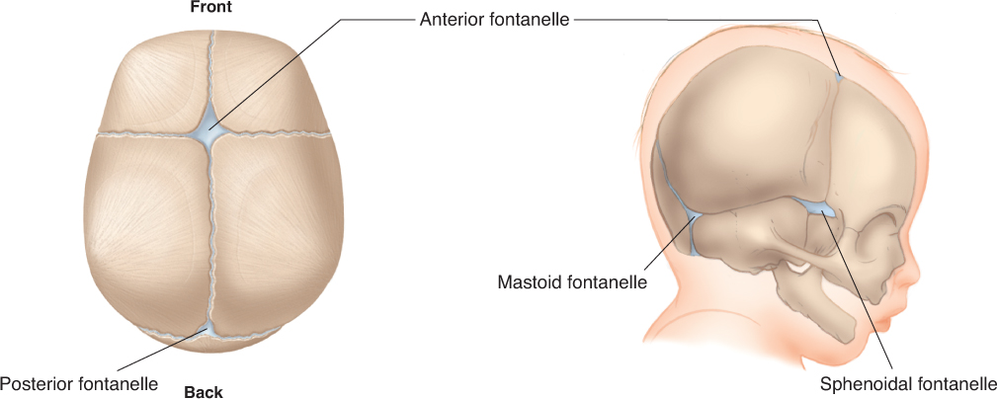
Neonates & Infants (5 of 7)
Fontanelles
  Spaces between the bones that eventually fuse to form the skull
© Jones & Bartlett Learning.
Notes:
Lecture Outline
c. A neonate’s fontanelles are the spaces between the bones that eventually fuse to form the skull.
i. The posterior fontanelle fuses by 3 months.
ii. The anterior fontanelle fuses between 9 and 18 months of age.

Slide 8
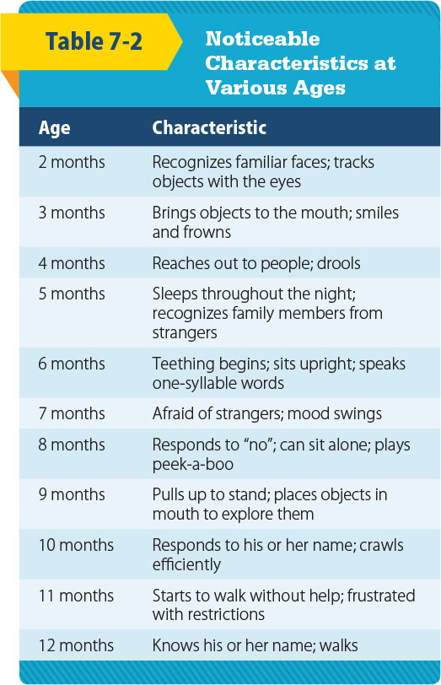
Neonates & Infants (6 of 7)
Infant’s immune system maintains some of the mother’s immunities.
Psychosocial changes begin at birth and evolve.
© Jones & Bartlett Learning.
Notes:
Lecture Outline
6. Immune system
a. The immune system maintains some of the mother’s immunities.
b. Infants can also receive antibodies via breastfeeding, further bolstering their immune system.
D. Psychosocial changes
1. Begin at birth and evolve as the infant interacts with, and reacts to, the environment

Slide 9
Neonates & Infants (7 of 7)
Psychosocial changes (cont’d)
  Crying is the main method of communicating.
  Bonding is based on a secure attachment.
  Separation anxiety is common in older infants.
  Trust and mistrust involves needs being met.
Notes:
Lecture Outline
2. Crying is the main method of communicating distress.
3. Bonding is based on a secure attachment.
a. Anxious-avoidant attachment is found in infants who are repeatedly rejected.
b. Children show little emotional response to their parents or caregivers and treat them as they would strangers.
4. Separation anxiety is common in older infants.
5. Trust and mistrust refers to a stage of development from birth to about 18 months, which involves an infant’s needs being met by his or her parents or caregivers.

Slide 10

Toddlers and Preschoolers
(1 of 4)
Toddlers (1 to 3 years)
  Pulse: 90 to 150 beats/min
  Respiratory rate: 20 to 30 breaths/min
  Systolic blood pressure: 80 to 100 mm Hg
© EML/ShutterStock.
Notes:
Lecture Outline
III. Toddlers and Preschoolers
A. Physical changes
1. Toddlers (ages 1 to 3 years)
a. Pulse rate is normally 90 to 150 beats/min.
b. Respiratory rate is 20 to 30 breaths/min.
c. Systolic blood pressure is 80 to 100 mm Hg.

Slide 11
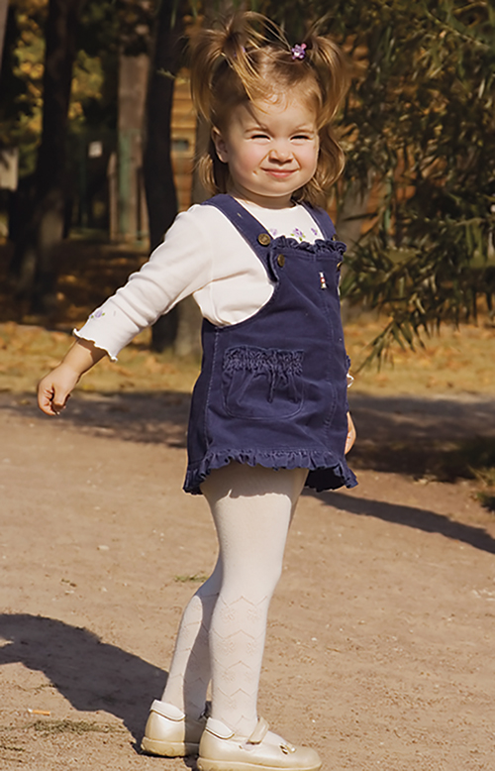
Toddlers and Preschoolers
(2 of 4)
Preschoolers (3 to 6 years)
  Pulse: 80 to 140 beats/min
  Respiratory rate: 20 to 25 breaths/min
  Systolic blood pressure: 80 to 100 mm Hg
© Maxim Bolotnikov/ShutterStock.
Notes:
Lecture Outline
2. Preschoolers (ages 3 to 6 years)
a. Pulse rate is 80 to 140 beats/min.
b. Respiratory rate is 20 to 25 breaths/min.
c. Systolic blood pressure is 80 to 100 mm Hg.

Slide 12
Toddlers and Preschoolers
(3 of 4)
Do not have well-developed lung musculature
Passive immunity is lost.
Neuromuscular growth makes considerable progress.
Average age for completion of toilet training is 28 months of age
Notes:
Lecture Outline
d. Toddlers and preschoolers do not have well-developed lung musculature so they are unable to sustain deep or rapid respirations for an extended period of time.
3. The loss of passive immunity is possibly the most obvious development at this stage of human life.
4. Neuromuscular growth makes considerable progress at this age.

Slide 13
Toddlers and Preschoolers
(4 of 4)
Psychosocial changes
  Learn to speak and express themselves
  Master basic language
  Interact and play games with other children
  Begin to understand cause and effect
Notes:
Lecture Outline
B. Psychosocial changes
1. Toddlers or preschoolers learn to speak and express themselves.
2. At 36 months of age, basic language is mastered.
3. Interaction and playing games with other children begin.
4. By 18 to 24 months, cause and effect begin to become understood.
5. Children learn to recognize gender differences by observing role models.

Slide 14

School-Age Children (1 of 3)
6 to 12 years
Vital signs approach those of adulthood
  Pulse: 70 to 120 beats/min
  Respiration rate: 15 to 20 breaths/min
  Systolic blood pressure: 80 to 110 mm Hg
© Trout55/ShutterStock.
Notes:
Lecture Outline
IV. School-Age Children
A. Physical changes
1. From ages 6 to 12 years, a school-age child’s vital signs and body gradually approach those observed in adulthood.
a. Pulse rate is approximately 70 to 120 beats/min.
b. Respiratory rate is 15 to 20 breaths/min.
c. Systolic blood pressure is 80 to 110 mm Hg.

Slide 15
School-Age Children (2 of 3)
Obvious physical traits and body function changes become apparent.
Growth of 4 lb and 2.5″ each year
Permanent teeth come in.
Brain activity increases in both hemispheres.
Notes:
Lecture Outline
2. Obvious physical traits and body function changes become apparent.
a. Growth of 4 lb (2 kg) and 2.5" (6 cm) each year
3. Permanent teeth come in.
4. Brain activity increases in both hemispheres.

Slide 16
School-Age Children (3 of 3)
Psychosocial changes
  Preconventional reasoning: act to avoid punishment and get what they want
  Conventional reasoning: look for approval from peers and society
  Postconventional reasoning: make decisions guided by their conscience
  Self-concept and self-esteem develop.
Notes:
Lecture Outline
B. Psychosocial changes
1. Children learn various types of reasoning.
a. Preconventional reasoning: Children act almost purely to avoid punishment and get what they want.
b. Conventional reasoning: Children look for approval from their peers and society.
c. Postconventional reasoning: Children make decisions guided by their conscience.
2. Children begin to develop their self-concept and self-esteem.

Slide 17

Adolescents (Teenagers) (1 of 4)
12 to 18 years
Vital signs level off.
  Pulse: 60 to 100 beats/min
  Respirations: 12 to 20 breaths/min
  Systolic blood pressure: 90 to 110 mm Hg
© Jamie Wilson/ShutterStock.
Notes:
Lecture Outline
A. Physical changes
1. In adolescents (ages 12 to 18 years), vital signs begin to level off within the adult ranges.
a. Pulse rate is 60 to 100 beats/min.
b. Respiratory rate is 12 to 20 breaths/min.
c. Systolic blood pressure is between 90 and 110 mm Hg.

Slide 18
Adolescents (Teenagers) (2 of 4)
2- to 3-year growth spurt
  Girls finish by 16 years, boys by 18 years.
Reproductive system matures.
  Secondary sexual development takes place.
  Voices start to change.
  Menstruation begins.
Notes:
Lecture Outline
2. Adolescents experience a 2- to 3-year growth spurt (an increase in muscle and bone growth) and body changes.
a. Girls generally finish their growth spurt by 16 years, boys by 18 years.
3. The reproductive system matures and secondary sexual development takes place.
a. Pubic hair and axillary hair begin to appear.
b. Voices start to change.
c. Menstruation begins.

Slide 19
Adolescents (Teenagers) (3 of 4)
Psychosocial changes
  Adolescents and their families often deal with conflict.
  Privacy becomes an issue.
  Self-consciousness increases.
  Adolescents may struggle to create their own identity.
Notes:
Lecture Outline
B. Psychosocial changes
1. Adolescents and their families often deal with conflict as adolescents try to gain control of their lives from their parents.
a. Privacy becomes an issue.
b. Self-consciousness increases.
2. Adolescents may struggle to create their own identity.
3. They often want to be treated like adults, yet cared for like younger children.

Slide 20
Adolescents (Teenagers) (4 of 4)
Psychosocial changes (cont’d)
  Antisocial behavior and peer pressure peak at age 14 to 16 years.
    Smoking, illicit drug use, unprotected sex
    Eating disorders
  Code of ethics develops.
  High risk of suicide and depression
Notes:
Lecture Outline
4. Antisocial behavior and peer pressure tend to peak at age 14 to 16 years.
a. Smoking, illicit drug use, and unprotected sex are problems that may arise.
b. Eating disorders can arise in adolescents from an attempt to gain self-control through what they eat.
5. A code of personal ethics develops, based partly on parents’ ethics and values and partly on the influence of the adolescent’s environment.
6. Adolescents have a high risk for suicide and depression.

Slide 21
Early Adults
Ages 19 to 40 years
Vital signs do not vary greatly.
From 19 to 25 years, the body should be functioning at its optimal level.
Psychosocial changes
  Life centers on work, family, and stress.
  Settling down, love, childbirth
  One of the more stable periods of life
Notes:
Lecture Outline
VI. Early Adults
A. Early adults range in age from 19 to 40 years.
B. Physical changes
1. Their vital signs do not vary greatly from those seen through adulthood.
a. The pulse rate will average around 70 beats/min and range between 60 and 100 beats/min.
b. The respiratory rate will stay in the range of 12 to 20 breaths/min.
c. The systolic blood pressure will be between 90 and 140 mm Hg.
2. From age 19 years to shortly after 25 years, the body should be functioning at its optimal level.
a. Lifelong habits are solidified.
b. The body is working at peak efficiency, but, as early adulthood continues, subtle erosion begins.
C. Psychosocial changes
1. Life centers on work, family, and stress.
2. During this period, adults strive to create a place for themselves in the world, and many strive to “settle down.”
a. Along with this comes marriage and family.
3. Despite all of this stress and change, this is one of the more stable periods of life.

Slide 22
Middle Adults (1 of 2)
Ages 41 to 60 years
Vital signs remain the same.
Vulnerable to vision and hearing loss
Cancer incidence increases.
Menopause occurs in late 40s or early 50s
Diabetes, hypertension, weight problems
Exercise and healthy diet are important.
Notes:
Lecture Outline
VII. Middle Adults
A. Middle adults are ages 41 to 60 years.
B. Physical changes
1. Vital signs remain the same.
2. Middle adults are vulnerable to vision and hearing loss.
3. Cardiovascular health becomes an issue.
4. Cancer incidence increases.
5. Menopause takes place in the late 40s or early 50s.
6. Diabetes, hypertension, and weight problems are common.
7. Exercise and a healthy diet can diminish the effects of aging.

Slide 23
Middle Adults (2 of 2)
Psychosocial changes
  Focus on achieving life goals
  Readjust lifestyle as children leave home
  Generally have the physical, emotional, and spiritual reserves to handle life’s issues
  May be caring for children leaving for college, along with aging parents
Notes:
Lecture Outline
C. Psychosocial changes
1. Focus is on achieving life goals
2. Middle adults must readjust their lifestyle as children leave home.
3. Finances become a worrisome issue.
4. Generally people of this age have the physical, emotional, and spiritual reserves to handle life’s issues.
5. Middle adults may find themselves caring for children leaving for college and caring for their aging parents as well.

Slide 24
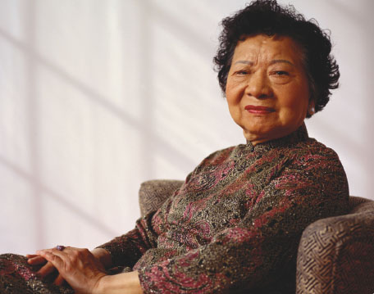
Older Adults (1 of 10)
61 years and older
Life expectancy is constantly changing.
  Now approximately 78 years
© Photodisc.
Notes:
Lecture Outline
VIII. Older Adults
A. Older adults include those ages 61 years and older.
B. Physical changes
1. Life expectancy is constantly changing.
a. It is now approximately 78 years.

Slide 25
Older Adults (2 of 10)
Vital signs depend on:
  Overall health
  Medical conditions
  Medications taken
Older adults are often able to overcome numerous medical problems but may need multiple medications.
Notes:
Lecture Outline
2. Vital signs depend on the patient’s:
a. Overall health
b. Medical conditions
c. Medications taken
3. Older adults are often able to overcome numerous medical problems but may need multiple medications to do so.

Slide 26
Older Adults (3 of 10)
Cardiovascular system
  Declines with age largely due to atherosclerosis
  Heart rate and cardiac output decrease.
  Vascular system becomes stiff.
  Ability to replace blood cells declines, as does blood volume.
Notes:
Lecture Outline
4. Cardiovascular system
a. Cardiac function declines with age, largely due to atherosclerosis.
b. Heart rate and cardiac output decrease.
i. Cardiac output can no longer meet the demands of the body.
c. The vascular system becomes stiff.
i. The heart must work harder to move the blood effectively.
d. The ability to produce replacement blood cells declines, as does the blood volume.

Slide 27
Older Adults (4 of 10)
Respiratory system
  Size of airway increases.
  Surface area of alveoli decrease.
  Natural elasticity of the lungs decreases.
    Breathing becomes more labor intense.
  Aspiration and obstruction become more likely.
  Vital capacity decreases.
  Residual volume increases.
Notes:
Lecture Outline
5. Respiratory system
a. The size of the airway increases and the surface area of the alveoli decrease.
b. The natural elasticity of the lungs also decreases.
i. Breathing becomes more labor intensive.
c. Aspiration and obstruction become more likely.
d. By age 75 years, the vital capacity may amount to only 50% of the vital capacity of a young adult. Factors include:
i. Loss of respiratory muscle mass
ii. Increased stiffness of the thoracic cage
iii. Decreased surface area available for the exchange of air
e. Residual volume increases with age.
i. A lifetime of breathing, especially breathing air with high levels of pollution, causes the accumulation of pollutants in the lungs.

Slide 28
Older Adults (5 of 10)
Endocrine system
  Insulin production drops off.
  Metabolism decreases.
  Physical activity slows, but often there is no decrease in food intake.
  Hormone production for both sexes gradually decreases.
  Sexual desire may diminish, but does not cease.
Notes:
Lecture Outline
6. Endocrine system
a. Insulin production drops off and metabolism decreases.
b. People tend to slow down their physical activity but don’t decrease their food intake.
i. The pancreas may not be able to produce enough insulin for the person’s body size, which can lead to diabetes mellitus.
c. The reproductive system changes to some extent.
i. Hormone production for both sexes gradually decreases as they age.
ii. Sexual desire may diminish with age but does not cease.

Slide 29
Older Adults (6 of 10)
Digestive system
  Taste sensations decrease.
  Saliva secretion decreases.
  Ability of intestines to contract and move food diminishes.
Notes:
Lecture Outline
7. Digestive system
a. Changes in gastric and intestinal function may inhibit nutritional intake and utilization in older adults.
i. Taste sensations decrease.
b. Saliva secretion decreases and reduces the body’s ability to process complex carbohydrates.
c. The ability of intestines to contract and move food diminishes.
d. Gallstones become increasingly common.

Slide 30
Older Adults (7 of 10)
Renal system
  Filtration function declines.
  Kidney mass decreases by 20%.
  Decreased ability to clear wastes from the body
  Decreased ability to conserve fluids when needed
Notes:
Lecture Outline
8. Renal systems
a. The filtration function declines by 50% from age 20 to 90 years.
b. Kidney mass decreases 20% over the same span.
c. There is a decreased ability to clear wastes from the body.
d. There is a decreased ability to conserve fluids when needed.

Slide 31
Older Adults (8 of 10)
Nervous system
  Motor and sensory neural networks slow down.
  Neurons are lost.
  Sleep patterns change.
  Peripheral nerve sensation diminishes.
  Brain mass decreases.
Notes:
Lecture Outline
9. Nervous system
a. In the central nervous system, the brain weight may shrink 10% to 20% by age 80 years.
i. Motor and sensory neural networks become slower.
b. Neurons are lost, but this does not mean there is a loss of knowledge or skill.
c. Sleep patterns change.
d. Peripheral nerve sensation is diminished.
i. Increased reaction times cause longer delays between stimulation and motion.
ii. The resulting slowdown in reflexes and decreased kinesthetic sense may contribute to the incidence of falls and trauma.
e. Age-related shrinkage creates a void between the brain and the outermost layer of the meninges, which provides room for the brain to move when stressed.

Slide 32
Older Adults (9 of 10)
Sensory changes
  Most older adults can see and hear well.
  May need glasses or hearing aids
  Visual distortions are common.
  Hearing loss is four times more common than vision loss.
Notes:
Lecture Outline
10. Sensory changes
a. Most older adults can see and hear well, but may need glasses or hearing aids.
i. It is wrong to assume that older patients are blind or deaf.
ii. Visual distortions are common.
b. Hearing loss is four times more common than vision loss.

Slide 33
Older Adults (10 of 10)
Psychosocial changes
  Most people retain high brain function until about 5 years before death.
  Statistics indicate that 95% of the elderly live at home.
  Financial limitations may restrict access to health care or medications.
  Isolation and depression can be challenges.
Notes:
Lecture Outline
C. Psychosocial changes
1. Until about 5 years before death, most people retain high brain function.
a. In the 5 years preceding death, mental function is presumed to decline, a theory referred to as the terminal drop hypothesis.
2. Statistics indicate that 95% of the elderly live at home.
a. The increasing number of elderly in the United States, as a result of the baby boom of the 1940s and 1960s, has produced a need for additional assisted living facilities.
3. Financial limits may restrict access to health care or medications.
a. Today, more than 50% of all single women in the United States who are 60 years of age or older are living at or below the poverty level.
4. One of the important issues that the elderly need to face is their own mortality.
a. Isolation and depression can be challenges.

Slide 34

Review
When providing bag-mask ventilations to an infant, what is most important to remember?
  Blood pressure typically increases with age.
  An infant’s lungs are fragile.
  An infant grows at a rate of about 30 g per day.
  An infant has a proportionately larger tongue than an adult.

Slide 35
Review
Answer: B
Rationale: It is important to remember that an infant’s lungs are fragile; ventilations that are too forceful can result in trauma from pressure, or barotrauma. Due to the large size of the infant’s occiput and the increased flexibility of the trachea, the airway can easily be inadvertently occluded by incorrect positioning, either overextension or overflexion.

Slide 36
Review
When providing bag-mask ventilations to an infant, what is most important to remember?
  Blood pressure typically increases with age.
  Rationale: This is not crucial information when giving ventilations.
  An infant’s lungs are fragile.
  Rationale: Correct answer

Slide 37
Review
When providing bag-mask ventilations to an infant, what is most important to remember?
  An infant grows at a rate of about 30 g per day.
  Rationale: This is not crucial information when giving ventilations.
  An infant has a proportionately larger tongue than an adult.
  Rationale: The large tongue could occlude the airway, but it is more important to remember the fragility of the lungs.

Slide 38
Review
You see an infant capable of reaching out to people and drooling. She is most likely:
  2 months of age.
  3 months of age.
  4 months of age.
  5 months of age.

Slide 39
Review
Answer: C
Rationale: An infant’s psychosocial development begins at birth and continues to evolve as the infant interacts with, and reacts to, the environment. At 4 months of age, an infant is likely to start reaching out to people and drooling.

Slide 40
Review
You see an infant capable of reaching out to people and drooling. She is most likely:
  2 months of age.
  Rationale: Psychosocial development at this age involves recognizing familiar faces.
  3 months of age.
  Rationale: Psychosocial development involves bringing objects to the mouth.

Slide 41
Review
You see an infant capable of reaching out to people and drooling. She is most likely:
  4 months of age.
  Rationale: Correct answer
  5 months of age.
  Rationale: Psychosocial development involves sleeping through the night.

Slide 42
Review
An infant who is repeatedly rejected experiences what type of attachment?
  Secure attachment
  Anxious-avoidant attachment
  Trust and mistrust
  Rejection attachment

Slide 43
Review
Answer: B
Rationale: Anxious-avoidant attachment is observed in infants who are repeatedly rejected. In this attachment style, children show little emotional response to their parents or caregivers and treat them as they would strangers. These children develop an isolated lifestyle where they do not have to depend on the support and care of others.

Slide 44
Review
An infant who is repeatedly rejected experiences what type of attachment?
  Secure attachment
  Rationale: An infant understands that parents or caregivers will be responsive to his or her needs.
  Anxious-avoidant attachment
  Rationale: Correct answer

Slide 45
Review
An infant who is repeatedly rejected experiences what type of attachment?
  Trust and mistrust
  Rationale: An infant’s needs are met by his or her parents or caregivers.
  Rejection attachment
  Rationale: Not a real type of attachment.

Slide 46
Review
Why do colds develop so easily in toddlers and preschoolers?
  They experience a loss of passive immunity.
  They do not have well-developed lung musculature.
  They are spending a lot of time around playmates and classmates.
  All of the above

Slide 47
Review
Answer: D
Rationale: All of these choices contribute to a toddler or preschooler’s increased likelihood of contracting a cold.

Slide 48
Review
Why do colds develop so easily in toddlers and preschoolers?
  They experience a loss of passive immunity.
  Rationale: Colds easily develop and can manifest as gastrointestinal distress or upper respiratory tract infections.
  They do not have well-developed lung musculature.
  Rationale: This prevents them from sustaining deep or rapid respirations for an extended period of time.

Slide 49
Review
Why do colds develop so easily in toddlers and preschoolers?
  They are spending a lot of time around playmates and classmates.
  Rationale: They can contract viruses and bacteria easily around other children.
  All of the above
  Rationale: Correct answer

Slide 50
Review
The pulse rate of a toddler is:
  80 to 140 beats/min
  90 to 150 beats/min
  90 to 180 beats/min
  100 to 160 beats/min

Slide 51
Review
Answer: B
Rationale: A toddler’s pulse rate is 90 to 150 beats/min.

Slide 52
Review
The pulse rate of a toddler is:
  80 to 140 beats/min.
  Rationale: The pulse rate of a preschool-age child is 80 to 140 beats/min.
  90 to 150 beats/min.
  Rationale: Correct answer
  90 to 180 beats/min
  Rationale: The pulse rate of a neonate is 90 to 180 beats/min.
  100 to 160 beats/min
  Rationale: The pulse rate of an infant is 100 to 160 beats/min.

Slide 53
Review
A school-age child looking for approval from his peers and society is demonstrating what kind of reasoning?
  Preconventional reasoning
  Conventional reasoning
  Postconventional reasoning
  Trust and mistrust

Slide 54
Review
Answer: B
Rationale: During school-age development, children begin to develop their self-concept and self-esteem. It is a critical time in human development. Children who look for approval from their peers and society are demonstrating conventional reasoning.

Slide 55
Review
A school-age child looking for approval from his peers and society is demonstrating what kind of reasoning?
  Preconventional reasoning
  Rationale: Children act almost purely to avoid punishment and to get what they want.
  Conventional reasoning
  Rationale: Correct answer

Slide 56
Review
A school-age child looking for approval from his peers and society is demonstrating what kind of reasoning?
  Postconventional reasoning
  Rationale: Children make decisions guided by their conscience.
  Trust and mistrust
  Rationale: Refers to a stage of infant development.

Slide 57
Review
Self-concept is:
  our perception of ourselves.
  how we feel about ourselves.
  how we fit in with peers.
  how we react to certain situations.

Slide 58
Review
Answer: A
Rationale: Self-concept is how we perceive ourselves.

Slide 59
Review
Self-concept is:
  our perception of ourselves.
  Rationale: Correct answer.
  how we feel about ourselves.
  Rationale: This is an example of self-esteem.
  how we fit in with peers.
  Rationale: This is an example of self-esteem.
  how we feel about others.
  Rationale: This is an example of how we perceive others.

Slide 60
Review
Why should you be concerned about a 16-year-old patient who seems depressed?
  She could be exhibiting rebellious behavior.
  She has just finished her growth spurt and may be disappointed in the results.
  Adolescents are at a higher risk for suicide.
  She may be having unprotected sex.

Slide 61
Review
Answer: C
Rationale: Adolescents are struggling to create their own identity, but are caught between two worlds. They want to be treated like adults, yet also want to be cared for like younger children. Many adolescents are fixated on their public image and are terrified of being embarrassed. Because of all these factors, adolescents are at a higher risk than other populations for suicide and depression.

Slide 62
Review
Why should you be concerned about a 16-year-old patient who seems depressed?
  She could be exhibiting rebellious behavior.
  Rationale: An adolescent may exhibit rebellious behavior to try and find his or her identity, but it is not a cause for concern.
  She has just finished her growth spurt and may be disappointed in the results.
  Rationale: While girls finish their growth spurt around 16 years of age, it will not likely cause depression.

Slide 63
Review
Why should you be concerned about a 16-year-old patient who seems depressed?
  Adolescents are at a higher risk for suicide.
  Rationale: Correct answer
  She may be having unprotected sex.
  Rationale: Peer pressure among adolescents could cause such rebellious behavior, but depression is not proof of such activity.

Slide 64
Review
Why do finances become an issue during middle adulthood?
  Middle adults are often supporting both their children and their parents.
  Middle adults make less money than early adults.
  Their deteriorating health makes it difficult to get to work.
  Hearing loss prevents them from working.

Slide 65
Review
Answer: A
Rationale: The parents of adults in this age group are getting older and now need care. Most of the elderly in the United States are cared for by family members inside the home. Therefore, a person in middle adulthood may need to manage children who are leaving for college while at the same time caring for parents who require greater assistance.

Slide 66
Review
Why do finances become an issue during middle adulthood?
  Middle adults are often supporting both their children and their parents.
  Rationale: Correct answer
  Middle adults make less money than early adults.
  Rationale: This statement has no evidentiary support.

Slide 67
Review
Why do finances become an issue during middle adulthood?
  Their deteriorating health makes it difficult to get to work.
  Rationale: Generally, health is stable during middle adulthood, and crisis is viewed as a challenge to be overcome.
  Hearing loss prevents them from working.
  Rationale: Middle adults are vulnerable to hearing loss, but this does not stop them from excelling in the workplace.

Slide 68
Review
Why is breathing more labor intensive for the elderly?
  The size of the airway increases and the surface area of the alveoli decreases.
  The natural elasticity of the lungs decreases.
  The overall strength of the intercostal muscles and the diaphragm decreases.
  All of the above

Slide 69
Review
Answer: D
Rationale: All three of these factors make breathing more labor intensive for the elderly.

Slide 70
Review
Why is breathing more labor intensive for the elderly?
  The size of the airway increases and the surface area of the alveoli decreases.
  Rationale: Breathing becomes more difficult when the alveoli can no longer exchange gases.
  The natural elasticity of the lungs decreases.
  Rationale: This forces individuals to use the muscles between their ribs to breathe, which makes breathing more difficult.

Slide 71
Review
Why is breathing more labor intensive for the elderly?
  The overall strength of the intercostal muscles and the diaphragm decreases.
  Rationale: Breathing becomes more difficult when these muscles are weakened.
  All of the above
  Rationale: Correct answer

