Slide 1
Chapter 8
Lifting and Moving Patients
Notes:
Chapter 8: Lifting and Moving Patients

Slide 2
National EMS Education Standard Competencies
EMS Operations
Knowledge of operational roles and responsibilities to ensure patient, public, and personnel safety.
Notes:
National EMS Education Standard Competencies
EMS Operations
Knowledge of operational roles and responsibilities to ensure safe patient, public, and personnel safety.

Slide 3
Introduction
In the course of a call, you will have to move patients to provide emergency medical care and transport.
To move patients without injury, you need to learn the proper techniques.
Knowledge of proper body mechanics and a power grip is important.
Notes:
Lecture Outline
I. Introduction
A. In the course of a call, you will have to move patients several times to provide emergency medical care and transport.
1. Once you have assessed the patient and provided emergency care, you and your team may have to move the patient onto a backboard or stretcher.
B. At a minimum, you will have to lift and carry the patient to the stretcher, move the stretcher to the ambulance, and load the stretcher into the patient compartment.
C. Upon arrival at the hospital, the patient must be removed from the ambulance, wheeled into the emergency department (ED), and transferred to the ED bed.
D. To move patients without injury to the patient, yourself, or your team, you need to learn how to lift and carry a patient properly.
1. Knowledge of proper body mechanics and a power grip is important.
E. Lifting and carrying are dynamic processes; to avoid unexpected, dangerous shifts in weight and to reduce the risk of injury to yourself, your part­ner, and the patient, you and your team should practice these techniques often.

Slide 4
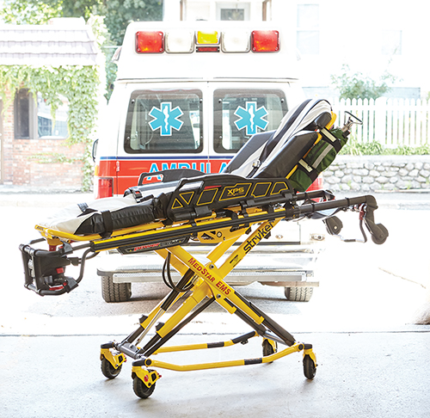
The Wheeled Ambulance Stretcher (1 of 5)
Wheeled ambulance stretcher
Also called an ambulance stretcher or gurney
Most commonly used device
© Jones and Bartlett Learning.
Notes:
Lecture Outline
II. The Wheeled Ambulance Stretcher
A. Also called an ambulance stretcher or gurney
1. The device most commonly used to move and transport patients

Slide 5
The Wheeled Ambulance Stretcher (2 of 5)
The wheeled ambulance stretcher weighs 40–145 lb.
Generally not taken up or down stairs or where the patient must be carried for any significant distance
Notes:
Lecture Outline
2. Weighs 40–145 lb (18–66 kg), depending on its design and features
3. Generally not taken up or down stairs or to other locations where the patient must be carried for any significant distance

Slide 6
The Wheeled Ambulance Stretcher (3 of 5)
Moving a patient by rolling, using a stretcher or other wheeled device, is preferred when the situation allows and helps prevent injuries from carrying.
A number of models are available.
Before going on a call, familiarize yourself with the specific features of the stretcher your ambulance carries.
Notes:
Lecture Outline
4. Moving a patient by rolling, using a stretcher or other wheeled device, is pre­ferred when the situation allows and helps prevent injuries from carrying.
5. Modern stretchers are available in a number of models.
a. Before going on a call, familiarize yourself with the specific features of the stretcher that your ambulance carries.

Slide 7
The Wheeled Ambulance Stretcher (4 of 5)
General features
Head end and foot end
Strong metal frame to which all other parts are attached
Hinges at center allow for elevation of head/back.
Guardrails prevent the patient from rolling out.
Notes:
Lecture Outline
6. General features of stretchers
a. Specific head end and specific foot end
b. Strong, rectangular, tubular metal main frame to which all other parts are attached
c. Stretcher is pulled, pushed, or lifted by this main frame or its handles.
d. Most models have a second tubular frame made up of three sections that is attached within or above the main frame.
i. A metal plate is fastened to each of the three sections between its sides and serves as the platform on which the stretcher mattress and patient are supported.
e. The head section of the stretcher runs from the head end to near the center, where the patient’s hips will be.
f. Hinges at the center allow the head end to be elevated and the patient’s back to be positioned at any desired angle.
g. Retractable guardrails are attached along the central portion of the main frame.
i. Can be lowered when a patient is being loaded onto or out of a stretcher
ii. Prevent the patient from rolling off of the stretcher

Slide 8
The Wheeled Ambulance Stretcher (5 of 5)
General features (cont’d)
Undercarriage frame allows adjustment to any height.
Mattress must be fluid resistant.
The patient is secured with straps.
Help protect the patient from further injury
Notes:
Lecture Outline
h. The undercarriage frame allows the litter to be adjusted to any height and locked into place.
i. From 12 inches above the ground for when the stretcher is secured within the ambulance to 32–36 inches above the ground for when the stretcher is being rolled
i. The mattress on a stretcher must be fluid resis­tant so that it does not absorb any type of potentially infectious material, including water, blood, or other body fluid.
j. Patients must always be secured with the straps on the stretcher. In the event of a crash while en route to the hospital, the straps help safeguard the patient from further injury.

Slide 9
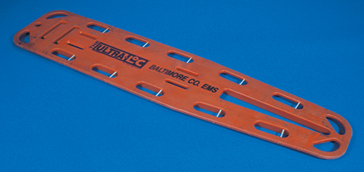
Backboards (1 of 2)
Long, flat, and made of rigid rectangular material (mostly plastic)
Used to carry and immobilize patients with suspected spinal injury or other trauma
© Jones & Bartlett Learning. Courtesy of MIEMSS.
Notes:
Lecture Outline
III. Backboards
A. Long, flat boards made of rigid, rectangular material
1. Used to carry and immobilize supine patients with suspected hip, pelvic, spinal, and lower extremity injuries or other multiple trauma

Slide 10
Backboards (2 of 2)
Commonly used for patients found lying down
Used to move patients out of awkward places
6–7 feet long
Holes serve as handles and as a place to secure straps.
Notes:
Lecture Outline
2. Can also be used to move patients out of awkward places
3. Backboards are 6–7 feet long.
4. Commonly used for patients who are found lying down
5. Parallel to the sides and ends of the board are long holes that serve as handles and that allow straps to be used to secure the patient to the board.
6. If your service uses wooden backboards, you must follow infection control procedures before you can reuse them.
7. Newer backboards are made of lighter plastic materials that will not absorb blood or other infectious substances.

Slide 11
Moving and Positioning the Patient (1 of 2)
When you move a patient, take care that injury does not occur:
To you
To your team
To the patient
Patient lifting and moving are technical skills that require repeated training and practice.
Notes:
Lecture Outline
IV. Moving and Positioning the Patient
A. When you move a patient, take care that injury does not occur:
1. To you
2. To your team
3. To the patient
B. Patient lifting and moving are technical skills that require repeated training and practice.

Slide 12
Moving and Positioning the Patient (2 of 2)
Many EMTs are injured lifting and moving patients.
Using proper body mechanics and maintaining physical fitness greatly reduce the chance of injury.
Notes:
Lecture Outline
C. Many EMTs are injured while lifting and moving patients.
D. Using proper body mechanics and maintaining physical fitness greatly reduce the chance of injury.
E. You must master the skills necessary for the use of all equip­ment and understand the advantages and limitations of each device before you use it in the field.

Slide 13
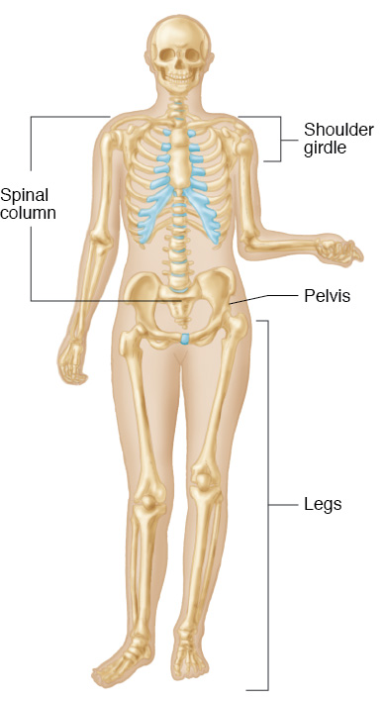
Body Mechanics (1 of 9)
Anatomy review
© Jones and Bartlett Learning.
Notes:
Lecture Outline
V. Body Mechanics
A. Anatomy review
1. The shoulder girdle rests on the rib cage and is supported by the vertebrae.
2. The arms are connected to and hang from the shoulder girdle.
3. When standing upright, the vertebrae are stacked on top of each other and aligned over the sacrum.
4. The sacrum is both the mechanical weight-bearing base of the spinal column and the fused central posterior section of the pelvic girdle.
5. Body mechanics: the relationship between the body’s anatomic structures and the physical forces associated with lifting, moving, and carrying
a. Maintaining proper posture and body movement during daily activities is applying the use of body mechanics.
b. Using good body mechanics while lifting and moving patients reduces your risk of injury.
6. When standing upright, the weight of anything being lifted and carried in the hands is reflected onto the shoulder girdle, the spinal column, the pelvis, and then the legs

Slide 14
Body Mechanics (2 of 9)
Lifting position
Shoulder girdle should be aligned over pelvis
Hands should be held close to legs
Force then goes essentially straight down spinal column
Very little strain occurs
Notes:
Lecture Outline
B. Lifting position
1. The shoulder girdle should be aligned over the pelvis.
2. The hands should be held close to the legs.
3. Force then goes essentially straight down the spinal column.
4. Very little strain occurs.

Slide 15
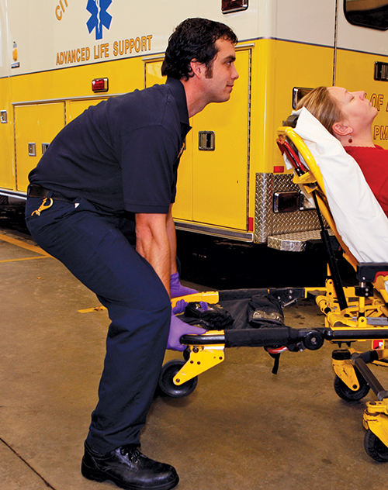
Body Mechanics (3 of 9)
This is the correct way to lift.
© Jones & Bartlett Learning. Courtesy of MIEMSS.
Notes:
This figure shows the correct way to lift.

Slide 16
Body Mechanics (4 of 9)
You may injure your back:
If you lift while leaning forward
If you lift with your back straight but bent significantly forward at the hips
Notes:
Lecture Outline
C. You may injure your back:
1. If you lift while leaning forward
2. If you lift with your back straight but bent forward at the hips

Slide 17
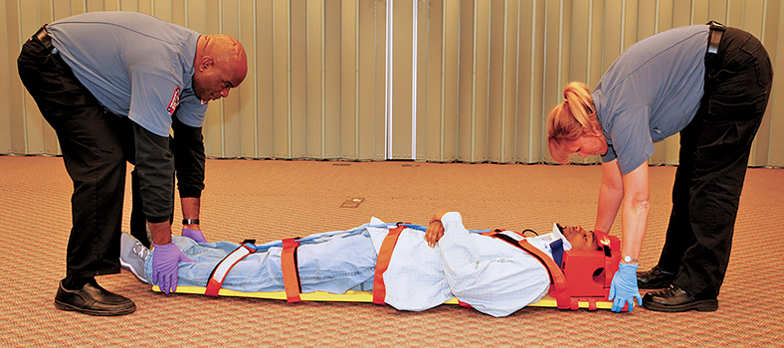
Body Mechanics (5 of 9)
This is an incorrect method of lifting.
© Jones & Bartlett Learning. Courtesy of MIEMSS.
Notes:
This figure shows an incorrect way to lift.

Slide 18
Body Mechanics (6 of 9)
Lifting technique
Legs should be spread about 15 inches apart (shoulder width).
Place feet so the center of gravity is balanced.
With your back held upright, bring your upper body down by bending the legs.
Grasp the patient/stretcher.
Notes:
Lecture Outline
D. Lifting technique
1. Legs should be spread about 15 inches apart (shoulder width).
2. Place feet so that your center of gravity is properly balanced.
3. With your back held upright, bring your upper body down by bending the legs.
4. Grasp the patient or stretcher and make any necessary adjustments in the location of your feet.

Slide 19
Body Mechanics (7 of 9)
Lifting technique (cont’d)
Lift the patient by raising your upper body and arms and straightening your legs until standing.
Keep the weight close to your body.
Keep your arms the same distance apart.
Notes:
Lecture Outline
5. Lift the patient by raising your upper body and arms and straightening your legs until you are in a standing position, and then curling your arms up to waist height.
6. Lifting by extending the properly placed flexed legs is the safest and most powerful way to lift.
a. This is called the power lift.
7. Hold your arms so that your hands are almost adjacent to the plane described by your anterior torso, and keep the weight you are lifting as close to your body as possible.
8. Keep your arms the same distance apart as when hanging your arms at each side of your body.
E. Reverse these steps when you are lowering the stretcher.

Slide 20
Body Mechanics (8 of 9)
The power grip gets maximum force from the hands.
Palms up
Hands about 10 inches apart
All fingers at same angle
Fully support handle on curved palm
Notes:
Lecture Outline
F. Use the power grip to get maximum force from hands when you are lifting.
1. Palms up and the thumbs extended upward
2. Hands about 10 inches apart
3. All fingers at same angle; fingers and thumb curled tightly over the top of the handle
4. Fully support the handle on your curved palm.
5. When directly lifting a patient, tightly grip the patient in a place and manner that will ensure that you will not lose your grasp on the patient.

Slide 21
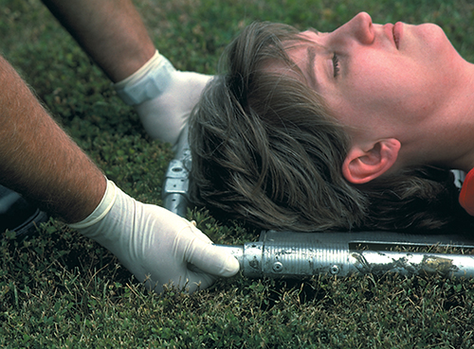
Body Mechanics (9 of 9)
When directly lifting a patient, tightly grip the patient in a place and manner that will ensure that you will not lose your grasp on the patient.
© Jones & Bartlett Learning. Courtesy of MIEMSS.
Notes:
Lecture Outline
5. When directly lifting a patient, tightly grip the patient in a place and manner that will ensure that you will not lose your grasp on the patient.

Slide 22
Principles of Safe Reaching and Pulling (1 of 6)
Body drag
The same body mechanics and principles apply to moving, lifting, and carrying a patient.
Keep your back locked by tightening your abdominal muscles.
Kneel.
Extend your arms no more than 15–20 inches in front of you.
Alternate between pulling the patient by flexing your arms and repositioning yourself.
Notes:
Lecture Outline
VI. Principles of Safe Reaching and Pulling
A. The same body mechanics and principles apply to moving, lifting, and carrying a patient.
B. Body drag
1. Keep your back locked in a slight curve created by tightening your abdominal muscles, not curved or bent laterally
2. Kneel to minimize the distance you will have to lean over.
3. Extend arms no more than 15–20 inches in front of you.
4. When you can pull no farther because your hands have reached the front of your torso, stop and move back another 15–20 inches.
5. Alternate between pull­ing the patient by slowly flexing your arms and reposi­tioning yourself.

Slide 23
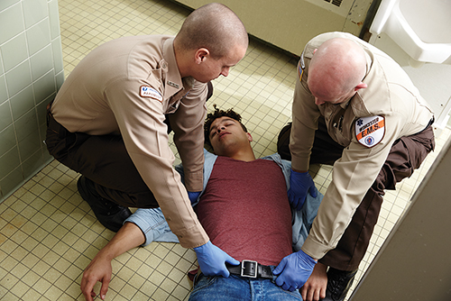
Principles of Safe Reaching and Pulling (2 of 6)
© Jones & Bartlett Learning.
© Jones & Bartlett Learning.
Notes:
These figures show how to perform a body drag.

Slide 24
Principles of Safe Reaching and Pulling (3 of 6)
To drag a patient across a bed:
Kneel on the bed to avoid reaching beyond the recommended distance.
Drag the patient to within 15–20 inches.
Complete the drag while standing at the side of the bed.
Use the sheet or blanket under the patient rather than dragging the patient by his or her clothing.
Notes:
Lecture Outline
C. If you must drag a patient across a bed, kneel on the bed to avoid reaching beyond the recommended distance.
1. Drag the patient to within 15–20 inches.
2. Complete the drag while standing at the side of the bed.
3. Use the sheet or blanket under the patient rather than dragging the patient by his or her clothing.

Slide 25
Principles of Safe Reaching and Pulling (4 of 6)
In the hospital, transfer the patient from the stretcher to a bed with a body drag.
The stretcher should be the same height or slightly higher than the bed.
You and a partner should kneel on the bed and drag in increments.
Notes:
Lecture Outline
D. In the hospital, transfer the patient from the stretcher to a bed with a body drag.
1. The stretcher should be the same height or slightly higher than the bed.
2. You and a partner should kneel on the bed and drag in increments.
E. Another method involves an EMT on each side of the patient, just beyond the patient’s shoulder and facing the patient’s groin.
a. Extend one arm across and in front of your chest, and grasp the patient’s armpit.
b. Extend your other arm in front and to the side of the patient’s torso, and grasp the patient’s belt.
c. Raise your elbows and flex your arms to pull the patient.

Slide 26
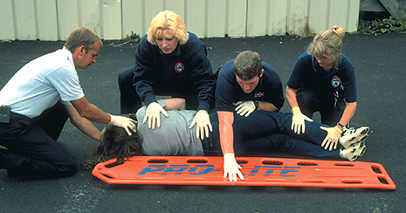
Principles of Safe Reaching and Pulling (5 of 6)
Log roll the patient onto his or her side to place a patient on a backboard.
© Jones & Bartlett Learning. Courtesy of MIEMSS.
Notes:
Lecture Outline
F. Log rolling a patient onto his or her side

Slide 27
Principles of Safe Reaching and Pulling (6 of 6)
Log rolling (cont’d)
Kneel as close to the patient’s side as possible.
Keep your back straight and lean solely from the hips.
Roll the patient without stopping until the patient is resting on his or her side and braced against your thighs.
Pulling toward you allows your legs to prevent the patient from rolling over completely.
Notes:
Lecture Outline
1. Kneel as close to the patient’s side as possible.
2. When you lean forward, keep your back straight and lean solely from the hips.
3. Roll the patient without stopping until the patient is resting on his or her side and braced against your thighs.
4. Pulling toward you allows your legs to prevent the patient from rolling over completely and from rolling beyond the intended distance.

Slide 28
Principles of Safe Lifting and Carrying (1 of 11)
Whenever possible, use a device that can be rolled.
When a wheeled device is not available, make sure that you understand and follow the guidelines for carrying a patient on a stretcher.
Notes:
Lecture Outline
VII. Principles of Safe Lifting and Carrying
A. Whenever possible, use a device that can be rolled to move a patient.
B. When a wheeled device is not available, make sure that you understand and follow the proper guidelines for carrying a patient on a stretcher.

Slide 29
Principles of Safe Lifting and Carrying (2 of 11)
Patient weight
Estimate the patient’s weight before lifting.
Adults often weigh 120–220 lb.
Two EMTs should be able to safely lift this weight.
Try to use four providers to lift when possible.
More stability
Requires less strength
Notes:
Lecture Outline
C. Patient weight
1. Estimate the patient’s weight before lifting.
a. Adults often weigh 120–220 lb.
b. Two EMTs should be able to safely lift this weight.
2. Try to use four providers to lift when possible.
a. More stability
b. Requires less strength

Slide 30
Principles of Safe Lifting and Carrying (3 of 11)
Patient weight (cont’d)
Do not attempt to lift a patient who weighs more than 250 lb with fewer than four providers.
Know the weight limitations of the equipment and how to handle patients who exceed the weight limitations.
Notes:
Lecture Outline
3. Do not attempt to lift a patient who weighs more than 250 lb with fewer than four providers.
4. Know the weight limitations of the equipment and how to handle patients who exceed the weight limitations.

Slide 31
Principles of Safe Lifting and Carrying (4 of 11)
Lifting and carrying a patient on a backboard or stretcher
More of the patient’s weight rests on the head half of the device than on the foot half.
The diamond carry and the one-handed carry use one EMT at the head and the foot, and one on each side of the patient’s torso.
Notes:
Lecture Outline
D. Lifting and carrying a patient on a backboard or stretcher
1. More of the patient’s weight rests on the head half of the device than on the foot half.
2. The diamond carry uses one EMT at the head and one at the foot of the backboard, and one on each side of the torso (Skill Drill 8-2).
3. The one-handed carry includes four or more rescuers each using one hand to support the backboard so that they are able to face forward as they are walking (Skill Drill 8-3).

Slide 32
Principles of Safe Lifting and Carrying (5 of 11)
© Jones & Bartlett Learning. Courtesy of MIEMSS.
Notes:
This figure shows the diamond carry for stretchers.

Slide 33
Principles of Safe Lifting and Carrying (6 of 11)
Lifting and carrying a patient on a backboard or stretcher (cont’d)
Use four providers—one provider at each corner of the stretcher to provide an even lift.
When rolling the wheeled ambulance stretcher, make sure that it is in the fully elevated position.
Your partner should control the head end and assist you by pushing with his or her arms held with the elbows bent.
Notes:
Lecture Outline
4. When the stretcher must be carried, it is best if four providers are available to carry it. One provider should be positioned at each corner of the stretcher to provide an even lift.
5. When you are rolling the wheeled ambulance stretcher, make sure that it is in the fully elevated position.
a. Your partner should control the head end and assist you by pushing with his or her arms held with the elbows bent.

Slide 34
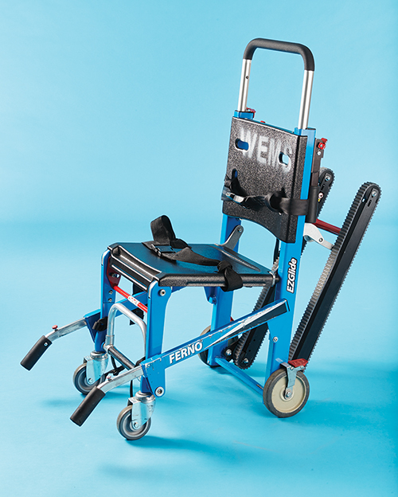
Principles of Safe Lifting and Carrying (7 of 11)
Moving a patient with a stair chair
Use a stair chair to carry a conscious patient up or down a flight of stairs
This lightweight, wheeled folding chair has a molded seat, adjustable safety straps, and fold-out handles at both the head and feet.
© Jones & Bartlett Learning.
Notes:
Lecture Outline
E. Moving a patient with a stair chair
1. Use a stair chair to carry a patient up or down a flight of stairs or other significant incline if:
a. The patient is conscious.
b. The patient’s condition allows him or her to be placed in a sitting position.
2. A stair chair is a lightweight folding chair with a molded seat, adjust­able safety straps, and fold-out handles at both the head and feet.
3. Most models have rubber wheels in the back with casters in front so that they can roll along the floor and make turns.
4. Some have a specially designed track to facilitate movement down steps with little lifting required.

Slide 35
Principles of Safe Lifting and Carrying (8 of 11)
Moving a patient on stairs with a stretcher
A backboard should be used instead for a patient:
Who is unresponsive
Who must be moved in supine position
Who must be immobilized
Notes:
Lecture Outline
F. Moving a patient on stairs with a stretcher
1. A backboard should be used for a patient:
a. Who is unresponsive
b. Who must be moved in supine position
c. Who must be immobilized

Slide 36
Principles of Safe Lifting and Carrying (9 of 11)
Moving a patient on stairs with a stretcher (cont’d)
Carry the patient on the backboard down to the prepared stretcher.
Place the strongest EMTs at the head and foot ends, with the taller person at the foot end.
Place both the backboard and the patient on the stretcher; secure both to the stretcher with additional straps.
Notes:
Lecture Outline
2. Carry the patient on the backboard down the stairs to the prepared stretcher.
a. Place the strongest EMTs at the head and foot ends of the board.
b. The taller person should be at the foot end.
3. Once you reach the stretcher, place both the backboard and the patient on the stretcher; secure both to the stretcher with additional straps.
4. To carry a patient on stairs on a backboard, follow the steps in Skill Drill 8-5.

Slide 37
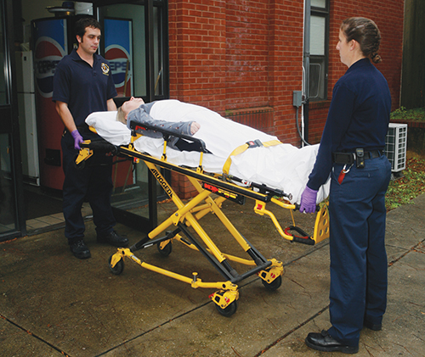
Principles of Safe Lifting and Carrying (10 of 11)
Loading a wheeled stretcher into an ambulance
Ensure the frame is held firmly between two hands so it does not tip.
© Jones & Bartlett Learning.
Notes:
Lecture Outline
G. Loading a wheeled stretcher into an ambulance
1. Ensure the frame is held firmly between two hands so it does not tip.

Slide 38
Principles of Safe Lifting and Carrying (11 of 11)
Loading a wheeled stretcher into an ambulance (cont’d)
Newer models are self-loading, allowing you to push the stretcher into the ambulance.
Other models need to be lowered and lifted to the height of the floor of ambulance.
Clamps in the ambulance hold the stretcher in place.
Notes:
Lecture Outline
2. Newer models are self-loading.
a. Extra wheels at the head end of the stretcher allow you to push the stretcher into the back of the ambulance.
3. Models that are not self-loading need to be lowered and then lifted to the height of the floor of the ambulance.
4. Clamps inside the ambulance will hold the stretcher in place during transport.
5. Follow the steps in Skill Drill 35-6 to load a stretcher onto an ambulance.

Slide 39
Directions and Commands (1 of 3)
Team actions must be coordinated.
Team leader
Indicates where each team member should be
Rapidly describes the sequence of steps to perform before lifting
Notes:
Lecture Outline
VIII. Directions and Commands
A. Team actions must be coordinated.
B. Team leader
1. Indicates where each team member should be
2. Rapidly describes the sequence of steps to perform before lifting

Slide 40
Directions and Commands (2 of 3)
Preparatory commands are used.
Example:
Team leader says, “All ready to stop,” to get team’s attention.
Team leader says, “Stop!” in a louder voice.
Countdowns are also used.
Notes:
Lecture Outline
C. Preparatory commands are used.
D. Example
1. The team leader says, “All ready to stop,” to get the team’s attention, identify who should act, and prepare the team to act.
2. The team leader says, “Stop!” in a louder voice to indicate the exact moment of execution.
3. Countdowns are often used to lift a patient.
a. Example: “One, two, three.”
b. Always clarify if “three” is part of the preparatory command or whether it is to serve as the order to execute.

Slide 41
Directions and Commands (3 of 3)
Carefully plan ahead.
Select the methods that will involve the least amount of lifting and carrying.
Consider whether there is an option that will cause less strain.
Notes:
Lecture Outline
4. Carefully plan ahead.
5. Select the methods that will involve the least amount of lifting and carrying.
a. Always consider whether there is an option that will cause less strain to you and the other EMTs.

Slide 42
Emergency Moves (1 of 5)
Use when there is potential for danger
Fire, explosives, hazardous materials
Use when you cannot properly assess the patient or provide immediate care because of the patient’s location or position
Notes:
Lecture Outline
IX. Emergency Moves
A. Emergency moves are used when there is a potential for danger before assessment and care are provided.
1. Examples: fire, explosives, hazardous materials
B. Use such moves when you cannot properly assess the patient or provide immediate care because of the patient’s location or position.

Slide 43
Emergency Moves (2 of 5)
If you are alone, use a drag to pull the patient along the long axis of the body.
Use techniques to help prevent aggravation of patient spinal injury.
Clothes drag
Blanket drag
Arm drag
Arm-to-arm drag
Notes:
Lecture Outline
C. If you are alone, use a drag to pull the patient along the long axis of the body.
D. Use techniques to help prevent aggravation of the patient’s spinal injury, if present.
1. Clothes drag: Pull on the patient’s clothing in the neck and shoulder area.
2. Blanket drag: Place the patient on a blanket, coat, or other item that can be pulled.
3. Arm drag: Rotate the patient’s arms so they are extended straight on the ground beyond his or her head, grasp the wrists, and drag the patient.
4. Arm-to-arm drag: Place your arms under the patient’s shoulders and through the armpits, and, while grasping your opposite wrist, drag the patient backward.

Slide 44
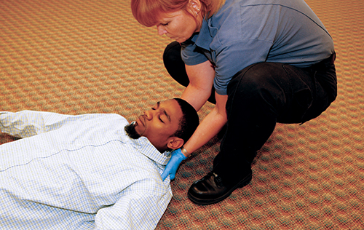
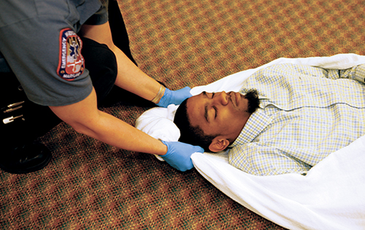
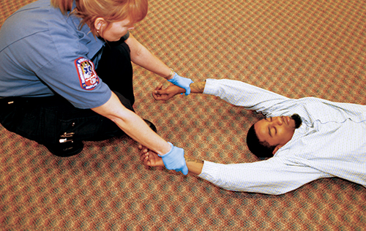
Emergency Moves (3 of 5)
© Jones & Bartlett Learning. Courtesy of MIEMSS.
© Jones & Bartlett Learning. Courtesy of MIEMSS.
© Jones & Bartlett Learning. Courtesy of MIEMSS.
© Jones & Bartlett Learning. Courtesy of MIEMSS.
Notes:
These figures show the different types of drags: clothes drag, blanket drag, arm drag, and armpit drag.

Slide 45
Emergency Moves (4 of 5)
To remove an unconscious patient from a vehicle alone:
Move the patient’s legs clear of the pedals.
Rotate the patient so the back is toward the open car door.
Place your arms through the armpits and support the head against your body.
Drag the patient from the seat to a safe location.
Notes:
Lecture Outline
E. Removing an unconscious patient from a vehicle alone
1. Move the patient’s legs clear of the pedals.
2. Rotate the patient so that his or her back is toward the open car door.
3. Place your arms under the patient’s shoulders and through the patient’s armpits, and support the patient’s head against your body.
4. If the legs and feet clear the car, rapidly drag the patient from the seat to a safe location.
a. If the legs and feet do not clear the car, lower the patient to the ground until the patient is on his or her back, clear the legs from the vehicle, and drag the patient to a safe location.

Slide 46
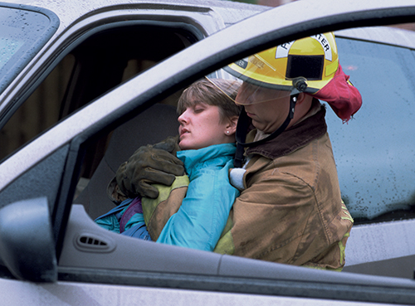
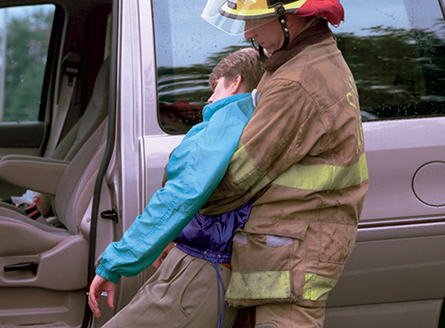
Emergency Moves (5 of 5)
© Jones & Bartlett Learning. Courtesy of MIEMSS.
© Jones & Bartlett Learning. Courtesy of MIEMSS.
Notes:
These figures show the steps to remove an unconscious patient from a vehicle.

Slide 47
Urgent Moves (1 of 2)
Necessary to move patient:
With altered level of consciousness
With inadequate ventilation
In shock
In extreme weather conditions
Rapid extrication technique requires a team of knowledgeable EMTs.
Notes:
Lecture Outline
X. Urgent Moves
A. An urgent move may be necessary to move patient:
1. With altered level of consciousness
2. With inadequate ventilation
3. In shock
4. In extreme weather conditions
B. Rapid extrication technique should be used when a patient is sitting in a vehicle and must be urgently moved (Skill Drill 8-7). Whether a backboard is used for this skill will depend on your local protocols.

Slide 48
Urgent Moves (2 of 2)
Rapid extrication technique should be used only if urgency exists.
The patient can be moved within 1 minute.
This techniques increases the risk of damage if the patient has a spinal injury.
Look at all options before using an urgent move.
Notes:
Lecture Outline
1. This technique should be used if only urgency exists.
a. The vehicle or scene is unsafe.
b. Explosives or other hazards are on scene.
c. There is fire or a danger of fire.
d. The patient cannot be properly assessed prior to removal from the vehicle.
e. The patient needs immediate intervention that requires a supine position.
f. The patient has a life-threatening condition requiring immediate transport.
g. The patient blocks your access to another seriously injured patient.
2. Proper placement of immobilization devices usually requires 6–8 minutes.
3. Using the rapid extrication technique, a patient can be moved from sitting in a vehicle to supine on a backboard in 1 minute or less.
4. Because of its rapid nature, this technique increases the risk of damage if the patient has a spinal injury.
5. Look at all available options before using this technique.
6. You should not use this technique if no urgency exists.
7. It requires a team of three providers who are knowledgeable and practiced in the procedure.
8. Once the patient has been moved onto the backboard, move the patient away from the hazard to begin life-saving treatment.

Slide 49
Nonurgent Moves (1 of 4)
Used when both the scene and the patient are stable
Carefully plan how to move the patient.
Team leader should plan the move.
Personnel
Obstacles identified
Equipment
Procedure and path
Notes:
Lecture Outline
XI. Nonurgent Moves
A. Used when both the scene and the patient are stable.
B. Carefully plan how to move the patient.
C. The team leader must ensure there are enough providers, obstacles are identified and removed, the proper equipment is available, and the procedure and path to be followed are identified.

Slide 50
Nonurgent Moves (2 of 4)
Choose between:
Direct ground lift
For patients with no suspected spinal injury who are supine
Patients who need to be carried over some distance
EMTs stand side by side to lift and carry the patients.
Notes:
Lecture Outline
D. Methods for lifting and carrying
1. Direct ground lift (Skill Drill 8-8)
a. Used for patients with no suspected spinal injury who are found supine on the ground
b. Use the direct ground lift when the patient will need to be carried a distance to the stretcher.
c. EMTs stand side by side to lift and carry the patient.
d. Ideally it should be performed by three EMTs, but it can be done with two.

Slide 51
Nonurgent Moves (3 of 4)
Extremity lift
For those patients with no suspected spinal injury who are supine or sitting
Helpful when the patient is in a small space
One EMT is at the patient’s head and the other at the patient’s feet.
Coordinate moves verbally.
Notes:
Lecture Outline
2. Extremity lift (Skill Drill 8-9)
a. Used for patients with no suspected extremity or spinal injury who are supine or in a sitting position
b. May be helpful when the patient is in a small space because it does not require EMTs to stand side by side
c. One EMT is positioned at the patient’s head and the other EMT is positioned at the patient’s feet.
d. Coordinate your movements using direct verbal commands.

Slide 52
Nonurgent Moves (4 of 4)
Transfer moves
Direct carry
Move supine patient from bed to stretcher using a direct carry method
Draw sheet method
Move patient from bed to stretcher using a sheet or blanket
Scoop stretcher
Notes:
Lecture Outline
E. Transfer moves
1. Direct carry
a. With two or more rescuers, move the supine patient from the bed to stretcher using a direct carry method (Skill Drill 8-10).
2. Draw sheet method
a. With two or more rescuers, move the patient from the bed to the stretcher using a sheet or blanket.
b. Place the stretcher next to the bed, making sure it is at the same height or slightly lower, the rails are lowered, and straps are unbuckled. Hold or secure the stretcher to keep it from moving. Loosen the bottom sheet underneath the patient, or log roll the patient onto a blanket. Reach across the stretcher, and grasp the sheet or blanket firmly at the patient’s head, chest, hips, and knees. Gently slide the patient onto the stretcher.
c. Center the patient on the sheet and tightly roll up the excess fabric on each side. This produces a cylindrical handle that provides a strong, secure way to grasp the fabric.
3. Using a scoop stretcher (Skill Drill 8-11)
a. Insert the halves of the scoop stretcher under each side of the patient.
b. Fasten the sides together.
c. With two or more rescuers, move the patient to a nearby stretcher.
4. Other carries
a. Place a backboard next to the patient, log roll or slide to move the patient onto the backboard, secure the patient, and lift and carry the backboard to the nearby prepared stretcher.
b. Assist the patient to the edge of the bed, and place the patient’s legs over the side, helping the patient to sit up. Move the stretcher so that its foot end touches the bed near the patient. Help the patient to stand and rotate so that he or she can sit down on the center of the stretcher. Lift the patient’s legs, and rotate them onto the stretcher while your partner lowers the patient’s torso onto the stretcher.
F. If the patient is in a chair and cannot assist you, transfer the patient from the chair to a stair chair.

Slide 53
Geriatrics (1 of 2)
Most patients transported by EMS are geriatric patients.
Skeletal changes may cause brittle bones, rigidity, and spinal curvatures that present special challenges.
Allay the patient’s fears with a sympathetic and compassionate approach.
Notes:
Lecture Outline
XII. Geriatrics
A. Most patients transported by EMS are geriatric patients.
B. Skeletal changes
1. Skeletal changes in older people may cause brittle bones, rigidity, and spinal curvatures.
2. Present special challenges in packaging and moving older patients
3. Many patients cannot lie supine on a backboard or scoop stretcher without causing further injury.
4. Consider geriatric-specific immobilization devices, such as a vacuum mattress.
5. Consult local protocols.
C. Fear
1. For many older patients, the fear of illness and disability is ever present, and an emergency trip to the hospital can be a terrifying and disorienting experience. The possibility of never returning home is a real fear for many of these patients.
2. Allay the patient’s fears with a sympathetic and compassionate approach.
3. Slow down, explain, and anticipate.

Slide 54
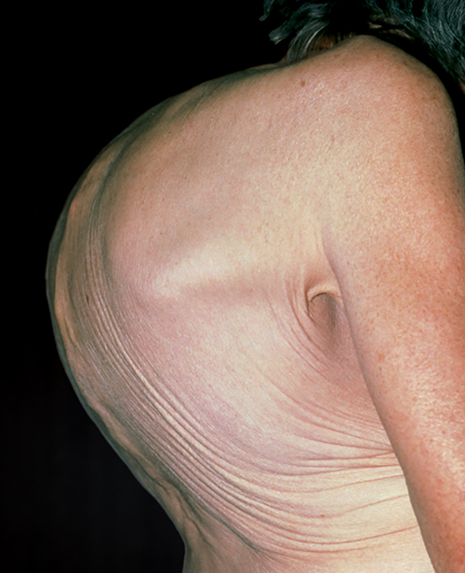
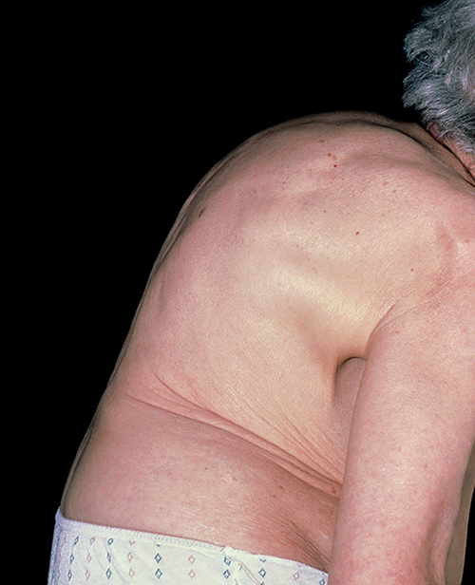
Geriatrics (2 of 2)
© Dr. P. Marazzi/Photo Researchers, Inc.
© Dr. P. Marazzi/Photo Researchers, Inc.
Kyphosis
Spondylosis
Notes:
These figures show the skeletal changes caused by aging.

Slide 55
Bariatrics (1 of 2)
Refers to management of obesity
76 million US adults are obese.
30–40% of adults are obese.
Approximately 17% of children are obese.
Back injuries account for the largest number of missed days of work.
Notes:
Lecture Outline
XIII. Bariatrics
A. Approximately 76 million adults in the United States are obese.
1. 40% of adults aged 40–59
2. 30% of adults aged 20–39
3. 35% of adults aged 61 or older
4. 17% of children
B. Bariatrics: the management (prevention or control) of obesity and allied diseases.
C. The larger the patient, the more likely he or she will need emergency treatment and transportation.
D. Bariatric patients are taking an increasing toll on the health of EMTs; back injuries account for the largest number of missed days of work.

Slide 56
Bariatrics (2 of 2)
Stretchers and equipment are being produced with higher capacities.
Does not address danger to users of that equipment
Mechanical ambulance lifts are uncommon in the United States.
Notes:
Lecture Outline
E. Stretchers and equipment are being produced with ever-higher capacities.
1. Increased capacity does not address the danger to users of that equipment.
2. Mechanical ambulance lifts are used in Europe but are uncommon in the United States.

Slide 57
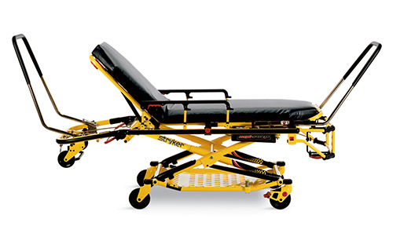
Additional Patient-Moving Equipment (1 of 13)
Bariatric stretchers
Specialized for overweight or obese patients
Wider wheelbase for increased stability
Courtesy of Stryker Medical, a division of Stryker Corporation.
Notes:
Lecture Outline
XIV. Additional Patient-Moving Equipment
A. Bariatric stretchers
1. A specialized wheeled stretcher for overweight or obese patients
2. Wider patient surface area
3. Wider wheelbase allowing for increased stability

Slide 58
Additional Patient-Moving Equipment (2 of 13)
Bariatric stretchers (cont’d)
Some have a tow package with a winch.
Rated to hold 850–900 lb
Regular stretcher rated for 650 lb maximum
Notes:
Lecture Outline
4. Some are equipped with optional features such as a tow package, which allows for an ambulance-mounted winch to assist in loading the patient into the ambulance, or telescoping side lift handles, which allow for increased leverage when lifting with multiple providers.
5. The most important feature is the increased weight-lifting capacity.
a. Typical stretchers are rated to a maximum weight of 650 lb.
b. The bariatric stretcher is rated to hold 850–900 lb.

Slide 59
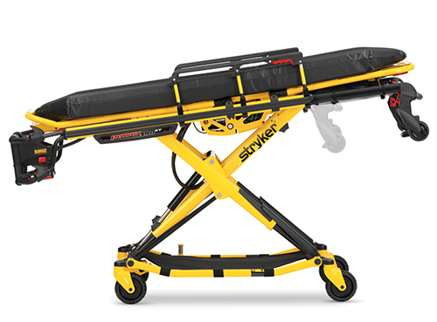
Additional Patient-Moving Equipment (3 of 13)
Pneumatic and electronic-powered wheeled stretchers
Battery operated with electronic controls to raise/lower the undercarriage
Increases the weight of the stretcher
Hazardous in uneven terrain
Courtesy of Stryker Medical, a division of Stryker Corporation.
Notes:
Lecture Outline
B. Pneumatic and electronic-powered wheeled stretchers
1. Battery operated with electronic controls to raise and lower the undercarriage
2. The added controls and equipment increase the weight of the stretcher.
a. This creates a potential hazard when transporting a patient on uneven terrain or up and down steps.

Slide 60
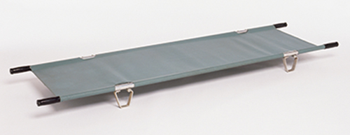
Additional Patient-Moving Equipment (4 of 13)
Portable/folding stretchers
Strong, rectangular tubular metal frame with fabric stretched across it
© Steve Gorton/Getty Images.
Notes:
Lecture Outline
C. Portable/folding stretchers
1. A stretcher with a strong rectangular tubular metal frame with rigid fabric stretched across it

Slide 61
Additional Patient-Moving Equipment (5 of 13)
Portable/folding stretchers (cont’d)
Some models have two wheels.
Some can be folded in half.
Used in difficult-to-reach areas
Weigh less then wheeled stretchers
Notes:
Lecture Outline
2. Does not have a second frame or an adjustable undercarriage
3. Some models have two wheels that make it easier to move the loaded stretcher.
4. Some models can be folded in half for storage.
5. Used in areas that are difficult to reach or when a second patient must be transported on the squad bench
6. Weigh much less than wheeled stretchers
7. Because most models do not have wheels, your team must support all of the patient’s weight, equipment, and the stretcher itself.

Slide 62
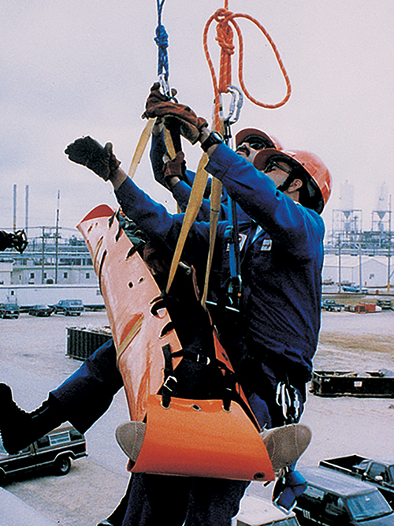
Additional Patient-Moving Equipment (6 of 13)
Flexible stretchers
Excellent for storage and carrying
Conform around a patient’s sides
Useful for confined spaces
Uncomfortable, but provide support and immobilization
© American Academy of Orthopaedic Surgeons.
Notes:
Lecture Outline
D. Flexible stretchers
1. Can be rolled up across the stretcher’s width or length so the stretcher becomes a smaller tubular package
2. Excellent for storage and carrying
3. Conform around a patient’s sides and do not extend beyond them
4. When extended, useful when removing a patient from or through a confined space
5. Certain flexible stretchers can be belayed or rappelled by ropes.
6. The most uncomfortable stretcher but provides excellent support and immobilization

Slide 63
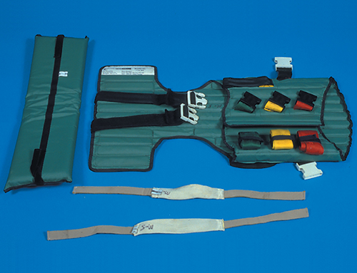
Additional Patient-Moving Equipment (7 of 13)
Short backboards
Used to immobilize seated patients
Example: the KED vest-type device
© Jones & Bartlett Learning. Courtesy of MIEMSS.
Notes:
Lecture Outline
E. Short backboards
1. Used to immobilize the head, torso, and neck of a seated patient with a suspected spinal injury until the patient can be moved to a long backboard
a. 3–4 feet long
b. Short wooden backboards have mostly been replaced with a vest-type device such as the KED, which is designed to immobilize that patient until he or she is moved from a sitting position to a supine position on a backboard.

Slide 64
Additional Patient-Moving Equipment (8 of 13)
Vacuum mattresses
Alternative to backboards for immobilizing geriatric and pediatric patients
Air is removed from the device, allowing it to mold around the patient.
Provides immobilization, comfort, and thermal insulation
Notes:
Lecture Outline
F. Vacuum mattresses
1. Alternative to the backboard for immobilizing geriatric and pediatric patients
2. The patient is placed on the mattress and the air is removed from the device, allowing it to mold around the patient.
3. Provides a high degree of immobilization, comfort, and thermal insulation

Slide 65
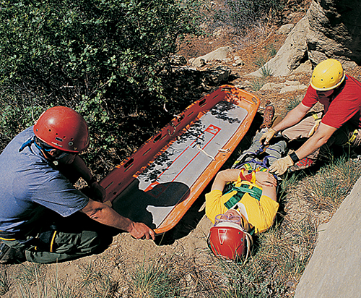
Additional Patient-Moving Equipment (9 of 13)
Basket stretchers
Rigid stretcher
Also called a Stokes litter
Used for patient removal in remote locations, including in water rescues and technical rope rescues
© Jones & Bartlett Learning. Courtesy of MIEMSS.
Notes:
Lecture Outline
G. Basket stretcher
1. A rigid stretcher also called a Stokes litter
2. Used to carry the patient across uneven terrain from a remote location that is inaccessible by ambulance or other vehicle
3. Used for technical rope rescues and some water rescues

Slide 66
Additional Patient-Moving Equipment (10 of 13)
Basket stretchers (cont’d)
If the patient has a spinal injury, secure the patient to the backboard and place it inside the basket stretcher to carry the patient out of the location.
When you return to ambulance, lift the backboard out of basket stretcher and place it on the wheeled stretcher.
Notes:
Lecture Outline
4. If the patient has a suspected spinal injury, secure the patient to a backboard and place the backboard inside the basket stretcher.
5. When you return the ambulance, lift the backboard out of the basket stretcher and place it on the wheeled ambulance stretcher.
6. Basket stretchers are made of plastic with an aluminum frame or have a full steel frame that is connected by woven wire mesh.
7. Their design allows water to drain through the stretcher.

Slide 67
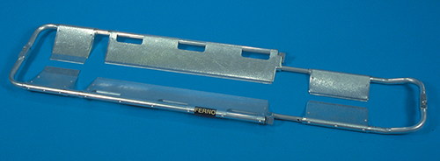
Additional Patient-Moving Equipment (11 of 13)
Scoop stretchers
Also called orthopaedic stretcher
© Jones & Bartlett Learning. Courtesy of MIEMSS.
Notes:
Lecture Outline
H. Scoop stretchers
1. Also called an orthopaedic stretcher

Slide 68
Additional Patient-Moving Equipment (12 of 13)
Scoop stretchers (cont’d)
Splits into two or four pieces
Pieces fit around patient who is lying on flat surface, and then reconnect
Both sides of the patient must be accessible.
The patient must be stabilized and secured on a scoop stretcher.
Notes:
Lecture Outline
2. Designed to be split into two or four pieces
3. Pieces are fitted around the patient who is lying on the ground or on a flat surface
4. The parts are then reconnected and the patient is lifted and put onto a backboard.
5. Both sides of the patient must be accessible to use a scoop stretcher.
6. You must fully immobilize and secure the patient on the scoop stretcher.

Slide 69
Additional Patient-Moving Equipment (13 of 13)
Neonatal isolette
Sometimes called an incubator
Neonates cannot be transported on a wheeled stretcher.
The isolette keeps the neonate warm, and protects the child from noise, draft, infection, and excess handling.
The isolette may be secured to a wheeled ambulance stretcher or freestanding.
Notes:
Lecture Outline
I. Neonatal isolette
1. A neonatal patient cannot be transported on a wheeled ambulance stretcher.
2. A neonatal isolette is sometimes referred to as an incubator.
3. Keeps the neonatal patient warm, with moistened air in a clean environment
4. Protects from noise, drafts, infection, and excess handling
5. The isolette can be:
a. Placed directly on a wheeled ambulance stretcher and secured with seatbelts
b. Freestanding and secured into the back of an ambulance in place of where the standard stretcher would be

Slide 70
Decontamination
Decontaminate equipment after use.
For your safety
For the safety of the crew
For the safety of the patient
To prevent the spread of disease
Notes:
Lecture Outline
J. Decontamination
1. It is essential that you decontaminate equipment after use.
a. For your own safety
b. For the safety of crew using the equipment after you
c. For the safety of your patients
d. To prevent the spread of disease
e. Know and follow your local standard operating procedures for disinfecting equipment.

Slide 71
Patient Positioning (1 of 2)
Proper position depends on the chief complaint.
Patients with head injury, shock, spinal injury, pregnancy, and obese patients need special lifting and moving techniques.
A patient reporting chest pain or respiratory distress should be placed in a position of comfort—typically a Fowler or semi-Fowler position.
Patients in shock should be placed supine.
Notes:
Lecture Outline
XV. Patient Positioning
A. A patient must be properly positioned based on the chief complaint.
1. Certain patient conditions, such as head injury, shock, spinal injury, pregnancy, and obese patients, call for special lifting and moving techniques.
2. A patient with no suspected injury reporting chest pain or respiratory distress should be placed in a position of comfort—typically a Fowler or semi-Fowler position.
3. Patients who are in shock should be packaged and placed in a supine position.

Slide 72
Patient Positioning (2 of 2)
Proper position (cont’d)
Patients in late stages of pregnancy should be positioned and transported on their left side.
An unresponsive patient with no suspected spinal injury should be placed in the recovery position.
A patient who is nauseated or vomiting should be transported in a position of comfort.
Obese patients should be positioned the same as other patients with a similar condition.
Notes:
Lecture Outline
4. Patients in late stages of pregnancy should be positioned and transported on their left side if they are uncomfortable or hypotensive when supine.
5. An unresponsive patient with no suspected spinal, hip, or pelvic injury should be placed in the recovery position.
6. A patient who is nauseated or vomiting should be transported in a position of comfort.
7. Obese patients should be positioned the same as other patients with a similar condition
a. Ensure their dignity is maintained.

Slide 73
Medical Restraints (1 of 2)
Evaluate for correctible causes of combativeness.
Head injury, hypoxia, hypoglycemia
Follow local protocols.
Restraint requires five personnel.
Restrain the patient in a supine position.
Positional asphyxia may develop in the prone position.
Notes:
Lecture Outline
XVI. Medical Restraints
A. First evaluate the patient for correctible causes of combativeness.
1. These include head injury, hypoxia, and hypoglycemia.
B. Follow local protocols. Obtain medical control authorization if necessary.
1. There may be consequences for either applying the restraints or failing to restrain a patient who should have been restrained.
C. If the patient poses a danger to you, your team members, himself or herself, or bystanders, the application of physical restraints needs to be considered.
1. Before you take action to restrain the patient, attempt to speak to the patient in a calming manner, and de-escalate the situation.
D. Restraint requires a minimum of five personnel.
1. One for each extremity of the patient, and one for his or her head
2. One EMT should be the established team leader.
3. Develop a plan to restrain the patient together.
4. A patient who is caught off guard is less likely to cause injury to responders.
E. The patient should be in the supine position.
1. A patient in the prone position can develop positional asphyxia.

Slide 74
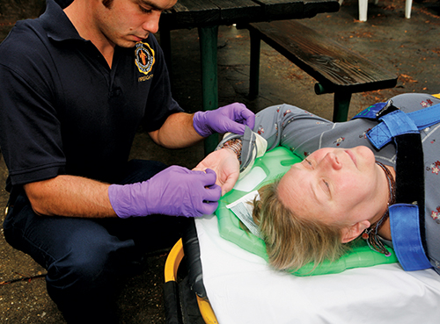
Medical Restraints (2 of 2)
Apply a restraint to each extremity.
Assess ABCs, mental status, and distal circulation after restraints are applied.
Document all information.
© Jones & Bartlett Learning. Courtesy of MIEMSS.
Notes:
Lecture Outline
F. Each extremity should have a restraint applied to it.
G. The patient should be restrained on a backboard with one arm above his or her head and the other arm by his or her side.
H. Assess the patient’s ABCs, mental status, and distal circulation after restraints are applied.
I. Document all information.

Slide 75
Personnel Considerations
Questions to ask before moving patient:
Am I physically strong enough to lift/move this patient?
Is there adequate room to get the proper stance to lift the patient?
Do I need additional personnel for lifting assistance?
Injured EMTs cannot help anyone.
Notes:
Lecture Outline
XVII. Personnel Considerations
A. Ask yourself these questions before moving a patient:
1. Am I physically strong enough to lift/move this patient?
2. Is there adequate room to get the proper stance to lift the patient?
3. Do I need additional personnel for lifting assistance?
B. Injured EMTs cannot help anyone.

Slide 76
Review
What is the first rule of lifting?
Twist slowly when you lift.
Keep your back in a straight position.
Bend at the waist to pick something up.
Use your arms to do most of the lifting.

Slide 77
Review
Answer: B
Rationale: The first rule of lifting is to always keep your back in a straight, upright, position and use the powerful muscles of your thighs. Never twist while lifting.

Slide 78
Review
What is the first rule of lifting?
Twist slowly when you lift. Rationale: You should never twist your back.
Keep your back in a straight position. Rationale: Correct answer
Bend at the waist to pick something up. Rationale: You should never bend at the waist. Your back should be properly maintained in an upright position.
Use your arms to do most of the lifting. Rationale: Use your leg muscles since they are well developed and very strong.

Slide 79
Review
When lifting a stretcher using the power lift, you should:
bend at the hips, knees, back, and arms.
bend at the waist and keep your back straight.
place your hands palms up on the litter handle.
place your hands palms down on the litter's side bars.

Slide 80
Review
Answer: C
Rationale: When lifting any heavy object, your hands should be facing palms up; this provides better lifting power and is not as stressful on the wrists.

Slide 81
Review (1 of 2)
When lifting a stretcher using the power lift, you should:
bend at the hips, knees, back, and arms. Rationale: When lifting, keep your back and arms straight. Always bend at the knees.
bend at the waist and keep your back straight. Rationale: When lifting, always keep your back straight. Never bend at the waist.

Slide 82
Review (2 of 2)
When lifting a stretcher using the power lift, you should:
place your hands palms up on the litter handle. Rationale: Correct answer
place your hands palms down on the litter's side bars. Rationale: Your hands have the greatest strength when your palms are facing up.

Slide 83
Review
It is impractical to apply a vest-type extrication device on a critically injured patient to remove him or her from a wrecked vehicle because it:
takes too long to correctly apply.
does not fully immobilize the spine.
cannot be used on patients who are in their car.
does not provide adequate stabilization.

Slide 84
Review
Answer: A
Rationale: It takes several minutes to correctly apply a vest-type extrication device. This is too much time to waste when treating a critically injured patient. A long backboard would be more appropriate. Vest-type immobilization devices, when applied correctly, provide adequate spinal stabilization and are ideal to use in stable patients who need to be removed from their vehicle.

Slide 85
Review (1 of 2)
It is impractical to apply a vest-type extrication device on a critically injured patient to remove him or her from a wrecked vehicle because it:
takes too long to correctly apply. Rationale: Correct answer
does not fully immobilize the spine. Rationale: When applied correctly, the vest provides adequate immobilization of the spine.

Slide 86
Review (2 of 2)
It is impractical to apply a vest-type extrication device on a critically injured patient to remove him or her from a wrecked vehicle because it:
cannot be used on patients who are in their car. Rationale: When a patient is stable, the vest is a beneficial device for vehicle extrications.
does not provide adequate stabilization. Rationale: The vest provides adequate stabilization of the spine.

Slide 87
Review
Proper guidelines for correct reaching include all of the following, EXCEPT:
avoiding twisting your back.
avoiding hyperextension of your back.
keeping the back in a locked-in position.
reaching no more than 30 inches in front of your body.

Slide 88
Review
Answer: D
Rationale: When reaching, you should keep your back in a locked-in position, and avoid twisting or hyperextending your back. Do not reach more than 15–20 inches in front of your body.

Slide 89
Review (1 of 2)
Proper guidelines for correct reaching include all of the following, EXCEPT:
avoiding twisting your back. Rationale: Never twist your back while reaching or lifting.
avoiding hyperextension of your back. Rationale: Never bend or hyperextend your back.

Slide 90
Review (2 of 2)
Proper guidelines for correct reaching include all of the following, EXCEPT:
keeping the back in a locked-in position. Rationale: Always keep your back straight in a locked position.
reaching no more than 30 inches in front of your body. Rationale: Correct answer

Slide 91
Review
An injured hang glider is trapped at the top of a large mountain and must be evacuated to the ground. The terrain is very rough and uneven. Which of the following devices would be the safest and most appropriate to use?
Stair chair
Stokes basket
Scoop stretcher
Long backboard

Slide 92
Review
Answer: B
Rationale: A basket stretcher, also called a Stokes basket, should be used to carry patients over rough or uneven terrain that is inaccessible by ambulance. Its closed-ended sides protect the patient from falling out of the device.

Slide 93
Review (1 of 2)
An injured hang glider is trapped at the top of a large mountain and must be evacuated to the ground. The terrain is very rough and uneven. Which of the following devices would be the safest and most appropriate to use?
Stair chair Rationale: This is used to transfer a patient up and down stairs.
Stokes basket Rationale: Correct answer

Slide 94
Review (2 of 2)
An injured hang glider is trapped at the top of a large mountain and must be evacuated to the ground. The terrain is very rough and uneven. Which of the following devices would be the safest and most appropriate to use?
Scoop stretcher Rationale: This is designed to split into two or four pieces. The EMT must have access to both sides of the patient, and the patient should be lying on a relatively flat surface.
Long backboard Rationale: There is no protection for the patient from falling off or out of the device.

Slide 95
Review
When two EMTs are lifting a patient on a long backboard, they should:
lift the patient from the sides of the board.
make every attempt to lift with their backs.
position the strongest EMT at the foot of the board.
position the strongest EMT at the head of the board.

Slide 96
Review
Answer: D
Rationale: Since more than half of the patient's weight is distributed to the head end of a backboard or stretcher, you should always ensure that the strongest EMT is at that position. This will reduce the risk of injury to less strong personnel as well as the risk of dropping the patient.

Slide 97
Review (1 of 2)
When two EMTs are lifting a patient on a long backboard, they should:
lift the patient from the sides of the board. Rationale: This may cause the backboard to tip since the upper torso is heavier.
make every attempt to lift with their backs. Rationale: Never lift with your back. Always use your legs.

Slide 98
Review (2 of 2)
When two EMTs are lifting a patient on a long backboard, they should:
position the strongest EMT at the foot of the board. Rationale: The strongest EMT should be at the patient’s head, where the patient’s weight is greater.
position the strongest EMT at the head of the board. Rationale: Correct answer

Slide 99
Review
Which of the following techniques is considered to be an emergency move?
Extremity lift
Supine transfer
Firefighter's drag
Direct ground lift

Slide 100
Review
Answer: C
Rationale: The firefighter's drag is a one-person technique that is used when a patient must be removed from a life-threatening situation immediately.

Slide 101
Review
Which of the following techniques is considered to be an emergency move?
Extremity lift Rationale: This is a nonurgent move, helpful in narrow spaces.
Supine transfer Rationale: This is not considered to be an emergency move.
Firefighter's drag Rationale: Correct answer
Direct ground lift Rationale: This is a nonurgent move, used to carry a patient over long distances to the cot.

Slide 102
Review
To extract a patient from the basement of a building, you must transport the patient up a flight of stairs. In doing this, you must ensure that:
the elevated head of the backboard goes first.
the backboard with the elevated foot end goes first.
the backboard is slightly tilted to the left to distribute weight.
the patient's feet are higher than his or her head, whichever end is carried first.

Slide 103
Review
Answer: A
Rationale: When you carry a patient upstairs or up an incline, you must ensure that the elevated head of the backboard or stretcher goes first. This will help to equally distribute the weight.

Slide 104
Review (1 of 2)
To extract a patient from the basement of a building, you must transport the patient up a flight of stairs. In doing this, you must ensure that:
the elevated head of the backboard goes first. Rationale: Correct answer
the backboard with the elevated foot end goes first. Rationale: Always try to carry the head higher to distribute the weight.

Slide 105
Review (2 of 2)
To extract a patient from the basement of a building, you must transport the patient up a flight of stairs. In doing this, you must ensure that:
the backboard is slightly tilted to the left to distribute weight. Rationale: Backboards are designed to carry a patient flat, and the weight is best distributed when the head is slightly elevated.
the patient's feet are higher than his or her head, whichever end is carried first. Rationale: Carries are easier with the patient’s head first and elevated for distribution of the patient’s weight.

Slide 106
Review
If an injured patient needs to be moved but is not in immediate danger from fire or building collapse, you should first:
order the equipment you need for extrication.
check the patient’s airway, breathing, and circulation.
remove the patient with the rapid extrication technique.
determine the number of people you will need to move the patient.

Slide 107
Review
Answer: B
Rationale: The only time your attention should be directed away from the primary assessment of the patient is when the patient’s life or your life is in immediate danger.

Slide 108
Review (1 of 2)
If an injured patient needs to be moved but is not in immediate danger from fire or building collapse, you should first:
order the equipment you need for extrication. Rationale: This is not the first thing you should do.
check the patient’s airway, breathing, and circulation. Rationale: Correct answer

Slide 109
Review (2 of 2)
If an injured patient needs to be moved but is not in immediate danger from fire or building collapse, you should first:
remove the patient with the rapid extrication technique. Rationale: The patient is not in immediate danger, so this is not needed.
determine the number of people you will need to move the patient. Rationale: After the ABCs have been checked, the EMT can then determine the safest method of extrication.

Slide 110
Review
The rapid extrication technique is a:
nonurgent move to remove a patient from a vehicle.
technique used to transfer a patient from a bed to a stretcher.
technique used to lift a patient with no suspected spinal injury onto a stretcher.
technique used to quickly remove a patient from a vehicle and onto a backboard.

Slide 111
Review
Answer: D
Rationale: With the rapid extrication technique, a seriously injured patient can be moved from a sitting position in a vehicle to a supine position on a backboard while protecting the spine at the same time.

Slide 112
Review (1 of 2)
The rapid extrication technique is a:
nonurgent move to remove a patient from a vehicle. Rationale: This technique is considered to be an urgent move.
technique used to transfer a patient from a bed to a stretcher. Rationale: This technique is used to move a patient from a vehicle to a backboard.

Slide 113
Review (2 of 2)
The rapid extrication technique is a:
technique used to lift a patient with no suspected spinal injury onto a stretcher. Rationale: This is not a lifting technique. The patient is placed on a backboard, not a stretcher.
technique used to quickly remove a patient from a vehicle and onto a backboard. Rationale: Correct answer

