Slide 1
Chapter 8
Lifting and Moving Patients
Notes:
Chapter 8: Lifting and Moving Patients

Slide 2
Introduction
In the course of a call, you will have to move patients.
To move patients without injury, you need to learn the proper techniques.
Knowledge of proper body mechanics and a power grip are important.
Notes:
Lecture Outline
I. Introduction
A. In the course of a call, you will have to move patients several times to provide emergency medical care and transport.
B. At a minimum, you will have to lift and carry the patient to the stretcher, move the stretcher to the ambulance, and load the stretcher into the patient compartment.
C. To move patients without injury to the patient, yourself, or your team, you need to learn how to lift and carry a patient properly.
D. Knowledge of proper body mechanics and a power grip is important.

Slide 3
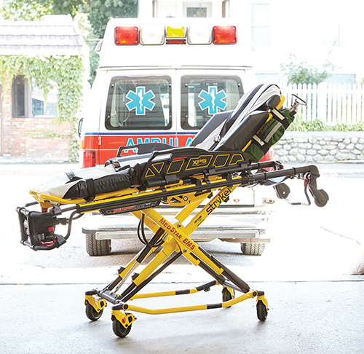
The Wheeled Ambulance Stretcher (1 of 2)
Also called a stretcher or gurney
Device most commonly used to move patients
Not taken up or down stairs
© Jones & Bartlett Learning.
Notes:
Lecture Outline
II. The Wheeled Ambulance Stretcher
A. Also called an ambulance stretcher or gurney
1. The device most commonly used to move and transport patients
2. Generally not taken up or down stairs or to other locations where the patient must be carried for any significant distance
3. Moving a patient by rolling, using a stretcher or other wheeled device, is preferred when the situation allows and helps prevent injuries from carrying.

Slide 4
The Wheeled Ambulance Stretcher (2 of 2)
General features
  Strong metal frame, adjustable to any height
  Hinges at center allow the head end to be elevated
  Guardrails prevent patient from rolling off
  Mattress must be fluid resistant
  Patient is secured with straps
Notes:
Lecture Outline
4. General features
a. Specific head end and specific foot end
b. Strong, horizontal, rectangular, metal main frame to which all other parts are attached
c. The undercarriage frame allows the litter to be adjusted to any height and locked into place. The stretcher remains locked at its present height when the controls are not activated.
d. Hinges at the center allow the head end to be elevated and the patient’s back to be positioned at any desired angle.
e. Retractable guardrails are attached along the central portion of the main frame to prevent the patient from rolling off of the stretcher.
f. The mattress on a stretcher must be fluid resistant so that it does not absorb any type of potentially infectious material, including water, blood, or other body fluid.
g. Patients must always be secured with the straps on the stretcher. In the event of a crash while en route to the hospital, these straps help prevent the patient from further injury.

Slide 5
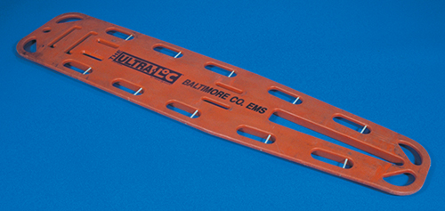
Backboards
Used to carry and immobilize patients with suspected spinal injury or other trauma
Holes serve as handles and a place to secure straps
© Jones & Bartlett Learning. Courtesy of MIEMSS.
Notes:
Lecture Outline
III. Backboards
A. Long, flat boards made of rigid, rectangular material
1. Used to carry and immobilize supine patients with suspected hip, pelvic, spinal, and lower extremity injuries or other multiple trauma
2. Can also be used to move patients out of awkward places
3. Parallel to the sides and ends of the board are long holes that serve as handles and that allow straps to be used to secure the patient to the board.

Slide 6
Moving and Positioning the Patient
When you move a patient, take care that injury does not occur.
Patient lifting and moving are technical skills that require repeated training and practice.
Using proper body mechanics and maintaining physical fitness greatly reduces the chance of injuries.
Notes:
Lecture Outline
IV. Moving and Positioning the Patient
A. When you move a patient, take care that injury does not occur:
1. To you
2. To your team
3. To the patient
B. Patient lifting and moving are technical skills that require repeated training and practice.
C. Using proper body mechanics and maintaining physical fitness greatly reduces the chance of injuries.
D. You must master the skills necessary for the use of all equipment and understand the advantages and limitations of each device before you use it in the field.

Slide 7
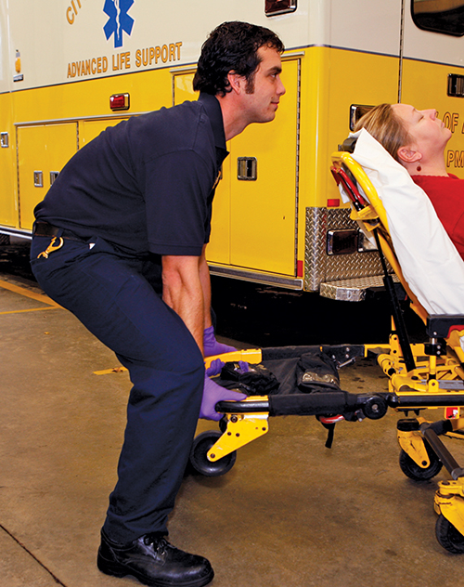
Body Mechanics (1 of 5)
Lifting position
  Shoulder girdle should be aligned over pelvis
  Hands should be held close to legs
© Jones & Bartlett Learning. Courtesy of MIEMSS.
Notes:
Lecture Outline
V. Body Mechanics
A. Lifting position
1. The shoulder girdle should be aligned over the pelvis.
2. The hands should be held close to the legs.
3. Force then goes essentially straight down the spinal column.
4. Very little strain occurs.

Slide 8
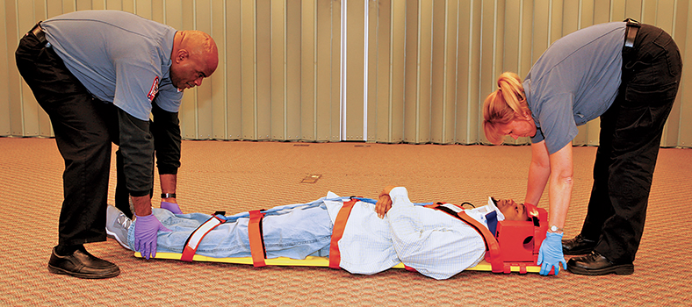
Body Mechanics (2 of 5)
You may injure your back:
  If you lift while leaning forward
  If you lift with your back straight but bent significantly forward at the hips
© Jones & Bartlett Learning. Courtesy of MIEMSS.
Notes:
Lecture Outline
B. You may injure your back:
1. If you lift while leaning forward
2. If you lift with your back straight but bent forward at the hips

Slide 9
Body Mechanics (3 of 5)
Lifting technique
  Legs should be spread about 15 inches apart (shoulder width).
  Place feet so the center of gravity is balanced.
  With your back held upright, bring your upper body down by bending the legs.
  Grasp the patient/stretcher.
Notes:
Lecture Outline
C. Lifting technique
1. Legs should be spread about 15 inches apart (shoulder width).
2. Place feet so that your center of gravity is properly balanced.
3. With your back held upright, bring your upper body down by bending the legs.
4. Grasp the patient or stretcher and make any necessary adjustments in the location of your feet.

Slide 10
Body Mechanics (4 of 5)
Lifting technique (cont’d)
  Lift the patient by raising your upper body and arms and straightening your legs until standing.
  Keep the weight close to your body.
  Keep your arms the same distance apart.
Notes:
Lecture Outline
5. Lift the patient by raising your upper body and arms and straightening your legs until you in a standing position and then curling your arms up to waist height.
6. Lifting by extending the properly placed flexed legs is the safest and most powerful way to lift.
a. This is called the power lift (Skill Drill 8-1).
7. Keep the weight you are lifting as close to your body as possible.
8. Keep your arms the same distance apart as when hanging your arms at each side of your body.

Slide 11
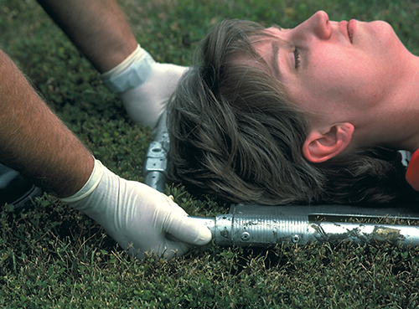
Body Mechanics (5 of 5)
Power grip gets maximum force from hands
  Palms up
  Hands about 10 inches apart
  All fingers at same angle
  Fully support handle on curved palm
© Jones & Bartlett Learning. Courtesy of MIEMSS.
Notes:
Lecture Outline
D. Use a power grip to get the maximum force from your hands when you are lifting.
1. Palms up and thumbs extended outward
2. Hands about 10 inches apart
3. All fingers at same angle; fingers and thumb curled tightly over the top of the handle
4. Fully support the handle on your curved palm.
5. When directly lifting a patient, tightly grip the patient in a place and manner that will ensure that you will not lose your grasp on the patient.

Slide 12
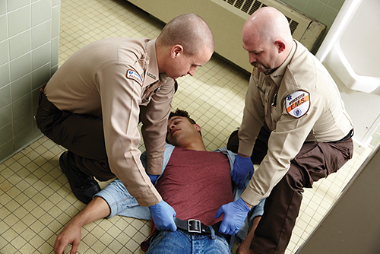
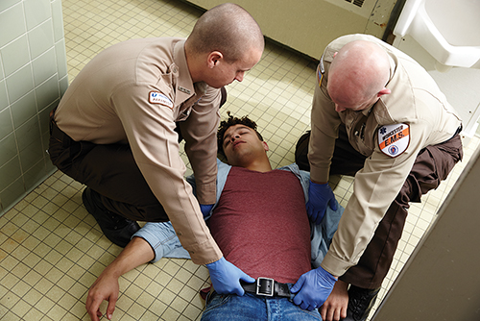
Principles of Safe Reaching and Pulling (1 of 5)
Body drag
  Keep back locked and straight by tightening abdominal muscles
  Kneel and extend arms no more than 15–20 inches in front of you.
  Alternate between pulling the patient by flexing your arms and repositioning yourself
© Jones & Bartlett Learning - Darren Stahlman
© Jones & Bartlett Learning - Darren Stahlman
Notes:
Lecture Outline
VI. Principles of Safe Reaching and Pulling
A. The same body mechanics and principles apply to moving, lifting, and carrying a patient.
B. Body drag
1. Keep your back locked in a slight curve created by tightening your abdominal muscles.
2. Kneel and extend your arms no more than 15–20 inches in front of you.
3. When you can pull no farther because your hands have reached the front of your torso, stop and move back another 15–20 inches.
4. Alternate between pulling the patient by slowly flexing your arms and repositioning yourself.

Slide 13
Principles of Safe Reaching and Pulling (2 of 5)
To drag a patient across a bed
  Kneel on the bed to avoid reaching beyond the recommended distance.
  Complete the drag while standing at the side of the bed.
  Use the sheet or blanket under the patient rather than dragging the patient by his or her clothing.
Notes:
Lecture Outline
B. If you must drag a patient across a bed, kneel on the bed to avoid reaching beyond the recommended distance.
1. Complete the drag while standing at the side of the bed.
2. Use the sheet or blanket under the patient rather than dragging the patient by his or her clothing.

Slide 14
Principles of Safe Reaching and Pulling (3 of 5)
In the hospital, transfer the patient from the stretcher to a bed with a body drag.
  The stretcher should be the same height or slightly higher than the bed.
  You and a partner should kneel on the bed and drag in increments.
Notes:
Lecture Outline
C. In the hospital, transfer the patient from the stretcher to a bed with a body drag.
1. The stretcher should be the same height or slightly higher than the bed.
2. You and a partner should kneel on the bed and drag in increments.

Slide 15
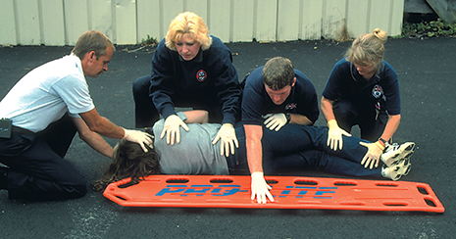
Principles of Safe Reaching and Pulling (4 of 5)
Log rolling
  Log roll the patient onto his or her side to place a patient on a backboard.
© Jones & Bartlett Learning – MIEMSS
Notes:
Lecture Outline
D. Log rolling a patient onto his or her side

Slide 16
Principles of Safe Reaching and Pulling (5 of 5)
Log rolling (cont’d)
  Kneel as close to the patient’s side as possible.
  Keep your back straight and lean solely from the hips.
  Roll the patient without stopping until the patient is resting on his or her side and braced against your thighs.
  Pulling toward you allows your legs to prevent the patient from rolling over completely.
Notes:
Lecture Outline
D. Log rolling a patient onto his or her side
1. Kneel as close to the patient’s side as possible.
2. When you lean forward, keep your back straight and lean solely from the hips.
3. Roll the patient without stopping until the patient is resting on his or her side and braced against your thighs.

Slide 17
Principles of Safe Lifting and Carrying (1 of 7)
Patient weight
  Estimate the patient’s weight before lifting.
  Do not attempt to lift a patient who weighs more than 250 lb with fewer than four providers.
  Know the weight limitations of the equipment and how to handle patients who exceed the weight limitations.
Notes:
Lecture Outline
VII. Principles of Safe Lifting and Carrying
A. Whenever possible, use a device that can be rolled to move a patient.
B. When a wheeled device is not available, make sure that you understand and follow proper guidelines for carrying a patient on a stretcher.
C. Patient weight
1. Estimate the patient’s weight before lifting.
a. Adults often weigh 120–220 lb.
b. Two EMTs should be able to safely lift this weight.
2. Do not attempt to lift a patient who weighs more than 250 lb with fewer than four providers.
3. Know the weight limitations of the equipment and how to handle patients who exceed the weight limitations.

Slide 18
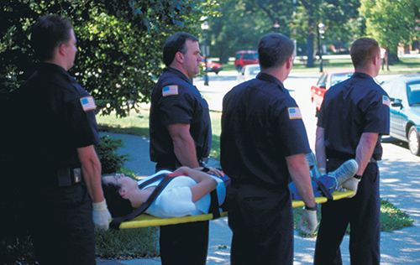
Principles of Safe Lifting and Carrying (2 of 7)
Lifting and carrying a patient on a backboard or stretcher
  More of the patient’s weight rests at the head.
  Diamond carry and one-handed carry
© Jones & Bartlett Learning. Courtesy of MIEMSS.
Notes:
Lecture Outline
D. Lifting and carrying a patient on a backboard or stretcher
1. More of the patient’s weight rests on the head half of the device than on the foot half.
2. The diamond carry uses one EMT at the head and one at the foot of the backboard, and one on each side of the torso (Skill Drill 8-2).
3. The one-handed carry includes four or more rescuers, each using one hand to support the backboard, so that they are able to face forward as they are walking (Skill Drill 8-3).
4. When the stretcher must be carried, it is best if four providers are available to carry it. One provider should be positioned at each corner of the stretcher to provide an even lift.

Slide 19
Principles of Safe Lifting and Carrying (3 of 7)
Rolling a wheeled stretcher
  Make sure that it is in the fully elevated position.
  Your partner should control the head end and assist you by pushing with his or her arms held with the elbows bent.
Notes:
Lecture Outline
5. When you are rolling the wheeled ambulance stretcher, make sure that it is in the fully elevated position.

Slide 20
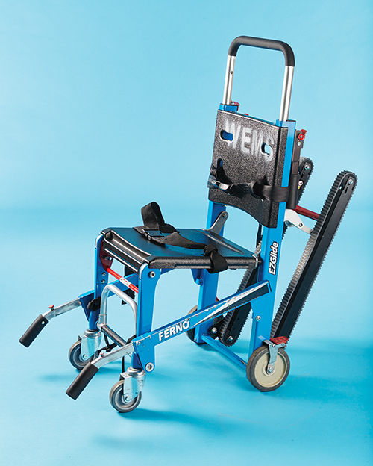
Principles of Safe Lifting and Carrying (4 of 7)
Moving a patient with a stair chair
  Use a stair chair to carry a conscious patient up or down a flight of stairs.
  Lightweight, wheeled folding chair
© Jones & Bartlett Learning.
Notes:
Lecture Outline
E. Moving a patient with a stair chair
1. Use a stair chair to carry a patient up or down a flight of stairs or other significant incline if:
a. The patient is conscious.
b. The patient’s condition allows him or her to be placed in a sitting position.
2. A stair chair is a lightweight folding chair with a molded seat, adjustable safety straps, and fold-out handles at both the head and feet.
3. Most models have rubber wheels in the back with casters in front so that they can roll along the floor and make turns.
4. Used to bring a conscious patient down to a stretcher (Skill Drill 8-4)

Slide 21
Principles of Safe Lifting and Carrying (5 of 7)
Moving a patient on stairs
  Backboard should be used instead for patient:
    Who is unresponsive
    Who must be moved in supine position
    Who must be immobilized
  Carry the patient on the backboard down the stairs to the prepared stretcher.
Notes:
Lecture Outline
F. Moving a patient on stairs with a stretcher
1. A backboard should be used for a patient:
a. Who is unresponsive
b. Who must be moved in supine position
c. Who must be immobilized
2. Carry the patient on the backboard down the stairs to the prepared stretcher.
a. Place the strongest EMTs at the head and foot ends of the board.
b. The taller person should be at the foot end.
3. See Skill Drill 8-5.

Slide 22
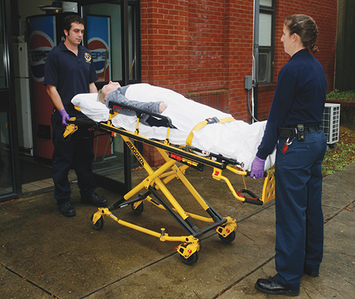
Principles of Safe Lifting and Carrying (6 of 7)
Loading a wheeled stretcher into an ambulance
  Ensure the frame is held firmly between two hands so it does not tip
© Jones and Bartlett Learning.
Notes:
Lecture Outline
G. Loading a wheeled stretcher into an ambulance
1. Ensure the frame is held firmly between two hands so it does not tip.
2. Newer models are self-loading.
a. Extra wheels at the head end of the stretcher allow you to push the stretcher into the back of the ambulance.
3. Models that are not self-loading need to be lowered and then lifted to the height of the floor of the ambulance.
4. Clamps inside the ambulance will hold the stretcher in place during transport.
5. See Skill Drill 8-6.

Slide 23
Principles of Safe Lifting and Carrying (7 of 7)
Loading a wheeled stretcher into an ambulance (cont.)
  Newer models are self-loading, allowing you to push the stretcher into the ambulance.
  Other models need to be lowered and lifted to the height of the floor of ambulance.
  Clamps in the ambulance hold the stretcher in place.
Notes:
Lecture Outline
G. Loading a wheeled stretcher into an ambulance
1. Ensure the frame is held firmly between two hands so it does not tip.
2. Newer models are self-loading.
a. Extra wheels at the head end of the stretcher allow you to push the stretcher into the back of the ambulance.
3. Models that are not self-loading need to be lowered and then lifted to the height of the floor of the ambulance.
4. Clamps inside the ambulance will hold the stretcher in place during transport.
5. See Skill Drill 8-6.

Slide 24
Directions and Commands
Team actions must be coordinated.
Team leader:
  Indicates where each team member should be
  Rapidly describes sequence of steps to perform before lifting
Use preparatory commands and countdowns.
Notes:
Lecture Outline
VIII. Directions and Commands
A. Team actions must be coordinated.
B. Team leader:
1. Indicates where each team member should be
2. Rapidly describes sequence of steps to perform before lifting
C. Preparatory commands and countdowns are used.

Slide 25
Emergency Moves (1 of 4)
Use when there is potential for danger
  Fire, explosives, hazardous materials
Use when you cannot properly assess the patient or provide immediate care because of the patient’s location or position
Notes:
Lecture Outline
IX. Emergency Moves
A. Emergency moves are used when there is a potential for danger before assessment and care are provided.
1. Examples: fire, explosives, hazardous materials
B. Use these moves when you cannot properly assess the patient or provide immediate care because of the patient’s location or position.

Slide 26
Emergency Moves (2 of 4)
Use techniques to help prevent aggravation of patient spinal injury
  Clothes drag
  Blanket drag
  Arm drag
  Arm-to-arm drag
Notes:
Lecture Outline
C. Use techniques to help prevent aggravation of patient’s spinal injury.
1. Clothes drag: Pull on the patient’s clothing in the neck and shoulder area.
2. Blanket drag: Place the patient on a blanket, coat, or other item that can be pulled.
3. Arm drag: Rotate the patient’s arms so they are extended straight on the ground beyond his or her head, grasp the wrists, and drag the patient.
4. Arm-to-arm drag: Place your arms under the patient’s shoulders and through the armpits, and, while grasping your opposite wrist, drag the patient backward.

Slide 27
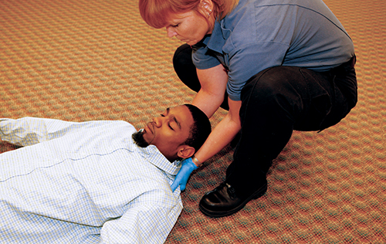
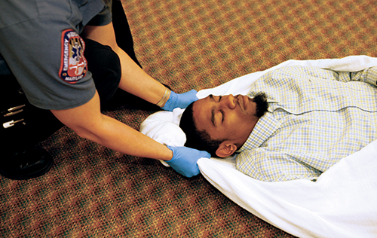
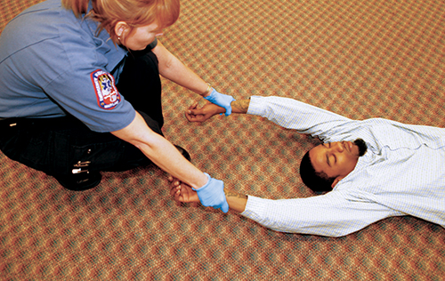
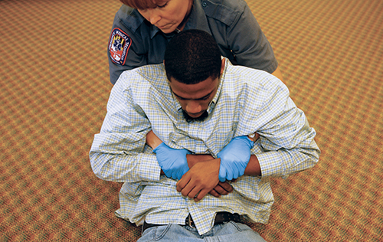
Emergency Moves (3 of 4)
© Jones & Bartlett Learning. Courtesy of MIEMSS.
© Jones & Bartlett Learning. Courtesy of MIEMSS.
© Jones & Bartlett Learning. Courtesy of MIEMSS.
© Jones & Bartlett Learning. Courtesy of MIEMSS.
Notes:
These figures show the different types of drags: clothes drag, blanket drag, arm drag, and arm-to-arm drag.

Slide 28
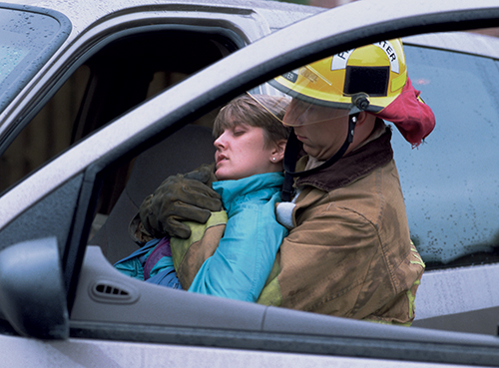
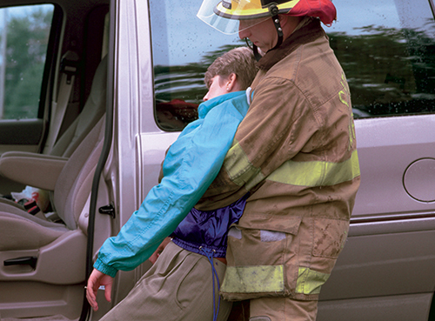
Emergency Moves (4 of 4)
Removing an unconscious patient from a vehicle while alone:
  Move patient’s legs clear of the pedals
  Rotate patient so back is toward open car door
  Place arms through armpits, supporting head against your body
  Drag to a safe location
© Jones & Bartlett Learning. Courtesy of MIEMSS.
© Jones & Bartlett Learning. Courtesy of MIEMSS.
Notes:
Lecture Outline
D. Removing an unconscious patient from a vehicle while alone
1. Move the patient’s legs clear of the pedals.
2. Rotate the patient so that his or her back is toward the open car door.
3. Place your arms under the patient’s shoulders and through the patient’s armpits, and support the patient’s head against your body.
4. If the legs and feet clear the car, rapidly drag the patient from the seat to a safe location.

Slide 29
Urgent Moves (1 of 2)
Necessary to move patients:
  With altered level of consciousness
  With inadequate ventilation
  In shock
Notes:
Lecture Outline
X. Urgent Moves
A. An urgent move may be necessary to move patients:
1. With altered level of consciousness
2. With inadequate ventilation
3. In shock

Slide 30
Urgent Moves (2 of 2)
Rapid extrication technique should be used only if urgency exists.
This technique increases the risk of damage if the patient has a spinal injury.
Consider all options before using this technique.
Notes:
Lecture Outline
B. Rapid extrication technique should be used when a patient is sitting in a vehicle and must be urgently moved (Skill Drill 8-7). Whether a backboard is used for this skill will depend on your local protocols.
1. This technique should be used only if urgency exists.
a. The vehicle or scene is unsafe.
b. Explosives or other hazards are on scene.
c. There is fire or a danger of fire.
d. The patient cannot be properly assessed prior to removal from the vehicle.
e. The patient needs immediate intervention that requires a supine position.
f. The patient has a life-threatening condition requiring immediate transport.
g. The patient blocks your access to another seriously injured patient.
2. Using the rapid extrication technique, a patient can be moved from sitting in a vehicle to supine on a backboard in 1 minute or less.
3. Because of its rapid nature, this technique increases the risk of damage if the patient has a spinal injury.
4. Look at all available options before using this technique.
5. Once the patient has been moved onto the backboard, move the patient away from the hazard to begin life-saving treatment.

Slide 31
Nonurgent Moves (1 of 4)
Used when both scene and patient are stable
Carefully plan how to move the patient.
Notes:
Lecture Outline
XI. Nonurgent Moves
A. Used when both the scene and the patient are stable
B. Carefully plan how to move the patient.

Slide 32
Nonurgent Moves (2 of 4)
Choose between:
  Direct ground lift
    For supine patients with no suspected spinal injury
    For patients who need to be carried over some distance
    EMTs stand side by side to lift/carry the patient.
Notes:
Lecture Outline
C. Methods for lifting and carrying
1. Direct ground lift (Skill Drill 8-8)
a. Used for patients with no suspected spinal injury who are found supine on the ground
b. Use the direct ground lift when the patient will need to be carried a distance to the stretcher.
c. EMTs stand side by side to lift and carry the patient.

Slide 33
Nonurgent Moves (3 of 4)
  Extremity lift
    For patients with no suspected spinal injury who are supine or sitting
    Patients who are in a small space
    One EMT is at the patient’s head and the other at the patient’s feet.
    Coordinate moves verbally.
Notes:
Lecture Outline
2. Extremity lift (Skill Drill 8-9)
a. Used for patients with no suspected extremity or spinal injury who are supine or in a sitting position
b. May be helpful when patient is in a small space because it does not require EMTs to stand side by side
c. One EMT is positioned at the patient’s head and the other EMT is positioned at the patient’s feet.
d. Coordinate your movements using direct verbal commands.

Slide 34
Nonurgent Moves (4 of 4)
Transfer moves
  Direct carry
    Move supine patient from bed to stretcher
  Draw sheet method
    Move patient using a sheet or blanket
  Scoop stretcher
Notes:
Lecture Outline
D. Transfer moves
1. Direct carry (Skill Drill 8-10)
a. With two or more rescuers, move the supine patient from the bed to the stretcher using a direct carry method.
2. Draw sheet method
a. With two or more rescuers, move the patient from the bed to the stretcher using a sheet or blanket.
3. Using a scoop stretcher (Skill Drill 8-11)
a. Insert the halves of the scoop stretcher under each side of a patient.
b. Fasten the sides together.
c. With two or more rescuers, move the patient to a nearby stretcher.
4. Other carries
a. Log roll or slide to move the patient onto the backboard, secure the patient, and lift and carry the backboard to the nearby prepared stretcher.
b. Assist the patient to the edge of the bed, and place the patient’s legs over the side, helping the patient to sit up. Move the stretcher so that its foot end touches the bed near the patient. Help the patient to stand and rotate so that he or she can sit down on the center of the stretcher. Lift the patient’s legs, and rotate them onto the stretcher while your partner lowers the patient’s torso onto the stretcher.

Slide 35
Geriatrics (1 of 2)
Many patients transported by EMS are geriatric patients.
Brittle bones, rigidity, and spinal curvatures may present special challenges.
Allay the patient’s fears with a sympathetic and compassionate approach.
Notes:
Lecture Outline
XII. Geriatrics
A. Many patients transported by EMS are geriatric patients.
B. Skeletal changes
1. Skeletal changes in older people may cause brittle bones, rigidity, and spinal curvatures.
2. Present special challenges in packaging and moving older patients
3. Many patients cannot lie supine on a backboard or scoop stretcher without causing further injury.
4. Consider the use of geriatric-specific immobilization devices, such as a vacuum mattress.
C. Fear
1. Allay the patient’s fears with a sympathetic and compassionate approach.
2. Slow down, explain, and anticipate.

Slide 36
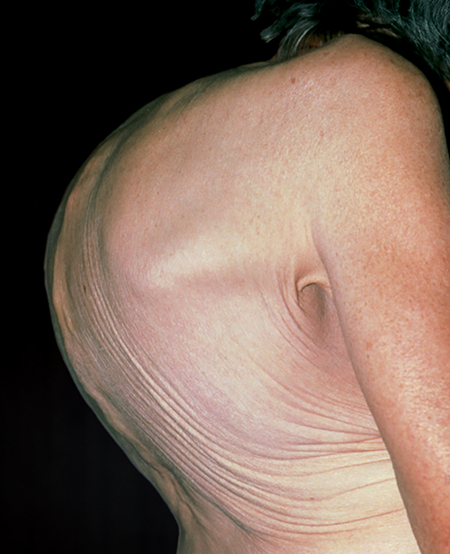
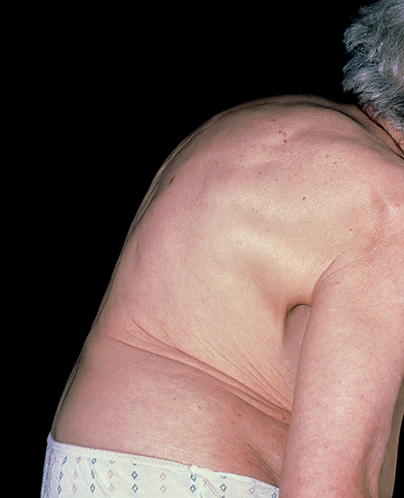
Geriatrics (2 of 2)
© Dr. P. Marazzi/Photo Researchers, Inc.
© Dr. P. Marazzi/Photo Researchers, Inc.
Kyphosis
Spondylosis
Notes:
The figures on this slide show the skeletal changes that can occur in geriatric patients. A. Kyphosis. B. Spondylosis.

Slide 37
Bariatrics
Refers to management of obesity
Back injuries account for the largest number of missed days of work.
Stretchers and equipment are being produced with higher capacities.
  Does not address danger to users of that equipment
Notes:
Lecture Outline
XIII. Bariatrics
A. Bariatrics: the management (prevention or control) of obesity and allied diseases
B. Bariatric patients are taking an increasing toll on the health of EMTs; back injuries account for the largest number of missed days of work.
C. Stretchers and equipment are being produced with ever-higher capacities.
1. Increased capacity does not address the danger to users of that equipment.
2. Mechanical ambulance lifts are used in Europe but are uncommon in the United States.

Slide 38
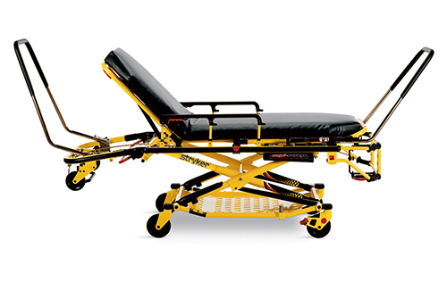
Additional Patient-Moving Equipment (1 of 10)
Bariatric stretchers
  Specialized for overweight or obese patients
  Wider wheelbase for increased stability
Courtesy of Stryker Medical, a division of Stryker Corporation.
Notes:
Lecture Outline
XIV. Additional Patient-Moving Equipment
A. Bariatric stretchers
1. Specialized wheeled stretchers for overweight or obese patients
2. Have a wider patient surface area and wider wheelbase allowing for increased stability
3. The most important feature is the increased weight-lifting capacity.

Slide 39
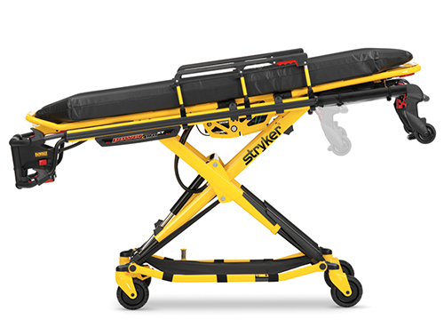
Additional Patient-Moving Equipment (2 of 10)
Pneumatic and electronic-powered wheeled stretchers
  Electronic controls to raise/lower undercarriage
  Increased stretcher weight
  Hazardous in uneven terrain
Courtesy of Stryker Medical, a division of Stryker Corporation.
Notes:
Lecture Outline
B. Pneumatic and electronic-powered wheeled stretchers
1. Battery- or air-operated units with electronic controls to raise and lower the undercarriage
2. The added controls and equipment increase the weight of the stretcher.

Slide 40
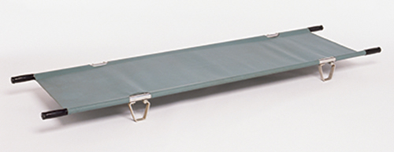
Additional Patient-Moving Equipment (3 of 10)
Portable/folding stretchers
  Strong, rectangular tubular metal frame with fabric stretched across it
© Steve Gorton/Getty Images.
Notes:
Lecture Outline
C. Portable/folding stretchers
1. Stretchers with a strong rectangular tubular metal frame with rigid fabric stretched across it
2. Used in areas that are difficult to reach
3. Weigh much less than wheeled stretchers

Slide 41
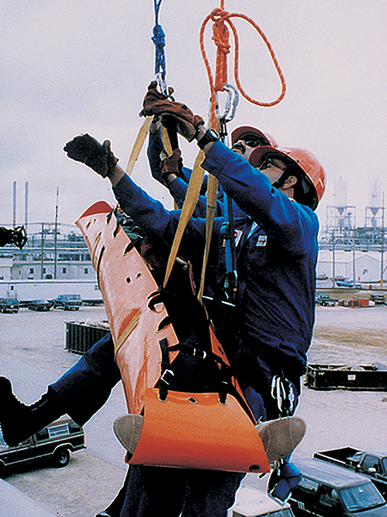
Additional Patient-Moving Equipment (4 of 10)
Flexible stretchers
  Can be rolled into a tubular package
  Conform around a patient’s sides
  Useful for confined spaces
© American Academy of Orthopaedic Surgeons.
Notes:
Lecture Outline
D. Flexible stretchers
1. Can be rolled up across the stretcher’s width or length so the stretcher becomes a smaller tubular package
2. Conforms around a patient’s sides and does not extend beyond them
3. When extended, useful for removing a patient from or through a confined space

Slide 42
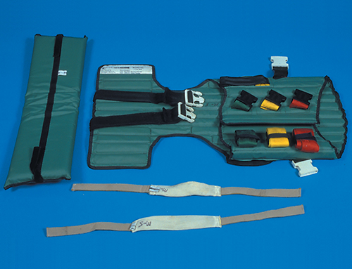
Additional Patient-Moving Equipment (5 of 10)
Short backboards
  Used to immobilize seated patients
    Example: KED vest-type device
© Jones & Bartlett Learning. Courtesy of MIEMSS.
Notes:
Lecture Outline
E. Short backboards
1. Used to immobilize the head, torso, and neck of a seated patient with a suspected spinal injury
2. Short wooden backboards have mostly been replaced with a vest-type device such as the KED.

Slide 43
Additional Patient-Moving Equipment (6 of 10)
Vacuum mattresses
  Alternative to backboard for immobilizing geriatric and pediatric patients
  Air is removed from the device, allowing it to mold around the patient.
  Provides immobilization, comfort, and thermal insulation
Notes:
Lecture Outline
F. Vacuum mattresses
1. An alternative to the backboard for immobilizing geriatric and pediatric patients
2. The patient is placed on the mattress and the air is removed from the device, allowing it to mold around the patient.
3. Provides a high degree of immobilization, comfort, and thermal insulation

Slide 44
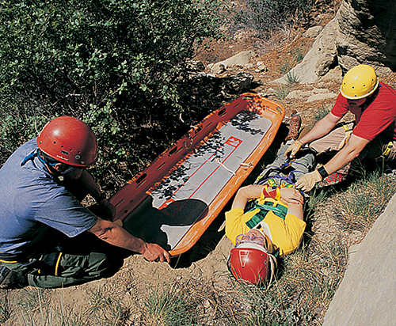
Additional Patient-Moving Equipment (7 of 10)
Basket stretchers
  Rigid litter
  Also called a Stokes litter
  Used for remote locations, including water rescue and technical rope rescue
© Jones & Bartlett Learning. Courtesy of MIEMSS.
Notes:
Lecture Outline
G. Basket stretchers
1. Rigid stretchers used to carry patients across uneven terrain from a remote location that is inaccessible by ambulance or other vehicle

Slide 45
Additional Patient-Moving Equipment (8 of 10)
Basket stretchers (cont’d)
  In case of spinal injury, secure the patient to the backboard, and then secure it inside the basket stretcher to carry the patient out of the location.
  When you return to the ambulance, lift the backboard out of basket stretcher and place it on the wheeled stretcher.
Notes:
Lecture Outline
2. If the patient has a suspected spinal injury, secure the patient to a backboard and secure the backboard inside the basket stretcher.
3. When you return to the ambulance, lift the backboard out of the basket stretcher and place it on the wheeled ambulance stretcher.
4. Used for technical rope rescues and some water rescues

Slide 46
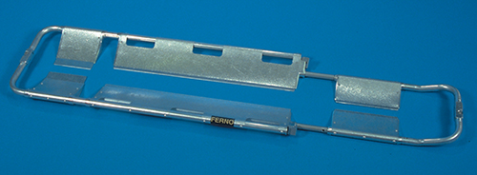
Additional Patient-Moving Equipment (9 of 10)
Scoop stretchers
  Splits into two or four pieces
    Pieces fit around patient who is lying on flat surface
  Patient must be stabilized and secured on scoop stretcher
© Jones & Bartlett Learning. Courtesy of MIEMSS.
Notes:
Lecture Outline
H. Scoop stretchers
1. Designed to be split into two or four pieces
2. The pieces are fitted around a patient who is lying on the ground or on a flat surface.
3. The parts are then reconnected, and the patient is lifted and put onto a backboard.
4. You must fully stabilize immobilize and secure the patient on the scoop stretcher.

Slide 47
Additional Patient-Moving Equipment (10 of 10)
Neonatal isolettes
  Neonates cannot be transported on a wheeled stretcher.
  The isolette keeps the neonate warm, and protects the child from noise, draft, infection, and excess handling.
  The isolette may be secured to a wheeled ambulance stretcher or freestanding.
Notes:
Lecture Outline
I. Neonatal isolettes
1. A neonatal patient cannot be transported on a wheeled ambulance stretcher.
2. A neonatal isolette keeps the neonatal patient warm, with moistened air in a clean environment.
4. Protects from noise, drafts, infection, and excess handling
5. The isolette can be:
a. Placed directly on a wheeled ambulance stretcher and secured with seat belts
b. Freestanding and secured into the back of an ambulance in place of where the standard stretcher would be

Slide 48
Decontamination
Decontaminate equipment after use:
  For your safety
  For the safety of the crew
  For the safety of the patient
  To prevent the spread of disease
Notes:
Lecture Outline
J. Decontamination
1. It is essential that you decontaminate equipment after use:
a. For your own safety
b. For the safety of crew using the equipment after you
c. For the safety of your patients
d. To prevent the spread of disease
2. Know and follow your local standard operating procedures for disinfecting equipment.

Slide 49
Patient Positioning (1 of 2)
Proper position is based on the chief complaint.
  A patient reporting chest pain or respiratory distress should be placed in a position of comfort
  Patients in shock should be placed supine.
  Patients in late stages of pregnancy should be positioned and transported on their left side.
Notes:
Lecture Outline
XV. Patient Positioning
A. A patient must be properly positioned based on the chief complaint.
1. A patient with no suspected injury reporting chest pain or respiratory distress should be placed in a position of comfort—typically a Fowler or semi-Fowler position.
2. Patients who are in shock should be packaged and placed in a supine position.
3. Patients in late stages of pregnancy should be positioned and transported on their left side if they are uncomfortable or hypotensive when supine.

Slide 50
Patient Positioning (2 of 2)
Proper position (cont’d)
  An unresponsive patient with no suspected spinal injury should be placed in the recovery position.
  A patient who is nauseated or vomiting should be transported in a position of comfort.
Notes:
Lecture Outline
4. An unresponsive patient with no suspected spinal, hip, or pelvic injury should be placed in the recovery position.
5. A patient who is nauseated or vomiting should be transported in a position of comfort.

Slide 51
Medical Restraints (1 of 2)
Evaluate for correctible causes of combativeness.
  Head injury, hypoxia, hypoglycemia
Follow local protocols.
Restraint requires five personnel.
Restrain the patient supine.
  Positional asphyxia may develop in prone position.
Notes:
Lecture Outline
XVI. Medical Restraints
A. First evaluate the patient for correctible causes of combativeness.
1. Head injury, hypoxia, hypoglycemia
B. Follow local protocols. Obtain medical control authorization if necessary.
C. Restraint requires a minimum of five personnel.
1. One for each extremity of the patient, and one for the patient’s head
2. One EMT should be the established team leader.
D. The patient should be in the supine position.
1. A patient in the prone position can develop positional asphyxia.

Slide 52
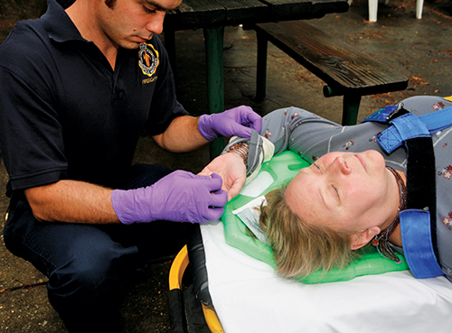
Medical Restraints (2 of 2)
Apply a restraint to each extremity.
Assess ABCs, mental status, and distal circulation after restraints are applied.
Document all information.
© Jones & Bartlett Learning. Courtesy of MIEMSS.
Notes:
Lecture Outline
E. Each extremity should have a restraint applied to it.
F. The patient should be restrained on a backboard with one arm above his or her head and the other arm by his or her side.
G. Continually assess the patient’s ABCs, mental status, and distal circulation after restraints are applied.
H. Document all information.

Slide 53
Personnel Considerations
Questions to ask before moving a patient:
  Am I physically strong enough to lift/move this patient?
  Is there adequate room to get the proper stance to lift the patient?
  Do I need additional personnel for lifting assistance?
Injured EMTs cannot help anyone.
Notes:
Lecture Outline
XVII. Personnel Considerations
A. Ask yourself these questions before moving a patient:
1. Am I physically strong enough to lift/move this patient?
2. Is there adequate room to get the proper stance to lift the patient?
3. Do I need additional personnel for lifting assistance?
B. Injured EMTs cannot help anyone.

Slide 54
Review
What is the first rule of lifting?
  Twist slowly when you lift
  Keep your back in a straight position
  Bend at the waist to pick something up
  Use your arms to do most of the lifting

Slide 55
Review
Answer: B
Rationale: The first rule of lifting is to always keep your back in a straight, upright, position and use the powerful muscles of your thighs. Never twist while lifting.

Slide 56
Review
What is the first rule of lifting?
  Twist slowly when you lift
  Rationale: You should never twist your back.
  Keep your back in a straight position
  Rationale: Correct answer
  Bend at the waist to pick something up
  Rationale: You should never bend at the waist. Your back should be properly maintained in an upright position.
  Use your arms to do most of the lifting
  Rationale: Use your leg muscles since they are well developed and very strong.

Slide 57
Review
When lifting a stretcher using the power lift, you should:
  bend at the hips, knees, back, and arms.
  bend at the waist and keep your back straight.
  place your hands palms up on the litter handle.
  place your hands palms down on the litter's side bars.

Slide 58
Review
Answer: C
Rationale: When lifting any heavy object, your hands should be facing palms up; this provides better lifting power and is not as stressful on the wrists.

Slide 59
Review (1 of 2)
When lifting a stretcher using the power lift, you should:
  bend at the hips, knees, back, and arms.
  Rationale: When lifting, keep your back and arms straight. Always bend at the knees.
  bend at the waist and keep your back straight.
  Rationale: When lifting, always keep your back straight. Never bend at the waist.

Slide 60
Review (2 of 2)
When lifting a stretcher using the power lift, you should:
  place your hands palms up on the litter handle.
  Rationale: Correct answer
  place your hands palms down on the litter's side bars.
  Rationale: Your hands have the greatest strength when your palms are facing up.

Slide 61
Review
It is impractical to apply a vest-type extrication device on a critically injured patient to remove him or her from a wrecked vehicle because it:
  takes too long to correctly apply.
  does not fully immobilize the spine.
  cannot be used on patients who are in their car.
  does not provide adequate stabilization.

Slide 62
Review
Answer: A
Rationale: It takes several minutes to correctly apply a vest-type extrication device. This is too much time to waste when treating a critically injured patient. A long backboard would be more appropriate. Vest-type immobilization devices, when applied correctly, provide adequate spinal stabilization and are ideal to use in stable patients who need to be removed from their vehicle.

Slide 63
Review (1 of 2)
It is impractical to apply a vest-type extrication device on a critically injured patient to remove him or her from a wrecked vehicle because it:
  takes too long to correctly apply.
  Rationale: Correct answer
  does not fully immobilize the spine.
  Rationale: When applied correctly, the vest provides adequate immobilization of the spine.

Slide 64
Review (2 of 2)
It is impractical to apply a vest-type extrication device on a critically injured patient to remove him or her from a wrecked vehicle because it:
  cannot be used on patients who are in their car.
  Rationale: When a patient is stable, the vest is a beneficial device for vehicle extrications.
  does not provide adequate stabilization.
  Rationale: The vest provides adequate stabilization of the spine.

Slide 65
Review
Proper guidelines for correct reaching include all of the following, EXCEPT:
  avoiding twisting your back.
  avoiding hyperextension of your back.
  keeping the back in a locked-in position.
  reaching no more than 30 inches in front of your body.

Slide 66
Review
Answer: D
Rationale: When reaching, you should keep your back in a locked-in position, and avoid twisting or hyperextending your back. Do not reach more than 15–20 inches in front of your body.

Slide 67
Review (1 of 2)
Proper guidelines for correct reaching include all of the following, EXCEPT:
  avoiding twisting your back.
  Rationale: Never twist your back while reaching or lifting.
  avoiding hyperextension of your back.
  Rationale: Never bend or hyperextend your back.

Slide 68
Review (2 of 2)
Proper guidelines for correct reaching include all of the following, EXCEPT:
  keeping the back in a locked-in position.
  Rationale: Always keep your back straight in a locked position.
  reaching no more than 30 inches in front of your body.
  Rationale: Correct answer

Slide 69
Review
An injured hang glider is trapped at the top of a large mountain and must be evacuated to the ground. The terrain is very rough and uneven. Which of the following devices would be the safest and most appropriate to use?
  Stair chair
  Stokes basket
  Scoop stretcher
  Long backboard

Slide 70
Review
Answer: B
Rationale: A basket stretcher, also called a Stokes basket, should be used to carry patients over rough or uneven terrain that is inaccessible by ambulance. Its closed-ended sides protect the patient from falling out of the device.

Slide 71
Review (1 of 2)
An injured hang glider is trapped at the top of a large mountain and must be evacuated to the ground. The terrain is very rough and uneven. Which of the following devices would be the safest and most appropriate to use?
  Stair chair
  Rationale: This is used to transfer a patient up and down stairs.
  Stokes basket
  Rationale: Correct answer

Slide 72
Review (2 of 2)
An injured hang glider is trapped at the top of a large mountain and must be evacuated to the ground. The terrain is very rough and uneven. Which of the following devices would be the safest and most appropriate to use?
  Scoop stretcher
  Rationale: This is designed to split into 2 or 4 pieces. The EMT must have access to both sides of the patient, and the patient should be lying on a relatively flat surface.
  Long backboard
  Rationale: There is no protection for the patient from falling off or out of the device.

Slide 73
Review
When two EMTs are lifting a patient on a long backboard, they should:
  lift the patient from the sides of the board.
  make every attempt to lift with their backs.
  position the strongest EMT at the foot of the board.
  position the strongest EMT at the head of the board.

Slide 74
Review
Answer: D
Rationale: Since more than half of the patient's weight is distributed to the head end of a backboard or stretcher, you should always ensure that the strongest EMT is at that position. This will reduce the risk of injury to less strong personnel as well as the risk of dropping the patient.

Slide 75
Review (1 of 2)
When two EMTs are lifting a patient on a long backboard, they should:
  lift the patient from the sides of the board.
  Rationale: This may cause the backboard to tip since the upper torso is heavier.
  make every attempt to lift with their backs.
  Rationale: Never lift with your back. Always use your legs.

Slide 76
Review (2 of 2)
When two EMTs are lifting a patient on a long backboard, they should:
  position the strongest EMT at the foot of the board.
  Rationale: The strongest EMT should be at the patient’s head, where the patient’s weight is greater.
  position the strongest EMT at the head of the board.
  Rationale: Correct answer

Slide 77
Review
Which of the following techniques is considered to be an emergency move?
  Extremity lift
  Supine transfer
  Firefighter's drag
  Direct ground lift

Slide 78
Review
Answer: C
Rationale: The firefighter's drag is a one-person technique that is used when a patient must be removed from a life-threatening situation immediately.

Slide 79
Review
Which of the following techniques is considered to be an emergency move?
  Extremity lift
  Rationale: This is a nonurgent move, helpful in narrow spaces.
  Supine transfer
  Rationale: This is not considered an emergency move.
  Firefighter's drag
  Rationale: Correct answer
  Direct ground lift
  Rationale: This is a nonurgent move, used to carry a patient long distances to the cot.

Slide 80
Review
To extract a patient from the basement of a building, you must transport the patient up a flight of stairs. In doing this, you must ensure that:
  the elevated head of the backboard goes first.
  the backboard with the elevated foot end goes first.
  the backboard is slightly tilted to the left to distribute weight.
  the patient's feet are higher than his or her head, whichever end is carried first.

Slide 81
Review
Answer: A
Rationale: When you carry a patient upstairs or up an incline, you must ensure that the elevated head of the backboard or stretcher goes first. This will help to equally distribute the weight.

Slide 82
Review (1 of 2)
To extract a patient from the basement of a building, you must transport the patient up a flight of stairs. In doing this, you must ensure that:
  the elevated head of the backboard goes first.
  Rationale: Correct answer
  the backboard with the elevated foot end goes first.
  Rationale: Always try to carry the head higher to distribute the weight.

Slide 83
Review (2 of 2)
To extract a patient from the basement of a building, you must transport the patient up a flight of stairs. In doing this, you must ensure that:
  the backboard is slightly tilted to the left to distribute weight.
  Rationale: Backboards are designed to carry a patient flat, and the weight is best distributed when the head is slightly elevated.
  the patient's feet are higher than his or her head, whichever end is carried first.
  Rationale: Carries are easier with the patient’s head first and elevated for distribution of the patient’s weight.

Slide 84
Review
If an injured patient needs to be moved but is not in immediate danger from fire or building collapse, you should first:
  order the equipment you need for extrication.
  check the patient’s airway, breathing, and circulation.
  remove the patient with the rapid extrication technique.
  determine the number of people you will need to move the patient.

Slide 85
Review
Answer: B
Rationale: The only time your attention should be directed away from the primary assessment of the patient is when the patient’s life or your life is in immediate danger.

Slide 86
Review (1 of 2)
If an injured patient needs to be moved but is not in immediate danger from fire or building collapse, you should first:
  order the equipment you need for extrication.
  Rationale: This is not the first thing you should do.
  check the patient’s airway, breathing, and circulation.
  Rationale: Correct answer

Slide 87
Review (2 of 2)
If an injured patient needs to be moved but is not in immediate danger from fire or building collapse, you should first:
  remove the patient with the rapid extrication technique.
  Rationale: The patient is not in immediate danger, so this is not needed.
  determine the number of people you will need to move the patient.
  Rationale: After the ABCs have been checked, then the EMT can determine the safest method of extrication.

Slide 88
Review
The rapid extrication technique is a:
  nonurgent technique to remove a patient from a vehicle.
  technique used to transfer a patient from a bed to a stretcher.
  technique used to lift a patient with no suspected spinal injury onto a stretcher.
  technique used to quickly remove a patient from a vehicle and onto a backboard.

Slide 89
Review
Answer: D
Rationale: By using the rapid extrication technique, a seriously injured patient can be moved from a sitting position in a vehicle to a supine position on a backboard while protecting the spine at the same time.

Slide 90
Review (1 of 2)
The rapid extrication technique is a:
  nonurgent technique to remove a patient from a vehicle.
  Rationale: This technique is considered to be an urgent move.
  technique used to transfer a patient from a bed to a stretcher.
  Rationale: This technique is used to move a patient from a vehicle to a backboard.

Slide 91
Review (2 of 2)
The rapid extrication technique is a:
  technique used to lift a patient with no suspected spinal injury onto a stretcher.
  Rationale: This is not a lifting technique. The patient is placed on a backboard, not a stretcher.
  technique used to quickly remove a patient from a vehicle and onto a backboard.
  Rationale: Correct answer

