Slide 1
Chapter 11
Principles of Pharmacology
Notes:
Chapter 11: Principles of Pharmacology

Slide 2
Introduction
Medications are an important intervention.
Failure to administer medications safely and competently can lead to serious consequences.
As an EMT, you will:
Administer medications
Help patients self-administer medications
Notes:
Lecture Outline
I. Introduction
A. Medications are an important intervention available to you as an EMT.
B. When used appropriately, medications may alleviate pain and improve a patient’s condition.
C. Failure to administer medications safely and competently can lead to serious consequences for the patient, including death.
D. As an EMT, you will:
1. Administer medications
2. Help patients self-administer medications
3. Ask patients about medication use and allergies
4. Report patients’ medication information to hospital personnel

Slide 3
How Medications Work (1 of 2)
Pharmacology: the science of drugs
Medication: a substance used to:
Prevent or treat disease
Relieve pain
Pharmacodynamics: the process by which medication works on the body
Notes:
Lecture Outline
II. How Medications Work
A. Medical definitions
1. Pharmacology: the science of drugs, including their ingredients, preparation, uses, and actions on the body
2. Medication: a substance used to treat or prevent disease or relieve pain
3. Pharmacodynamics: the process by which medication works on the body
a. A medication can either increase or decrease a normal function of the body.

Slide 4
How Medications Work (2 of 2)
Terminology
Agonist
Antagonist
Dose
Action
Indications
Contraindications
Side effects
Notes:
Lecture Outline
4. Agonist: medication that causes stimulation of receptors
5. Antagonist: medication that binds to a receptor and blocks other medications or chemicals from attaching there
6. Dose: the amount of the medication that is given, which depends on:
a. Patient’s weight
b. Patient’s age
c. Desired action of the medication
7. Action: the therapeutic effect that a medication is expected to have on the body
8. Indications: reasons or conditions for which a particular medication is given
9. Contraindications: when a medication would either harm the patient or have no positive effect
a. Absolute contraindications: when the medication should never be given
b. Relative contraindications: when the benefits of administering the drug may outweigh the risks
10. Side effects: any actions of a medication other than the desired ones
a. Unintended effects: effects that are undesirable but pose little risk to the patient
b. Untoward effects: effects that can be harmful to the patient

Slide 5
Medication Names (1 of 2)
Generic name: simple, clear, nonproprietary name
Example: ibuprofen
Trade name: manufacturer’s brand name
A drug may have more than one trade name.
Example: Tylenol
Notes:
Lecture Outline
B. Medication names
1. The generic name is a simple, clear, nonproprietary name.
a. Generic names are not capitalized.
2. The trade name is the brand name that a manufacturer gives to a drug.
a. Examples: Tylenol, Lasix
b. Trade names begin with a capital letter.
c. One drug may have more than one trade name.

Slide 6
Medication Names (2 of 2)
Prescription medications
Over-the-counter (OTC) medications
Recreational drugs
Herbal remedies
Enhancement drugs
Vitamin supplements
Notes:
Lecture Outline
3. Prescription drugs are distributed only by pharmacists and require a physician’s order.
4. Over-the-counter (OTC) drugs may be purchased directly without a prescription.
5. Other kinds of drugs
a. Recreational drugs (eg, heroin, cocaine)
b. Herbal remedies
c. Enhancement drugs
d. Vitamin supplements
6. Any medication that a patient takes can be pharmacologically active and can cause an effect, so ask patients about any and all medications or drugs they are taking.

Slide 7
Routes of Administration (1 of 2)
Absorption: the process by which medications travel through body tissues to the bloodstream
Enteral medications enter the body through the digestive system.
Parenteral medications enter the body by some other means.
Notes:
Lecture Outline
C. Routes of administration
1. Enteral medications enter the body through the digestive system.
a. Often in pill or liquid form, such as cough medicine
b. Medications administered via this route tend to be absorbed slowly and are not commonly used in an emergency setting.
2. Parenteral medications enter the body by some other means.
a. Often in liquid form administered through needles or syringes
b. Absorbed more quickly and offer a more predictable and measurable response
3. Absorption: the process by which medications travel through body tissues to the bloodstream

Slide 8
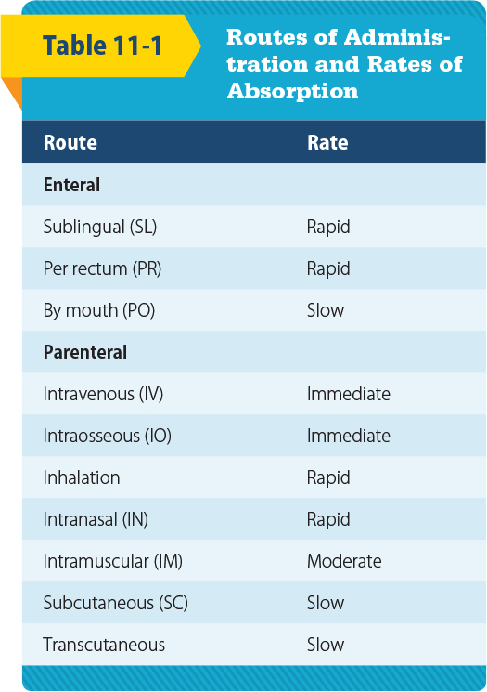
Routes of Administration (2 of 2)
© Jones and Bartlett Publishers
Notes:
Lecture Outline
4. Common routes of administration
a. Per rectum (PR)
i. “By rectum”
ii. Easy to administer; provides reliable absorption
b. Oral (PO)
i. “By mouth”
ii. Enters the bloodstream through the digestive system
iii. Takes as long as 1 hour for absorption to occur
c. Intravenous (IV) injection
i. “Into the vein”
ii. Fastest delivery, but cannot be used for all medications
d. Intraosseous (IO) injection
i. “Into the bone”
ii. Reaches the bloodstream through the bone marrow
iii. Requires drilling a needle into the outer layer of bone
e. Subcutaneous (SC) injection
i. “Beneath the skin”
ii. Injection given into the fatty tissue between the skin and muscle
f. Intramuscular (IM) injection
i. “Into the muscle”
ii. Usually absorbed quickly
iii. Not all medications can be administered by the IM route.
iv. Examples:
(a) EpiPen auto-injector
(b) Mark-1 auto-injector
g. Inhalation
i. Breathed into the lungs
ii. Absorbed into the bloodstream quickly
iii. Forms include aerosols, fine powders, and sprays
h. Sublingual (SL)
i. “Under the tongue”
ii. Enters through the oral mucosa under the tongue and is absorbed into the bloodstream within minutes
iii. Example: nitroglycerin tablets
i. Transcutaneous (transdermal)
i. “Through the skin”
ii. Applied as a patch to the skin
iii. Longer-lasting effect than other routes
iv. Examples:
(a) Nicotine patch
(b) Nitroglycerin patch
j. Intranasal (IN)
i. Relatively new format for the delivery of medication
ii. The medication is pushed through a device called a mucosal atomizer device (MAD) that aerosolizes the liquid for delivery into the nostril.
iii. Quick absorption
iv. Examples:
(a) Flu vaccine
(b) Naloxone

Slide 9
Medication Forms
The form of a medication usually dictates the route of administration.
Tablets and capsules
Solutions and suspensions
Metered-dose inhalers
Topical medications
Transcutaneous medications
Gels
Gases for inhalation
Notes:
Lecture Outline
III. Medication Forms
A. The form of a medication usually dictates the route of administration.
1. The manufacturer chooses the form to ensure:
a. Proper route of administration
b. Timing of the medication’s release into the bloodstream
c. Effects on the target organs or body systems

Slide 10
Tablets and Capsules
Capsules are gelatin shells filled with powdered or liquid medication.
Tablets often contain other materials that are mixed with the medication and compressed.
Notes:
Lecture Outline
B. Tablets and capsules
1. Most medications given by mouth are in tablet or capsule form.
2. Capsules are gelatin shells filled with powder or liquid medication.
3. Tablets often contain other materials that are mixed with the medication and compressed.

Slide 11
Solutions and Suspensions (1 of 2)
Solution: a liquid mixture of substances
The mixture cannot be separated by filtering or letting it stand.
Many solutions can be given as an IV, IM, or SC injection.
Notes:
Lecture Outline
C. Solutions and suspensions
1. Solution: a liquid mixture of one or more substances that cannot be separated simply
2. Solutions can be given by almost any route.
a. When given by mouth, solutions may be absorbed from the stomach fairly quickly because the medication is already dissolved
b. Many solutions can be given as an IV, IM, or SC injection.

Slide 12
Solutions and Suspensions (2 of 2)
Suspension: a substance that does not dissolve well in liquids
Will separate if it stands or is filtered
Notes:
Lecture Outline
3. Suspension: a mixture of finely ground particles that are distributed evenly throughout a liquid by shaking or stirring but do not dissolve
a. Suspensions separate if they stand or are filtered.
b. It is important to shake or swirl a suspension before its administration.

Slide 13
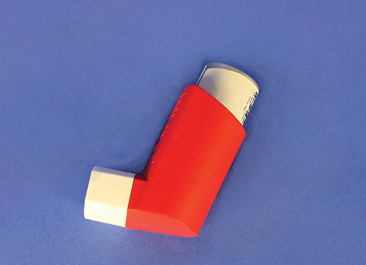
Metered-Dose Inhalers
Liquids or solids broken into small enough droplets or particles may be inhaled.
Metered-dose inhaler (MDI): directs these substances through the mouth and into the lungs
Delivers same amount each time
Notes:
Lecture Outline
D. Metered-dose inhalers (MDIs)
1. Liquids or solids that are broken into small enough droplets or particles may be inhaled.
2. A spray canister directs such substances through the mouth and into the lungs.
3. Delivers the same amount of medication each time it is used
4. Often used for respiratory illnesses such as asthma or emphysema

Slide 14
Topical Medications
Include lotions, creams, and ointments
Applied to skin surface and affect only that area
Examples:
Lotion: calamine lotion
Cream: hydrocortisone cream
Ointment: Neosporin ointment
Notes:
Lecture Outline
E. Topical medications
1. Include lotions, creams, and ointments
2. Applied to the skin surface and affect only that area

Slide 15
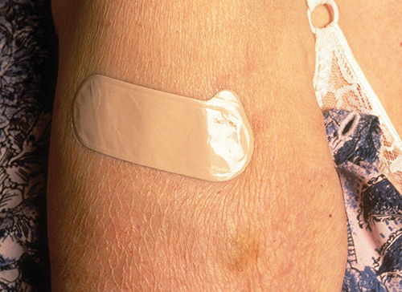
Transcutaneous Medications
Designed to be absorbed through the skin
Also referred to as transdermal medications
May have systemic effects
Examples:
Nitroglycerin paste
Adhesive patch
(c) Publiphoto / Science Source
Notes:
Lecture Outline
F. Transcutaneous medications
1. Also referred to as transdermal medications
2. Absorbed through the skin
3. Unlike topical medications, which affect only the intended site, many transdermal medications have systemic (whole-body) effects, such as nitroglycerin paste or patch.
4. If you touch the medication with your skin, you will absorb it just like the patient.

Slide 16
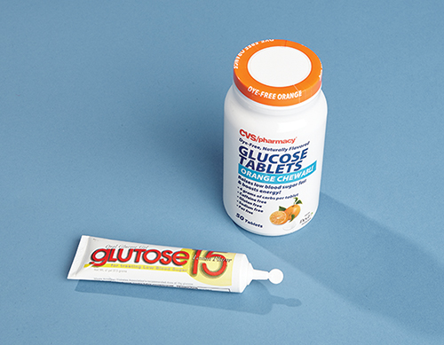
Gels
Semiliquid
Administered in capsules or through plastic tubes
Example: oral glucose for patient with diabetes
© Jones & Bartlett Learning.
Notes:
Lecture Outline
G. Gels
1. Semiliquid
2. Administered in capsules or through plastic tubes
3. Example: oral glucose for patient with diabetes

Slide 17
Gases for Inhalation
Oxygen is the most commonly used gas in EMS
Usually delivered through a nonrebreathing mask or nasal cannula
Notes:
Lecture Outline
H. Gases for inhalation
1. Usually delivered through a nonrebreathing mask or nasal cannula
2. Oxygen is the medication most commonly used in gas form outside the operating room.

Slide 18
General Steps in Administering Medication
© Jones and Bartlett Publishers
Notes:
Lecture Outline
IV. General Steps in Administering Medication
A. Medications should be administered only under the authorization of online or off-line medical direction.
B. Follow the “six rights.”
1. Right patient: Ensure that the patient who needs the medication is the person who receives the medication.
2. Right medication: Verify the proper medication and prescription.
3. Right dose: Verify the form and dose of the medication.
4. Right route: Verify the route of the medication.
5. Right time: Check the expiration date and condition of the medication.
6. Right documentation: Document your actions and the patient’s response.
C. Medication errors almost always result from failure to follow these six rights.

Slide 19
Medication Administration and the EMT
Circumstances to administer medications:
Peer-assisted medication
Patient-assisted medication
EMT-administered medication
Determined by:
State and local protocols
Medical control
Notes:
Lecture Outline
V. Medication Administration and the EMT
A. Over the years, EMTs have been allowed increasing responsibility to work with medications.
B. Many departments have strict guidelines on when an EMT is allowed to administer a medication.
1. Peer-assisted medication
a. You administer medication to yourself or your partner.
b. Example: You were exposed to a toxic agent.
2. Patient-assisted medication
a. You assist the patient with administering his or her own medication.
b. Examples: epinephrine auto-injector, nitroglycerin, metered-dose inhaler
3. EMT-administered medication
a. The EMT directly administers the medication to the patient.
b. The patient may be severely confused or unable to understand the need for the medication.
c. Examples: oxygen, oral glucose, aspirin
C. Medical control, state guidelines, and local protocols determine what an EMT in your system may administer.
1. Refer to your local standards to obtain a listing of how and when EMTs can administer medications.

Slide 20
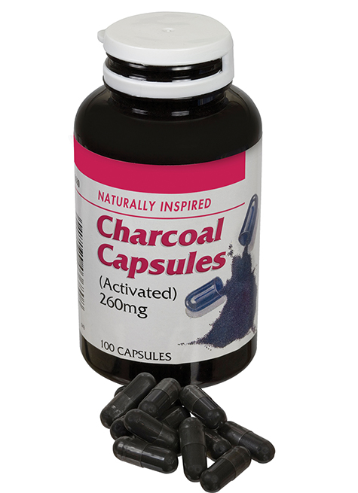
Oral Medications (1 of 3)
Activated charcoal
Reduces the amount of medication absorbed in the stomach
Ground into a fine powder, frequently suspended with sorbitol
Do not give to patients with altered LOC
© Julie Woodhouse f/Alamy.
Notes:
Lecture Outline
VI. Medications Used by EMTs
A. Oral medications
1. Considerations
a. Advantages
i. Ease of access
b. Disadvantages
i. The digestive tract can be easily affected by foods, stress, and illness.
2. Activated charcoal
a. Many poisonings involve overdoses taken by mouth.
b. Activated charcoal reduces the amount of medication being absorbed by the body by binding the drug to its surface (adsorption).
c. Frequently suspended with sorbitol (a sugar), which has a laxative effect that causes the medication and the charcoal to move quickly through the digestive system
d. Administered by mouth (may be unappealing to patients, so use a covered container and ask the patient to drink the fluid through a straw)
e. May stain clothing
f. Should not be given to patients who:
i. Have altered level of consciousness (risk of aspiration)
ii. Have ingested an acid, an alkali, or a petroleum product

Slide 21
Oral Medications (2 of 3)
Oral glucose
A sugar that cells use for energy
Treats hypoglycemia
Do not give to an unconscious patient or one who cannot protect the airway
Notes:
Lecture Outline
3. Oral glucose
a. Glucose is a sugar that cells use for energy; it is necessary for brain cells.
b. Hypoglycemia: extremely low blood glucose
c. Oral glucose can counteract the effects of hypoglycemia.
d. An EMT can give glucose only by mouth.
i. Available as a gel designed to be spread on the mucous membranes between the cheek and gum
ii. Also available as glucose tablets
e. Never administer oral medications to an unconscious patient or to one who is unable to swallow or protect the airway.

Slide 22
Oral Medications (3 of 3)
Aspirin
Reduces fever, pain, and inflammation
Inhibits platelet aggregation
Useful during heart attack
Contraindications:
Hypersensitivity to aspirin
Liver damage, bleeding disorder, asthma
Should not be given to children
Notes:
Lecture Outline
4. Aspirin
a. Reduces fever, pain, and inflammation
b. Inhibits platelet aggregation (clumping), which is useful during a potential heart attack
c. Contraindications
i. Hypersensitivity to aspirin
ii. Preexisting liver damage, bleeding disorders, and asthma
iii. Should not be given to children

Slide 23
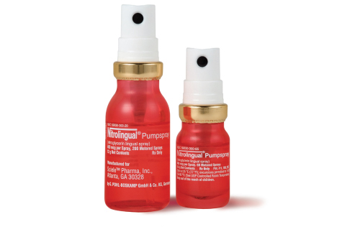
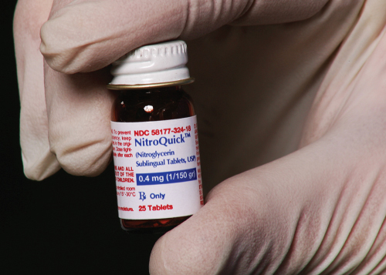
Sublingual Medications (1 of 2)
Nitroglycerin
Relieves angina pain (cardiac patients)
Should not be used with ED medications
Courtesy of Shionogi Pharma, Inc.
© Jones & Bartlett Learning.
Notes:
Lecture Outline
B. Sublingual medications
1. Considerations
a. Advantages
i. Easy to talk with awake and alert patients and advise them to place a pill under their tongue
ii. Absorption is relatively quick.
b. Disadvantages
i. Any medication placed in the mouth requires constant evaluation of the airway.
ii. Should not be used if the patient is uncooperative or unconscious
2. Nitroglycerin
a. Many cardiac patients carry fast-acting nitroglycerin to relieve angina pain.
b. Nitroglycerin increases blood flow by relieving the spasms and causes arteries to dilate by relaxing muscles of the coronary arteries and veins.
c. Also relaxes veins throughout the body so that less blood is returned to the heart, decreasing workload and blood pressure
d. Before administration
i. Check the patient’s blood pressure before administering nitroglycerin.
(a) If the systolic blood pressure is less than 100 mm Hg, nitroglycerin may have a harmful effect.
(b) Even a patient who has adequate blood pressure should sit or lie down with the head elevated before taking this medication (to avoid fainting).
(c) If a significant drop in blood pressure occurs and the patient feels dizzy or sick, have the patient lie down.
ii. Obtain a medical order or follow local protocols to administer nitroglycerin.
e. Can have potentially fatal interactions with erectile dysfunction (ED) medications taken within the past 24 hours:
i. Sildenafil (Viagra)
ii. Tadalafil (Cialis)
iii. Vardenafil (Levitra)
iv. Erectile dysfunction drugs may be used by both men and women.

Slide 24
Sublingual Medications (2 of 2)
Nitroglycerin (cont’d)
Administration by tablet
Sublingually
Administration by metered-dose spray
One sublingual spray = one tablet
Notes:
Lecture Outline
f. Administration by tablet
i. Place the tablet under tongue, where it dissolves.
ii. The patient should experience a slight tingling or burning sensation.
iii. Should be stored in its original glass container with the cap screwed on tightly
g. Administration by metered-dose spray
i. Deposits medication on or under the tongue
ii. One spray equals one tablet.
h. Know and follow your local protocols.

Slide 25
Intramuscular Medications
Epinephrine
Also called adrenaline, released inside body under stress
Controls fight-or-flight response
Sympathomimetic
Increases heart rate and causes vasoconstriction
May be delivered with an auto-injector to treat life-threatening anaphylaxis
Notes:
Lecture Outline
C. Intramuscular medications
1. Considerations
a. Advantages
i. Provides quick and easy access to the circulatory system without the need for placing a needle within a vein
ii. Blood flow to the muscles is relatively stable even during circumstances of severe illness or injury.
b. Disadvantages
i. Use of a needle and subsequent pain
2. Epinephrine (adrenaline)
a. Also known as adrenaline
b. Released inside the body when there is sudden stress
c. Main hormone that controls the body’s fight-or-flight response
d. Sympathomimetic (mimics the effect of the sympathetic nervous system)
e. Effects
i. Increases heart rate
ii. Constricts blood vessels, causing increased blood pressure
iii. Dilates passages in the lungs
f. Should be given only to patients who are experiencing a life-threatening allergic reaction.
g. Epinephrine may be dispensed from an auto-injector.
i. Automatically delivers a preset amount of the medication (usually 0.3 mg)
h. Some services do not permit EMTs to carry epinephrine but do allow them to assist patients in administering their own epinephrine.

Slide 26
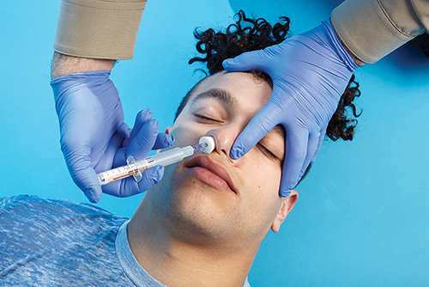
Intranasal Medications
Naloxone
Used to reverse the effects of an opioid overdose
The most common technique for naloxone administration is via the intranasal route.
© Jones & Bartlett Learning.
Notes:
Lecture Outline
D. Intranasal medications
1. Naloxone
a. Used to reverse the effects of an opioid overdose
b. The most common technique for naloxone administration is via the intranasal route.
i. Place the atomizer in one nostril, pointing up and slightly outward.
ii. Administer a half dose (1 ml. maximum) into each nostril.

Slide 27
Inhalation Medications (1 of 2)
Oxygen
All cells need it to survive
Generally administered via:
Nonrebreathing mask
Nasal cannula
Notes:
Lecture Outline
E. Inhalation medications
1. Oxygen
a. By far the most commonly administered medication in the prehospital setting
b. All cells, especially those in the heart and brain, need oxygen to function properly.
c. Generally administered:
i. Via a nonrebreathing mask at 10 to 15 L/min
ii. Via nasal cannula at 2 to 6 L/min
d. Must also provide artificial ventilations if the patient is not breathing (using a bag-valve mask at 15 L/min)
e. Ensure that there are no open flames, lit cigarettes, or sparks in the area in which you are administering oxygen.

Slide 28
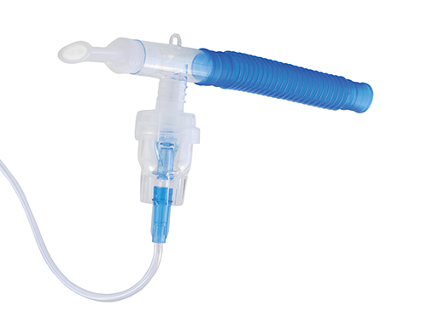
Inhalation Medications (2 of 2)
Metered-dose inhalers
Liquid turned into mist or spray
Medication is breathed in and delivered to the alveoli
Fast absorption
Easy route to access
Portable
© Chas/ShutterStock, Inc.
Notes:
Lecture Outline
2. Metered-dose inhalers and nebulizers
a. Used to administer liquid medications that have been turned into a fine mist by a flow of air or oxygen
b. Medication is atomized, breathed into the lungs, and delivered to the alveoli
c. Advantages
i. Fast and relatively easy route to access
d. Disadvantages
i. Patient needs to be cooperative and control breathing
ii. Cannot be used for unconscious patients
3. Medications administered using an MDI
a. An MDI requires a great deal of coordination to administer.
i. May be difficult to achieve when a person is having trouble breathing
b. Use a spacer (adapter) to avoid spray misdirection.
i. A spacer fits over the inhaler like a sleeve.
ii. A spacer has an opening for the inhaler at one end and a mouthpiece on the other end.
iii. The patient sprays the prescribed dose into the chamber and then breathes in and out of the mouthpiece until the mist is completely inhaled.
c. The only medications that will be effective during an acute attack of shortness of breath are fast-acting rescue inhalers (eg, albuterol [Proventil or Ventolin]).

Slide 29
Patient Medications
Patient assessment includes finding out which medications the patient is taking.
Provides vital clues to the patient’s condition
Guides treatment
Will be useful to emergency department
Notes:
Lecture Outline
VII. Patient Medications
A. Patient assessment includes finding out which medications the patient is currently taking.
B. This information may provide vital clues to the patient’s condition.
1. May help guide your treatment
2. May be extremely useful to the emergency department physician
3. Can help you determine a chronic or underlying condition when a patient is unable to relate his or her medical history
C. Discover what the patient takes and transport the medications or a list of them with you to the emergency department.
D. Ask about any nonprescription drugs (eg, OTC, herbal, or illegal drugs).

Slide 30
Medication Errors
Inappropriate use of a medication could lead to patient harm.
If a medication error occurs:
Provide appropriate patient care.
Notify medical control.
Document thoroughly, accurately, and honestly.
Talk with your supervisor or medical director.
Notes:
Lecture Outline
VIII. Medication Errors
A. A medication error is inappropriate use of a medication that could lead to patient harm.
B. Ensure that the environment does not contribute to errors.
1. Ensure lighting is sufficient.
2. Organize equipment.
3. Limit distractions as much as possible.
4. Consider using a “cheat sheet” to help yourself remember all crucial steps to medication administration.
C. If a medication error does take place:
1. Rapidly provide any appropriate patient care that is required.
2. Notify medical control as quickly as possible.
3. Follow your local protocols.
4. Document the incident thoroughly, accurately, and honestly.
5. Talk with your supervisor or medical director.
a. Represents an opportunity to learn
b. Identifies areas to target during quality improvement

Slide 31
Review
Pharmacology is defined as the:
study of cells and tissues.
study of drugs and medications.
effects of medications in the lungs.
distribution of drugs to the body’s tissues.

Slide 32
Review
Answer: B
Rationale: Pharmacology is a field of science that deals with the study of drugs and medications.

Slide 33
Review (1 of 2)
Pharmacology is defined as the:
study of cells and tissues. Rationale: This is physiology, which is a branch of biology.
study of drugs and medications. Rationale: Correct answer

Slide 34
Review (2 of 2)
Pharmacology is defined as the:
effects of medications in the lungs. Rationale: This is pharmacodynamics, which includes the processes of the body’s response to medications.
distribution of drugs to the body’s tissues. Rationale: This is pharmacokinetics, which studies medication distribution within the body.

Slide 35
Review
Which of the following statements regarding medications is FALSE?
Many medications are known by different names.
Some medications affect more than one body system.
Over-the-counter drugs must be prescribed by a physician.
EMTs should ask about any herbal remedies or vitamins that the patient may be taking.

Slide 36
Review
Answer: C
Rationale: Over-the-counter (OTC) drugs, such as aspirin, Tylenol, or Motrin, do not require a physician prescription. They can be purchased at a supermarket or drugstore. Most medications have a generic name and a trade name. For example, acetaminophen is the generic name for Tylenol, and ibuprofen is the generic name for Motrin.

Slide 37
Review (1 of 2)
Which of the following statements regarding medications is FALSE?
Many medications are known by different names. Rationale: True; medications can have several different names.
Some medications affect more than one body system. Rationale: True; medications can affect many different body systems.

Slide 38
Review (2 of 2)
Which of the following statements regarding medications is FALSE?
Over-the-counter drugs must be prescribed by a physician. Rationale: Correct answer
EMTs should ask about any herbal remedies or vitamins that the patient may be taking. Rationale: True; herbal remedies and vitamins can have interactions and effects on patient’s health and condition.

Slide 39
Review
Which of the following routes of medication administration has the fastest effect?
Oral
Intravenous
Subcutaneous
Intramuscular

Slide 40
Review
Answer: B
Rationale: Because administration is directly into a vein, the medication enters the body quickly. The intravenous route is the fastest acting of all the routes of medication administration.

Slide 41
Review (1 of 2)
Which of the following routes of medication administration has the fastest effect?
Oral Rationale: The medication must be absorbed through the mucous membranes first to get to the circulatory system.
Intravenous Rationale: Correct answer

Slide 42
Review (2 of 2)
Which of the following routes of medication administration has the fastest effect?
Subcutaneous Rationale: The medication must pass through the layers of skin before reaching the circulatory system.
Intramuscular Rationale: The medication needs to travel to the circulatory system.

Slide 43
Review
When applied to a patient, a metered-dose inhaler will:
deliver the same dose each time it is used.
be ineffective when given to patients with asthma.
deliver a different dose each time it is used.
Deliver the drug to the lungs over a period of 6 to 8 hours.

Slide 44
Review
Answer: A
Rationale: A metered-dose inhaler (MDI) delivers the same dose of medication each time it is used. Drugs given via the MDI act very quickly and are commonly prescribed to patients with asthma, emphysema, and other airway diseases.

Slide 45
Review (1 of 2)
When applied to a patient, a metered-dose inhaler will:
deliver the same dose each time it is used. Rationale: Correct answer
be ineffective when given to patients with asthma. Rationale: An inhaler is usually prescribed for patients with asthma.

Slide 46
Review (2 of 2)
When applied to a patient, a metered-dose inhaler will:
deliver a different dose each time it is used. Rationale: An inhaler is metered to deliver the same dose every time.
Deliver the drug to the lungs over a period of 6 to 8 hours. Rationale: The medication is delivered straight to the lungs almost immediately, because it is inhaled.

Slide 47
Review
You are managing a 62-year-old woman who complains of crushing chest pain. Her blood pressure is 84/64 mm Hg and her heart rate is 110 beats/min. Medical control advises you to assist her in taking her prescribed nitroglycerin. After receiving this order, you should:
reassess the patient’s heart rate and then assist with the nitroglycerin.
repeat the patient’s blood pressure to the physician and confirm the order.
wait 10 minutes, reassess the blood pressure, and then give the nitroglycerin.
administer the nitroglycerin to the patient and then reassess her blood pressure.

Slide 48
Review
Answer: B
Rationale: Nitroglycerin is a vasodilator and lowers the BP; therefore, it should not be given to patients with a systolic BP less than 100 mm Hg. If you receive an order to give nitroglycerin to a patient with a systolic BP less than 100 mm Hg, you should ensure that the physician is aware of the patient’s BP, then reconfirm the order.

Slide 49
Review (1 of 2)
You are managing a 62-year-old woman who complains of crushing chest pain. Her blood pressure is 84/64 mm Hg and her heart rate is 110 beats/min. Medical control advises you to assist her in taking her prescribed nitroglycerin. After receiving this order, you should:
reassess the patient’s heart rate and then assist with the nitroglycerin. Rationale: Administration of nitroglycerin is based on the patient’s blood pressure and not the patient’s heart rate.
repeat the patient’s blood pressure to the physician and confirm the order. Rationale: Correct answer

Slide 50
Review (2 of 2)
You are managing a 62-year-old woman who complains of crushing chest pain. Her blood pressure is 84/64 mm Hg and her heart rate is 110 beats/min. Medical control advises you to assist her in taking her prescribed nitroglycerin. After receiving this order, you should:
wait 10 minutes, reassess the blood pressure, and then give the nitroglycerin. Rationale: You should ensure that the physician is aware of the patient’s blood pressure and then reconfirm the order.
administer the nitroglycerin to the patient and then reassess her blood pressure. Rationale: Nitroglycerin is a vasodilator and lowers the patient’s blood pressure. This medication should not be given to patients with a systolic blood pressure less than 100 mm Hg.

Slide 51
Review
Activated charcoal is indicated for patients who have ingested certain drugs and toxins because it:
acts as a direct reversal agent for most medications.
induces vomiting before the chemical can be digested.
detoxifies the drug before it can cause harm to the patient.
binds to chemicals in the stomach and delays their absorption.

Slide 52
Review
Answer: D
Rationale: Activated charcoal is an adsorbent—that is, it binds to harmful chemicals that have been ingested. This binding effect delays digestion and absorption of the chemical by the body.

Slide 53
Review (1 of 2)
Activated charcoal is indicated for patients who have ingested certain drugs and toxins because it:
acts as a direct reversal agent for most medications. Rationale: Activated charcoal binds with chemicals.
induces vomiting before the chemical can be digested. Rationale: Activated charcoal is not the medication used to induce vomiting.

Slide 54
Review (2 of 2)
Activated charcoal is indicated for patients who have ingested certain drugs and toxins because it:
detoxifies the drug before it can cause harm to the patient. Rationale: Activated charcoal binds with chemicals, delays their absorption, and helps in getting chemicals through the digestive system.
binds to chemicals in the stomach and delays their absorption. Rationale: Correct answer

Slide 55
Review
With regard to pharmacology, the term “action” refers to the:
ability of a drug to cause harm.
ability of a drug to produce side effects.
amount of time it will take the drug to work.
expected effect of a drug on the patient’s body.

Slide 56
Review
Answer: D
Rationale: As it applies to pharmacology, the term “action” refers to the effect that a drug is expected to have on a patient’s body. Prior to administering any drug, the EMT must be aware of its action(s) on the body.

Slide 57
Review
With regard to pharmacology, the term “action” refers to the:
ability of a drug to cause harm. Rationale: This is called a contraindication.
ability of a drug to produce side effects. Rationale: This is any action of a medication other than the desired ones.
amount of time it will take the drug to work. Rationale: This is the onset of action.
expected effect of a drug on the patient’s body. Rationale: Correct answer

Slide 58
Review
Which of the following patients is the BEST candidate for oral glucose?
A conscious patient who is showing signs of hypoglycemia
An unconscious diabetic patient with a documented low blood sugar
A conscious diabetic patient suspected of being hyperglycemic
A semiconscious patient with signs and symptoms of low blood sugar

Slide 59
Review
Answer: A
Rationale: Oral glucose is given to diabetic patients with suspected or documented hypoglycemia (low blood sugar). It should not be given to unconscious patients or those who are otherwise unable to swallow because it may be aspirated into the lungs.

Slide 60
Review (1 of 2)
Which of the following patients is the BEST candidate for oral glucose?
A conscious patient who is showing signs of hypoglycemia Rationale: Correct answer
An unconscious diabetic patient with a documented low blood sugar Rationale: Oral glucose should not be given to unconscious patients.

Slide 61
Review (2 of 2)
Which of the following patients is the BEST candidate for oral glucose?
A conscious diabetic patient suspected of being hyperglycemic Rationale: Oral glucose is used for the treatment of hypoglycemia (low blood sugar).
A semiconscious patient with signs and symptoms of low blood sugar Rationale: Oral glucose should not be given to those patients who are unable or may become unable to swallow.

Slide 62
Review
Epinephrine is given to patients with anaphylactic shock because of its effects of:
bronchodilation and vasodilation.
bronchodilation and vasoconstriction.
vasodilation and bronchoconstriction.
bronchoconstriction and vasoconstriction.

Slide 63
Review
Answer: B
Rationale: The two major complications associated with anaphylactic shock are bronchoconstriction, which impairs air movement in and out of the lungs, and vasodilation, which causes a drop in blood pressure. Epinephrine reverses these processes by causing bronchodilation and vasoconstriction, thereby improving breathing and increasing the blood pressure, respectively.

Slide 64
Review (1 of 2)
Epinephrine is given to patients with anaphylactic shock because of its effects of:
bronchodilation and vasodilation. Rationale: Epinephrine dilates the bronchi but constricts the circulatory system.
bronchodilation and vasoconstriction. Rationale: Correct answer

Slide 65
Review (2 of 2)
Epinephrine is given to patients with anaphylactic shock because of its effects of:
vasodilation and bronchoconstriction. Rationale: Epinephrine constricts the circulatory system and dilates the bronchi.
bronchoconstriction and vasoconstriction. Rationale: Epinephrine dilates the bronchi and constricts the circulatory system.

Slide 66
Review
The process by which medications travel through body tissues until they reach the bloodstream is called:
adsorption.
onset of action.
absorption.
transformation.

Slide 67
Review
Answer: C
Rationale: The process by which medications travel through body tissues until they reach the bloodstream is called absorption. Adsorption refers to the binding of one chemical to another. Activated charcoal, for example, delays absorption of certain chemicals into the bloodstream because it adsorbs (binds to) them in the stomach.

Slide 68
Review (1 of 2)
The process by which medications travel through body tissues until they reach the bloodstream is called:
adsorption. Rationale: This is when particles bind to a surface.
onset of action. Rationale: This is the time that it takes for a medication to start doing what it is prescribed for.

Slide 69
Review (2 of 2)
The process by which medications travel through body tissues until they reach the bloodstream is called:
absorption. Rationale: Correct answer
transformation. Rationale: This has nothing to do with medication administration.

