Slide 1
Chapter 11
Principles of Pharmacology
Notes:
Chapter 11: Principles of Pharmacology

Slide 2
National EMS Education Standard Competencies (1 of 5)
Pharmacology
Applies fundamental knowledge of the medications that the EMT may assist/administer to a patient during an emergency.
Notes:
National EMS Education Standard Competencies
Pharmacology
Applies fundamental knowledge of the medications that the EMT may assist/administer to a patient during an emergency.

Slide 3
National EMS Education Standard Competencies (2 of 5)
Principles of Pharmacology
Medication safety
Kinds of medications used during an emergency
Notes:
National EMS Education Standard Competencies
Principles of Pharmacology
• Medication safety
• Kinds of medications used during an emergency

Slide 4
National EMS Education Standard Competencies (3 of 5)
Medication Administration
Self-administer medication
Peer-administer medication
Assist/administer medication to a patient
Notes:
National EMS Education Standard Competencies
Medication Administration
• Self-administer medication
• Peer-administer medication
• Assist/administer medications to a patient

Slide 5
National EMS Education Standard Competencies (4 of 5)
Emergency Medications
Names
Effects
Actions
Indications
Contraindications
Notes:
National EMS Education Standard Competencies
Emergency Medications
• Names
• Effects
• Actions
• Indications
• Contraindications

Slide 6
National EMS Education Standard Competencies (5 of 5)
Emergency Medications (cont’d)
Complications
Routes of administration
Side effects
Interactions
Dosages for the medications administered
Notes:
National EMS Education Standard Competencies
• Complications
• Routes of administration
• Side effects
• Interactions
• Dosages for the medications administered

Slide 7
Introduction (1 of 2)
Medications are an important intervention.
Medications may alleviate pain and improve the patient’s condition.
Failure to administer medications safely and competently can lead to serious consequences for the patient, including death.
Notes:
Lecture Outline
I. Introduction
A. Medications are an important intervention available to you as an EMT.
B. Used appropriately, medications may alleviate pain and improve a patient’s condition.
C. Failure to administer medications safely and competently can lead to serious consequences for the patient, including death.

Slide 8
Introduction (2 of 2)
As an EMT, you will:
Administer medications
Help patients self-administer medications
Ask patients about medication use
Report patient information to hospital personnel
Notes:
Lecture Outline
D. As an EMT, you will:
1. Administer medications
2. Help patients self-administer medications
3. Ask patients about medication use and allergies
4. Report patient information to hospital personnel
E. It is essential that you have the knowledge and skills to administer or assist in administration of these medications.

Slide 9
How Medications Work (1 of 3)
Pharmacology is the science of drugs.
A medication is a substance used to:
Prevent or treat disease
Relieve pain
Pharmacodynamics is a process by which medication works on the body.
Notes:
Lecture Outline
II. How Medications Work
A. Medical definitions
1. Pharmacology: the science of drugs, including their ingredients, preparation, uses, and actions on the body
2. Medication: a substance used to treat or prevent disease or relieve pain
3. Pharmacodynamics: the process by which medication works on the body
a. Different types of receptors are located throughout the body. These are sites on cells where medications or chemicals can bind and produce an effect. When medications are given, they bind to these sites and either stimulate the receptors to produce an effect or block the receptors to prevent other chemicals or medications from binding.
b. A medication can either increase or decrease a normal function of the body.

Slide 10
How Medications Work (2 of 3)
Agonist: causes stimulation of receptors
Antagonist: binds to a receptor and blocks other medications or chemicals
Dose: amount of medication given
Depends on weight, age, desired action
Notes:
Lecture Outline
4. Agonist: medication that causes stimulation of receptors
5. Antagonist: medication that binds to a receptor and blocks other medications or chemicals from attaching
6. Dose: the amount of the medication that is given, which depends on:
a. Patient’s weight
b. Patient’s age
c. Desired action of the medication

Slide 11
How Medications Work (3 of 3)
Action: therapeutic effect
Indications: reasons or conditions
Contraindications: harmful effects
Absolute
Relative
Side effects
Unintended effects
Untoward effects
Notes:
Lecture Outline
7. Action: the therapeutic effect that a medication is expected to have on the body
a. Also referred to as the desired or intended effect
8. Indications: reasons or conditions for which a particular medication is given
9. Contraindications: situations in which a medication would either harm the patient or have no positive effect
a. Absolute contraindications: situations in which a medication should never be given if the contraindication is present
b. Relative contraindications: situations in which the benefits of administering the drug may outweigh the risks
10. Side effects: any actions of a medication other than the desired ones
a. Unintended effects: effects that are undesirable but pose little risk to the patient
b. Untoward effects: effects that can be harmful to the patient

Slide 12
Medication Names (1 of 2)
The generic name is a simple, clear, nonproprietary name.
Example: ibuprofen
The trade name is the manufacturer’s brand name.
One drug may have more than one trade name.
Example: Tylenol
Notes:
Lecture Outline
B. Medication names
1. The generic name is a simple, clear, nonproprietary name.
a. Generic names are not capitalized.
b. Some medications (ie, nitroglycerin) are called by their generic name more often than their trade name.
2. The trade name is the brand name that a manufacturer gives to a drug.
a. Examples: Tylenol, Lasix
b. Trade names begin with a capital letter.
c. One drug may have more than one trade name.

Slide 13
Medication Names (2 of 2)
Prescription medications
Over-the-counter (OTC) medications
Recreational drugs
Herbal remedies
Enhancement drugs
Vitamin supplements
Notes:
Lecture Outline
3. Prescription drugs are distributed only by pharmacists and require a physician’s order.
4. Over-the-counter (OTC) drugs may be purchased directly without a prescription.
5. Other kinds of drugs
a. Recreational drugs (eg, heroin, cocaine)
b. Herbal remedies
c. Enhancement drugs
d. Vitamin supplements
6. Any medication that a patient takes can be pharmacologically active and can cause an effect, so ask patients about any and all medications or drugs they are taking.

Slide 14
Routes of Administration (1 of 5)
Enteral medications enter the body through the digestive system.
Parenteral medications enter the body by some other means.
Notes:
Lecture Outline
C. Routes of administration
1. Enteral medications enter the body through the digestive system.
a. Often in pill or liquid form such as cough medicine
b. Medications administered via this route tend to be absorbed slowly and are not commonly used in an emergency setting.
2. Parenteral medications enter the body by some other means.
a. Often in liquid form administered through needles or syringes
b. Absorbed more quickly and offer a more predictable and measurable response

Slide 15
Routes of Administration (2 of 5)
Absorption is the process by which medications travel through body tissues to the bloodstream.
Common routes of administration:
Per rectum (PR): by rectum
Oral or per os (PO): by mouth
Notes:
Lecture Outline
3. Absorption: the process by which medications travel through body tissues to the bloodstream
4. Common routes of administration
a. Per rectum (PR)
i. “By rectum”
ii. Frequently used with children
iii. Easy to administer; provides reliable absorption
iv. Often used with medications for nausea and vomiting
b. Oral (PO)
i. “By mouth”
ii. Enters the bloodstream through the digestive system
iii. Takes as long as 1 hour for absorption to occur
iv. Pros
(a) Noninvasive
(b) Less expensive than parenteral routes
v. Cons
(a) Unpredictability of medication absorptions
(b) Absorption affected by upset stomach or diarrhea
vi. Orally disintegrating tablets (ODTs) are put directly onto the tongue where they dissolve.

Slide 16
Routes of Administration (3 of 5)
Common routes of administration (cont’d):
Intravenous (IV): into the vein
Intraosseous (IO): into the bone
Subcutaneous (SC): beneath the skin
Intramuscular (IM): into the muscle
Notes:
Lecture Outline
c. Intravenous (IV) injection
i. “Into the vein”
ii. Fastest delivery but cannot be used for all medications
d. Intraosseous (IO) injection
i. “Into the bone”
ii. Reaches the bloodstream through the bone marrow
iii. Requires drilling a needle into the outer layer of bone
iv. Painful
(a) Often reserved for patients who are unconscious as a result of cardiac arrest or extreme shock
(b) Often used for children who have less available (or difficult-to-access) IV sites
e. Subcutaneous (SC, SQ, or sub-Q) injection
i. “Beneath the skin”
ii. Injection given into the fatty tissue between the skin and muscle
iii. Because there is less blood in these tissues than in the muscles, SC medications are generally absorbed more slowly and have longer-lasting effects.
iv. Examples
(a) Daily insulin injections
(b) Some forms of epinephrine
f. Intramuscular (IM) injection
i. “Into the muscle”
ii. Usually absorbed quickly
iii. Not all medications can be administered by the IM route.
iv. Examples
(a) EpiPen auto-injector
(b) Mark-1 auto-injector
v. Possible problems
(a) Damage to muscle tissue
(b) Uneven, unreliable absorption (especially in people with decreased tissue perfusion or who are in shock)

Slide 17
Routes of Administration (4 of 5)
Common routes of administration (cont’d):
Inhalation: inhaled into the lungs
Sublingual (SL): under the tongue
Transcutaneous (transdermal): through the skin
Intranasal (IN): into the nostril via a mucosal atomizer device
Notes:
Lecture Outline
g. Inhalation
i. Breathed into the lungs
ii. Absorbed into the bloodstream quickly
iii. Minimizes the effects of the medication in other body tissues
iv. Forms
(a) Aerosols
(b) Fine powders
(c) Sprays
h. Sublingual (SL)
i. “Under the tongue”
ii. Enters through the oral mucosa under the tongue and is absorbed into the bloodstream within minutes
iii. Faster than the oral route and protects medications from chemicals in the digestive system (ie, acids that can weaken or inactivate them)
iv. Example: nitroglycerin tablets
i. Transcutaneous (transdermal)
i. “Through the skin”
ii. Applied as a patch to the skin
iii. Longer-lasting effect than other routes
iv. Examples
(a) Nicotine patch
(b) Nitroglycerin patch
j. Intranasal (IN)
i. Relatively new format for the delivery of medication
ii. Medication is pushed through a mucosal atomizer device (MAD) that aerosolizes the liquid for delivery into the nostril.
iii. Liquid medication is aerosolized and is administered into a nostril.
iv. Quick absorption
v. Examples
(a) Flu vaccine
(b) Naloxone

Slide 18
Routes of Administration (5 of 5)
© Jones & Bartlett Publishers
Notes:
Lecture Outline
k. Table 11-1 lists common routes of medication administration and rates of absorption

Slide 19
Medication Forms (1 of 2)
The form of medication usually dictates the route of administration.
The manufacturer chooses the form to ensure:
Proper route of administration
Timing of the medication’s release into the bloodstream
Effects on the target organs or body systems
Notes:
Lecture Outline
III. Medication Forms
A. The form of a medication usually dictates the route of administration.
1. For example, a tablet or spray cannot be given through a needle.
2. The manufacturer chooses the form to ensure:
a. Proper route of administration
b. Timing of the medication’s release into the bloodstream
c. Effects on the target organs or body systems

Slide 20
Medication Forms (2 of 2)
Basic Forms
Tablets and capsules
Solutions and suspensions
Metered-dose inhalers
Topical medications
Transcutaneous medications
Gels
Gases for inhalation
Notes:
Lecture Outline
B. Basic medication forms
1. Tablets and capsules
2. Solutions and suspensions
3. Metered-dose inhalers (MDIs)
4. Topical medications
5. Transcutaneous medications
6. Gels
7. Gases for inhalation

Slide 21
Tablets and Capsules
Capsules are gelatin shells filled with powdered or liquid medication.
Tablets often contain other materials that are mixed with the medication and compressed.
Notes:
Lecture Outline
C. Tablets and capsules
1. Most medications given by mouth are in tablet or capsule form.
2. Capsules are gelatin shells filled with powder or liquid medication.
3. Tablets often contain other materials that are mixed with the medication and compressed.
4. A medication that must be swallowed and digested provides a slower route of delivery and is less useful in an emergency.

Slide 22
Solutions and Suspensions (1 of 2)
A solution is a liquid mixture of substances.
Mixture will not separate by filtering or letting it stand.
Many solutions can be given as an IV, IM, or SC injection.
Notes:
Lecture Outline
D. Solutions and suspensions
1. A solution is a liquid mixture of one or more substances that cannot be separated simply.
2. Solutions can be given by almost any route.
a. When given by mouth, solutions may be absorbed from the stomach fairly quickly because the medication is already dissolved
b. Many solutions can be given as an IV, IM, or SC injection.

Slide 23
Solutions and Suspensions (2 of 2)
A suspension is substance that does not dissolve well in liquids.
Will separate if it stands or is filtered
Notes:
Lecture Outline
3. A suspension is a mixture of finely ground particles that are distributed evenly throughout a liquid by shaking or stirring but do not dissolve.
a. Suspensions separate if they stand or are filtered.
b. It is important to shake or swirl a suspension before its administration.
c. Usually administered by mouth (eg, antibiotic for pediatric patient or activated charcoal)
d. Occasionally given rectally or applied directly to the skin (eg, calamine lotion)
e. May be given via IM or SC injection (eg, hormone shots or vaccinations)

Slide 24
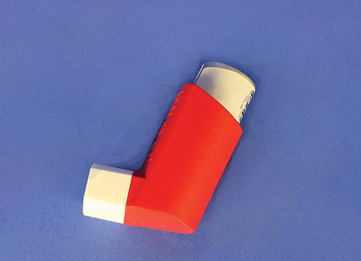
Metered-Dose Inhalers
Liquids or solids broken into small enough droplets or particles may be inhaled.
A metered-dose inhaler (MDI) directs such substances through mouth into lungs.
Delivers the same amount each time
Notes:
Lecture Outline
E. Metered-dose inhalers
1. Liquids or solids that are broken into small enough droplets or particles may be inhaled.
2. A spray canister directs such substances through the mouth and into the lungs.
3. Delivers the same amount of medication each time it is used
4. Often used for respiratory illnesses such as asthma or emphysema

Slide 25
Topical Medications
Include lotions, creams, and ointments
Applied to skin surface and affect only that area
Examples
Lotion: calamine lotion
Cream: hydrocortisone cream
Ointment: Neosporin ointment
Notes:
Lecture Outline
F. Topical medications
1. Include lotions, creams, and ointments
2. Applied to the skin surface and affect only that area
3. Lotions contain the most water and are absorbed rapidly.
4. Ointments contain the least water and are absorbed slowly.
5. Examples
a. Lotion: calamine lotion
b. Ointment: Neosporin ointment

Slide 26
Transcutaneous Medications (1 of 2)
Designed to be absorbed through the skin
Also referred to as transdermal
May have systemic effects
Notes:
Lecture Outline
G. Transcutaneous medications
1. Designed to be absorbed through skin (transcutaneously)
2. Also referred to as transdermal medications
3. Unlike topical medications, which affect only the intended site, many transdermal medications have systemic (whole-body) effects.

Slide 27
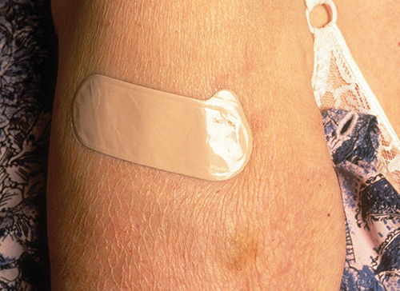
Transcutaneous Medications (2 of 2)
Examples:
Nitroglycerin paste
Adhesive patch
If you touch the medication with your skin, you will absorb it just like the patient.
© Publiphoto / Science Source
Notes:
Lecture Outline
4. Examples
a. Nitroglycerin paste
b. Adhesive patch
i. Nitroglycerin
ii. Nicotine
iii. Some pain medications
iv. Some contraceptives
5. If you touch the medication with your skin, you will absorb it just like the patient.

Slide 28
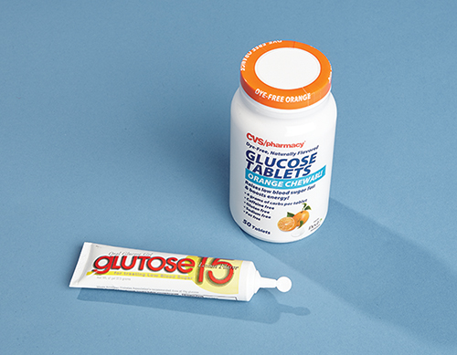
Gels
Semiliquid
Administered in capsules or through plastic tubes
Example: oral glucose for patient with diabetes
© Jones & Bartlett Learning.
Notes:
Lecture Outline
H. Gels
1. Semiliquid
2. Administered in capsules or through plastic tubes
3. Usually have the consistency of pastes or creams but are transparent (clear)
4. Example: oral glucose for patient with diabetes

Slide 29
Gases for Inhalation
Outside the operating room, most commonly used is oxygen
Usually delivered through a nonrebreathing mask or nasal cannula
Notes:
Lecture Outline
I. Gases for inhalation
1. Neither solid nor liquid
2. Usually delivered through a nonrebreathing mask or nasal cannula
3. Most often are given in an operating room
4. The most common medication in gas form used outside the operating room is oxygen.

Slide 30
General Steps in Administering Medication (1 of 2)
Medications should be administered only under the authorization of medical control.
Follow the “six rights” of medication administration.
Medication errors almost always result from failure to follow these “six rights.”
Notes:
Lecture Outline
IV. General Steps in Administering Medication
A. Medications should be administered only under the authorization of online or off-line medical direction.
B. Medical control may inform you to administer medications:
1. Off-line or indirectly via protocols and standing orders
2. Online via telephone or radio
C. Follow the “six rights.”
D. Medication errors almost always result from failure to follow these six rights.

Slide 31
General Steps in Administering Medication (2 of 2)
© Jones & Bartlett Publishers
Notes:
Lecture Outline
C. Follow the “six rights.”
1. Right patient: Ensure that the patient who needs the medication is the person who receives the medication.
2. Right medication: Verify the proper medication and prescription.
3. Right dose: Verify the form and dose of the medication.
4. Right route: Verify the route of the medication.
5. Right time: Check the expiration date and condition of the medication.
6. Right documentation: Document your actions and the patient’s response.

Slide 32
Medication Administration and the EMT (1 of 2)
Unit may carry:
Oxygen
Oral glucose
Activated charcoal
Aspirin
Epinephrine
Notes:
Lecture Outline
V. Medication Administration and the EMT
A. Your unit may carry:
1. Oxygen
2. Oral glucose
3. Activated charcoal
4. Aspirin
5. Epinephrine

Slide 33
Medication Administration and the EMT (2 of 2)
Circumstances in which medications may be administered:
Peer-assisted administration
Patient-assisted administration
EMT-administered medications
Determined by:
State and local protocols
Medical control
Notes:
Lecture Outline
B. You may give these medications only according to standing orders in a protocol or a direct order.
C. Over the years, EMTs have been allowed increasing responsibility to work with medications.
D. Many departments have strict guidelines on when an EMT is allowed to administer a medication. The circumstances are:
1. Peer-assisted administration
a. You administer medication to yourself or your partner.
b. Example: You were exposed to a toxic agent.
c. Typically auto-injector form
2. Patient-assisted administration
a. You assist the patient with administering his or her own medication.
b. Examples
i. Nitroglycerin
ii. EpiPen auto-injectors
iii. MDI bronchodilator
3. EMT-administered medications
a. EMT directly administers the medication to the patient.
b. The patient may be severely confused or unable to understand the need for the medication.
c. Examples
i. Oxygen
ii. Oral glucose
iii. Activated charcoal
iv. Nitroglycerin
v. Aspirin
E. The medication itself does not necessarily dictate whether you will be assisting with its administration or actually administering the drug.
1. Medical control, state guidelines, and local protocols determine which medications an EMT in your system may administer.
2. Refer to your local standards to obtain a listing of how and when EMTs can administer medications.

Slide 34
Medication Used by EMTs
The state, department, and medical director will define which medications are carried on your ambulance.
Notes:
Lecture Outline
VI. Medications Used by EMTs
A. The state, department, and medical director will define which medications are carried on your ambulance.
1. The 2009 National EMS Education Standards recognize that some regions of the country may need their EMTs involved in the administration of additional medications (aside from oxygen, oral glucose, activated charcoal, aspirin, and epinephrine).
2. Examples
a. Acetaminophen
b. Ibuprofen
c. Diphenhydramine

Slide 35
Oral Medications (1 of 5)
Advantages
Ease of access
Comfort level
Disadvantages
The digestive tract can be easily affected by foods, stress, and illness.
Speed of movement of food through the tract dramatically changes the speed of absorption.
Notes:
Lecture Outline
B. Oral medications
1. Considerations
a. Advantages
i. Ease of access
ii. Comfort level
b. Disadvantages
i. The digestive tract can be easily affected by foods, stress, and illness.
ii. Speed of movement of food through the tract dramatically changes the speed of absorption.

Slide 36
Oral Medications (2 of 5)
Confirm that the patient has a patent airway and is able to swallow, and then instruct the patient to swallow or chew the medication.
© Jones & Bartlett Learning.
Notes:
Lecture Outline
2. Follow these steps to perform oral medication administration:
a. Take standard precautions.
b. Confirm the medication is not expired.
c. Obtain medical direction per local protocol.
d. Confirm that the patient has a patent airway and is able to swallow, and then instruct the patient to swallow or chew the medication.
e. Monitor the patient’s condition and document.

Slide 37
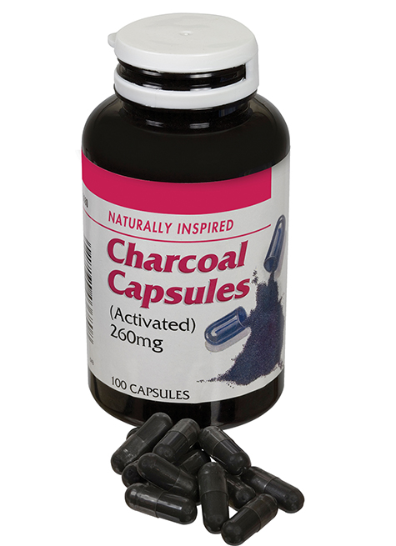
Oral Medications (3 of 5)
Activated charcoal
Reduces the amount of medication being absorbed
Ground into fine powder
Frequently suspended with sorbitol
Administered by mouth
Do not give to patients with altered level of consciousness.
© Julie Woodhouse f/Alamy.
Notes:
Lecture Outline
3. Activated charcoal
a. Many poisonings involve overdoses taken by mouth.
b. Activated charcoal reduces the amount of medication being absorbed by the body by binding the drug to its surface (adsorption).
c. Activated charcoal is ground into a very fine powder to provide the greatest surface area for binding.
d. If allowed by local protocol, you will carry a container with a premixed suspension of activated charcoal powder and water.
e. Activated charcoal is frequently suspended with sorbitol (a sugar), which has a laxative effect that causes the medication and the charcoal to move quickly through the digestive system.
f. Administered by mouth (may be unappealing to patients, so use a covered container and ask the patient to drink the fluid through a straw)
g. May stain
i. Use protective clothing over your uniform.
ii. Protect the patient’s clothing.
h. Should not be given to patients who:
i. Have altered level of consciousness (risk of aspiration)
ii. Have ingested an acid, an alkali, or a petroleum product

Slide 38
Oral Medications (4 of 5)
Oral glucose
A sugar that cells use for energy
Treats hypoglycemia
EMTs give it only by mouth.
Do not give to an unconscious patient or one who cannot protect the airway.
Notes:
Lecture Outline
4. Oral glucose
a. Glucose is a sugar that cells use for energy; it is necessary for brain cells’ survival.
b. Hypoglycemia
i. Defined as extremely low blood glucose
ii. Can be caused by an excess of insulin
c. Oral glucose can counteract the effects of hypoglycemia.
d. An EMT can give glucose only by mouth.
i. Available as a gel designed to be spread on the mucous membranes between the cheek and gum
ii. Not as quick as injections (for hospital personnel, AEMTs, and paramedics)
iii. Also available as glucose tablets
e. Never administer oral medications to an unconscious patient or to one who is unable to swallow or protect the airway.

Slide 39
Oral Medications (5 of 5)
Aspirin
Reduces fever, pain, and inflammation
Inhibits platelet aggregation
Useful during heart attack
Contraindications
Hypersensitivity to aspirin
Liver damage, bleeding disorder, asthma
Should not be given to children
Notes:
Lecture Outline
5. Aspirin
a. Purposes
i. Antipyretic (reduces fever)
ii. Analgesic (reduces pain)
iii. Anti-inflammatory (reduces inflammation)
iv. Inhibits platelet aggregation (clumping), which is useful during a potential heart attack
b. Contraindications
i. Hypersensitivity to aspirin
ii. Preexisting liver damage, bleeding disorders, and asthma
iii. Should not be given to children

Slide 40
Sublingual Medications (1 of 5)
Advantages
Easy to advise patients
Quick absorption
Disadvantages
Constant evaluation of the airway
Possible choking
Not for uncooperative or unconscious patients
Notes:
Lecture Outline
C. Sublingual medications
1. Considerations
a. Advantages
i. Easy to talk with awake and alert patients and advise them to place a pill under their tongue
ii. The head and face receive large amounts of blood flow, so absorption rates are relatively quick.
b. Disadvantages
i. Any medication placed in the mouth requires constant evaluation of the airway.
ii. Must also be alert to any signs of choking on the pill
iii. Should not be used if the patient is uncooperative or unconscious

Slide 41
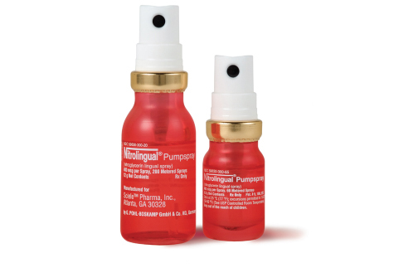
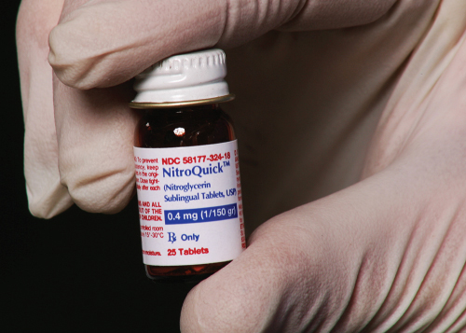
Sublingual Medications (2 of 5)
Nitroglycerin
Relieves angina pain (cardiac patients)
Increases blood flow
Relaxes veins
Courtesy of Shionogi Pharma, Inc.
© Jones & Bartlett Learning.
Notes:
Lecture Outline
2. Nitroglycerin
a. Many cardiac patients carry fast-acting nitroglycerin to relieve angina pain.
b. Nitroglycerin increases blood flow by relieving the spasms and causes arteries to dilate by relaxing muscles of coronary arteries and veins.
c. It also relaxes veins throughout the body so that less blood is returned to the heart, decreasing workload and blood pressure.

Slide 42
Sublingual Medications (3 of 5)
Nitroglycerin (cont’d)
Before administering:
Check blood pressure
Obtain order to administer
Possibility of MI, if no relief
Should not be used with erectile dysfunction medications
May cause mild headache
Notes:
Lecture Outline
d. Before administration:
i. Check blood pressure before administering nitroglycerin.
(a) If the systolic blood pressure is less than 100 mm Hg, nitroglycerin may have a harmful effect.
(b) Even a patient who has adequate blood pressure should sit or lie down with the head elevated before taking this medication (to avoid fainting).
(c) If a significant drop in blood pressure occurs and the patient feels dizzy or sick, lay the patient down.
ii. Obtain orders or follow your local protocol to administer nitroglycerin.
e. If nitroglycerin no longer brings relief to a person for whom it has previously worked, the person may be experiencing an MI instead of an angina attack.
i. Ask how much nitroglycerin the patient needed in the past to relieve pain and how much was taken this time.
ii. Report this information to medical control.
f. Can have potentially fatal interactions with erectile dysfunction (ED) medications taken within the past 24 hours:
i. Sildenafil (Viagra)
ii. Tadalafil (Cialis)
iii. Vardenafil (Levitra)
iv. Drugs for erectile dysfunction may be used by both men and women.
g. Effects
i. Relaxes the muscular walls of coronary arteries and veins
ii. Results in less blood returning to the heart
iii. Decreases blood pressure
iv. Relaxes arteries throughout the body
v. Often causes a mild headache and/or burning under the tongue after administration

Slide 43
Sublingual Medications (4 of 5)
Nitroglycerin (cont’d)
Administration by tablet
Sublingually under the tongue
Slight tingling or burning
Storage is important.
Administration by metered-dose spray
On or under tongue
One spray = one tablet
Notes:
Lecture Outline
h. Administration by tablet
i. Usually taken sublingually
ii. Place the tablet under the tongue, where it dissolves.
iii. The patient should experience a slight tingling or burning sensation.
(a) If not, the medication may have lost its potency because of aging or improper storage.
(b) Be sure to check the expiration date on the bottle.
iv. Nitroglycerin should be stored in its original glass container with the cap screwed on tightly.
(a) What looks like cotton in the container is actually rayon.
(b) Real cotton in the container can absorb nitroglycerin, reducing its potency.
(c) Do not place other medications in the container.
(d) Avoid exposure to light, heat, or air.
(e) Note any drug storage concerns in the patient’s medical history.
i. Administration by metered-dose spray
i. Deposits medication on or under the tongue
ii. One spray equals one tablet.
iii. Do not use a spacer with the metered-dose canister.

Slide 44
Sublingual Medications (5 of 5)
Administration considerations (for both tablet and spray):
Wait 5 minutes before repeating dose.
Monitor vital signs.
Wear gloves.
Know local protocols.
Notes:
Lecture Outline
j. Administration considerations (for both tablet and spray)
i. Wait 5 minutes for a response before repeating the dose.
ii. Closely monitor the patient’s vital signs, particularly the blood pressure.
iii. Give repeated doses per medical control and/or local protocol.
iv. Always wear gloves (the medication can be absorbed by your skin).
v. Reconfirm if the medication is still indicated for the patient.
vi. Know and understand local protocols.

Slide 45
Intramuscular Medications (1 of 5)
Advantages
Quick, easy access without using vein
Stable blood flow to muscles
Disadvantages
Use of a needle (and subsequent pain)
Patients may fear pain or injury.
Notes:
Lecture Outline
D. Intramuscular medications
1. Considerations
a. Advantages
i. Provides quick and easy access to the circulatory system without the need for placing a needle within a vein
ii. Blood flow to the muscles is relatively stable even during circumstances of severe illness or injury.
b. Disadvantages
i. Use of a needle (and subsequent pain)
ii. Patients may fear pain or injury.

Slide 46
Intramuscular Medications (2 of 5)
Epinephrine
Controls fight-or-flight response
Primary medication for delivery IM
Also called adrenaline, released inside the body under stress
Sympathomimetic
Notes:
Lecture Outline
2. Epinephrine (adrenaline)
a. Main hormone that controls the body’s fight-or-flight response
b. Primary medication that an EMT will deliver IM
c. Sympathomimetic (mimics the effect of the sympathetic nervous system)
d. Released inside the body when there is sudden stress
e. Also known as adrenaline

Slide 47
Intramuscular Medications (3 of 5)
Epinephrine (cont’d)
Increases heart rate and constricts blood vessels
Do not give to patients with hypertension, hypothermia, MI, or wheezing.
May be delivered with an auto-injector to treat life-threatening anaphylaxis
Notes:
Lecture Outline
f. Effects
i. Increases heart rate
ii. Constricts blood vessels, causing increased blood pressure
iii. Dilates passages in the lungs
iv. Eases breathing problems in asthma or allergic reactions
v. May maintain blood pressure in allergic reaction
g. Should not be given to patients who:
i. Have hypertension
ii. Are suffering from hypothermia
iii. Are experiencing a myocardial infarction
iv. Do not show signs of wheezing or airway obstruction due to an allergic reaction
h. Administering epinephrine by injection (permitted in some states)
i. Used to treat life-threatening anaphylaxis

Slide 48
Intramuscular Medications (4 of 5)
Epinephrine (cont’d)
Allergens cause body to over-release histamine.
Epinephrine acts as antidote to reverse the effects of histamine.
Dispensed from an auto-injector
© Jones & Bartlett Learning.
Notes:
Lecture Outline
i. Used to treat life-threatening anaphylaxis
(a) Insect venom or other allergens cause the body to over-release histamine.
(b) Over-release of histamine may:
(1) Reduce blood pressure
(2) Cause wheezing from bronchial spasms and swelling of the airway tissues (edema)
(3) Make it difficult for the patient to breathe
ii. Epinephrine acts as a specific antidote to reverse the effects of histamines by:
(a) Constricting the blood vessels
(b) Allowing blood pressure to rise
(c) Reducing swelling
(1) Dilating air passages to increase flow of air
iii. Epinephrine may be dispensed from an auto-injector
(a) Automatically delivers a preset amount of the medication (usually 0.3 mg)
iv. Side effects
(a) Causes a burning sensation where it is injected
(b) Increases heart rate
v. Some services do not permit EMTs to carry epinephrine but do allow them to assist patients in administering their own epinephrine.

Slide 49
Intramuscular Medications (5 of 5)
Naloxone
Used to reverse the effects of an opioid overdose
Important considerations:
Consult medical direction
Effects may not last as long as opioids; repeated doses may be necessary
Can cause severe withdrawal symptoms
Consider your safety
Notes:
Lecture Outline
i. Administering naloxone by injection
i. Used to reverse the effects of an opioid overdose
(a) Can be administered by family members or caregivers to help reverse dangerous side effects of opioid overdose, such as life-threatening respiratory depression.
ii. Important considerations:
(a) Consult medical direction to determine if EMTs are allowed to administer naloxone in your region. Always follow the local protocol. Consider requesting ALS assistance.
(b) Find out if naloxone has been administered by a bystander prior to your arrival.
(c) The effects of naloxone may not last as long as those of opioids. Repeat doses may be necessary.
(d) Can cause severe withdrawal symptoms, including seizures and cardiac arrest
(e) Consider your safety, as patients may become violent following naloxone administration.
iii. Begin administering naloxone in increments of 0.4 mg, then gradually increase based on the patient response or lack thereof.

Slide 50
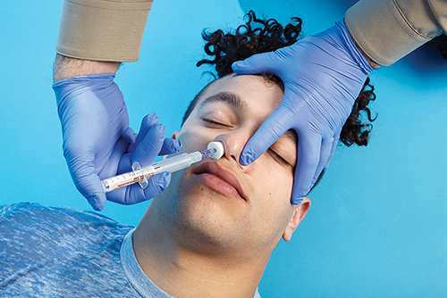
Intranasal Medications
Naloxone
The most common technique for naloxone administration is via the intranasal route.
© Jones & Bartlett Learning.
Notes:
Lecture Outline
E. Intranasal medications
1. Naloxone
a. Not all EMS departments use naloxone auto-injectors, due to their expense.
b. The most common technique for naloxone administration is via the intranasal route.
i. Other common routes of administration include intravenous and intramuscular.
ii. The same considerations listed for administering injectable naloxone apply when administering naloxone in any other form.
c. Steps to administer a medication intranasally:
i. Obtain medical direction per the local protocol.
ii. Confirm the correct medication and expiration date.
iv. Attempt to determine if the patient is allergic to any medications.
v. Prepare the medication and attach the atomizer. Never use a needle.
vi. Place the atomizer in one nostril, pointing up and slightly outward.
vii. Administer a half dose (1 mL maximum) into each nostril.
viii. Reassess the patient and document appropriately. If you do not have naloxone available, note that BVM ventilations provide necessary treatment to opioid overdose patients until definitive care can be reached.

Slide 51
Inhalation Medications (1 of 5)
Oxygen
All cells need it to survive.
Generally administered via:
Nonrebreathing mask
Preferred method
Nasal cannula
In patients who cannot tolerate a mask
Notes:
Lecture Outline
F. Inhalation medications
1. Oxygen
a. By far the most commonly administered medication in the prehospital setting
b. All cells, especially those in the heart and brain, need oxygen to function properly.
c. Oxygen should be administered when a patient is not breathing or is having trouble getting air.
d. Generally administered:
i. Via a nonrebreathing mask at 10 to 15 L/min
(a) Preferred method
(b) Can provide up to 90% inspired oxygen
ii. Via nasal cannula at 2 to 6 L/min
(a) For patients who cannot tolerate a nonrebreathing mask
(b) Oxygen flows through two small, tubelike prongs that fit into the patient’s nostrils.
(c) Can provide up to 44% inspired oxygen if the flowmeter is set at 6 L/min
e. Must also provide artificial ventilations if the patient is not breathing (using a bag-valve mask [BVM] at 15 L/min)
f. Ensure that there are no open flames, lit cigarettes, or sparks in the area in which you are administering oxygen.

Slide 52
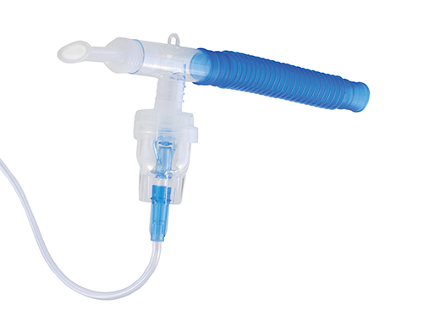
Inhalation Medications (2 of 5)
MDIs and nebulizers
Liquid turned into mist or spray
Medication breathed in and delivered to alveoli
Fast absorption rate
Easy route to access
Portable
© Chas/ShutterStock, Inc.
Notes:
Lecture Outline
2. Metered-dose inhalers and nebulizers
a. Used to administer liquid medications that have been turned into a fine mist by a flow of air or oxygen
b. Medication is atomized, breathed into the lungs, and delivered to the alveoli
c. Advantages
i. Blood flow to the alveoli is very high.
ii. Absorption rates are very close to those found with IV medications.
iii. Fast and relatively easy route to access
iv. Commonly used because of convenience and portability
d. Disadvantages
i. Patient needs to be cooperative and control breathing
ii. Cannot be used for unconscious patients
e. An EMT could use a nebulizer for more severe problems.
3. Medications administered using an MDI or small-volume nebulizer (SVN)
a. Usage
i. For respiratory conditions that are not severe enough to require epinephrine
ii. Chemical “cousins” of epinephrine are more narrowly focused on the lungs.
iii. Delivered with an MDI or SVN
b. An MDI requires a great deal of coordination to administer.
i. May be difficult to achieve when a person is having trouble breathing
ii. Patients must aim properly and spray just as they start to inhale.

Slide 53
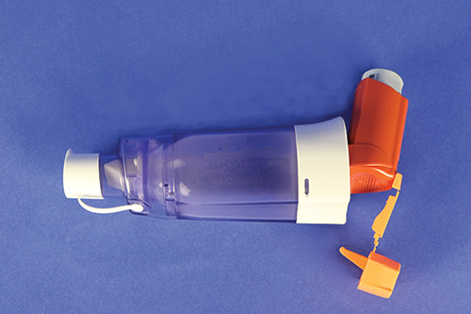
Inhalation Medications (3 of 5)
Use a spacer to avoid spray misdirection
Fits over the inhaler like a sleeve
Patient sprays the prescribed dose into the chamber and then breathes in and out of the mouthpiece
Especially useful with young children
Notes:
Lecture Outline
c. Use a spacer (adapter) to avoid spray misdirection.
i. A spacer fits over the inhaler like a sleeve.
ii. A spacer has an opening for the inhaler at one end and a mouthpiece on the other end.
iii. The patient sprays the prescribed dose into the chamber and then breathes in and out of the mouthpiece until the mist is completely inhaled.
iv. Spacer devices are especially useful with young children who have difficulty using an MDI.

Slide 54
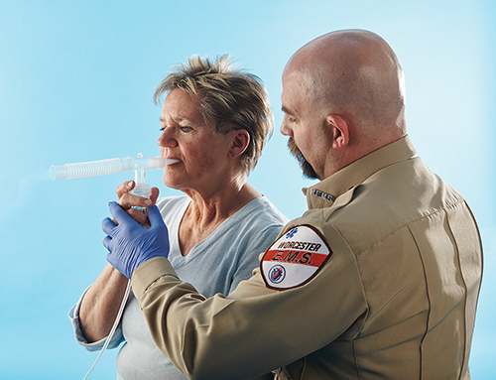
Inhalation Medications (4 of 5)
Small-volume nebulizers Easier to use than MDIs
Take longer to deliver medication
Require an external air or oxygen source
More effective in patients with moderate to severe respiratory distress
Can be used while a patient is on CPAP and during BVM ventilation
Notes:
Lecture Outline
d. SVNs are much easier to use than MDIs.
i. Take longer to deliver the medication
ii. Require an external air or oxygen source
iii. An SVN can be more effective than an MDI in patients with moderate to severe respiratory distress.
iv. Can be used while a patient is on CPAP and during BVM ventilation
v. Can be easily adapted to a nonrebreathing mask
vi. Assisting a patient with an SVN:
(a) Obtain medical direction per the local protocol.
(b) Confirm the correct medication and expiration date.
(c) Confirm that the patient is not allergic to the medication.
(d) Add the appropriate medication and dose to the nebulizer reservoir and assemble the device according to the manufacturer’s instructions.
(e) Connect the nebulizer machine or oxygen tank at 6 to 8 L/min.
(f) Place the nebulizer in the patient’s mouth and instruct the patient to breathe until the medication is gone (usually about 5 minutes).
(g) Reassess the patient and document appropriately.

Slide 55
Inhalation Medications (5 of 5)
Patients use:
“Rescue inhaler” MDIs to relieve bronchial spasms quickly
Maintenance or controller inhaler
The only medication that is effective during an acute attack of shortness of breath is fast-acting rescue inhalers.
Notes:
Lecture Outline
4. Some patients use “rescue inhaler” MDIs to relieve bronchial spasms quickly.
a. Examples
i. Primatene Mist
ii. Bronitin Mist
iii. Bronkaid Mist
b. Cousins of epinephrine that produce fewer side effects
i. Act more specifically than epinephrine on the bronchi of the lungs, causing dilation with a lesser effect on the heart
ii. Examples
(a) Metaproterenol (Alupent or Metaprel)
(b) Albuterol (Proventil or Ventolin)
c. Respiratory patients may also use a maintenance or controller inhaler.
i. Slow acting and meant to be taken regularly
ii. Not useful for a patient suffering acute respiratory distress
iii. Examples:
(a) Fluticasone propionate (Flovent Diskus)
(b) Budesonide (Pulmicort)
(c) Mometasone furoate (Asmanex Twisthaler)
(d) Beclomethasone dipropioate (Qvar)
(e) Ciclesonide (Alvesco)
d. Patients may be prescribed several types of MDIs at once.
i. Dozens of different MDIs are available.
ii. The only medication that will be effective during an acute attack of shortness of breath will be fast-acting rescue inhalers (eg, albuterol [Proventil or Ventolin])
e. Always be sure you have the right medication for a patient with acute respiratory distress.

Slide 56
Patient Medications
Patient assessment includes finding out which medications the patient is taking.
Provides vital clues to the patient’s condition
Guides treatment
Will be useful to the emergency department
Notes:
Lecture Outline
VII. Patient Medications
A. Patient assessment includes finding out which medications the patient is currently taking.
B. This information may provide vital clues to the patient’s condition.
1. May help guide your treatment
2. May be extremely useful to the emergency department physician
3. Can help you determine a chronic or underlying condition when a patient is unable to relate his or her medical history
C. Discover what the patient takes and transport the medications or a list of them with the patient to the emergency department.
D. Ask about use of any nonprescription drugs (eg, OTC, herbal, or illegal drugs).

Slide 57
Medication Errors (1 of 2)
Inappropriate use of a medication that could lead to patient harm
May be possible to minimize errors if circumstances are understood
Ensure the environment does not contribute to errors.
Notes:
Lecture Outline
VIII. Medication Errors
A. A medication error is inappropriate use of a medication that could lead to patient harm.
1. Could include incorrect communication of a dose or administration of an incorrect dose.
2. Rules-based error: administration of a medication that is outside one’s scope of practice
3. Knowledge-based error: choosing the wrong medication to administer
4. Skills-based error: using incorrect equipment or an incorrect procedure for administering a medication
B. If the circumstances of medication errors are understood, it may be possible to minimize them.
C. Ensure that the environment does not contribute to errors.
1. Ensure lighting is sufficient.
2. Organize the equipment.
3. Limit distractions as much as possible.
4. Consider using a “cheat sheet” to help yourself remember all crucial steps to medication administration.
5. Always stop to ask yourself, “Why am I doing this?”

Slide 58
Medication Errors (2 of 2)
If a medication error occurs:
Provide appropriate patient care.
Notify medical control.
Follow protocols.
Document thoroughly, accurately, and honestly.
Talk with your partner, supervisor, or medical director.
Notes:
Lecture Outline
D. If a medication error does take place:
1. Rapidly provide any appropriate patient care that is required.
2. Notify medical control as quickly as possible.
3. Follow your local protocols.
4. Document the incident thoroughly, accurately, and honestly.
5. Talk with your partner, supervisor, or medical director.
a. Opportunities to learn
b. Identify areas to target during quality improvement

Slide 59
Review
Pharmacology is defined as the:
study of cells and tissues.
study of drugs and medications.
effects of medications in the lungs.
distribution of drugs to the body’s tissues.

Slide 60
Review
Answer: B
Rationale: Pharmacology is the field of science that deals with the study of drugs and medications.

Slide 61
Review (1 of 2)
Pharmacology is defined as the:
study of cells and tissues. Rationale: This is physiology, which is a branch of biology.
study of drugs and medications. Rationale: Correct answer

Slide 62
Review (2 of 2)
Pharmacology is defined as the:
effects of medications in the lungs. Rationale: This is pharmacodynamics, which includes the processes of the body’s response to medications.
distribution of drugs to the body’s tissues. Rationale: This is pharmacokinetics, which studies medication distribution within the body.

Slide 63
Review
Which of the following statements regarding medications is FALSE?
Many medications are known by different names.
Some medications affect more than one body system.
Over-the-counter drugs must be prescribed by a physician.
EMTs should ask about any herbal remedies or vitamins that the patient may be taking.

Slide 64
Review
Answer: C
Rationale: Over-the-counter (OTC) drugs, such as aspirin, Tylenol, and Motrin, do not require a physician prescription. They can be purchased at a supermarket or drugstore. Most medications have a generic name and a trade name. For example, acetaminophen is the generic name for Tylenol, and ibuprofen is the generic name for Motrin.

Slide 65
Review (1 of 2)
Which of the following statements regarding medications is FALSE?
Many medications are known by different names. Rationale: True; medications can have several different names.
Some medications affect more than one body system. Rationale: True; medications can affect many different body systems.

Slide 66
Review (2 of 2)
Which of the following statements regarding medications is FALSE?
Over-the-counter drugs must be prescribed by a physician. Rationale: Correct answer
EMTs should ask about any herbal remedies or vitamins that the patient may be taking. Rationale: True; herbal remedies and vitamins can have interactions and effects on the patient’s health and condition.

Slide 67
Review
Which of the following routes of medication administration has the fastest effect?
Oral
Intravenous
Subcutaneous
Intramuscular

Slide 68
Review
Answer: B
Rationale: Because its administration is directly into a vein, a drug given intravenously enters the body quickly. The intravenous route is the fastest acting of all the routes of medication administration.

Slide 69
Review (1 of 2)
Which of the following routes of medication administration has the fastest effect?
Oral Rationale: The medication must be absorbed through the mucous membranes first to get to the circulatory system.
Intravenous Rationale: Correct answer

Slide 70
Review (2 of 2)
Which of the following routes of medication administration has the fastest effect?
Subcutaneous Rationale: The medication must pass through the layers of skin before reaching the circulatory system.
Intramuscular Rationale: The medication needs to travel to the circulatory system.

Slide 71
Review
When administered to a patient, a metered-dose inhaler will:
deliver the same dose each time it is administered.
be ineffective when given to patients with asthma.
deliver a different dose each time it is administered.
be delivered to the lungs over a period of 6 to 8 hours.

Slide 72
Review
Answer: A
Rationale: The metered-dose inhaler (MDI) delivers the same dose of medication each time it is used. Drugs given via the MDI act very quickly and are commonly prescribed to patients with asthma, emphysema, and other airway diseases.

Slide 73
Review (1 of 2)
When administered to a patient, a metered-dose inhaler will:
deliver the same dose each time it is administered. Rationale: Correct answer
be ineffective when given to patients with asthma. Rationale: An inhaler is usually prescribed for patients with asthma.

Slide 74
Review (2 of 2)
When administered to a patient, a metered-dose inhaler will:
deliver a different dose each time it is administered. Rationale: An inhaler is metered to deliver the same dose every time.
be delivered to the lungs over a period of 6 to 8 hours. Rationale: The medication is delivered straight to the lungs, almost immediately, because it is inhaled.

Slide 75
Review
You are managing a 62-year-old woman who complains of crushing chest pain. Her blood pressure is 84/64 mm Hg and her heart rate is 110 beats/min. Medical control advises you to assist her in taking her prescribed nitroglycerin. After receiving this order, you should:
reassess the patient’s heart rate and then assist with the nitroglycerin.
repeat the patient’s blood pressure to the physician and confirm the order.
wait 10 minutes, reassess the blood pressure, and then give the nitroglycerin.
administer the nitroglycerin to the patient and then reassess her blood pressure.

Slide 76
Review
Answer: B
Rationale: Nitroglycerin is a vasodilator and lowers blood pressure (BP); therefore, it should not be given to patients with a systolic BP less than 100 mm Hg. If you receive an order to give nitroglycerin to a patient with a systolic BP less than 100 mm Hg, you should ensure that the physician is aware of the patient’s BP, then reconfirm the order.

Slide 77
Review (1 of 2)
You are managing a 62-year-old woman who complains of crushing chest pain. Her blood pressure is 84/64 mm Hg and her heart rate is 110 beats/min. Medical control advises you to assist her in taking her prescribed nitroglycerin. After receiving this order, you should:
reassess the patient’s heart rate and then assist with the nitroglycerin. Rationale: Administration of nitroglycerin is based on the patient’s blood pressure, not on the patient’s heart rate.
repeat the patient’s blood pressure to the physician and confirm the order. Rationale: Correct answer

Slide 78
Review (2 of 2)
You are managing a 62-year-old woman who complains of crushing chest pain. Her blood pressure is 84/64 mm Hg and her heart rate is 110 beats/min. Medical control advises you to assist her in taking her prescribed nitroglycerin. After receiving this order, you should:
wait 10 minutes, reassess the blood pressure, and then give the nitroglycerin. Rationale: You should ensure that the physician is aware of the patient’s blood pressure and then reconfirm the order.
administer the nitroglycerin to the patient and then reassess her blood pressure. Rationale: Nitroglycerin is a vasodilator and lowers the patient’s blood pressure. This medication should not be given to patients with a systolic blood pressure less than 100 mm Hg.

Slide 79
Review
Activated charcoal is indicated for patients who have ingested certain drugs and toxins because it:
acts as a direct reversal agent for most medications.
induces vomiting before the chemical can be digested.
detoxifies the drug before it can cause harm to the patient.
binds to chemicals in the stomach and delays absorption.

Slide 80
Review
Answer: D
Rationale: Activated charcoal is an adsorbent—that is, it binds to harmful chemicals that have been ingested. This binding effect delays digestion and absorption of the chemical by the body.

Slide 81
Review (1 of 2)
Activated charcoal is indicated for patients who have ingested certain drugs and toxins because it:
acts as a direct reversal agent for most medications. Rationale: Activated charcoal binds with chemicals.
induces vomiting before the chemical can be digested. Rationale: Activated charcoal is not the medication used to induce vomiting.

Slide 82
Review (2 of 2)
Activated charcoal is indicated for patients who have ingested certain drugs and toxins because it:
detoxifies the drug before it can cause harm to the patient. Rationale: Activated charcoal binds with chemicals, delays absorption, and helps in getting chemicals through the digestive system.
binds to chemicals in the stomach and delays absorption. Rationale: Correct answer

Slide 83
Review
With regard to pharmacology, the term “action” refers to the:
ability of a drug to cause harm.
ability of a drug to produce side effects.
amount of time it will take the drug to work.
expected effect of a drug on the patient’s body.

Slide 84
Review
Answer: D
Rationale: As it applies to pharmacology, the term “action” refers to the effect that a drug is expected to have on a patient’s body. Prior to administering any drug, the EMT must be aware of its action(s) on the body.

Slide 85
Review
With regard to pharmacology, the term “action” refers to the:
ability of a drug to cause harm. Rationale: This is called a contraindication.
ability of a drug to produce side effects. Rationale: This is any action of a medication other than the desired ones.
amount of time it will take the drug to work. Rationale: This is the onset of action.
expected effect of a drug on the patient’s body. Rationale: Correct answer

Slide 86
Review
Which of the following patients is the BEST candidate for oral glucose?
Conscious patient who is showing signs of hypoglycemia
Unconscious diabetic patient with a documented low blood sugar
Conscious diabetic patient suspected of being hyperglycemic
Semiconscious patient with signs and symptoms of low blood sugar

Slide 87
Review
Answer: A
Rationale: Oral glucose is given to diabetic patients with suspected or documented hypoglycemia (low blood sugar). It should not be given to unconscious patients or those who are otherwise unable to swallow because it may be aspirated into the lungs.

Slide 88
Review (1 of 2)
Which of the following patients is the BEST candidate for oral glucose?
Conscious patient who is showing signs of hypoglycemia Rationale: Correct answer
Unconscious diabetic patient with a documented low blood sugar Rationale: Oral glucose should not be given to unconscious patients.

Slide 89
Review (2 of 2)
Which of the following patients is the BEST candidate for oral glucose?
Conscious diabetic patient suspected of being hyperglycemic Rationale: Oral glucose is used for the treatment of hypoglycemia (low blood sugar).
Semiconscious patient with signs and symptoms of low blood sugar Rationale: Oral glucose should not be given to those patients who are unable or may become unable to swallow.

Slide 90
Review
Epinephrine is given to patients with anaphylactic shock because of its effects of:
bronchodilation and vasodilation.
bronchodilation and vasoconstriction.
vasodilation and bronchoconstriction.
bronchoconstriction and vasoconstriction.

Slide 91
Review
Answer: B
Rationale: The two major complications associated with anaphylactic shock are bronchoconstriction, which impairs air move-ment in and out of the lungs, and vasodilation, which causes a drop in blood pressure. Epinephrine reverses these processes by causing bronchodilation and vasoconstriction, thereby improving breathing and increasing the blood pressure, respectively.

Slide 92
Review (1 of 2)
Epinephrine is given to patients with anaphylactic shock because of its effects of:
bronchodilation and vasodilation. Rationale: Epinephrine dilates the bronchi but constricts the circulatory system.
bronchodilation and vasoconstriction. Rationale: Correct answer

Slide 93
Review (2 of 2)
Epinephrine is given to patients with anaphylactic shock because of its effects of:
vasodilation and bronchoconstriction. Rationale: Epinephrine constricts the circulatory system and dilates the bronchi.
bronchoconstriction and vasoconstriction. Rationale: Epinephrine dilates the bronchi and constricts the circulatory system.

Slide 94
Review
The process by which medications travel through body tissues until they reach the bloodstream is called:
adsorption.
onset of action.
absorption.
transformation.

Slide 95
Review
Answer: C
Rationale: The process by which medications travel through body tissues until they reach the bloodstream is called absorption. Adsorption refers to the binding of one chemical to another. Activated charcoal, for example, delays absorption of certain chemicals into the bloodstream because it adsorbs (binds to) them in the stomach.

Slide 96
Review (1 of 2)
The process by which medications travel through body tissues until they reach the bloodstream is called:
adsorption. Rationale: In adsorption, particles bind to a surface.
onset of action. Rationale: Onset of action is the time that it takes for a medication to start doing what it is prescribed for.

Slide 97
Review (2 of 2)
The process by which medications travel through body tissues until they reach the bloodstream is called:
absorption. Rationale: Correct answer
transformation. Rationale: This has nothing to do with medication administration.

